Slide 1
ISO – 9000
AIR UNIVERSITY
JULY 2011
GP CAPT (RETD) EJAZ YAQUB
ASSTT PROF (MECH ENGG)
DEPT OF MECH & AEROSPACE ENGG

Slide 2
GP CAPT (RETD) EJAZ YAQUB
BE (AEROSPACE) CAE KARACHI JAN 1974
MS (AIRCRAFT DECIGN) CRANFIELD UK OCT 1981
BS (WAR STUDIES) & MSc (STRATEGIC STUDIES)
VARIOUS AERONAUTICAL, AUTOMOBILE & MANAGEMENT APPOINTMENTS IN THE PAF -- 28 YEARS
DIRECTOR AEROSPACE JF-17 THUNDER FIGHTER 1996 - 2002
NUST TEACHING CAE & CEME 14 YEARS
DMAE IAA AU 2009 – PRESENT 2 ¼ YEARS
ISO-9000 COURSE AND SEMINAR
ABOUT 80 US MIL SPECS INCORPORATED IN JF-17 JOINT PAK-CHINA FIGHTER AIRCRAFT DESIGN & DEVELOPMENT PROJECT

Slide 3
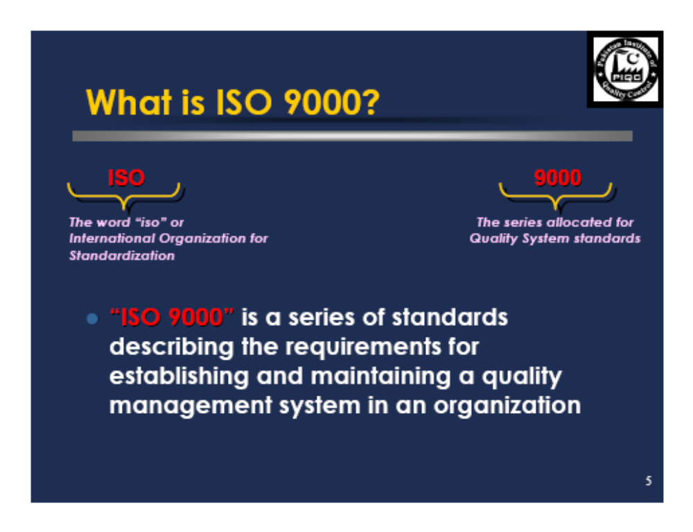

Slide 4
The International Organization for Standardization (ISO)
Based in Geneva, Switzerland
Established in 1947 to promote standards in international trade, communications, and manufacturing
Nongovernmental organization without authority to impose its standards

Slide 5
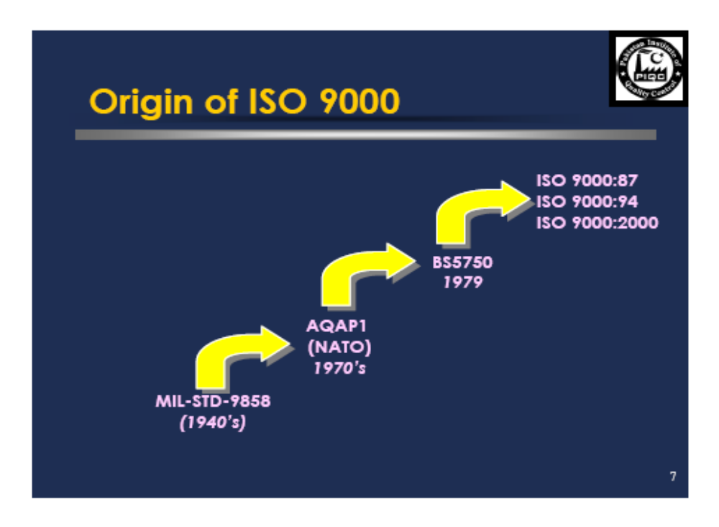

Slide 6
STANDARDISATION ENSURES:
  Interoperability : Ref Fuselage panels of F-6 Aircraft. Similar to doors or fenders of Mehran not fitting each other
  Ensuring products meet certain requirements : Meeting or exceeding specifications . If JF-17 has 300 km range it will drop specified bombs to this range and not flame out earlier!! You don’t want that your car doesn’t accelerate beyond 50 kph when the speed-o-meter shows much higher
  Commonality Bullets fit all guns having a specific bore. They don’t jam!
  Reliability For the design life gives a minimum assured performance. In the specified environmental conditions (Ref Rafiqui or Gilgit F-7 will operate!!) Your car Starts every morning, summers or winters, and for even two decades
  Total cost of ownership : Stable costs. Design, development, testing, production, induction, training, operations, maintenance, overhaul, disposal.
  Compatibility with logistics systems : Take off and land from standard airfields / carrier decks, park in the pens, maintain in the hangars, jacking up, tools, testers, test stands, tyres, oils, fuels etc

Slide 7

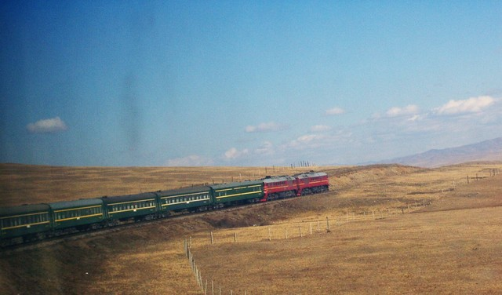
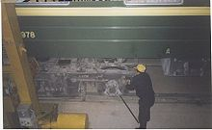
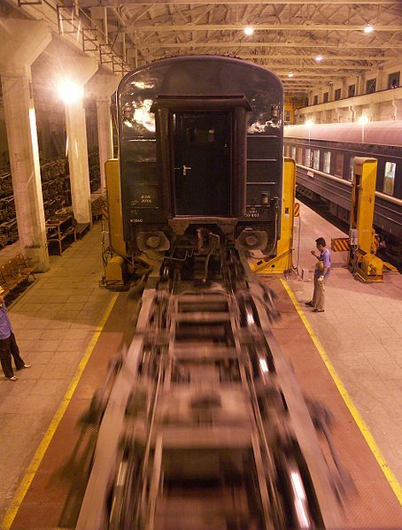
TRANS – MONGOLIAN TRAIN
The Trans-Mongolian Railway connects Ulan-Ude, on the (Trans-Siberian) railway in Russia, with the Chinese city of Jining, by way of Ulan Bator in Mongolia.
The gauge is 1,520 mm (4 ft 11 ⁵⁄₆ in) in Russia and Mongolia and 1,435 mm (4 ft 8 ¹⁄₂ in) in China
Broad gauge Indian 1,676 mm (5 ft 6 in) • Iberian 1,668 mm (5 ft 5 ²⁄₃ in) • Irish 1,600 mm (5 ft 3 in) • Russian 1,520 mm (4 ft 11 ⁵⁄₆ in) Standard gauge 1,435 mm (4 ft 8 ¹⁄₂ in) Narrow gauge Scotch 4 ft 6 in (1,372 mm) • Cape 1,067 mm (3 ft 6 in) • Metre 1,000 mm (3 ft 3 ³⁄₈ in)

Slide 8
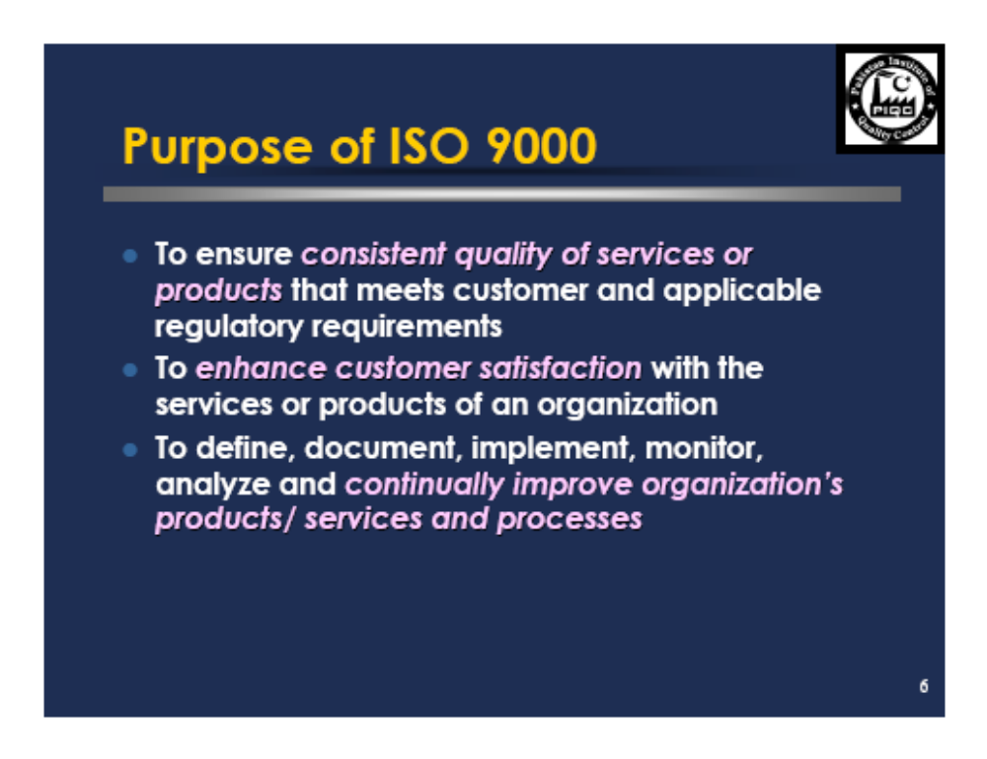

Slide 9
ISO 9000 2000 standards are based on EIGHT QUALITY MANAGEMENT PRINCIPLES. ISO chose these principles because they can be used to improve organizational performance and achieve success.
Customer Focus
System Approach to Management
Leadership
Continual Improvement
Involvement of People
Factual Approach to Decision Making
Process Approach
Mutually Beneficial Supplier Relationships

Slide 10
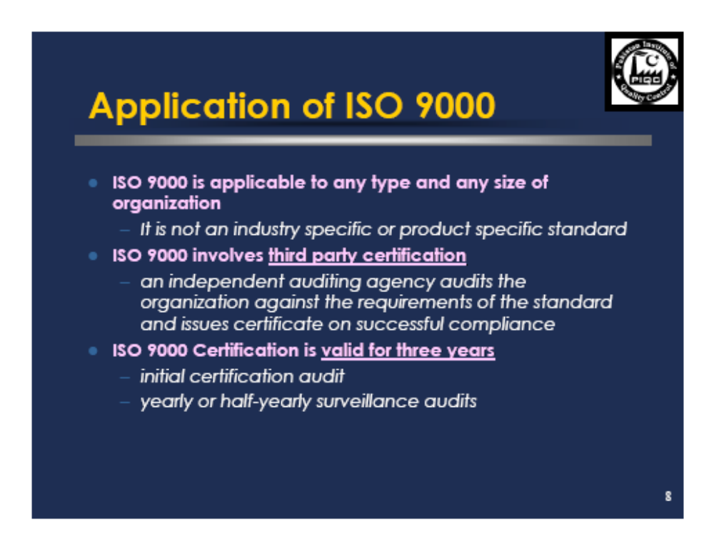

Slide 11
Major Benefits
1 Customer Satisfaction
2 Top management commitment/Leadership
3 Clear understanding of the difference between
    ISO 9000 and product/ service standards.
4 Involvement of people in setting the system
5 Gaining competence and expertise in quality control.
6 Increased consistency, effectiveness,
    and efficiency
7 Increased market share
8 Reduced cost

Slide 12
Major Benefits (cont’d)
9 Reduced waste (Time,rework,etc)
10 Better Integration between Quality system
and other management systems in the organization
11 Gained international recognition/confidence
12 Continual improvement
13 Better relation with suppliers
14 Updated facts
15 Wide applicability and basis for various
sectors
16 Preservation of Know How

Slide 13
ISO 9000:2000 Clauses
Quality Management System
Resource Management
Product or Service Realization
Management Responsibility
Measurement, Analysis and Improvement

Slide 14
1. Quality Management System (QMS)
Concerned with the documentation and management of the QMS
Sub-clauses:
  Quality Manual
  Control of documents
  Control of records

Slide 15
2. Resource Management
Concerned with the provision of resources needed to implement the QMS
Sub-clauses:
  Provision of resources
  Human resources
  Infrastructure
  Work environment

Slide 16
3. Product or Service Realization
Concerned with the provision of processes to implement the product or service
Sub-clauses:
  Planning of product realization
  Customer related processes
  Customer requirements
  Customer communication
  Design and development
  Control of changes
  Purchasing process
  Production and service provision
  Validation of processes
  Identification and traceability
  Customer property
  Preservation of product
  Control of measuring and monitoring devices

Slide 17
4. Management Responsibility
Concerned with the responsibility of management in the implementation of the quality system
Sub-clauses:
  Management commitment
  Customer focus
  Quality policy
  Planning
  Responsibility, authority, and communication
  Management review

Slide 18
5. Measurement, Analysis and Improvement
Concerned with the establishment of a measurement program to measure QMS performance and to identify problems
Sub-clauses:
  Measurement of customer satisfaction
  Internal audits
  Measurement and monitoring of processes
  Measurement and monitoring of product
  Control of nonconformity
  Analysis of data
  Continual improvement
  Corrective action
  Preventive action

Slide 19
Implementing ISO 9000:2000
Awareness Training
Establish a Team
Establish ISO 9000 Status
Prepare Action Plan
Track Action Plan
Present Status of Action Plan
ISO 9000 Readiness Assessment
Contact Registrar (Certification Body)
Official ISO 9000 Audit
Continuous Improvement
Celebrate!

Slide 20
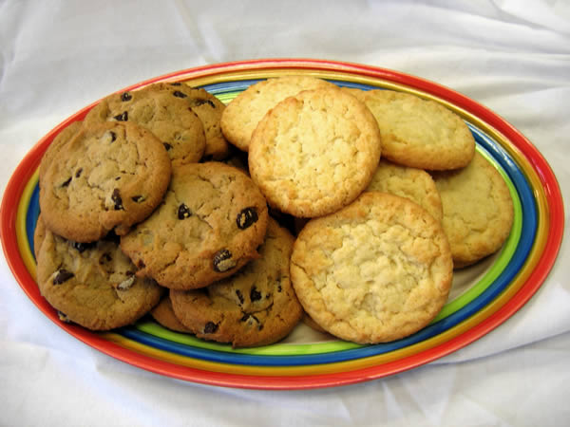
Q & A

