Slide 1


Slide 2

SIX SIGMA
"Delivering Tomorrow's Performance Today"
AIR CDRE ABDUL WAHAB

Slide 3
PRESENTATION LAYOUT
Six Sigma: An overview
What is Sigma and Six Sigma?
Why Six Sigma?
Six Sigma Levels
Six Sigma Methodology and Management
Key Roles for Six Sigma
Tools for Six Sigma
Trainings and Certifications
Conclusion

Slide 4
BEFORE WE START !!!
Your participation is key to success…
If any doubts you can ask question at the end
Share your thoughts…
Get involved…
Switch off / Silent your mobile phones…
Participate, contribute and make this program successful

Slide 5

Your first question is likely….
What is Six Sigma?
Your second question is likely…
Why Six Sigma?
Notes:
The term “Six Sigma” was coined by Bill Smith, an engineer with
Motorola
•Late 1970s - Motorola started experimenting with problem solving
through statistical analysis
•1987 - Motorola officially launched it’s Six Sigma program

Slide 6
WHAT IS SIGMA ?
A term (Greek) used in statistics to represent
standard deviation from mean value, an indicator of the degree of variation in a set of a process.
Sigma measures how far a given process deviates from perfection. Higher sigma capability, better performance
Notes:
Sigma is a Greek symbol represented by "σ".
The term “sigma” is used to designate the distribution or spread about the mean (average) of any process or procedure.
For a process, the sigma capability (z-value) is a metric that indicates how well that process is performing. The higher the sigma
capability, the better. Sigma capability measures the capability of the process to produce defect-free outputs. A defect is anything that
results in customer dissatisfaction.

Slide 7
WHAT IS SIX SIGMA?
Six Sigma - A highly disciplined process that enables organizations deliver nearly perfect products and services.
The figure of six arrived statistically from current average maturity of most business enterprises
A philosophy and a goal: as perfect as practically possible.
A methodology and a symbol of quality.
Contd…
Notes:
Why do we call Six Sigma as Six Sigma and not Four or Five Sigma or Eight Alpha (another Greek symbol)? Sigma is a statistical term that measures process deviation from process mean or target. Mean is also referred as average in common language. The figure of six was arrived statistically by looking at the current average maturity of most business enterprises. We would like to revise this figure to 8 or may be 9 provided the world becomes a more orderly and predictable (even with increasing entropy or chaos) place to live!

Slide 8
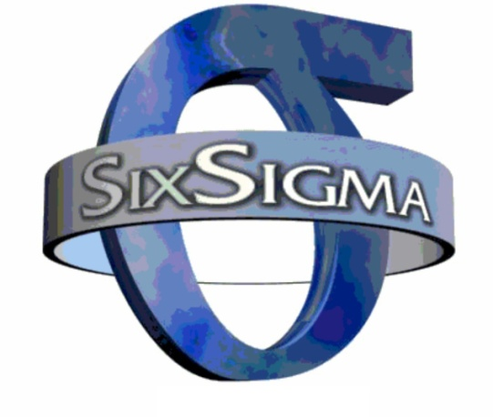
WHAT IS SIX SIGMA?
A statistical concept that measures a process in terms of defects – at the six sigma level, there 3.4 defects per million opportunities.
Contd…
But, it is much more!
Notes:
Six Sigma is a methodology that provides businesses with the tools to improve the capability of their business processes. This increase in performance and decrease in process variation leads to defect reduction and vast improvement in profits, employee morale and quality of product.

Slide 9
WHAT IS SIX SIGMA
Six Sigma is not:
•A standard
•A certification
•Another metric like percentage
Rather!
•It is a Quality Philosophy and the way of improving performance by knowing where you are and where you could be.
Methodology to measure and improve company’s performance, practices and systems
Notes:
Six Sigma is a rigorous and a systematic methodology that utilizes information (management by facts) and statistical analysis to measure and improve a company's operational performance, practices and systems by identifying and preventing 'defects' in manufacturing and service-related processes in order to anticipate and exceed expectations of all stakeholders to accomplish effectiveness.

Slide 10
WHY SIX SIGMA ?
Six Sigma emerged as a natural evolution in business to increase profit by eliminating defects
The Current business environment now demands and rewards innovation more than ever before due to:
Customer Expectations
Technological Change
Global Competition
Market Fragmentation
Notes:
The goal of Six Sigma is to increase profits by eliminating variability, defects and waste that undermine customer loyalty.

Slide 11
SIGMA LEVELS
Sigma Level ( Process Capability) | Defects per Million Opportunities
2 | 308,537
3 | 66,807
4 | 6,210
5 | 233
6 | 3.4

Slide 12






COMPANIES USING
Six Sigma is in use in virtually all industries around the world. Some of companies can be listed as:
Motorola
Ericsson
General Electric
Sony
Ford Motor Co.
CITI bank

Slide 13
SIX SIGMA METHODOLOGY
(It takes money to save money)
BPMS
  Business Process Management System
DMAIC
  Six Sigma Improvement Methodology
DMADV
  Creating new process which will perform at Six Sigma
Notes:
In the world of Six Sigma quality, the saying holds true: it takes money to save money using the Six Sigma quality methodology. You can't expect to significantly reduce costs and increase sales using Six Sigma without investing in training, organizational infrastructure and culture evolution.

Slide 14
BUSINESS PROCESS MANAGEMENT SYSTEM:
BPM strategies emphasize on process improvement and automation to derive performance
Combining BPM strategies with sigma six is most powerful way to improve performance
Both strategies are not mutually exclusive but some companies produced dramatic results by combining them.
Notes:
One of the most powerful ways to improve business performance is combining business process management (BPM) strategies with Six Sigma strategies. BPM strategies emphasize process improvements and automation to drive performance, while Six Sigma uses statistical analysis to drive quality improvements. The two strategies are not mutually exclusive, however, and some savvy companies have discovered that combining BPM and Six Sigma can create dramatic results.

Slide 15
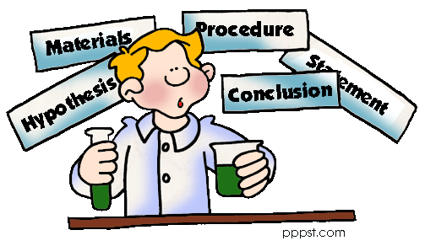
WHAT IS DMAIC?
(Define,Measure,Analyse,Improve.Control)
A logical and structured approach to problem solving and process improvement.
An iterative process (continuous improvement)
A quality tool which focus on change management style.
Notes:
Define process goals in terms of key critical parameters (i.e. critical to quality or critical to production) on the basis of customer requirements or Voice Of Customer (VOC)
Measure the current process performance in context of goals
Analyze the current scenario in terms of causes of variations and defects
Improve the process by systematically reducing variation and eliminating defects
Control future performance of the process
DMAIC is a basic component of the Six Sigma methodology- a way to improve work processes by eliminating defects. The Six Sigma methodology is widely used in many top corporations in the United States and around the world. It is normally defined as a set of practices that improve efficiency and eliminate defects.
Six Sigma has been around for more than 20 years and heavily influenced by TQM (total quality management) and Zero Defect principles. In its methodology, it asserts that in order to achieve high quality manufacturing and business processes, continued efforts must be made to reduce variations.

Slide 16
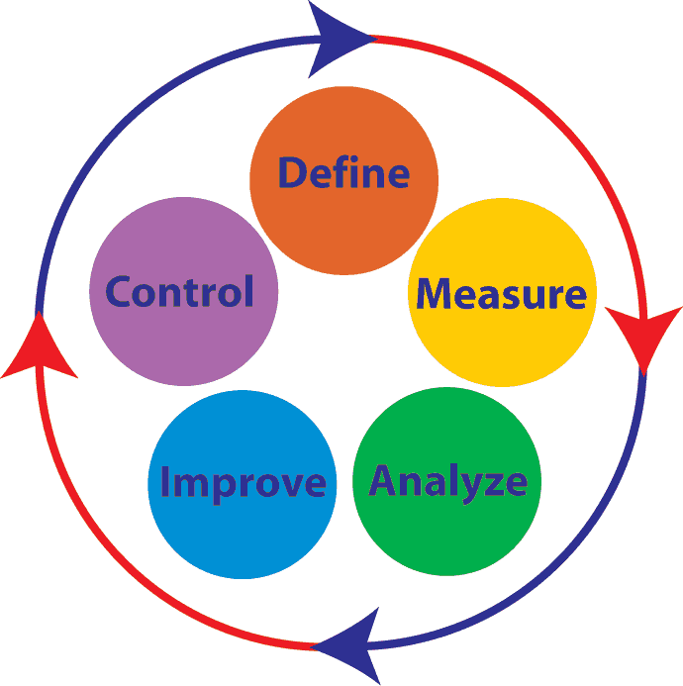
PHASES
Phases of Six Sigma are:
  Define specific goals to achieve outcomes, consistent with customers demand and business strategy
  Measure reduction of defects
  Analyze problems ,cause and effects must be considered
  Improve process on bases of measurements and analysis
  Control process to minimize defects
Notes:
Define: Define is the first step in the process. In this step, it is important to define specific goals in achieving outcomes that are consistent with both your customer’s demands and your own business’s strategy. In essence, you are laying down a road map for accomplishment.
Measure: In order to determine whether or not defects have been reduced, you need a base measurement. In this step, accurate measurements must be made and relevant data must be collected so that future comparisons can be measured to determine whether or not defects have been reduced.
Analyze: Analysis is extremely important to determine relationships and the factors of causality. If you are trying to understand how to fix a problem, cause and effect is extremely necessary and must be considered.
Improve: Making improvements or optimizing your processes based on measurements and analysis can ensure that defects are lowered and processes are streamlined.
Control: This is the last step in the DMAIC methodology. Control ensures that any variances stand out and are corrected before they can influence a process negatively causing defects. Controls can be in the form of pilot runs to determine if the processes are capable and then once data is collected, a process can transition into standard production. However, continued measurement and analysis must ensue to keep processes on track and free of defects below the Six Sigma limit.

Slide 17
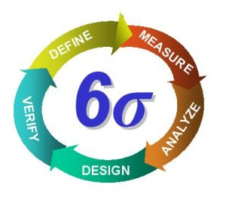
WHAT IS DMADV?
Acronym for:
Define the project
Measure the opportunity
Analyze the process options
Design the process
Verify the performance

Slide 18
WHEN SHOULD SIX SIGMA BE USED?
Its usage depends on the type of business. In general,
“If there are processes that generate a lot of negative customer feedback, whether that customer is internal or external, the components of Six Sigma should be considered as a means to study and rectify the problem.”

Slide 19
BENEFITS OF SIX SIGMA
Generates sustained success
Sets performance goal for everyone
Enhances value for customers
Accelerates rate of improvement
Promotes learning across boundaries
Executes strategic change

Slide 20
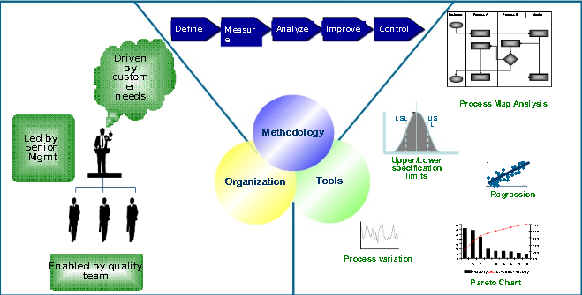
USAGE OF SIX SIGMA

Slide 21
SIX SIGMA MANAGEMENT
When practiced as a management system, Six Sigma is a high performance system for executing business strategy.
Six Sigma is a top down solution to help organizations:
Align their business strategy to critical improvement efforts
Mobilize teams to attack high impact projects
Accelerate improved business results
Govern efforts to ensure improvements are sustained

Slide 22
KEY ROLES FOR SIX SIGMA
Six Sigma identifies several key roles for its successful implementation:
Executive leadership
Champions
Master Black Belts (Identify projects& functions)
Black Belts (Identify non value added activities)
Green Belts ( works on small projects )
Top
Bottom
Notes:
The Six Sigma Belts (Green, Black, and Master Black) denote the different levels an individual can achieve in Six Sigma, a business management approach that was at the onset advanced by Motorola's manufacturing division in the USA in 1986. It has its basis on attentive and meticulous planning and constant determined application that can be made exclusive in dealing with issues that concern a business so as to improve on the marketability of their products and services.
The master, or master black belt is a person who is at the highest level of expertise on the subject. They are fully devoted to the process and have no other job responsibilities outside the methodology. They are involved in every aspect of training and mentoring of all of the lower belt ranks.
A certified Black Belt exhibits team leadership, understands team dynamics, and assigns their team members with roles and responsibilities. They have a complete understanding of the DMAIC model in accordance with the Six Sigma principles, have a basic knowledge of lean enterprise concepts, and they can quickly identify "non-value-added" activities. Black Belts primarily focus on project execution, whereas Champions and Master Black Belts focus on identifying projects and functions for Six Sigma.
Six Sigma Green Belt has emphasis on the DMAIC (Define, Measure, Analyze, Improve and Control) model. Six Sigma Green Belt certification helps the employee serve as a trained team member within his or her function-specific area of the organization. This focus allows the Green Belt to work on small, carefully defined Six Sigma projects, requiring less than a Black Belt's full-time commitment to Six Sigma throughout the organization.

Slide 23
TOOLS & TECHNIQUES
7QC tools
Check Sheets (collect data to make improvements)
Pareto Charts( define problem and frequency)
Cause and effect diagram (Identify possible causes to solve problem)
Histogram (Bar charts of accumulated data to evaluate distribution of data)
Scatter diagram (plots many data points and pattern between two variables)
Flow Chart (Identify unwanted steps)
Control charts (Control limits around mean value)
Notes:
Seven QC tools are utilized to organize the collected data in a way that is easy to understand and analyze. Moreover, from using the seven QC tools, any specific problems in a process are identified.
7QC tools always include :
Check Sheet is used to easily collect data. Decision-making and actions are taken from the data.
Pareto Chart is used to define problems, to set their priority, to illustrate the problems detected, and determine their frequency in the process.
Cause-and-Effect Diagram (Fishbone Diagram) is used to figure out any possible causes of a problem. After the major causes are known, we can solve the problem accurately.
Histogram shows a bar chart of accumulated data and provides the easiest way to evaluate the distribution of data.
Scatter Diagram is a graphical tool that plots many data points and shows a pattern of correlation between two variables.
Flow Chart shows the process step by step and can sometimes identify an unnecessary procedure.
Control Chart provides control limits which are generally three standard deviations above and below average, whether or not our process is in control.
T-Test
The t-test assesses whether the means of two groups are statistically different from each other. This analysis is appropriate whenever you want to compare the means of two groups.
he t-test (or student's t-test) gives an indication of the separateness of two sets of measurements, and is thus used to check whether two sets of measures are essentially different (and usually that an experimental effect has been demonstrated). The typical way of doing this is with the null hypothesis that means of the two sets of measures are equal.
The t-test assumes:
A normal distribution (parametric data)
Underlying variances are equal (if not, use Welch's test)
It is used when there is random assignment and only two sets of measurement to compare.
There are two main types of t-test:
Independent-measures t-test: when samples are not matched.
Matched-pair t-test: When samples appear in pairs (eg. before-and-after).
A single-sample t-test compares a sample against a known figure, for example where measures of a manufactured item are compared against the required standard.
Calculation
The value of t may be calculated using packages such as SPSS. The actual calculation for two groups is:
t = experimental effect / variability
= difference between group means /
standard error of difference between group means
Fault tree Analysis
A technique by which conditions and factors that can contribute to a specified undesired event are identified and organized in a logical manner and represented pictorially. Or A tool to investigate a problem.
Reliability engineering is an engineering field, that deals with the study of reliability: the ability of a system or component to perform its required functions under stated conditions for a specified period of time.^{[1]} It is often reported as a probability.

Slide 24

TRAININGS & CERTIFICATIONS
If you want to make yourself more valuable and attractive to employers then get training and certification
Option I – Certification as Six Sigma Green Belt
Option II – Certification as Six Sigma Black Belt

Slide 25
CONCLUSION
Six Sigma is methodology used for:
Aligning key business processes to achieve those requirements.
Utilizing rigorous data analysis to minimize data variation in those processes.
Driving rapid and sustainable improvement to business processes.
Notes:
References:
http://www.isixsigma.com
http://www.sixsigmaonline.org/index.html
http://www.businessballs.com/sixsigma.htm
http://www.ge.com/en/company/companyinfo/quality/whatis.htm
http://www.slideshare.net/Sixsigmacentral/10-six-sigmappt
http://mypptsearch.allpopular.info/search-ppt/six+sigma+ppt/

Slide 26
Q&A

Slide 27
THANKS

