Slide 1
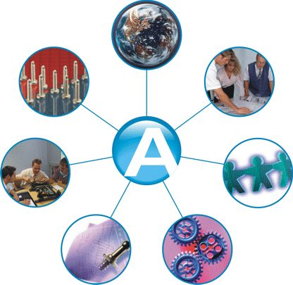
TOTAL QUALITY MANAGEMENT
“MUST KNOW” CONCEPTS FOR ENGINEERS

Slide 2
Sequence of presentation
Introduction
Three Quality Gurus
Commonality of Themes of Quality Gurus
DIFINITION OF QUALITY
Five Approaches of Defining Quality
System Approach for TQM
Triangle of wisdom
TQO HRM
Customer Satisfaction
Indicators for Customer Satisfaction
Cost of Quality
Benefits of TQM
Conclusion

Slide 3
INTRODUCTION TO TQM
What is TQM?
TQM is the integration of all functions and processes within an organization in order to achieve continuous improvement of the quality of goods and services. The goal is customer satisfaction.
“ No doubt , humans are always deficient”
(Al-Quran)

Slide 4
The Three Quality Gurus
Deming: the best known of the “early” pioneers, is credited with popularizing quality control in Japan in early 1950s.Today, he is regarded as a national hero in that country and is the father of the world famous Deming prize for quality.

Slide 5
JURAN
Juran, like Deming was invited to Japan in 1954 by the union of Japanese Scientists and engineers.
Juran defines quality as fitness for use in terms of design, conformance, availability, safety and field use. He focuses on top-down management and technical methods rather than worker pride and satisfaction.

Slide 6
Philip Crosby: author of popular book Quality is Free. His absolutes of quality are:
Quality is defined as conformance to requirements, not “goodness”
The system for achieving quality is prevention, not appraisal.
The performance standard is zero defects, not “that’s close enough”
The measurement of quality is the price of non-conformance, not indexes.

Slide 7
Commonality of Themes of Quality Gurus
Inspection is never the answer to quality improvement, nor is “policing”.
Involvement of leadership and top management is essential to the necessary culture of commitment to quality.
A program for quality requires organization-wide efforts and long term commitment, accompanied by the necessary investment in training.
Quality is first and schedules are second.

Slide 8
DIFINITION OF QUALITY
The concept and vocabulary of quality are elusive. Different people interpret quality differently. Few can define quality in measurable terms that can be proved operationalized. When asked what differentiates their product or service;
The banker will answer” service”
The healthcare worker will answer “quality health care”
The hotel employee will answer “customer satisfaction”
The manufacturer will simply answer “quality product”

Slide 9
Five Approaches of Defining Quality
Harvard professor David Garvin, in his book Managing Quality summarized five principal approaches to define quality.
Transcendent
Product based
User based
Manufacturing based
Value based

Slide 10
Transcendental view
Those who hold the transcendental view would say “I can’t define it, but I know it when I see it”
Advertisers are fond of promoting products in these terms.
“ Where shopping is a pleasure” (supermarket). “We love to fly and it shows" (airline).
Television and print media are awash with such indefinable claims and therein lies the problem:
Quality is difficult to define or to operationalize. It thus becomes elusive when using the approach as basis for competitive advantage. Moreover, the functions of design, production and service may find it difficult to use the definition as a basis for quality management.

Slide 11
PRODUCT BASED
Quality is viewed as a quantifiable or measurable characteristic or attribute. For example durability or reliability can be measured and the engineer can design to that benchmark.
Quality is determined objectively.
Although this approach has many benefits, it has limitation as well. Where quality is based on individual taste or preference, the benchmark for measurement may be misleading.

Slide 12
USER BASED
It is based on idea that quality is an individual matter and products that best satisfy their preferences are those with the highest quality. This is rational approach but leads to two problems;
Consumer preference vary widely and it is difficult to aggregate these preferences into products with wide appeal. This leads to the choice between a niche strategy or a market aggregation approach which tries to identify those product attributes that meet the needs of the largest number of consumers.
Another problem concerns the answer to the question “Are quality and customer satisfaction the same?” the answer is probably not. One may admit that a Lincoln continental has many quality attribute, but satisfaction may be better achieved with an Escort.

Slide 13
MANUFACTURING BASED
Manufacturing-based definitions are concerned primarily with engineering and manufacturing practices and use the universal definition of “conformance to requirements”. Requirements or specifications are established by design and any deviation implies a reduction in quality. The concept applies to services as well as product. Excellence in quality is not necessarily in the eye of the beholder but rather in the standards set by the organization.
This approach has the serious weakness. The consumer’s perception of quality is equated with conformance and hence is internally focused.

Slide 14
Value Based
It is defined in term of costs and prices as well as number of other attributes. Thus, the consumer’s purchased decision is based on quality at an acceptable price. This approach is reflected in the popular Consumer Reports magazine which ranks products and services based on two criteria: Quality and Value.
The highest quality is not usually the best value. That designation is assigned to the “best- buy” product or service.

Slide 15
System
MANAGEMENT OF PROCESS QUALITY
CUSTOMER
FOCUS
AND
SATISFACTION
Driver
HUMAN RESOURCE DEVELOPMENT AND MANAGEMENT
SENIOR
EXECUTIVE
LEADERSHIP
STRATEGIC QUALITY PLANNING
QUALITY
AND
OPERATIONAL
RESULTS
INFORMATION AND ANALYSIS
System Approach for TQM

Slide 16
TOW
Triangle of wisdom
LM
DM
KM

Slide 17
Characteristics of TQM Leader
Visible, Committed and Knowledgeable
A Missionary Zeal
Aggressive Targets
Strong Drivers
Communication of Values
Organization
Customers Contact

Slide 18
TQO HRM
Five Principles are:
Quality Work the First Time
Focus on the Customer
Strategic Holistic Approach to Improvement
CI as a Way of Life
Mutual Respect and Teamwork

Slide 19
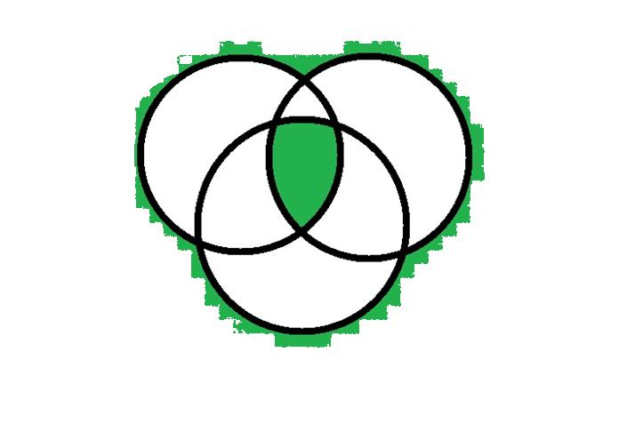
Customer Satisfaction
Three Part System
Human Resource Management
Customer Expectations
Company Operations
(Processes)
Customer Satisfaction

Slide 20
Indicators for Customer Satisfaction
Frontline empowerment
Excellent hiring, training, attitude and morale for front line employees
Proactive customer service system
Proactive management of relationship with customers
Use of all listening posts
Quality requirements of market segment
Commitment to customers
Understanding customer requirements
Service standards meeting customers requirements

Slide 21
Cost of Quality
Three Views of quality Costs
Higher quality means higher cost.
Quality attributes such as performance and features cost more in terms of labor, material, design and other costly resources.
The additional benefits from improved quality do not compensate for additional expense.
The cost of improving quality is less than the resulting savings.
The saving result from less rework, scrap and other direct expenses related defects.
This is said to account for the focus on continuous improvement of processes in Japanese firms.

Slide 22
Three Views of quality Costs
Quality costs are those incurred in excess of those that would have been incurred if the product were built or the service performed exactly right the first time.
This view is held by adherents of TQM philosophy.
Costs include not only those that are direct, but also those resulting from lost customers, lost market share and the many hidden costs and foregone opportunities not identified by modern cost accounting systems.

Slide 23
Quality Costs
COST OF QUALITY IS THE COST OF NON QUALITY
1: 10:100 Rule
“A stitch in time saves nine”

Slide 24
Types of Quality Costs
The cost of quality is generally classified into four categories
Cost of Prevention
Cost of Appraisal
Cost of Internal Failure
Cost of External Failure

Slide 25
Quality Costs
Cost of Prevention
Prevention costs include those activities which remove and prevent defects from occurring in the production process.
Included are such activities as quality planning, production reviews, training, and engineering analysis, which are incurred to ensure that poor quality is not produced.
Appraisal
Those costs incurred to identify poor quality products after they occur but before shipment to customers. e.g. Inspection activity.

Slide 26
Quality Costs
Internal Failure
Those incurred during the production process.
Include such items as machine downtime, poor quality materials, scrap, and rework.
External Failure
Those incurred after the product is shipped.
External failure costs include returns and allowances, warranty costs, and hidden costs of customer dissatisfaction and lost market share.

Slide 27
Benefits of TQM
Greater customer loyalty
Market share improvement
Higher stock prices
Reduced service calls
Higher prices
Greater productivity

Slide 28
Conclusion
Remember the earth revolves around the CUSTOMER. Quality begets customers and customers beget quality. Let us all have action plans to support quality, this will make the world happy and earn us the blessing of God Almighty.
“Actions are direct reflection of one’s intentions” (Al-Quran)

