Slide 1
Towards Automated Detection of Cross-Site Scripting Vulnerabilities in Web Applications
MUHAMMAD ADNAN SHAH
EXTERNAL SUPERVISOR DR.-ING ASHAR JAVED
SUPERVISORS: DR. NOMAN JAVED & PROFESSOR MUHAMMAD NAEEM AYYAZ

Slide 2
Agenda
Cross-Site Scripting (XSS)
Project Overview
Methodology
Results
Roadmap and To-dos
Facts and Figures

Slide 3
Cross-Site Scripting (XSS)
It is defined by OWASP as: “Cross-Site Scripting (XSS) attacks are a type of injection, in which malicious scripts are injected into otherwise benign and trusted websites.”
Reflected XSS:
It is defined by Netsparker as: “A reflected XSS vulnerability happens when the user input from a URL or POST data is reflected on the page without being stored.”

Slide 4
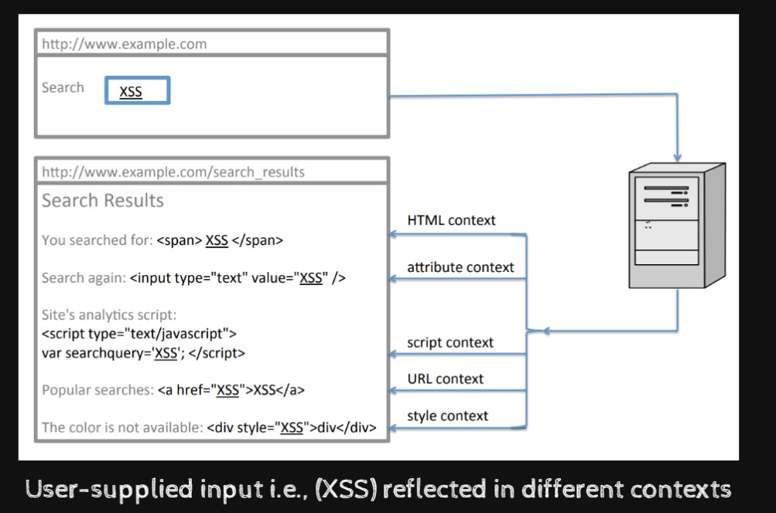
Context and Reflection
Context: As defined by Dr.-Ing Ashar Javed: “Context is an environment where the user supplied input or input from other applications eventually ends up or keeps on living.”
Reflection: It is the appearance of the user supplied input in the source code of a web application.
Figure: User supplied Input Reflected in Different Contexts: On Cross-Site Scripting, Fallback Authentication and Privacy in Web Applications by Ashar Javed

Slide 5
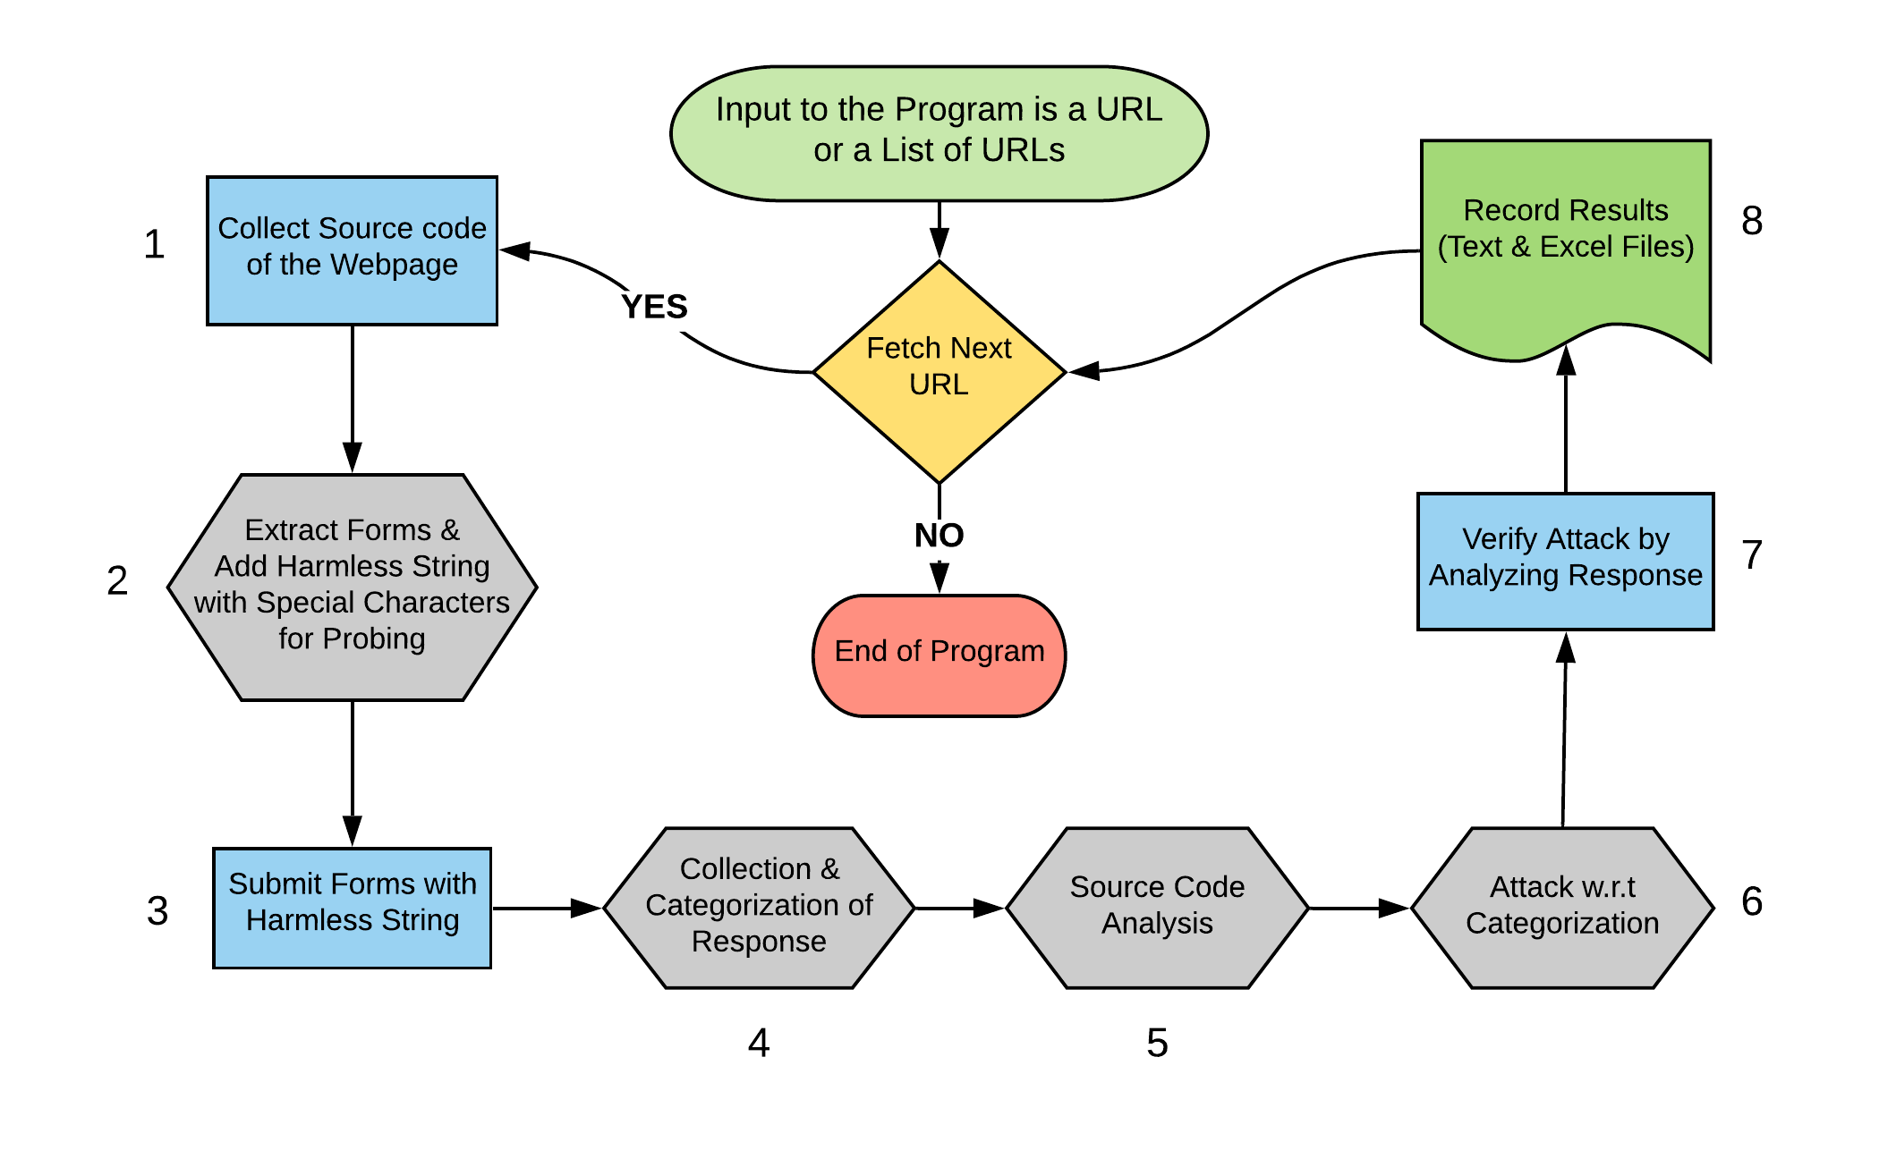
Project Overview

Slide 6
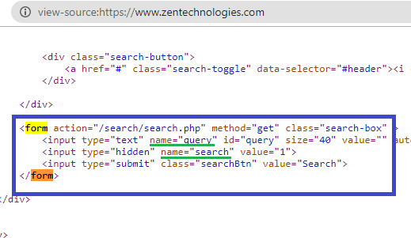
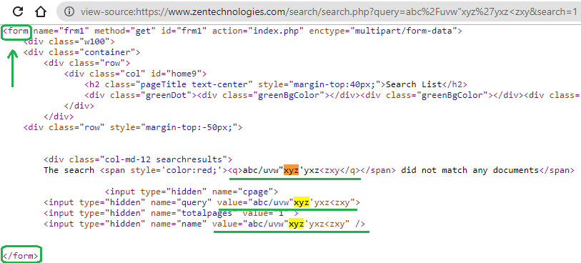
Extracting Forms and Adding Harmless Strings for Probing
EXTRACT FORMS (EXCEPT POST FORMS)
ADD HARMLESS STRING & SUBMIT FORM

Slide 7


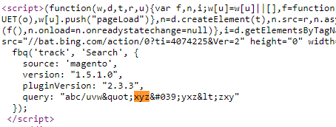
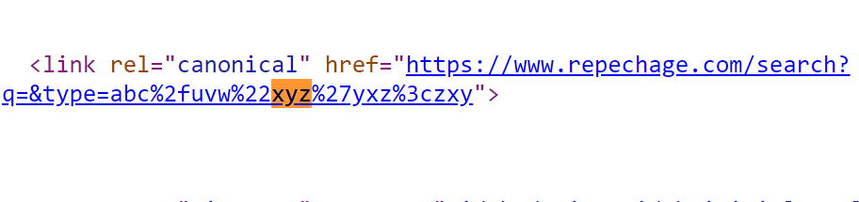
Collection & Categorization of Response
ATTRIBUTE & URL CONTEXT
HTML & SCRIPT CONTEXT

Slide 8
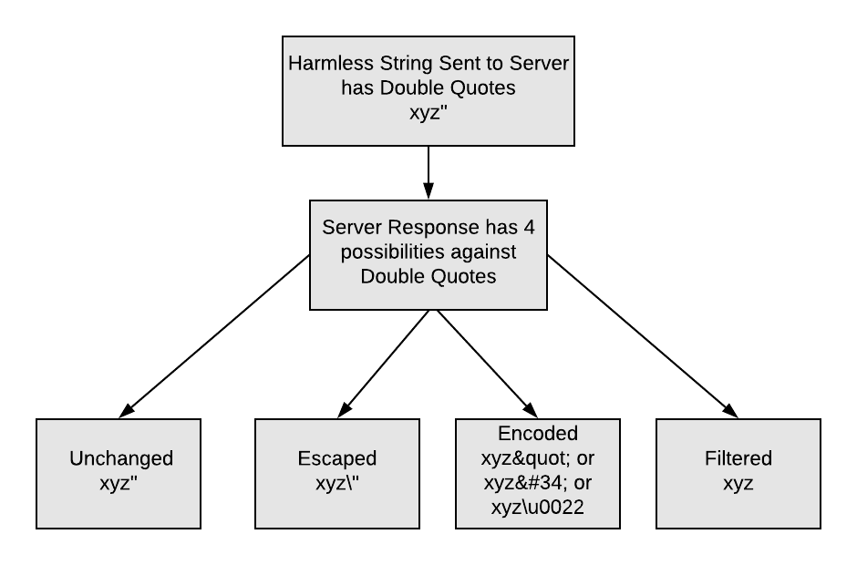
Source Code Analysis (Attribute & Script)

Slide 9
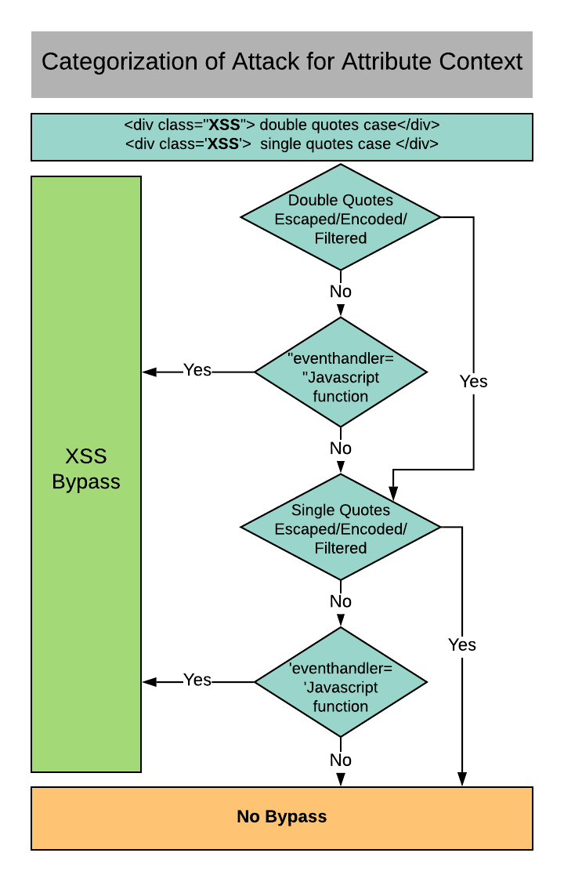
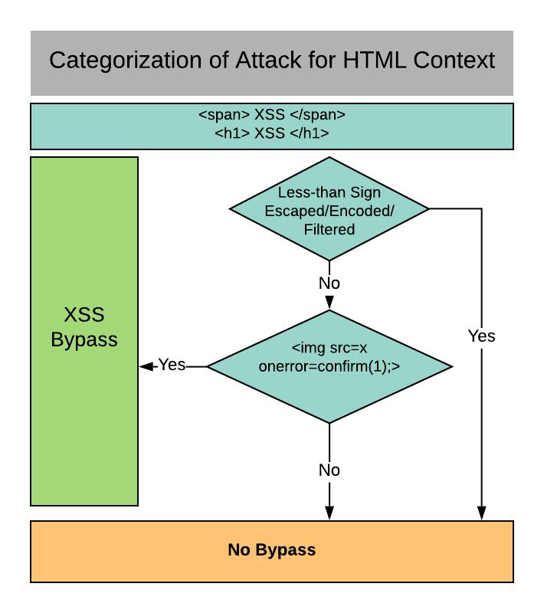
Attack w.r.t Categorization

Slide 10
Evaluation & Testing
The Tool has been Evaluated on 10,000 website urls
All of the website urls were tested in an automated fashion
Results and Findings of the Tool were also Verified Manually on 20 website urls
Both Manual and the Tool Findings were almost the same for these 20 website urls

Slide 11
Roadmap
Achievement of the Project:
Working of Tool in an automated fashion on GET parameters
To Dos:
Working of Tool in an automated fashion on POST parameters
Tuning and code optimization

Slide 12
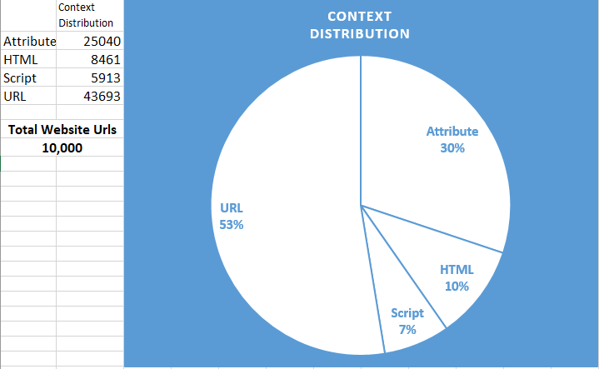
Context Distribution
The Pie chart is created from the data collected by the Tool
All website urls are tested automatically by the Tool
Data from these website urls is collected and stored in an automated manner

Slide 13
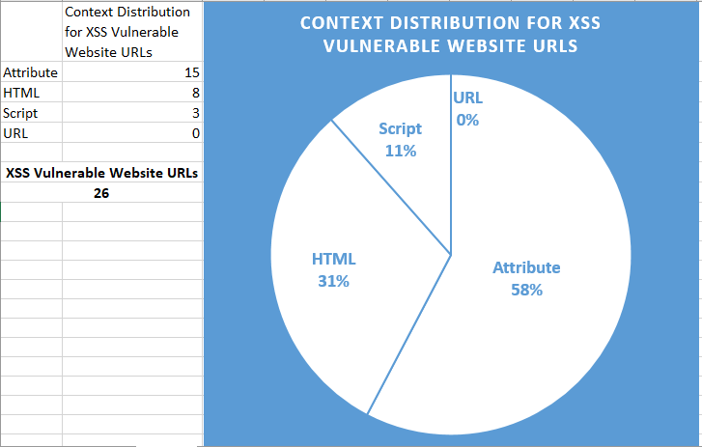
XSS ATTACK Context Distribution
Pie chart is created from the data collected by the Tool
The distribution is created from the vulnerable website urls found by the Tool
Testing of website urls and the storage of data was automated by the Tool

