Slide 1
Evaluation of Docker Container Networking
Muhammad Adnan Shah

Slide 2
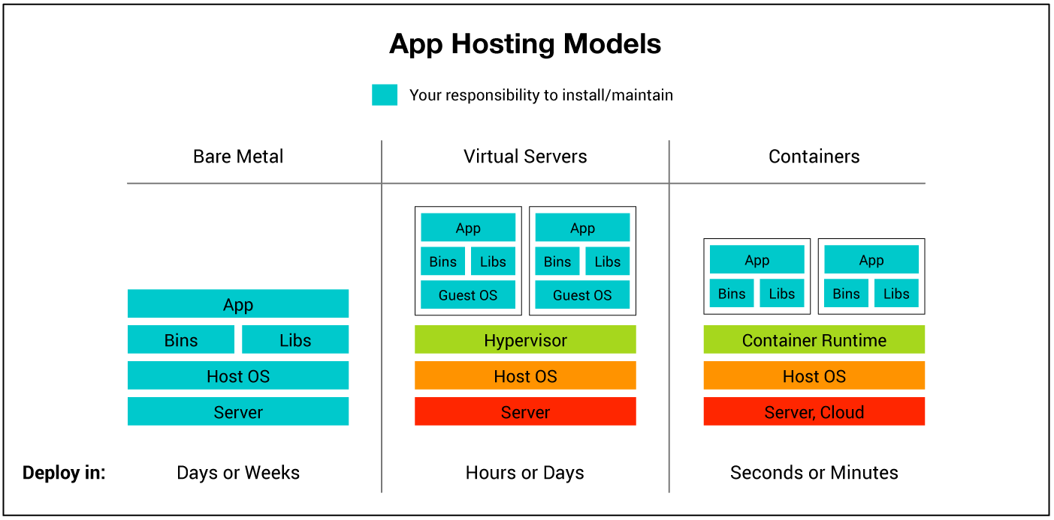
Background: Evolution of Technology
https://its.umich.edu/computing/virtualization-cloud/container-service/our-model

Slide 3
Docker: Introduction and Features
Docker Platform
  Docker Engine (Container Runtime)
  Docker Hub (Docker Images)
  Docker Client (Client Side)
Features
  Isolation
  Lightweight
  Portability

Slide 4
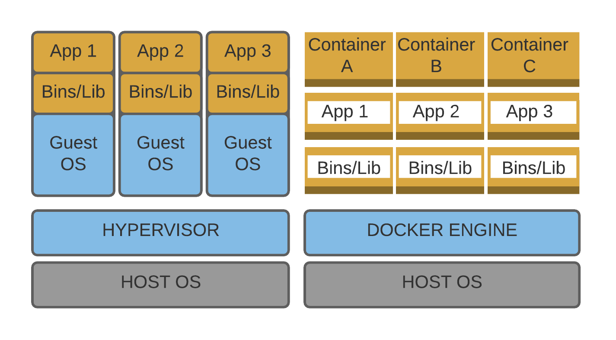
Virtual Machines Vs Containers

Slide 5
Docker Container Networking
Docker provides its own networking solutions for establishing and maintaining communications between containers and hosts.
Docker achieves this functionality with its Network Drivers

Slide 6
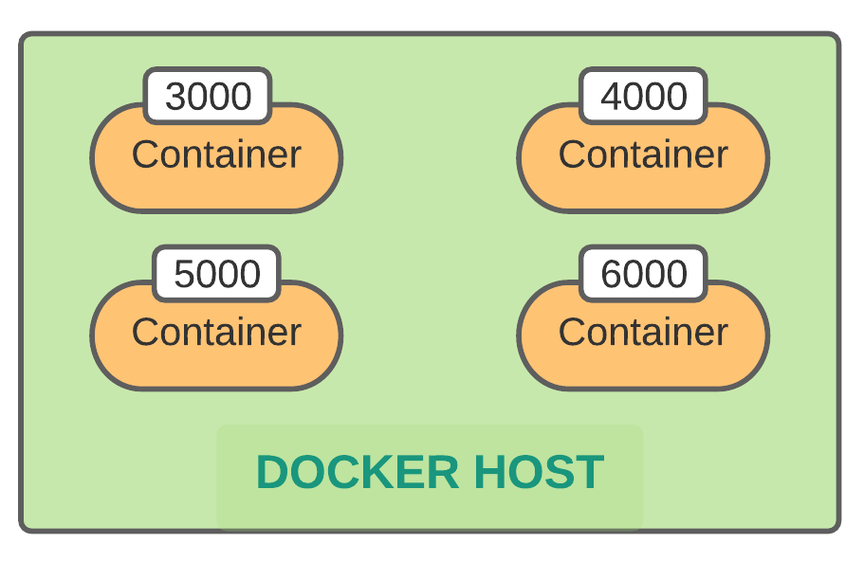
Scenario 1
Container-to-Host
(Host Network Driver)

Slide 7
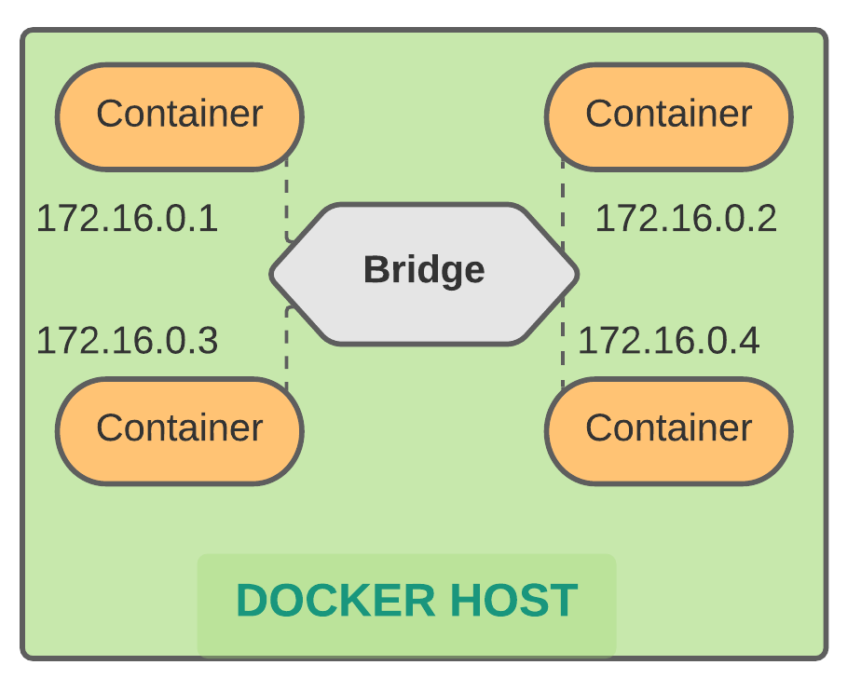
Scenario 2
Container-to-Container on same Host
(Bridge Network Driver)

Slide 8
Other Scenarios
Container-to-Container on different Host
(Overlay Network)
Host-to-Host
(Macvlan Driver)

Slide 9
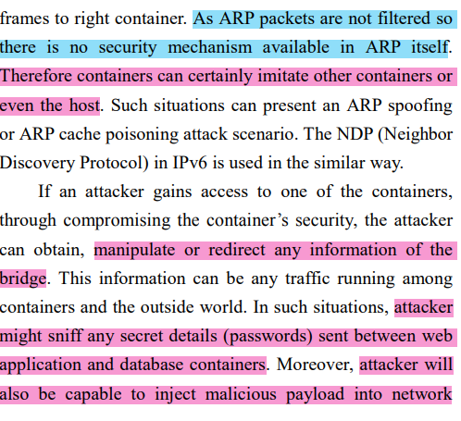
Research Paper: Mitigating Docker Security Issues
Yasrab, R. (2018). Mitigating docker security issues. arXiv preprint arXiv:1804.05039.

Slide 10
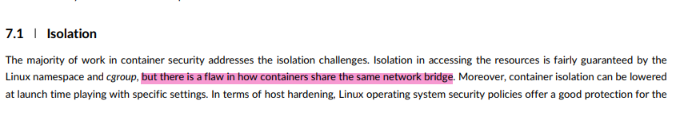
Research Paper: The state-of-the-art in container technologies: Application, orchestration and security
Casalicchio, E., & Iannucci, S. (2020). The state‐of‐the‐art in container technologies: Application, orchestration and security. Concurrency and Computation: Practice and Experience, 32(17), e5668.

Slide 11
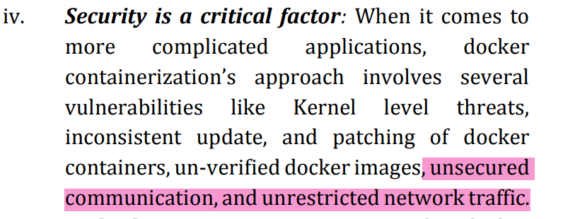
Research Paper: A Survey on Docker Container and its Use Cases
Bellishree, P and Deepamala, N (2020) A Survey on Docker Container and its Use Cases, International Research Journal of Engineering and Technology (IRJET)

Slide 12
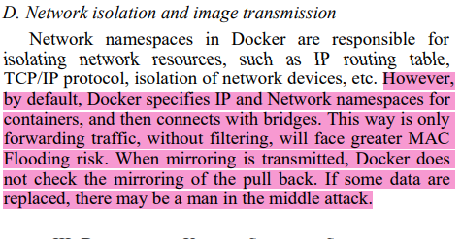
Research Paper: Vulnerability Analysis and Security Research of Docker Containers
Wenhao, J., & Zheng, L. (2020, September). Vulnerability Analysis and Security Research of Docker Container. In 2020 IEEE 3rd International Conference on Information Systems and Computer Aided Education (ICISCAE) (pp. 354-357). IEEE.

Slide 13
Problem Statement
Docker containers are widely used to facilitate the development, delivery and deployment of the software applications. However networking flaws inside the docker containers and especially the unfiltered traffic makes the communication insecure and susceptible to attacks such ARP poisoning, ARP spoofing, MAC flooding, DHCP starvation, Rogue DHCP attack and DoS attack.

Slide 14
Thank You

