Slide 1
Australian Rainfall Prediction Using Machine Learning
By Adnan Shaikh

Slide 2
Table Content
Introduction
Problem Statement & Aim
Objective
Dataset Overview
Methodology
Exploratory Data Analysis
Data Preprocessing & Cleaning
Model Selection & Training
Model Evaluation
Algorithms & Tools Used
Challenges
Advantages & Disadvantages
Applications
Conclusion & Future Scope

Slide 3
Introduction
Rainfall prediction is crucial for agriculture, transportation, and disaster management.
This project utilizes machine learning algorithms to analyze historical weather data from the Kaggle
Predict whether it will rain the next day. By applying EDA, feature engineering, and model evaluation, we aim to build an accurate predictive model to assist in decision-making.

Slide 4
Problem Statement
Accurate rainfall prediction is crucial for agriculture, disaster management, and resource planning. By leveraging machine learning, we aim to build a reliable predictive model to assist in decision-making

Slide 5
Aim of the Project
To develop a machine learning model that predicts rainfall probability using weather parameters, aiding climate adaptation and disaster preparedness.
Predicting whether it will rain tomorrow based on historical weather data using machine learning techniques.

Slide 6
Objective
Analyze historical weather data to identify key factors influencing rainfall.
Perform data preprocessing – handling missing values, outliers, and feature engineering.
Apply different machine learning models and evaluate their performance.
Optimize the best-performing model using hyperparameter tuning.

Slide 7
Dataset Overview
Target Variable:
Rain Tomorrow: Predicts if it will rain tomorrow
Feature Variables:
Date & Location
Temperature
Humidity & Pressure
Wind
Rain & Clouds

Slide 8
Methodology
Data Collection
Exploratory Data Analysis
Data Cleaning & Preprocessing
Model Selection & Training
Model Evaluation
Hyperparameter Tuning
Conclusion

Slide 9
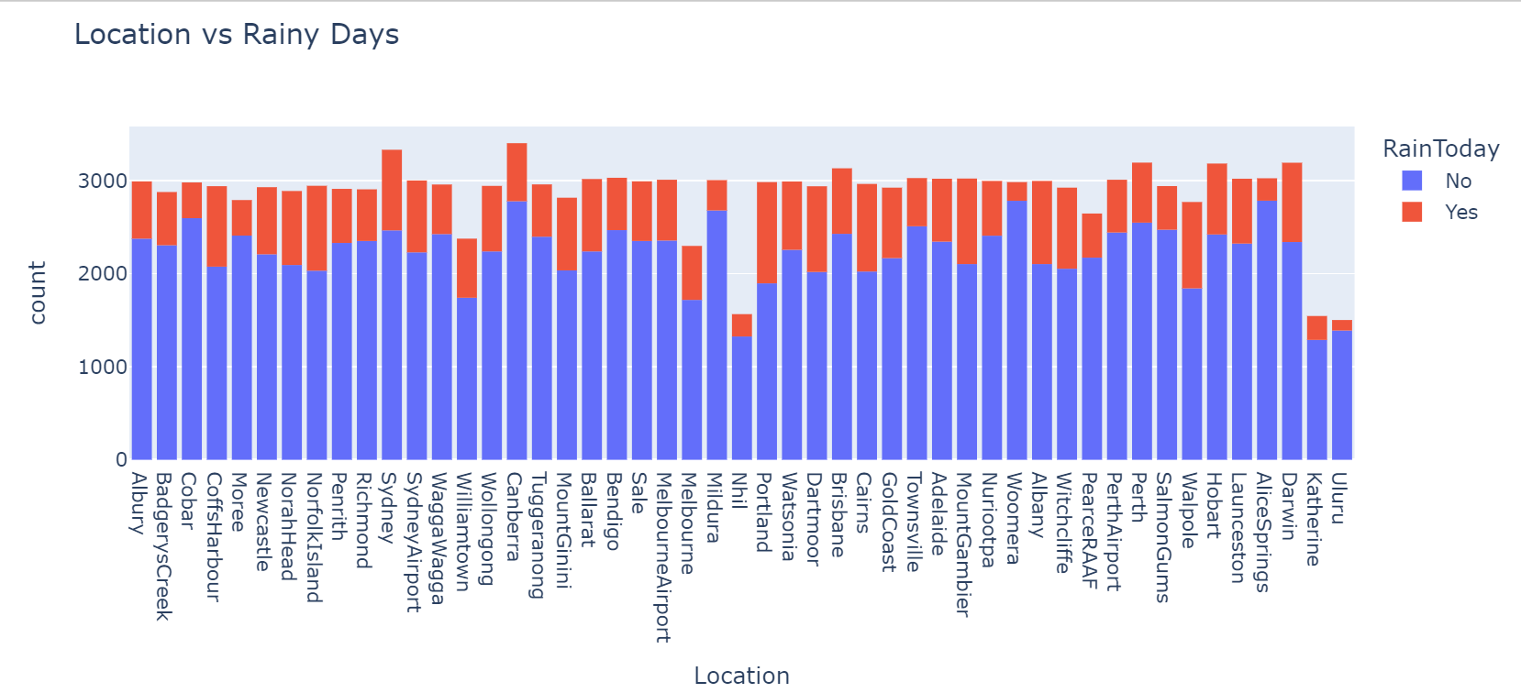
Exploratory Data Analysis
This histogram shows the distribution of rainy days across different locations, highlighting regional variations in rainfall frequency.

Slide 10
Data Preprocessing & Cleaning
Handling Missing Values – Filled missing values using mean, median, mode, or dropped them
Encoding Categorical Data – Used Label Encoding for categorical features.
Feature Selection – Selected key features using correlation & Boruta method
Handling Imbalanced Data – Used SMOTE to balance Rain Tomorrow classes
Multicollinearity Check Using Variance Inflation Factor

Slide 11
Algorithms Used
Random Forest
XG Boost
Gradient Boosting
Ada Boost
Logistic Regression
KNN
Decision Tree

Slide 12
Model Selection & Training
We Build 7 algorithm machine learning model
Split dataset into 75% training & 25% testing.
Evaluated models using Accuracy, Precision, Recall, F1-score
Random Forest performed best with the highest accuracy and F1-score

Slide 13
Model Evaluation
Model | Accuracy | Precision | Recall | F1-Score
Logistic | 75% | 76% | 74% | 75%
Decision | 83% | 83 | 84% | 84%
Random | 89% | 90% | 88% | 89%
XG Boost | 87% | 91% | 87% | 87%
KNN | 83% | 78% | 85% | 84%
ADA | 83% | 82% | 84% | 83%
Gradient | 81% | 80% | 82% | 81%

Slide 14
Hyperparameter Tuning
Hyperparameter Tuning: Optimizing model parameters to enhance performance, but it may not always lead to improvement.
Techniques Used: Grid Search
Findings in Our Project: After tuning, the performance decreased instead of improving.
Final Decision: We retained the default parameters, as they provided better performance.

Slide 15
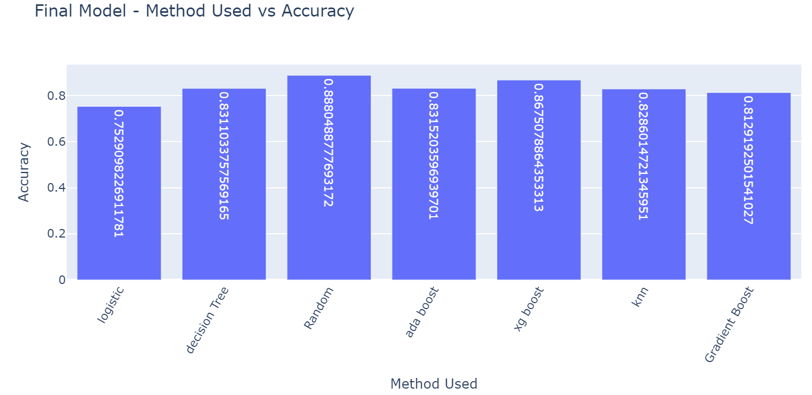
All the Model Performance

Slide 16
Best Performing Model
Best Performing Model – Random Forest
Achieved the highest accuracy 89% & F1-score 89% in this project.
Reduces overfitting by combining multiple decision trees.
Works well with non-linear relationships & large datasets.

Slide 17
Tools & Technologies
Programming Language: Python
Libraries Used: Pandas, NumPy, Matplotlib, Seaborn, Scikit-Learn
Environment: Jupyter Notebook
Data Sources : Kaggle

Slide 18
Challenges Faced
Challenges
Solution
Handling Missing Values:
Feature Selection:
Hyperparameter Tuning:
Used mean, median for numerical and mode for categorical
Used Boruta and correlation method
Finding the best parameters for Random Forest took time

Slide 19
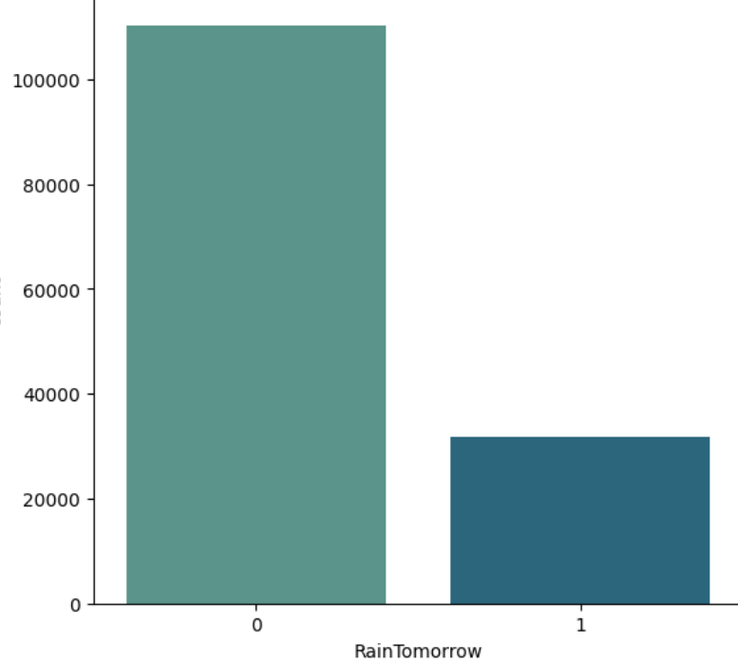
Class Imbalance: Rain Tomorrow (Yes/No) was imbalanced, affecting model performance.

Slide 20
Advantages
High Accuracy: Random Forest achieved 89% accuracy.
Can be scaled for real-time predictions
Handles Missing Data: Works well even with missing values
Feature Importance: Helps identify important factors affecting rainfall.

Slide 21
Disadvantages
Hyperparameter Tuning: Finding the best parameters was time-consuming.
Computationally Expensive: Takes more time & memory than simple models
Imbalanced Data: Required extra steps like SMOTE to handle imbalance

Slide 22
Applications
Weather Forecasting Services
Agriculture Planning
Water Resource Management
Disaster Risk Management
Urban Planning

Slide 23
Conclusion
Developed an ML model to predict rainfall using weather data.
Random Forest performed best with high accuracy.
Data preprocessing & feature selection improved model performance.

Slide 24
Value Addition
Improves Decision-Making: Helps farmers, city planners, and disaster management teams.
Enhances Climate Resilience: Assists in preparing for extreme weather events.
Optimizes Resources: Supports better water management and urban infrastructure.

Slide 25
Learnings & Future Scope
Deep Learning Models: Improve accuracy using LSTMs & CNNs for weather pattern recognition.
Integration with Real-Time Data: Connect with IoT sensors & satellite data for live weather updates.

