Slide 1
Introduction
4HYBD

Slide 2
4HYBD – Introduction
Course Objectives
By the end of the course, students should:
Know about mobile application
Choose the best tool for mobile apps
Be aware about hybrid apps

Slide 3
Summary
Discussion
Hybrid apps

Slide 4
1. Discussion

Slide 5
1. Discussion
During all the previous years, you have seen how to build website but also native mobile applications using various technologies.
This is or was the main way to build application for all devices, but as you can expect this was also leading to more work, and have multiple teams to handle the same project.

Slide 6
1. Discussion
While building mobile application you do have multiple solution, what are they? What did you use in class during the years? Try to list all solution you experimented with and define their pro and con if you can.
Did you try some other solution for your projects, personal projects or even for company projects?

Slide 7
1. Discussion
In the previous question you should have listed at least 4 or 5 technologies, maybe more depending how precise you are and which stack you used.
What is the use case for each of them? Where do you think each technology shine? In which use case ?

Slide 8
1. Discussion
What could be the advantage of using native technology to build a mobile application? What would be the best use case for such solution? Give some example of application that are build using that.

Slide 9
1. Discussion
You surely mentioned other solutions that are not native technology, for example Hybrid apps. What would be the use case for such technology? Looking at your phone, what application - or kind of application - rely on that stack?
What do you think would be the advantage of using that over native technology?

Slide 10
1. Discussion
If you started to write some code in the last 7-10 years, or know people that were writing code “back in the days” you may be aware of JQuery (and especially JQuery Mobile).
What do you think is (or was) the use case for such technology? Would you still use it today? For which reason?

Slide 11
1. Discussion
Now the browser capabilities have extended quite a lot in the past 7 years, allowing a lot more access to not just the browser but also the system. How do you think this is playing in the mobile or even desktop application landscape?
Are you aware of such solution running in the browser that you may use on a daily basis?

Slide 12
1. Discussion
Discuss the global trade-off between all the previous solutions. On which case would you use and favor one over the others? For which reason and type of application? If tomorrow you had to decide which tech stack to use, how would you do your choice? What would be the key factor to decide?

Slide 13
1. Discussion
Let’s go into some concrete example with some use case. What solution, and trade off would you take on the following ecosystem
large tech company, providing a game (voodoo, clash of clan)
medium sized company, with a blog solution (medium, dev.to)
small company that provide a targeted solution solving one business use case (let’s say upload of image and report from a construction company)

Slide 14
1. Discussion
Depending on the previous point, almost all technical stack can be justified for each projects, at the end they provides the same capabilities. But maybe the differentiator will be the capability to hire, the cost of build the application and maintaining it or even how the users will run it.

Slide 15
1. Discussion
What solutions do you know can be used to build hybrid apps?
Did you use some of them or only heard of them?
In what use case did you remember seeing them?
Was it part to a specific project ?

Slide 16
1. Discussion
If you used some hybrid solution (all of them, not one in particular) what was leading your choice to this solution? What was your benchmark against? What was the project and the ecosystem about?

Slide 17
1. Discussion
Do you think JavaScript is a good tool to build the hybrids
applications (it relies on JS framework)?
What do you think would be the impacts of using this technology over Kotlin / Swift ?
performance
building team / hiring
reusability

Slide 18
1. Discussion
Do you think all companies need to have the best performances (aka
pure applications) ?
In which case would you select to go to pure applications ?
Justify your choice.

Slide 19
1. Discussion
There is no good / bad solution on the previous answer, you can
choose all technologies to build all of the projects.
But most of the time you have a trade-off to take when you build a solution.
time
money
complexity

Slide 20
1. Discussion
As an engineer - senior and maybe manager - you will have to deal with
this kind of choice almost on a daily basis. After all the business will come with some needs, but without the knowledge on how to solve it.
You will have to ask yourself, and your team, some questions that would be like:
Is 90% of the base performance enough?
How are my users using the applications?
What are my users?

Slide 21
1. Discussion
But other more global questions can lead you in the way of finding the best solution:
What kind of users do I have, what's my public?
Do I need some specific features only available on one technical solution?
Do I have the good people to work on that?
Can I hire some new one?

Slide 22
1. Discussion
Using the previous question, try to answer using one of your project. It can be your year project, or a current project during your internship.
You can also extrapolate that with other projects you worked on.

Slide 23

Exercises

Slide 25
2. Hybrid apps

Slide 26
2. Hybrid apps
Since the rise of the iPhone (and so the smartphone trends) we use
more and more mobile devices on our daily life
check the direction / map
send email
buy online
take pictures and share it online

Slide 27
2. Hybrid apps
During the past 15ish years, we have seen a big change on how users
(consumers) use the tools and crave for more access with companies
needing to provide the best experience possible using their website.
But the trend is also to have an easy-to-use solution using only your
mobile device (smartphone, tablet...), and that for everything.
Would you use a bank without a mobile app? Would you be on a social network just having a website? But would you use a social network without a website?

Slide 28
2. Hybrid apps
It is hard to imagine, but before 2007 (or even before 2010) most of
the people didn't have a smartphone - and no one with unlimited
internet as fast as the current 4G/5G (even with the ADSL which was
~5Mbits).
On smartphone, internet wasn't a default solution and in France
people used a "fake internet" webportal.

Slide 29
2. Hybrid apps
Starting around 2010/2012 people had access to multiple types of
phones. Mainly the following list for the Operating System.
iOS
Android
Windows Phone
Blackberry

Slide 30
2. Hybrid apps
Blackberry was the "legacy" solution for all people to use (businessman) as this was the only solution done for professionals, and this was the main selling point. It was even used since a few years ago as the phone use by the USA president (It changed during the 2nd mandat of Barack Obama).
With the rise of the iPhone and Android, most of the population
moved to use one of these solutions, and the companies had to adapt.

Slide 31
2. Hybrid apps
Today more people own smartphone than computers, it is de facto the
base / target solution that companies should consider - but it also
depends of the public.
For example if you are working for an internal ERP you can be pretty
sure that the solution is here for people using a computer daily, where if you build a social network - like BeReal - you don’t really care about computer.

Slide 32
2. Hybrid apps
On the other end, if you build a real time solution to have some food
delivered, in that case people will mostly order from their phone
while delivery people will also follow that from their phone.
It always depends on what's your end target, it can help you to
choose a technology before another one.

Slide 33
2. Hybrid apps
Back in the early days of mobile, there was really only one way to give
your users the performance and features they expected. You had to
use each platform’s native toolset, and this comes with a trade-off.
Building in parallel for each mobile platform
Managing multiple codebases
Hiring and retaining highly specialized and costly native developers

Slide 34
2. Hybrid apps
Meanwhile, demand for mobile experiences continues to grow exponentially.
By 2025, 70% of all enterprise software interactions are expected
to occur on mobile devices (Gartner). This value may rise even higher with new technologies like wearable, and also with a lot of new countries jumping past computer to mobile directly.
Given the time and cost of traditional native development, it’s no
surprise that many development teams are struggling to keep up with
this demand.

Slide 35
2. Hybrid apps
Thankfully, times have changed. As mobile and web technology have
evolved, hybrid has emerged as a viable alternative to natives.
Many are now looking at hybrid development as a way to simplify and
speed up app creation.
Let’s take a look at the reasons for this shift.

Slide 36
2. Hybrid apps
The growing adoption of hybrid is evident. Multiple survey found
two-thirds of developers are choosing a cross-platform or web-based
approach over native tools.
Even the top brands like Target, Nationwide, and Southwest Airlines
have chosen a hybrid approach over native to power apps for their
customers and employees.

Slide 37
2. Hybrid apps
The top reasons for making the switch from native to hybrid, based
on independent research and testimonials, are:
speed
efficiency
design & UX
skillset

Slide 38
2. Hybrid apps
Speed
Building for multiple platforms from a single codebase often makes
delivering cross-platform apps 2-3x faster than native. As you use the same technology between multiple codebase (or technically this become only one codebase) you can factorise the R&D and building the core solution.

Slide 39
2. Hybrid apps
Efficiency
Reduced development times, and the avoided costs of hiring and
retaining specialized native talent, can save team 60% or more
compared to native.
With one language to develop them all, it is also easier to have good senior engineers that can move across projects, without learning a new stack.

Slide 40
2. Hybrid apps
Design & UX
With one codebase running on desktop, mobile, and web, hybrid apps
provide better design and UX consistency across channels.
This also help to harmonize how the application render, helping with the branding and visual of all the application. For example, having the same visual effect between Android and iOS applications an be quite hard normally (you can check apps like facebook, twitter or instagram)

Slide 41
2. Hybrid apps
Skillset
Hybrid gives web developers and businesses with in-house web
teams the tools to build powerful mobile apps using their existing
skills and talent.
You have less need to train or hire a dedicated team to support a specific device, and this could even include smart TV for example.

Slide 42
2. Hybrid apps
So, what's a hybrid app?
Hybrid apps are native apps. They’re downloaded from the platform’s
App Store or marketplace.
They also offer the same native features, offline support, and
hardware-based performance acceleration as any app built with a
native SDK.

Slide 43
2. Hybrid apps
The key difference is that hybrid apps are built using open web
technologies like HTML, CSS, and JavaScript, rather than the
proprietary or specialized languages used by iOS, Android, and
others.
That means anyone with a modern web developer skill-set can begin
building an app using the hybrid approach.

Slide 44
2. Hybrid apps
Hybrid apps run in a full-screen browser, called a webview, that is
invisible to the user. Through customizable native plugins, they can
access the native features of specific mobile devices (such as the
camera or touch ID), without the core code being tied to that device.
That means cross-platform hybrid applications can run on any
platform or device, all from a single codebase, while still delivering
native performance.

Slide 45
2. Hybrid apps
Following the native approach, that means you need to build separate
apps for each mobile platform, and sometimes specific apps for
tablets and smartphones. If you want to target all device for a TV app (like netflix), how many application should you build?
This is where hybrid development shines.

Slide 46
2. Hybrid apps
With a hybrid framework like Ionic, you can run your app on any
platform or device, all from a single codebase.
Ionic also provides adaptive styling, so the look-and-feel of your app
isn’t one-size-fits-all.
It automatically adapts to each platform.

Slide 47
2. Hybrid apps
And because hybrid technology is web-based, you can run your app in
any modern browser, for example Chrome - Firefox - Opera...
That means your users get a great experience across platforms and
devices, and you only have one codebase to worry about.

Slide 48
2. Hybrid apps
Write once Run everywhere (like Java ? :D)
Rarely is a mobile app only designed for a single platform.
Consumers, partners, and employees all have a choice of platforms
and devices.
Following the native approach, that means you need to build separate
apps for each mobile platform, and sometimes specific apps for
tablets and smartphones.

Slide 49
2. Hybrid apps
The web developer community is about 10x greater in size than the
number of native mobile app developers, according to the Stack
Overflow survey.
Many development teams already have a deep bench of programmers
who understand HTML, CSS and JavaScript.

Slide 50
2. Hybrid apps
With a hybrid framework like Ionic, your existing web teams can build
highperformance apps that run on any platform or device, using the
tools and technology they already know and love.
That’s a lot easier than outsourcing development, or recruiting,
training, and hiring specialists.

Slide 51
2. Hybrid apps
Plus, centralizing on a single skill set makes it much easier to reassign
teams when a project is finished - whether that’s a desktop web app
or another mobile project.
People can then move from one frontend solution to another one, with the same stack or something quite similar without the need to be retrained again and again.

Slide 52
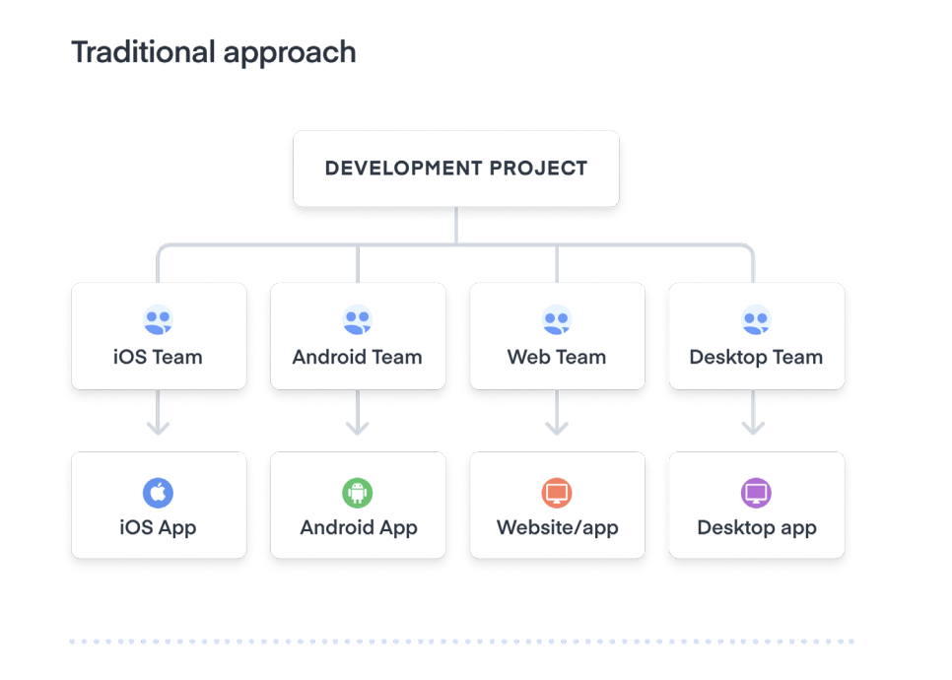
2. Hybrid apps

Slide 53
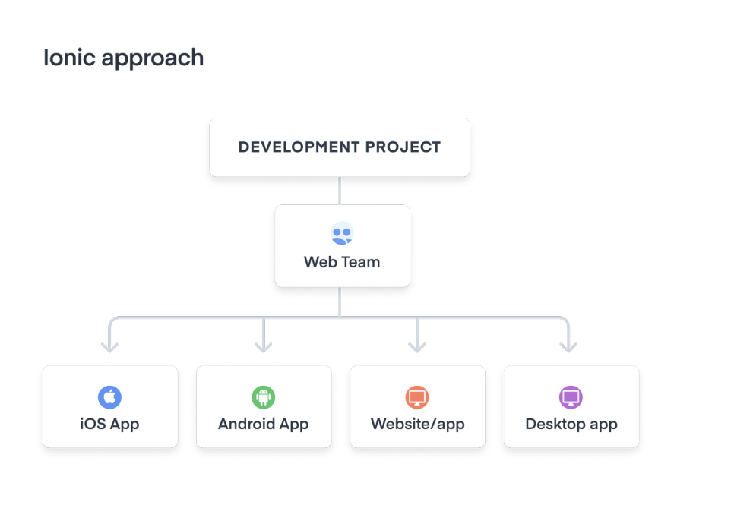
2. Hybrid apps

Slide 54
2. Hybrid apps
Native advocates will claim that only a native approach can deliver
the speed and performance that you need to create a great user
experience.
That may have been true five years ago, but today’s solutions offer
the same hardware based performance acceleration as native apps, and the difference is only needed for really specific applications with high custom needs. There is a good chance you don’t need that!

Slide 55
2. Hybrid apps
Of course, hybrid applications are not without their drawbacks, and the list really depend on what you want to do with it. Would it be recommended to build a full 3D game using that technology?
Maybe not, but today web browser can access the GPU quite easily, and rely on WASM for more performance. Nevertheless, some issues exist:
system overhead
plugin management
third-party dependence

Slide 56
2. Hybrid apps
System overhead
The use of the webview may introduce a degree of overhead
compared to native.
The abundance of performance APIs and increasingly powerful
hardware have made this less of a factor in recent years, but it’s still
something to consider.

Slide 57
2. Hybrid apps
System overhead
For most applications, the difference in performance is hardly
noticeable. But for 3D games and other performance-intensive
applications, a hybrid solution may not be the best choice.
This will be your role to check that through some benchmark to choose if the solution makes sense or not.

Slide 58
2. Hybrid apps
Plugin management
Cross-platform solutions like Ionic - as well as React Native and
others - are able to access nearly every native feature of a device, like
the camera or gyroscope, by using native plugins that unlock native
device features and integration using basic JavaScript.

Slide 59
2. Hybrid apps
Plugin management:
In a hybrid app, open source Cordova and Capacitor plugins are the
most popular solution to this problem. But the use of these plugins does add complexity to development, while simultaneously allowing you to access new features.

Slide 60
2. Hybrid apps
Third-party dependencies
Choosing a cross-platform approach means you’re placing trust in the
maker of the framework vendor (whether it’s Ionic, React Native,
Xamarin, etc.) to keep up with the latest and greatest native features
and design patterns of each mobile platform.

Slide 61
2. Hybrid apps
Third-party dependencies
While the various cross-platform frameworks available today—Ionic,
Xamarin, Flutter, and React Native—may appear similar on the
surface, there are a lot of differences between them that you’ll
realize as you dig in.

Slide 62
2. Hybrid apps
To summarize very briefly, Ionic Framework and tooling are all based
on open web technologies, from the languages that you use to build
Ionic apps (HTML, CSS, JavaScript), to the standardsbased UI
components running inside your app.
In that sense, when you choose Ionic, you’re really choosing the web -
the most time-tested, universal runtime in the world.
You build with the web, and we give you the tools and component libraries to help you succeed.

Slide 63
2. Hybrid apps
Most of the other frameworks add some level of custom UI rendering
to work across platforms.
For example, React Native translates your JavaScript code into native
code at runtime, and uses the native UI elements provided by iOS and
Android.
Flutter works with the Dart language and uses its own custom
graphics engine to work across devices.

Slide 64
2. Hybrid apps
Each approach has its benefits and drawbacks, which typically come
down to debates about performance, code sharing, customization,
and portability.

Slide 65
Exercises

