Slide 1
Ionic
4HYBD

Slide 2
4HYBD – Ionic
Course Objectives
By the end of the course, students should:
Setup an Ionic project
Understand the structure
Be able to know the basics components
Time:
course: 1.5h
exercises: 2.5h

Slide 3
Summary
Ionic
Setup
Ionic Components

Slide 4
1. Ionic

Slide 5
1. Ionic
The Ionic Framework enables cross-platform development by allowing developers to use web technologies like HTML, CSS, and JavaScript to create applications.
These applications can be deployed on iOS, Android, and the web without the need to rewrite the code for each platform, providing a streamlined development process.

Slide 6
1. Ionic
Ionic comes equipped with a comprehensive set of pre-styled and optimized UI components.
These components are designed to mimic native elements and automatically adapt to the platform on which the application is running, ensuring a consistent user experience across different devices.

Slide 7
1. Ionic
Initially designed to integrate seamlessly with Angular, the Ionic Framework has expanded to support other popular frameworks such as React and Vue.js.
This versatility makes it an attractive option for a wide range of web developers looking to build interactive and modern applications, being able to support all major framework that can be used in companies.

Slide 8
1. Ionic
Applications built with Ionic run on top of the device's web browser through WebViews, but they can also utilize native code to access more sophisticated device features and optimizations via plugins.
This hybrid approach allows for a balance between performance and accessibility of web technologies.

Slide 9
1. Ionic
Ionic leverages Capacitor, its own native bridge, to call native SDKs from the web code, as well as Cordova for additional support in accessing native device features such as the camera and GPS.
These tools enhance the functionality of Ionic applications, allowing them to interact more deeply with the host device by providing core support of features that would not be normally accessible on a pure web based application.

Slide 10
1. Ionic
Ionic benefits from a robust community of developers and a comprehensive ecosystem of plugins and third-party tools.
This support network enables developers to add complex functionalities to their applications and helps ensure that there are ample resources for troubleshooting and enhancement.

Slide 11
1. Ionic
Ionic offers a suite of development tools and services designed to streamline the app development process.
Ionic Studio, for instance, is a powerful IDE that facilitates the building of applications, while Ionic Appflow provides a mobile CI/CD service that simplifies the process of building and deploying apps directly to app stores.
But you can also use any IDE you do like, and using CI/CD using the solution you do prefere, from Github Action to Gitlab jobs.

Slide 12
1. Ionic
Ionic is built to perform and behave great on the latest mobile devices
with best practices like efficient hardware accelerated transitions,
and touch-optimized gestures.
Ionic emulates native app UI guidelines and uses native SDKs,
bringing the UI standards and device features of native apps together
with the full power and flexibility of the open web.
Ionic uses Capacitor (or Cordova) to deploy natively, or runs in the
browser as a Progressive Web App.

Slide 13
1. Ionic
Ionic is utilized across various domains, including enterprise applications where businesses need to integrate apps seamlessly with existing systems, e-commerce apps that provide rich user experiences across multiple platforms, and healthcare apps that require secure and effective operation on a variety of mobile devices.

Slide 14
1. Ionic
This makes Ionic an ideal choice for organizations that wish to leverage their existing web development skills to create versatile and functional mobile applications without committing extensive resources to native development for each platform.

Slide 15
1. Ionic
Ionic has been used by several large companies to build various applications, leveraging its flexibility and the ease with which it integrates with different technologies.
Here are examples of applications from larger companies that have utilized the Ionic Framework, showing that it can be used by all size companies from every sector.

Slide 16
1. Ionic
National Health Service (NHS)
The NHS in the UK developed their app using the Ionic Framework. The NHS app allows users to access a variety of services including booking appointments, ordering repeat prescriptions, and viewing their medical records. Ionic's ability to work across platforms was crucial for ensuring accessibility on various devices.

Slide 17
1. Ionic
Amtrak
The American railroad service uses Ionic to power its mobile booking and trip management application. This app provides functionalities such as booking tickets, checking train statuses, and managing reservations, all within a user-friendly interface made possible by Ionic's robust component library.

Slide 18
1. Ionic
Just Eat
The international online food order and delivery service has utilized Ionic to develop parts of its customer-facing mobile application. This enables users to browse menus, place orders, and pay for their food from their smartphones. Ionic's efficient performance and ease of use were key factors in its selection.

Slide 19
1. Ionic
Airbus Helicopters
Airbus Helicopters developed the Airbus Helicopters HCare Fleet app with Ionic, which is used for managing the maintenance and logistics of helicopters. The application provides technical information and tracking tools, critical for maintaining the safety and operational efficiency of the fleet.

Slide 20
1. Ionic
MarketWatch
MarketWatch, known for providing financial information, news, and analysis, has also used Ionic to develop its application. This app delivers up-to-date market data and news to users, benefiting from Ionic's ability to integrate smoothly with various backend services and APIs to fetch real-time data.

Slide 21
1. Ionic
These applications demonstrate Ionic's strength in creating diverse solutions, from health and fitness to financial tracking and entertainment platforms, all benefiting from its cross-platform capabilities and robust UI toolkit.

Slide 22

Exercises

Slide 24
2. Setup

Slide 25
2. Setup
Setting up a new Ionic Framework project using React involves a few simple steps that leverage Node.js and npm (Node Package Manager).
Before starting, ensure you have Node.js and npm installed on your machine (you should already know how to use and install that).
Ionic comes with a full CLI that allows you to create and build your
project. For that you can install it globally or use npx - for both of
them you need to have Node.js installed on your system (current LTS
is Node.js v20)

Slide 26

2. Setup
First, you need to install the Ionic Command Line Interface (CLI) globally on your computer. Open your terminal or command prompt and run the following command.

Slide 27

2. Setup
Once the Ionic CLI is installed, you can create a new project. To start a new Ionic project with React, use the following command:
Replace myApp with whatever you want to name your project. The CLI will ask you to choose a template for your new project.
You can select from several templates such as blank, tabs, sidemenu, etc. Let’s use the “tabs” one as a default one for this setup.

Slide 28

2. Setup
To start your application and see it in action, run the following command in your project directory:
This command will compile your app and host it on a local development server. Your default web browser should automatically open to http://localhost:8100 where you can see your new Ionic React app running.

Slide 29
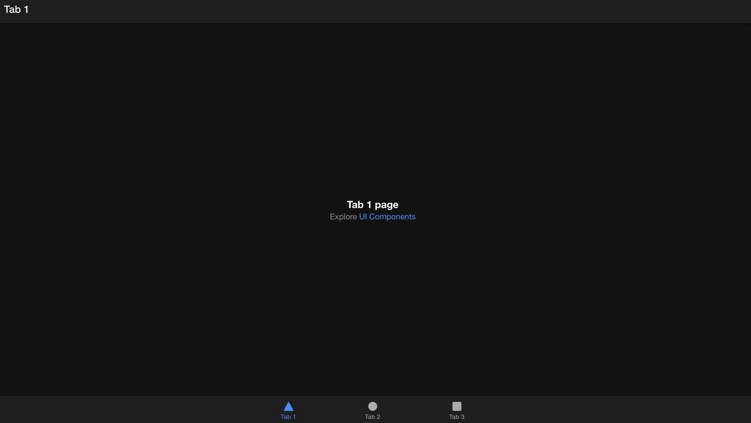
2. Setup

Slide 30
2. Setup
You can now start modifying your app by editing the React components in the src directory.
Ionic uses standard React component structure and styling, with additional Ionic components that you can include as needed.
This setup gets you started with an Ionic project using React, leveraging Ionic’s component library and the React framework to build interactive mobile applications that can be deployed across multiple platforms.

Slide 31
2. Setup
Let’s spend some time checking the content of the default project that we just generated. As you have experience with React (and other framework) you should be very familiar with the content and organization of the files and folders.

Slide 32
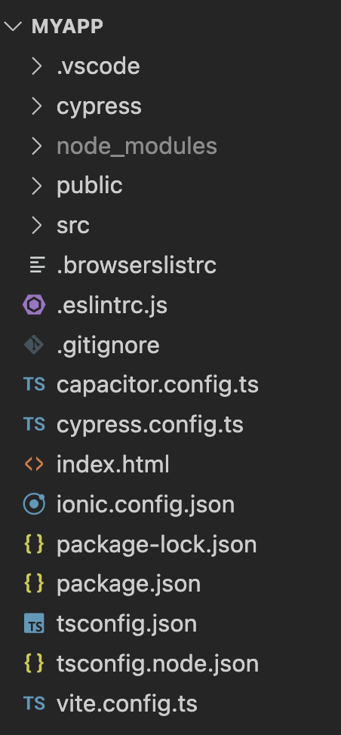
2. Setup

Slide 33
2. Setup
You can see all the configuration files at the root of the project, with most of them that you know of.
package.json and package-lock.json
tsconfig
vite config
ionic config
cypress config
capacitor config

Slide 34
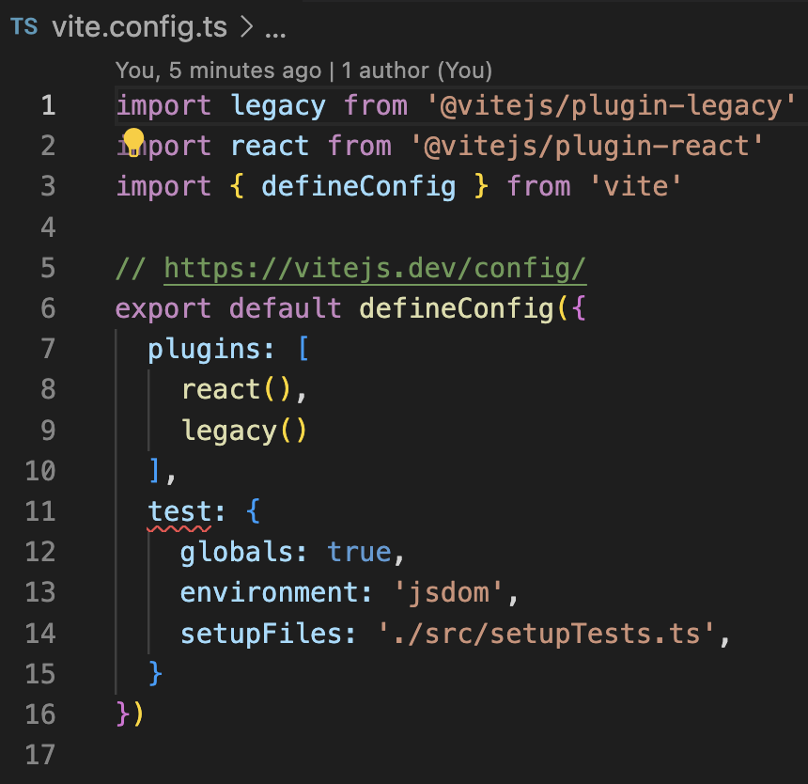
2. Setup

Slide 35
2. Setup
As you can see, Ionic use vite as the base tooling setup. You can work and change the configuration, but most of the time - except if you need customization - you won’t change it.
In the file generated we can see that it uses the react plugin and a link to the jest configuration file (or setup) for your project.

Slide 36
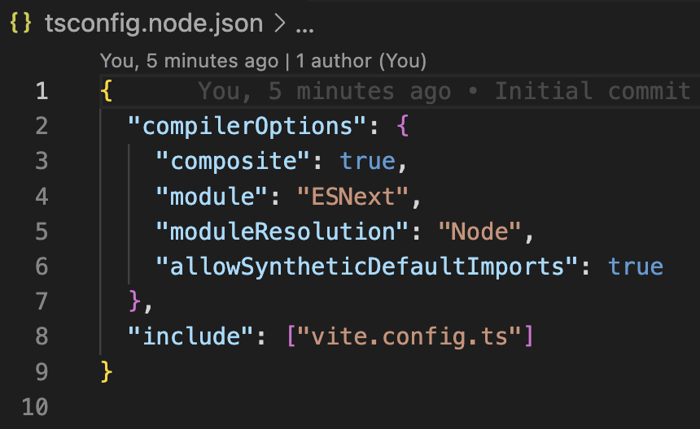
2. Setup

Slide 37
2. Setup
The tsconfig.node.json file in a TypeScript project is a configuration file specifically used for setting up TypeScript options that are tailored for Node.js environments.
This configuration file extends or modifies settings from a base tsconfig.json file, which is generally used to define options for compiling a TypeScript project.

Slide 38
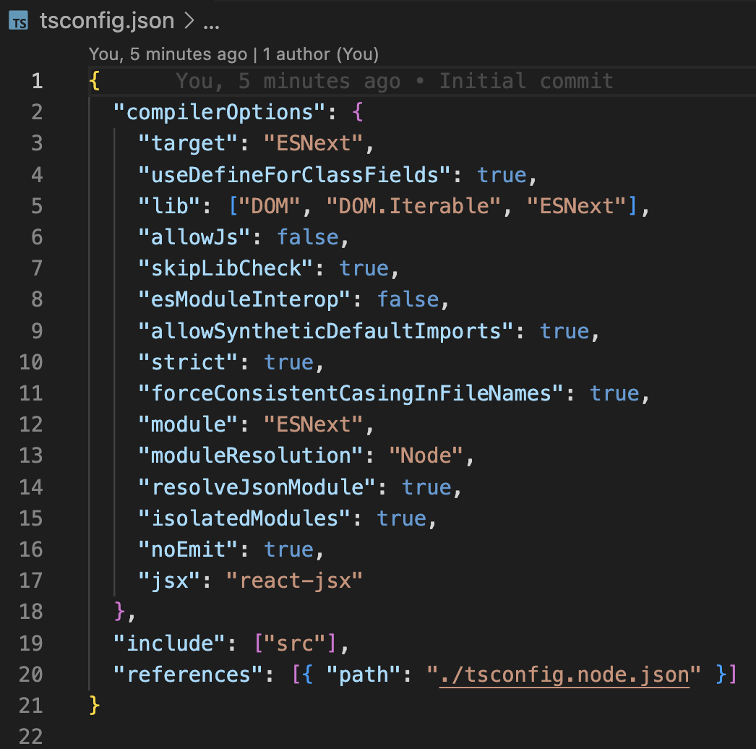
2. Setup

Slide 39
2. Setup
The tsconfig.json file is a central part of a TypeScript project, acting as the configuration file for the TypeScript compiler. This file specifies how TypeScript code is compiled into JavaScript, defining a variety of compiler options and behaviors.
The presence of a tsconfig.json file in a directory indicates that the directory is the root of a TypeScript project.

Slide 40
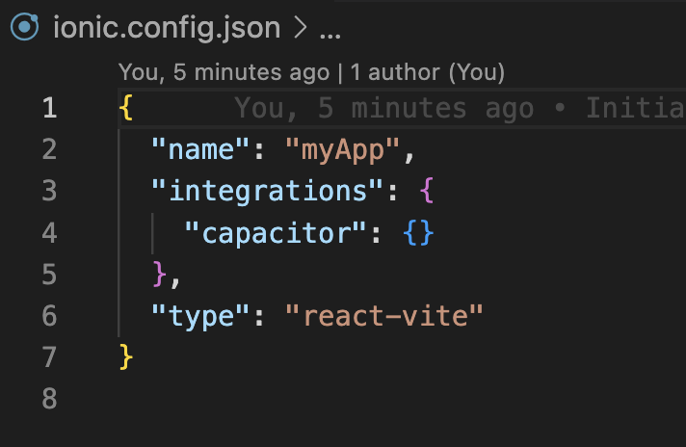
2. Setup

Slide 41
2. Setup
The ionic.config.json file is a crucial configuration file used in projects developed with the Ionic Framework. It contains metadata and configuration settings specific to how the Ionic CLI interacts with your project. This configuration impacts how your app builds, runs, and integrates with various Ionic services.

Slide 42
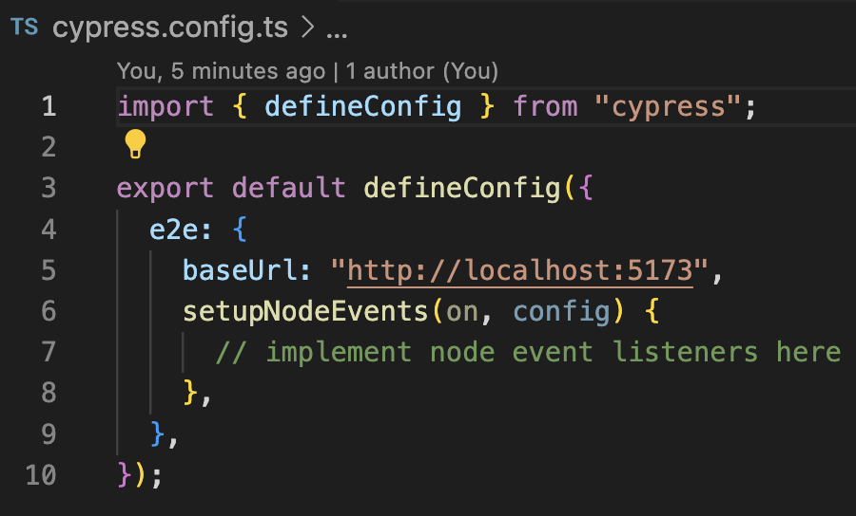
2. Setup

Slide 43
2. Setup
The cypress.config.ts file is the main configuration file for Cypress, a popular end-to-end testing framework. This TypeScript configuration file replaces the older cypress.json and allows more dynamic and programmable configuration options.
By using TypeScript for the configuration file, users benefit from type-checking and easier navigation through configuration properties, improving the developer experience.

Slide 44
2. Setup
By checking the package.json file, we can see that the base setup of an Ionic project rely on the latest technologies - and using the latest version each time.
Typescript
React
Capacitor
Cypress
Jest

Slide 45
2. Setup
Now that you are aware of the configuration file, let’s see what is living inside the “src” folder.
Inside this folder we have something that could be familiar if you worked on large project using React
pages
components
App.tsx
Main.tsx

Slide 46
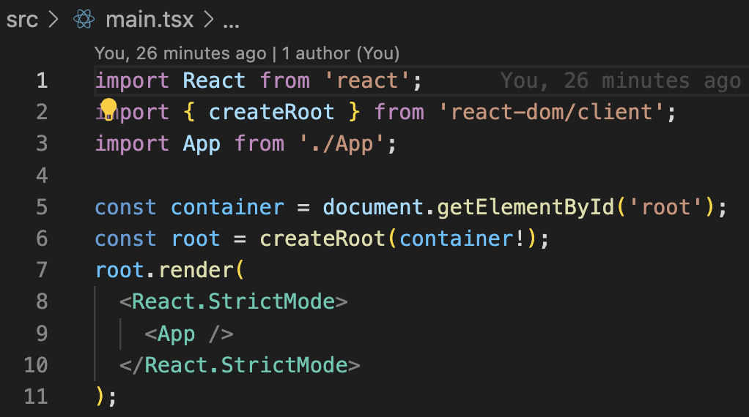
2. Setup

Slide 47
2. Setup
You can compare the “Main.tsx” file with the same file in a React project. This is almost the same content that a normal react project, and this file leverage just basic React setup. Seeing the content you should not discover new magic rules here!

Slide 48
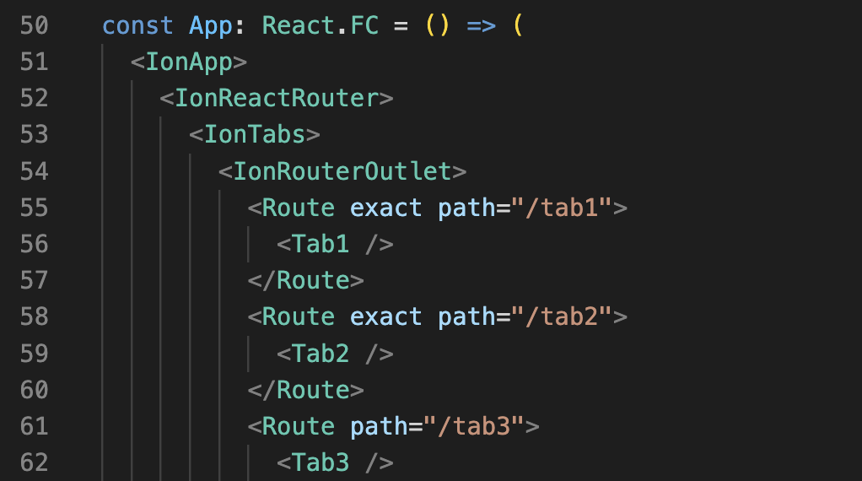
2. Setup

Slide 49
2. Setup
The default “App.tsx” is the larger file you will have in your default project, especially because of the setup we choose. As you can see - and guess - this also load and setup a router for our project as we have multiple pages. Using your knowledge, you should be able to spot
the setup of the router
loading and using pages depending on the route
specific component from Ionic

Slide 50
2. Setup
We will spend some more time a bit later to see all specific components coming from Ionic and how we can use them with efficiency on our project - and how they are mapped to other components in a more standard React / web based ecosystem.

Slide 51
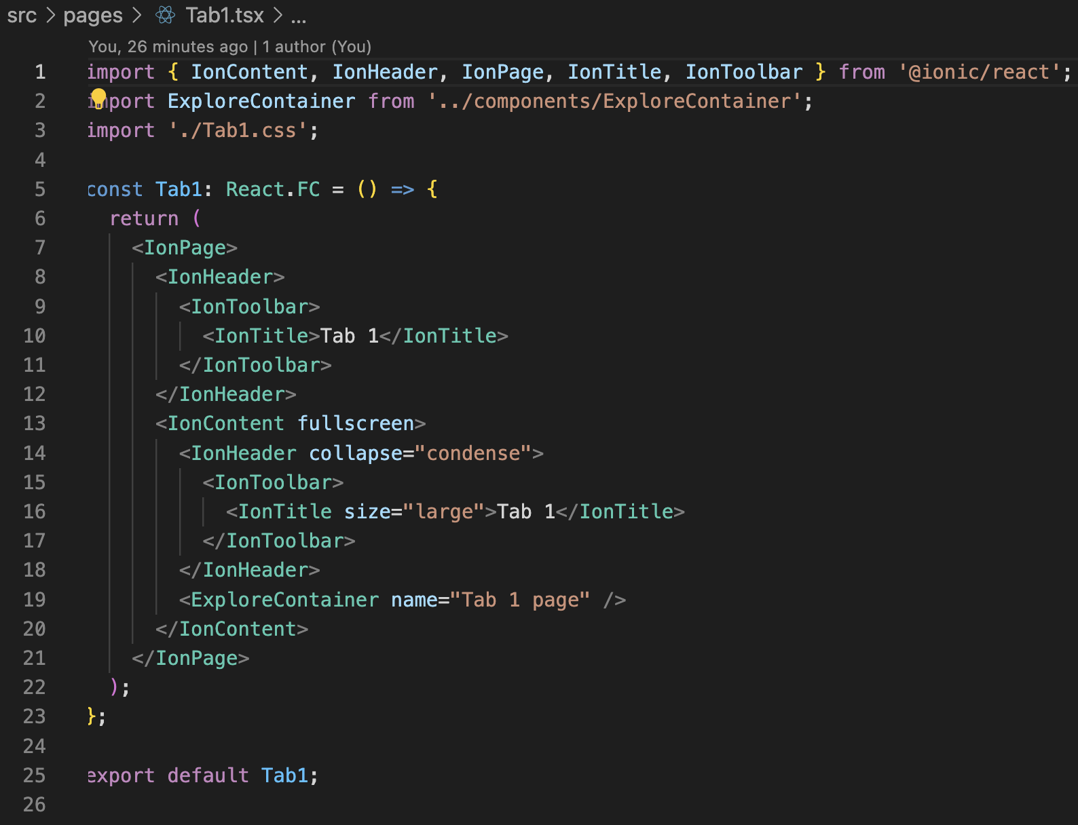
2. Setup

Slide 52
2. Setup
A page is simply a component using other component.

Slide 53
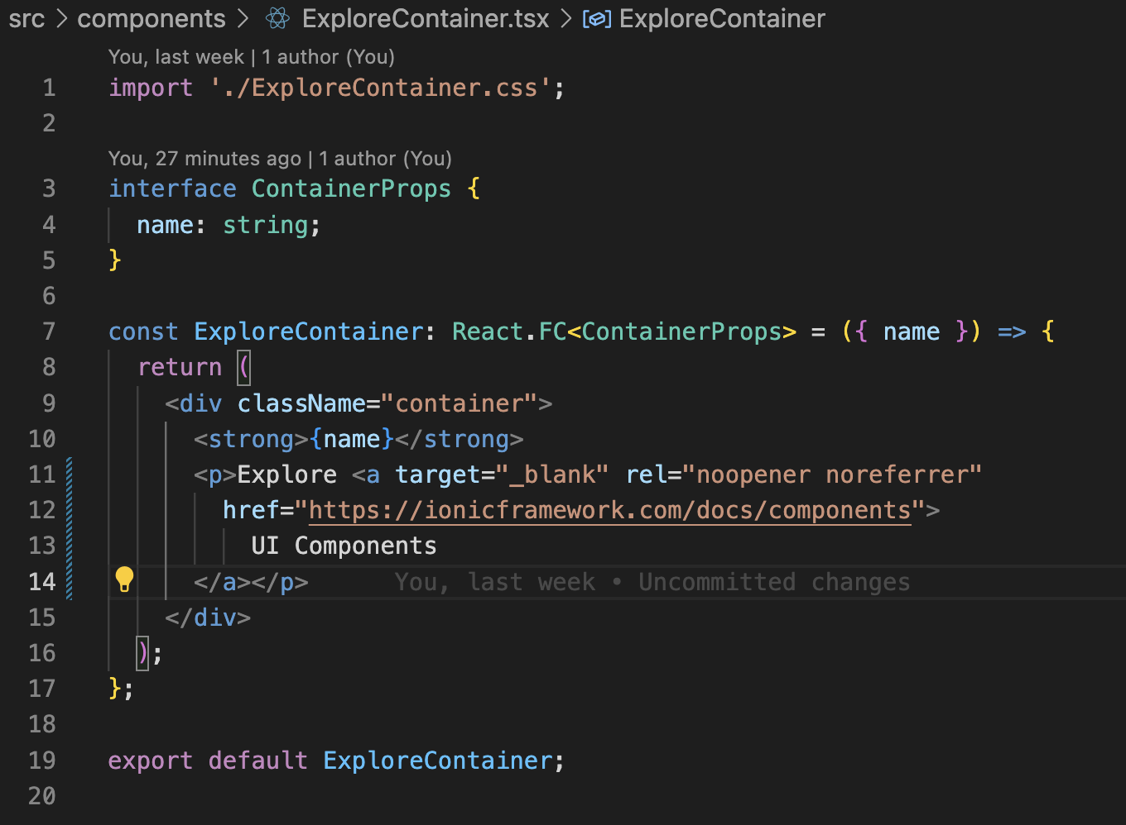
2. Setup

Slide 54
2. Setup
A basic component, like you would see hundreds of them in a React project. There is absolutely no custom code from Ionic, basic HTML, CSS and core JSX solution.

Slide 55
Exercises

Slide 57
3. Ionic Components

Slide 58
2. Ionic Components
Ionic Framework provides a robust set of UI components that are designed to offer high performance and a native-like experience across multiple platforms.
Let’s see a list of some common Ionic components that developers can leverage to build engaging mobile and desktop applications.

Slide 59
2. Ionic Components
Buttons (IonButton)
Ionic buttons are versatile UI elements that can be styled easily with various colors, shapes, and sizes. They can include icons along with text or be icon-only. Buttons can be used anywhere you need user interaction, like submitting forms, opening modals, or initiating any action.

Slide 60
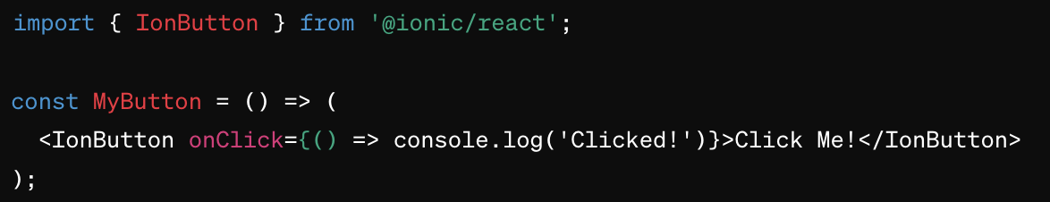
2. Ionic Components

Slide 61
2. Ionic Components
Cards (IonCard)
Cards are flexible boxes containing unique related data, such as photos, text, links, etc. They are commonly used to display information in a compact format and are often seen in social media or news feed applications.

Slide 62
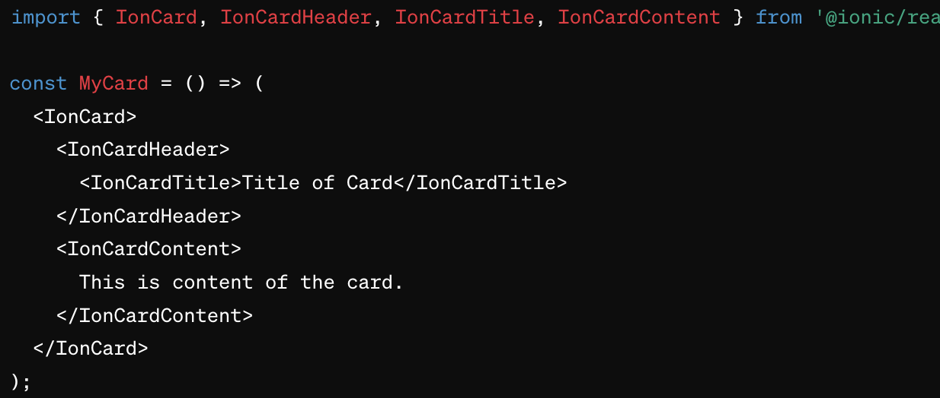
2. Ionic Components

Slide 63
2. Ionic Components
Alerts (IonAlert)
Alerts are dialogues that provide important information to the user or ask for a decision. They can include multiple buttons and even inputs for text, passwords, or numbers. Alerts are essential for interactions where user confirmation is required before proceeding.

Slide 64
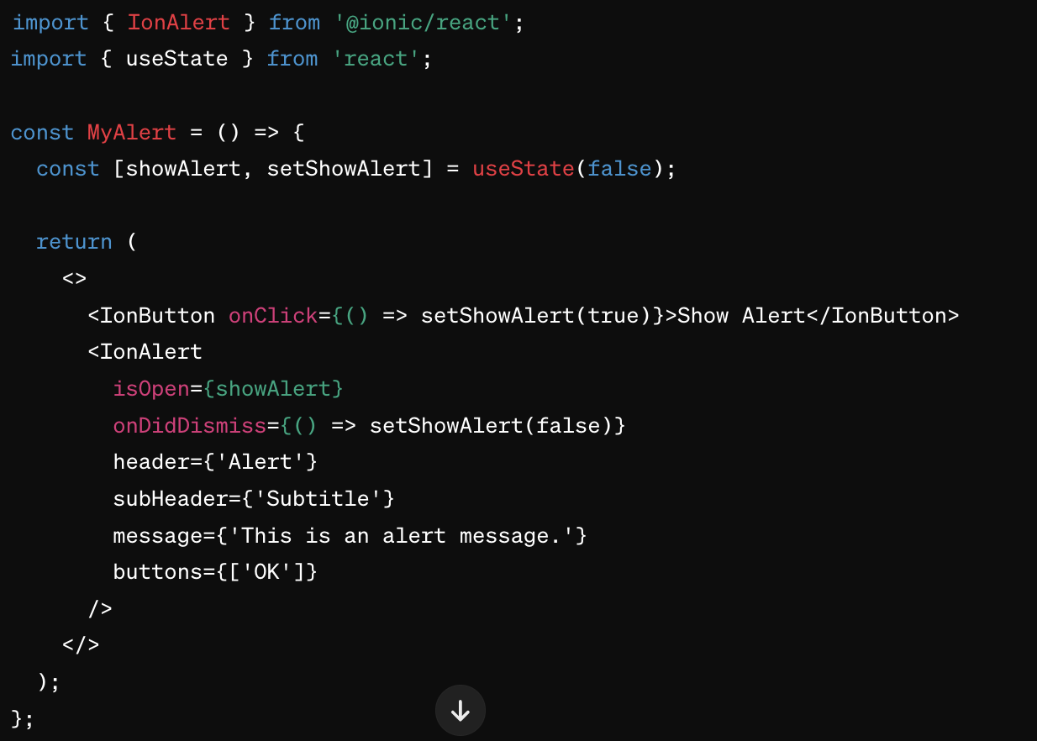
2. Ionic Components

Slide 65
2. Ionic Components
Badges (IonBadge)
Badges typically appear over another UI element and are used to give quick information to the user, like the number of unread messages or notifications. They are small and designed to catch the eye without being intrusive.

Slide 66
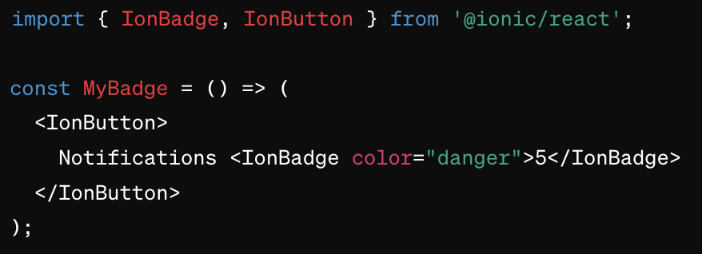
2. Ionic Components

Slide 67
2. Ionic Components
Checkbox (IonCheckbox)
Checkboxes allow the user to select multiple options from a set or toggle a single option on or off. They are a common element in forms and settings, providing a clear visual indication of an option's status.

Slide 68
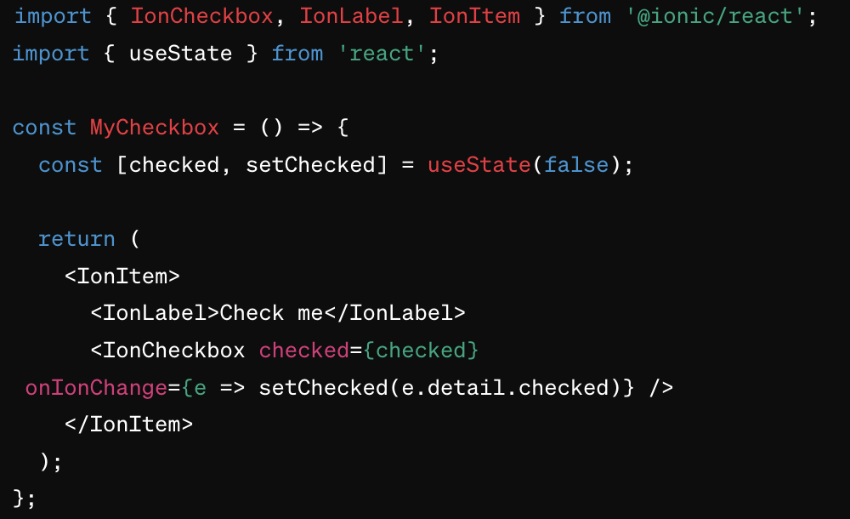
2. Ionic Components

Slide 69
2. Ionic Components
DateTime (IonDatetime)
This component presents an interface for date and time selection in various formats, supporting use cases such as appointment or reservation systems. It can display picker wheels, calendars, and time selectors based on configuration.

Slide 70
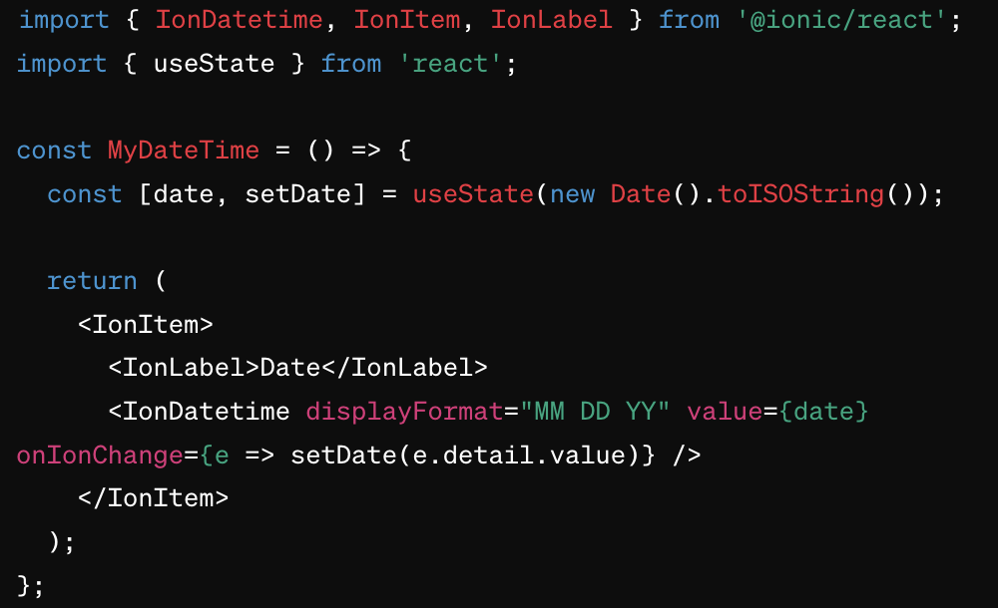
2. Ionic Components

Slide 71
2. Ionic Components
FABs (Floating Action Buttons - IonFab)
These are circular buttons that hover over content, commonly used to promote primary actions like adding, composing, or creating new elements. They’re effective in applications where quick access to certain functions is necessary.

Slide 72
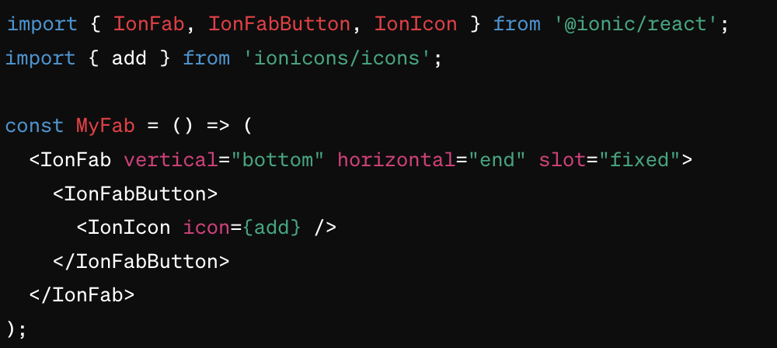
2. Ionic Components

Slide 73
2. Ionic Components
Grid (IonGrid)
The grid system is a powerful tool for creating responsive layouts. It uses rows (ion-row) and columns (ion-col) to divide the screen into sections, making it easier to design layouts that work on both small and large screens.

Slide 74
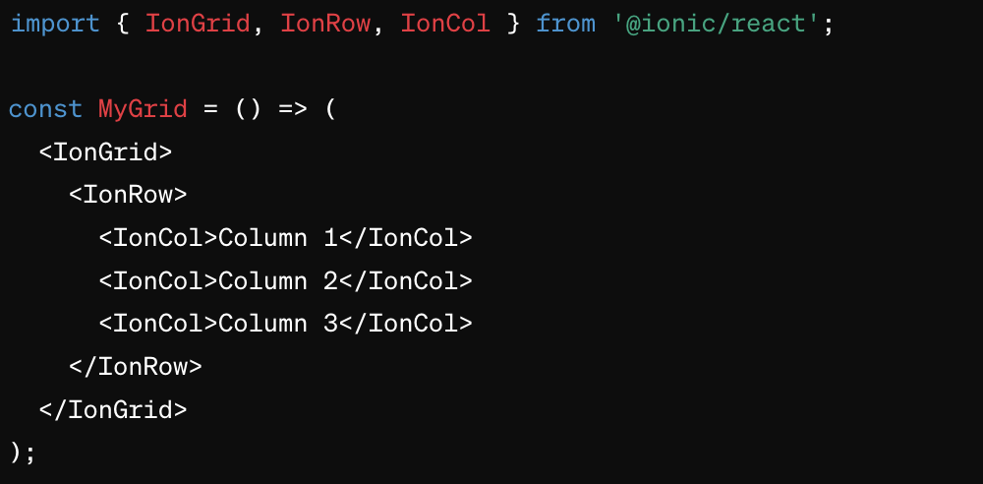
2. Ionic Components

Slide 75
2. Ionic Components
Icons (IonIcon)
Icons provide visual cues that help users interact with the application more intuitively. Ionic offers a comprehensive icon library that integrates seamlessly with its components.

Slide 76
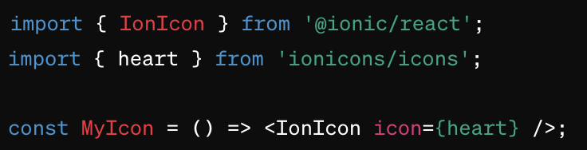
2. Ionic Components

Slide 77
2. Ionic Components
Input (IonInput)
This is used for text entry; it supports various types like text, password, and number. Inputs are essential for forms, enabling user interaction and data entry.

Slide 78
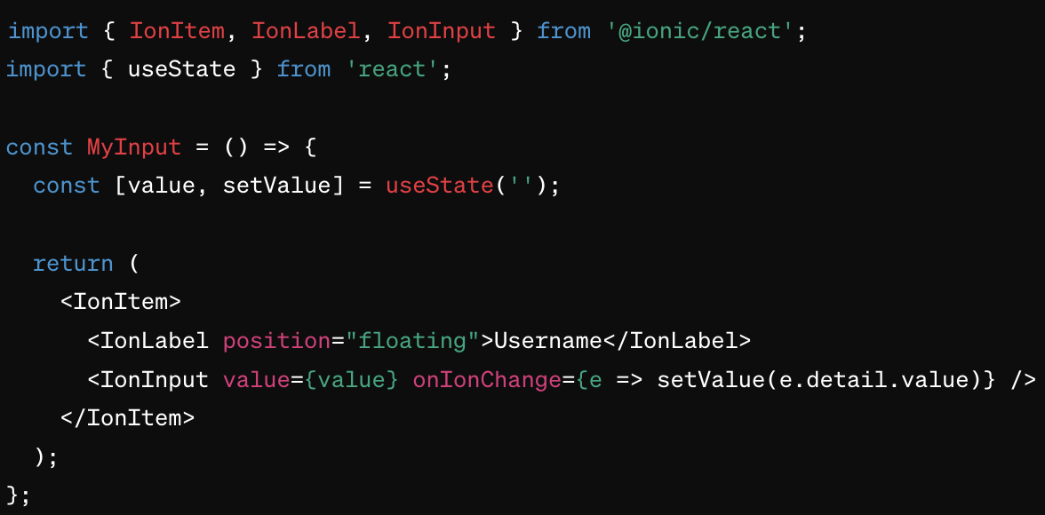
2. Ionic Components

Slide 79
2. Ionic Components
List (IonList)
Lists are used to display rows of information and can be divided with headers, sections, and include options such as sliding items that reveal controls like delete or edit. They are versatile and used in settings, menus, and any place where grouped content is needed.

Slide 80
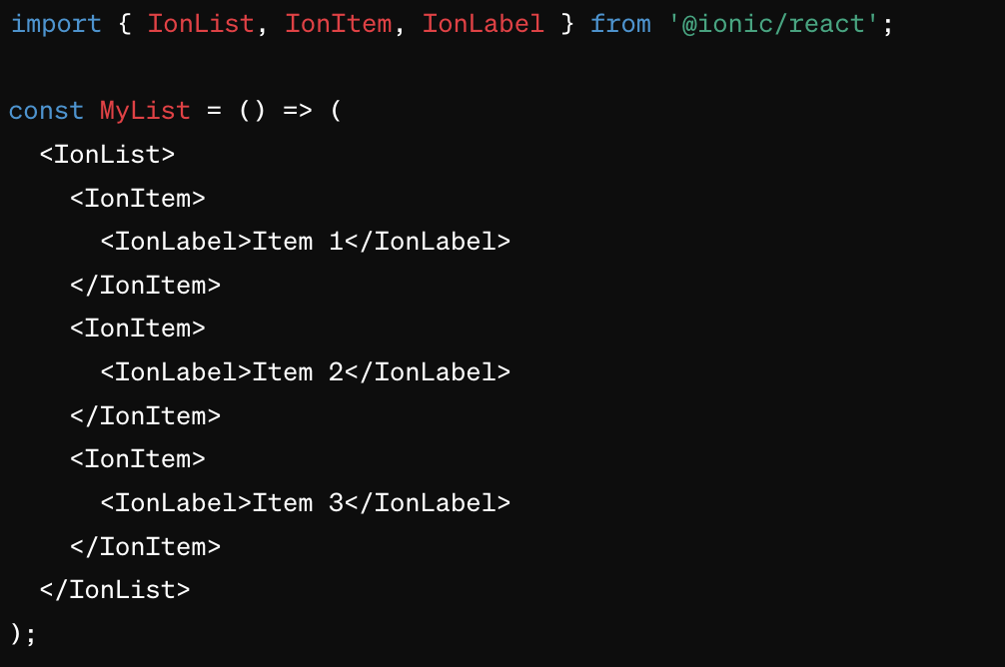
2. Ionic Components

Slide 81
2. Ionic Components
Modal (IonModal)
Modals are used to present content in a layer above the app's main content. They can be used to show more detailed information without leaving the current page or to get user input in isolation from the rest of the app's interface.

Slide 82
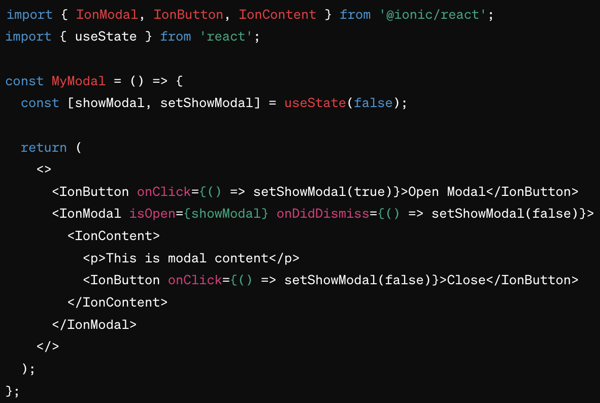
2. Ionic Components

Slide 83
2. Ionic Components
Tabs (IonTabs)
Tabs facilitate navigation between different views or functionalities within an app, providing an efficient way to switch between them without leaving the context.

Slide 84
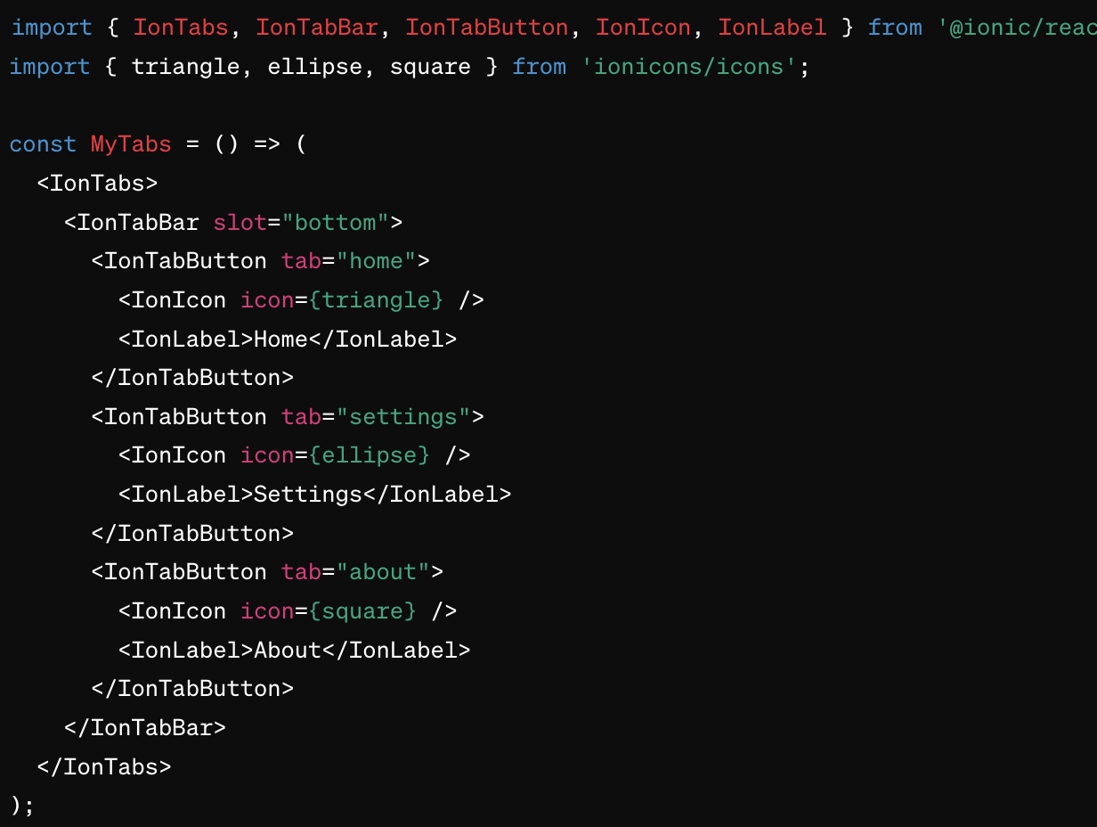
2. Ionic Components

Slide 85
2. Ionic Components
Each of these components is designed to be integrated into a variety of mobile and desktop applications, ensuring that the user experience is seamless across different platforms and devices.
They can be easily customized with CSS, and their behaviors can be controlled using JavaScript or Angular, React, and Vue bindings provided by Ionic.

Slide 86
2. Ionic Components
A complete list of all components can be found here. It is important to note that all components are working on all framework, from React to Angular.
This allow you to use the same “code” to render in the same way on all frameworks.

Slide 87
Exercises

