Slide 1
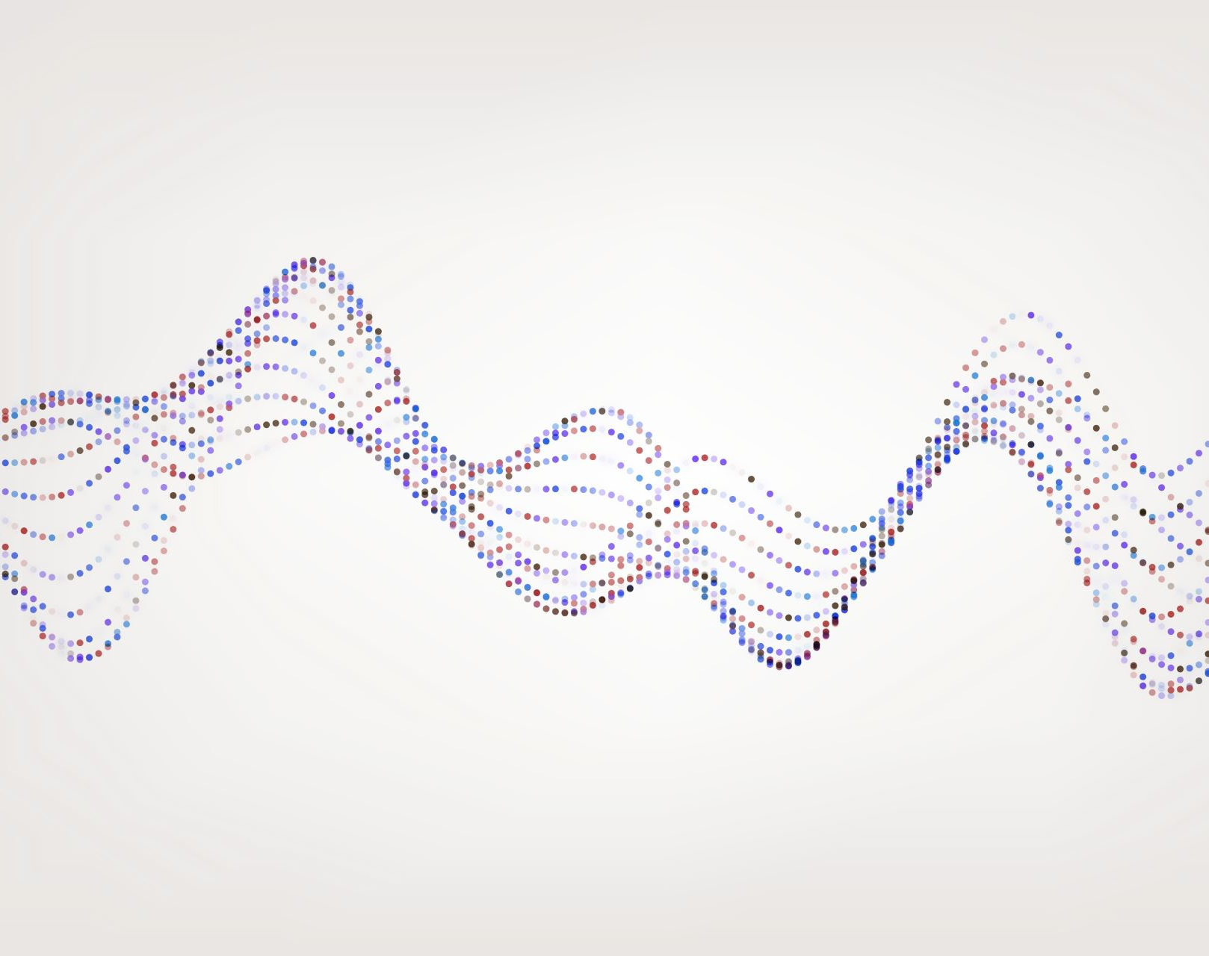
Airbnb Berlin Data Analysis
Adna Salković

Slide 2
Content
1. Data processing
2. Exploratory data analysis
3. Fitting predictive model

Slide 3
Data processing
Dataframes: airbnb_listings, airbnb_calendar, airbnb_reviews
Basic information using functions shape, info(), describe(), unique()
Deleting/removing unnecessary columns
Anomaly cleaning
Replacing NaN values with 0 or mean/median after histogram evaluation
Replacing and removing unwanted characters

Slide 4
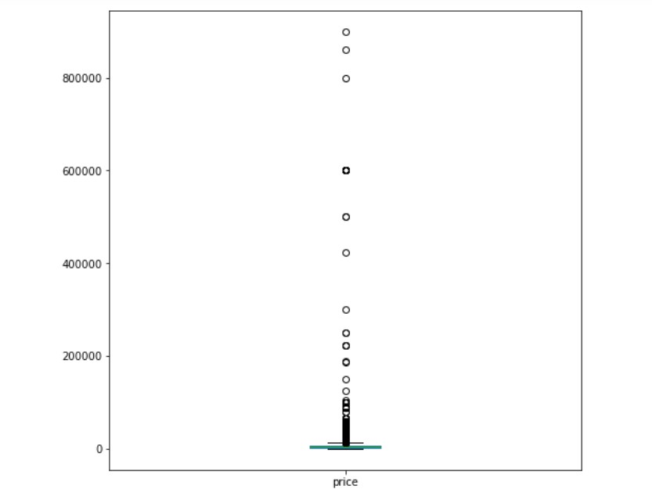
Picture 1: Checking outliers within variable 'price'
Checking and removing
Checking and removing outliers using boxplots
Removing
Removing infinite values
Adding
Adding categorized values
Removing
Removing duplicates

Slide 5
Exploratory data analysis
2.1. Distribution of prices and room_type
Frequency of different room_types
Room_type versus price distribution
Conclusion: Entire home/apt has the most expensive price per night with the median above $60

Slide 6
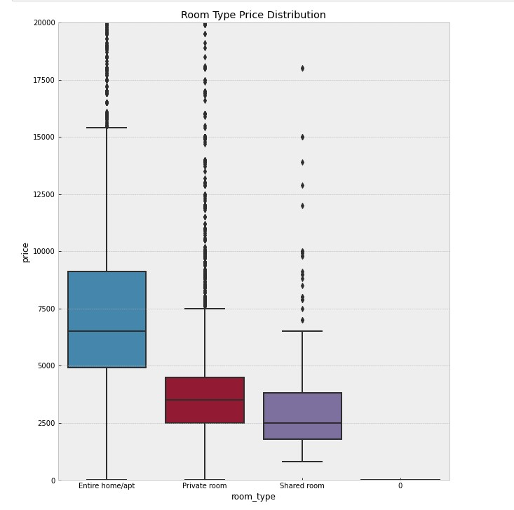
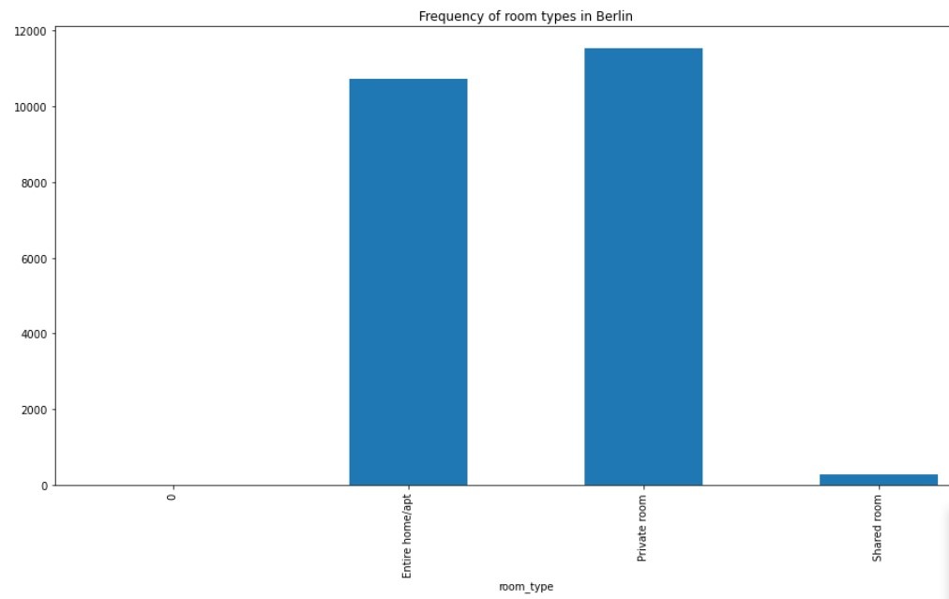
Picture 3
Picture 2

Slide 7
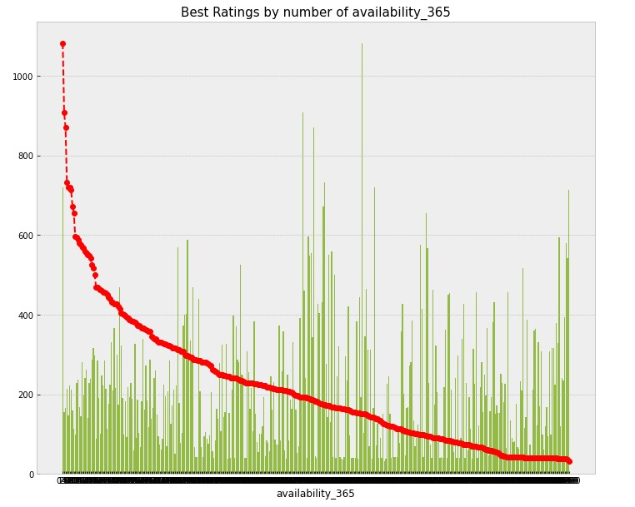
2.2. Relationship between other variables and availability_365/availability_30
Since availability_x=0 means that it is all booked, it was logical outcome that 0 value has rating of all ranges and therefore the best ones in both figures
However, in 1st figure (availability_365) it can be seen that best ratings/number of ratings appear in the middle
This can be explained by seasonal availability; it is rare that people expect facility to work the whole season
Picture 4

Slide 8
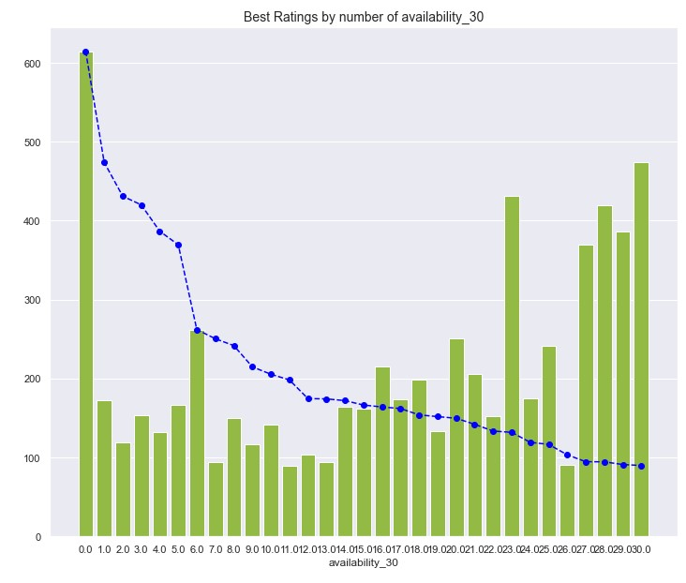
Picture 5
Therefore, people choose and therefore rate places who have about half of the available capacities in a certain period
Still, when looking at the 2nd figure, situation is different: bigger number of ratings has bigger number of available facilities
This can be explained by the small number (30) and in which case, the bigger no of available facilities is better and gives people more opportunities to choose between

Slide 9
Relationships between availability_365 and room_type including price, between availability_365 and minimum_nights including price and between availability_365 and neighbourhood_group_cleansed including price shown in code using heatmaps
From the 1st relationship it can be clearly seen that 'Entire home/apt' is the most expensive room_type
From the 3rd relationship it can be concluded that certain neighbourhood_groups have higher prices and that people tend to choose room_types with higher number of days available, but that number never 'needs' to be bigger than 30 when looking for a certain room_type
2.3. Relationship between price and availability_365 when considering room type, minimum number of nights and neighbourhood

Slide 10
2.4. & 2.5. Feature engineering and exploration toward fitting predictive model
From all rentals available in the dataset, 59.55% of them correspond to Entire-home apartments
Determining relation between property_type and room_type including mean price
Average price per night: $ 57.0
Top 10 listings based on their number of reviews
Investigating neighbourhood groups

Slide 11
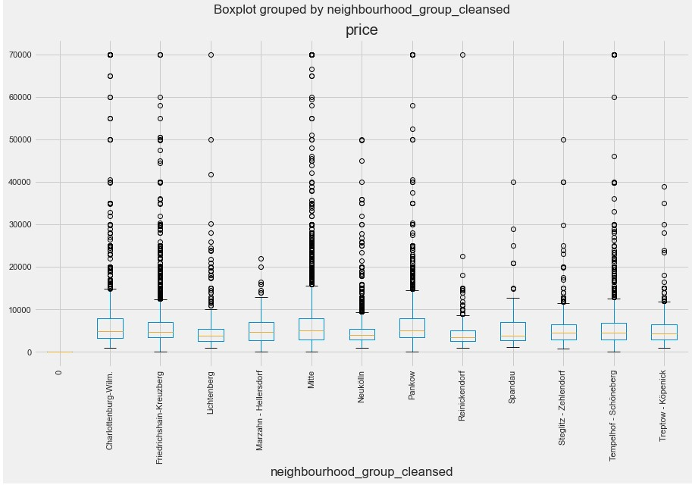
Also available in code:
Mean price of each neighbourhood
Most expensive neighbourhoods
Dependance of room type on the neighbourhood group
Dependance of prices on the number of nights
Conclusion: the normal value of the number of nights is arround 2 and the highest ones tends to be about 26
Distribution of minimum_nights and mean price
Map distribution using price overall
Picture 7

Slide 12
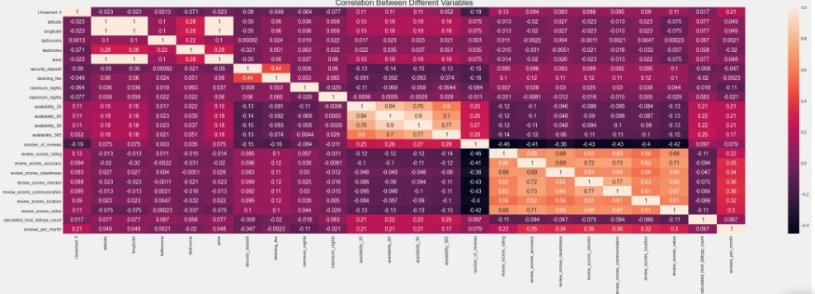
2.6. & 2.7. Finding 5 potentially most informative variables and 2 least informative variables for predicting price using multicolinearity
Picture 6

Slide 13
2.6. & 2.7.
From the graph it can be seen that 5 most informative variables for price prediction are bedrooms, availability_30, availability_60, availability_90 and availability_365
It can also be seen that 2 least informative variables for price prediction are review_scores_value and security_deposit

Slide 14
3. Fitting predictive model
Linear Regression assuming that data is mostly normally distributed
One-hot encoding
Splitting and scaling data
Visualization of residuals
Model score: 0.1

Slide 15
Thank you for your attention
Adna Salković

