Slide 1
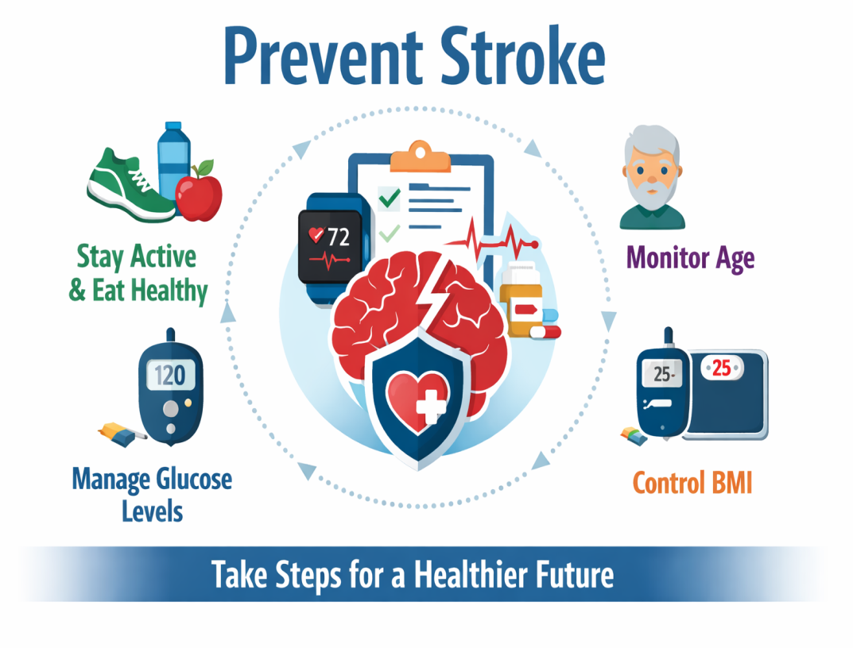
STROKE FACTOR
ANALYSIS
How to address the long-term prevention of stroke risk factors
Cohort 8 – DS3
03/07/2026

Slide 2
Adnan Takash
Aravind Vijayaragavan
Azadeh Selahvarzi
Karen Huang
Naveen Kumar Nair
Yuli Zhang
Team Members

Slide 3
Business Case
Identify the top 3 predictors of stroke risk from the dataset and determine whether they are primarily lifestyle-based or health-based factors.
Transform complex health data into an actionable priority list to guide prevention strategies.
Enable proactive healthcare interventions that reduce preventable hospitalizations and improve long-term health outcomes.

Slide 4
The Problem to Tackle
Stroke is a major global health burden, ranking as the 3rd leading cause of disability and mortality.
High economic impact: In Canada, average 1-year stroke costs exceed $33,000 per patient
Prevention gap: Preventive care is more effective and less costly than reactive treatment. Large amounts of data, make it difficult to identify the most critical risk factors to target.

Slide 5
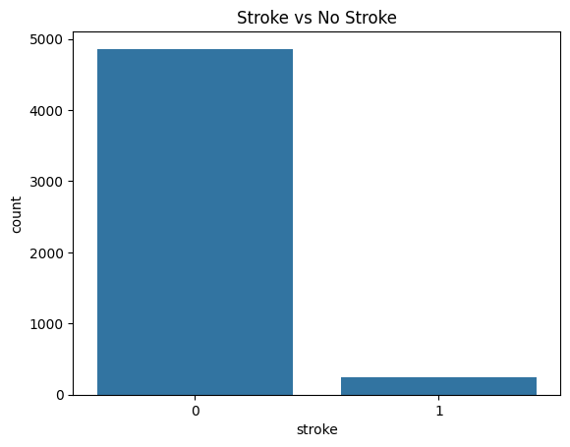
Stroke Class Distribution
Percentage distribution: Class %
0 (No stroke) 95.13
1 (Stroke) 4.87
Takeaways:
The dataset is highly imbalanced (5% positive class)

Slide 6
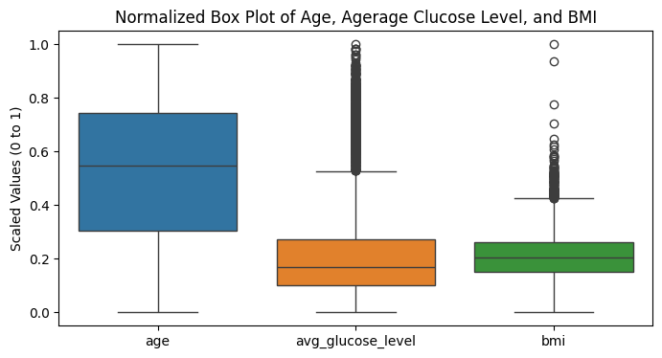
Normalized
Box Plot
Note how age is largely devoid of outliers, but glucose and BMI are not
How does age affect these factors, and how resilient they are?

Slide 7
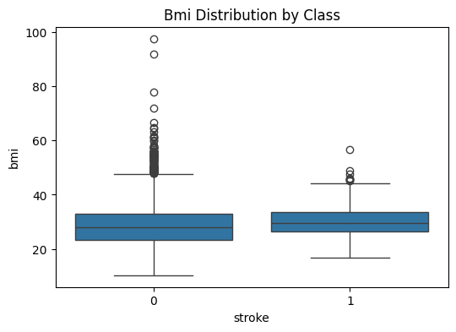
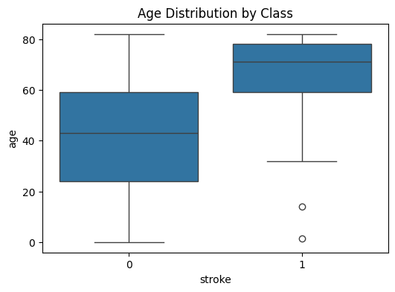
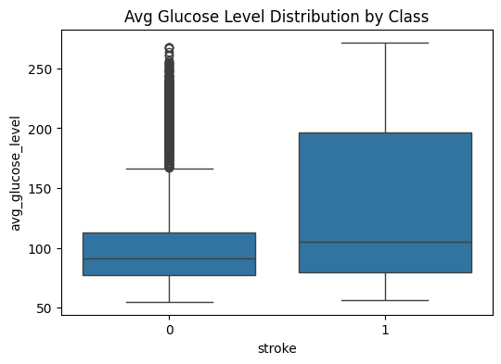
Bar Plot by Class

Slide 8
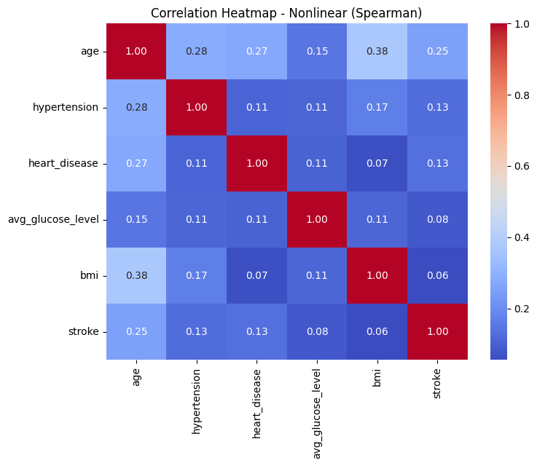
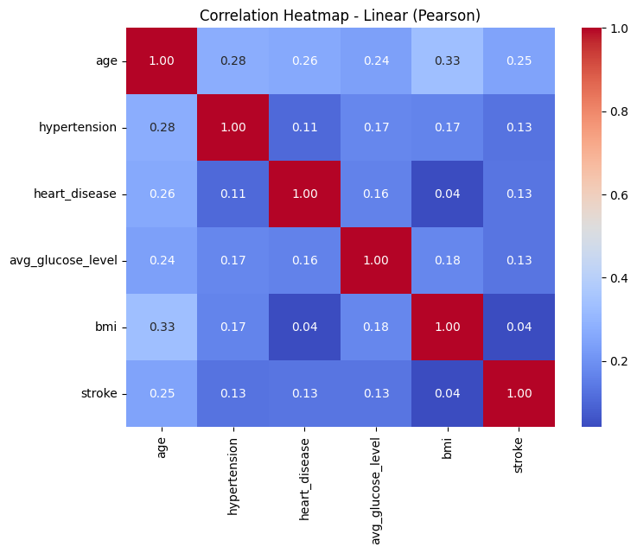
Correlation Plots
Spearman (nonlinear) vs Pearson (linear)
Linear / non-linear relations no correlation < 0.5

Slide 9
Classification Modelling Findings
The dataset is highly imbalanced (5% positive class)
Tree-based models best for imbalanced data.
Logistic Regression performed well when using balanced class weights.
Therefore, three models were selected for the analysis: XGBoost, Random Forest, and Logistic Regression.

Slide 10
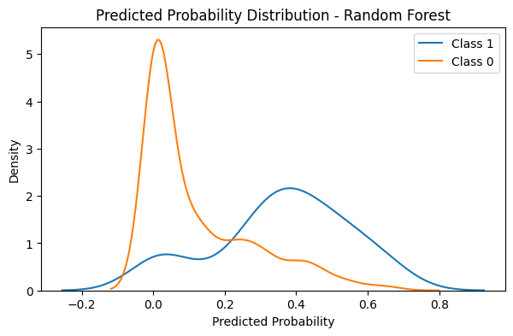
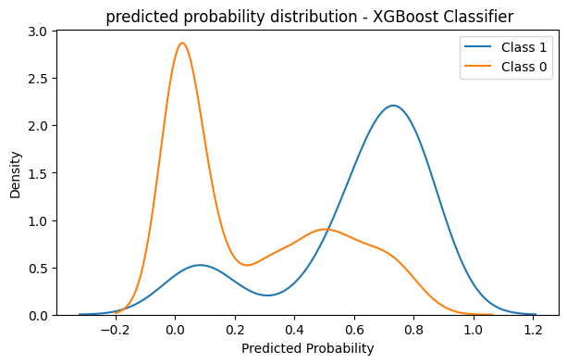
Classification Threshold- Recall
Recall: 0.8
Random Forest: Threshold: 0.24, PR-AUC: 0.22
XG Boost: Threshold: 0.51, PR-AUC: 0.26

Slide 11
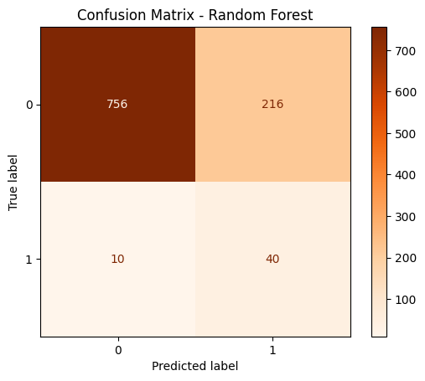
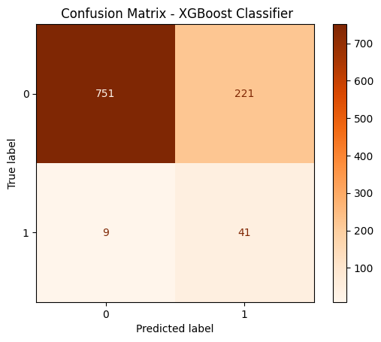
Confusion Matrix

Slide 12
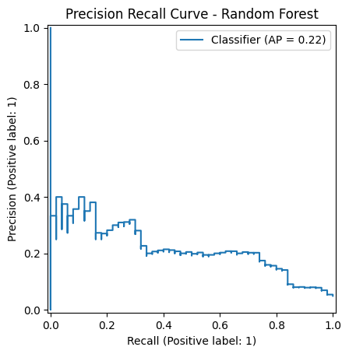
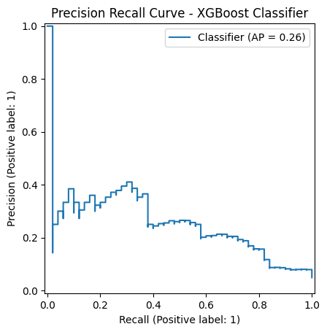
Precision Recall-Area Under Curve

Slide 13
Key Data
Findings
For Stakeholders
Blood Glucose, Old Age, High BMI
Different models weight age higher
Does age make BMI and Glucose harder to reduce?
What does this mean for our solution?

Slide 14
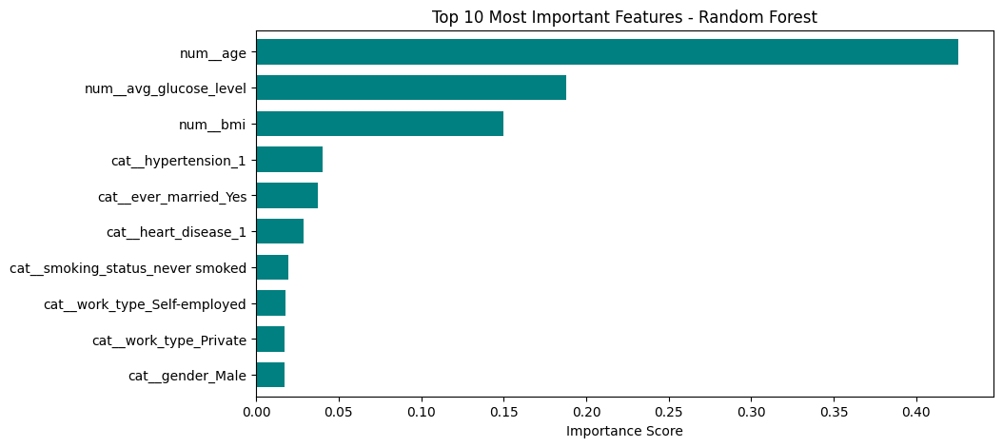
Top 10 Important Features

Slide 15
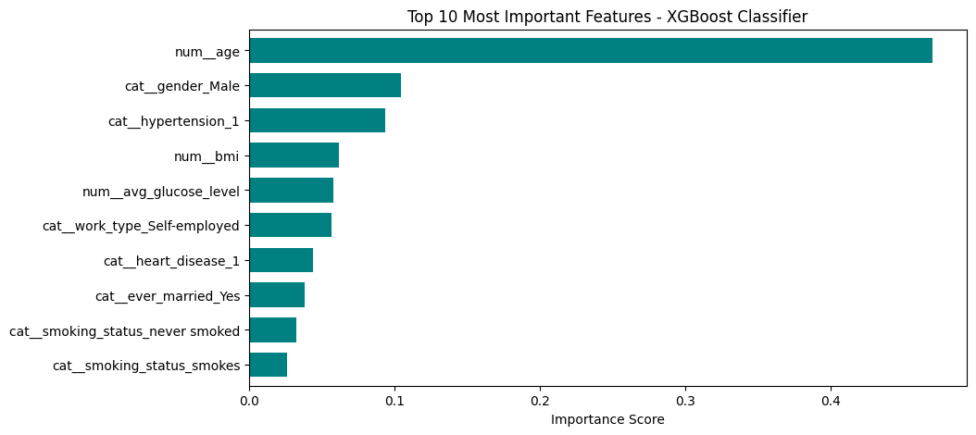
Top 10 Important Features

Slide 16
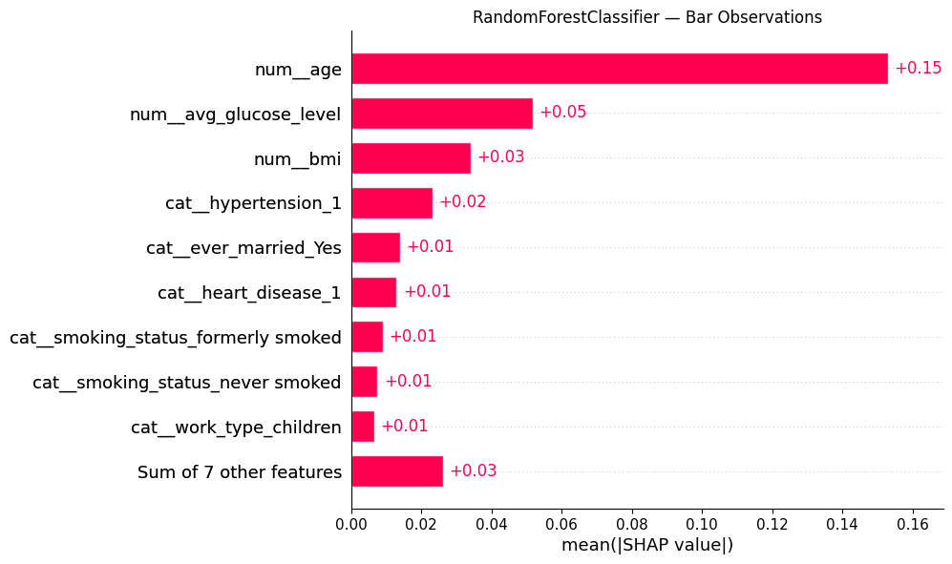
Bar Plots
The SHAP bar plot highlights the variables that most strongly influence the model’s predictions, ranking them by their overall importance.
The SHAP bar plot shows which variables are most important overall

Slide 17
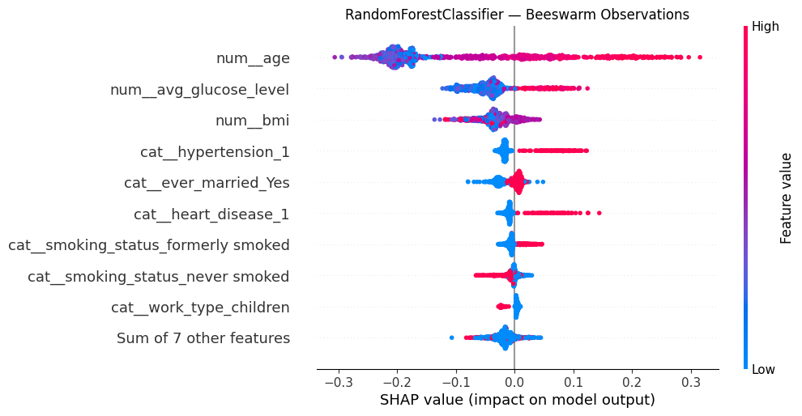
SHAP Beeswarm
Beeswarm plot shows how each feature influences model predictions for all observations.
Highlighting both feature importance and whether high or low values increase or decrease the prediction.

Slide 18
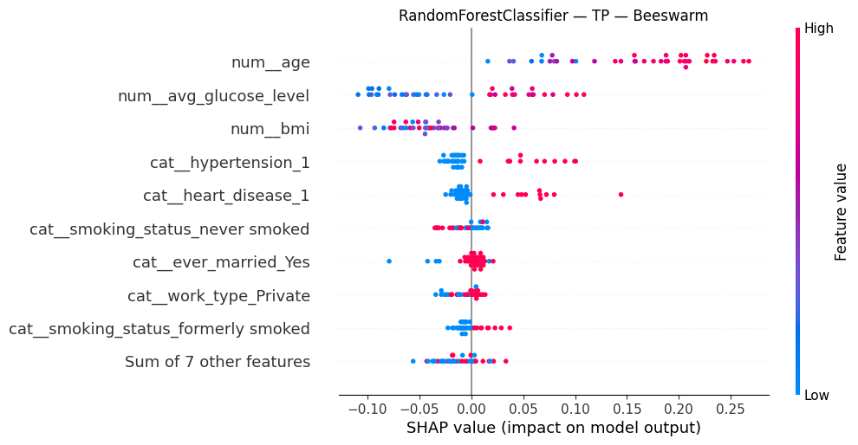
SHAP Beeswarm – True Positive

Slide 19
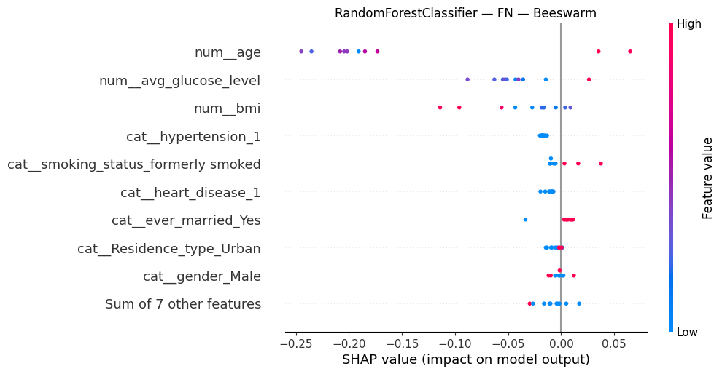
SHAP Beeswarm – False Negative

Slide 20
HABIT-FORMING PROGRAM:
Focus on long-term good habit development
Set up a program with Apple Watch or Fitbit to track changes
Enter niche of fitness app programs, but specifically for stroke reduction
Apps make it easy for people without a primary healthcare provider to participate
Solution to Business Case

Slide 21


THANK YOU!
We will be taking questions at this time.

