Slide 1
FOR INTERNAL USE ONLY
CPB Fraud Commercial Cards False Positive Reduction
Change Type: Discretionary
Project Number:1037907
Review Authority: Data CoE Design Authority Author: Amar Khwaja
Lead Designer: Amar Khwaja
Document Classification: Confidential
Document Version: 5

Slide 2
HLD Document Version History
Version | Date | Reviewers | Changes, Issues and Actions summary
1 | 12 May 2020 | Solution Designers | Initial Version
1.1 | 22 May 2020 | Stuart Dickson | Diagram updates
2.0 | 26 May 2020 | HLD Forum | Volumetrics, patterns, data flow into Hadoop SH
3.0 | 6 July 2020 | Designers/Architects | Kafka topics and Feature Bank clarifications

Slide 3
Glossary
Term | Definition |  | Term | Definition
BIS | Business Intelligence System A SQL Server Data Warehouse that contains credit card transactions and account holder data for Cards Analysis |  | ECP | Enterprise Cloud Platform – The bank’s cloud infrastructure service
EDH | Enterprise Data Hub – the Bank’s enterprise data platform |  | MQ | IBM Message Queue
EAS UCA | Enterprise Analytic Store – Use case Aligned |  | ML | Machine Learning models
Feature | A feature is an individual measurable property or characteristic of a phenomenon being observed |  | PCF | Pivotal Cloud Foundry (an open source, cloud platform)
FB | Feature Bank. A type of a data store that is specific to the requirements of Machine Learning models. It holds a collection of commonly used features (Categorical & Numerical) for use in data science/machine learning development and training/ re-training.
TSYS | Total Systems. A 3rd Party, credit cards data vendor

Slide 4
Project Background & Scope: Business Requirements
Request https://jira-dts.fm.rbsgrp.net/browse/EDHA-985#
CPB Fraud team need an automated way of discounting false positive alerts, so as to give them more time to focus on detection and resolution of new/genuine fraud cases.
The objective is to develop a supervised ML model to decide the predicted probability of a given fraud alert as being genuine or false, in near real time and to avoid the alert being passed to the Operations team, for an analyst to work on.
The scope of this solution will cover the development of the data and infrastructure to support the ML model and its integration with the Commercial Credit Card Fraud Management team processes.
The key benefits expected are immediate improvements in the false/positive ratio of daily/monthly alerts being handled by Fraud Operations and giving them more time prioritise, higher risk, real frauds.
Reduce the effort of manual investigations by CPB fraud teams (currently, average case handling time is ~9 minutes with more time required before and after the calls)
Currently about 250-300 alerts are generated per day.
Current false positive rate is about 67% of all fraud alerts generated.

Slide 5
Delivery Scope: Non-Functional Requirements
Data from source systems is required for creating Features on a T+1 basis.
TSYS Historic data is required for creating Features covering 4 years.
No specific SLA by which time the data required to create the Features must complete by.
Response to TSYS to be within 60 seconds of receipt of fraud alert by NW.
Ability to process upto 300 requests from TSYS in a 24 hour period.
Solution must operate on a 24x7 basis
Both the TSYS and NW fraud teams must be informed about any planned downtimes in advance (note that the least activity is from 2200hrs – 0600hrs).
For unplanned downtimes, both TSYS and NW teams, require the NW systems to be recovered within 4 hours.
Tier 3-4 service levels are acceptable.

Slide 6
Platform Resilience
Resilience / Data Classification, Measures and Metrics | EDI | EAS (Hadoop) | Streaming Platform | IBM MQ
Have the resilience requirements been approved by the Business Service owner or approved delegate | Yes | Yes | Yes | Yes
Name of the Business Service owner or approved delegate Tier 1 & 2 Asset List | N/A | N/A | N/A
Business Service Resilience Tier | 3 | 3 | 3 | 1
If Tier 1 or 2 provide: Service Name | N/A | N/A | N/A
If Tier 1 or 2 provide either: Service Element Name from Tier 1 & 2 Asset List NEW Service Element Name | N/A | N/A | N/A
Operational RTO (days, hours, minutes) | 03:00:00 | 01:00:00 | 00:04:00 | 00:00:00
Operational RPO (days, hours, minutes) | 00:00:00 | 00:00:00 | 00:00:15 Varies-dependent on use case. Zero data loss can be achieved. | 00:00:00
Disaster recovery RTO (days, hours or minutes) | 00:06:00 | 01:00:00 | N/A | 00:04:00
Disaster recovery RPO (days, hours or minutes) | 00:00:00 | 00:00:00 | N/A | 00:04:00
Data Classification | Confidential | Confidential | Confidential
Confidentiality rating | 2 | 1 | 4
Integrity rating | 2 | 1 | 4
Availability rating | 3 | 3 | 3

Slide 7
Delivery Scope: NFR - Security Requirements
Data Classification | Confidential
Rating Value | C | I | A
 | 1 | 1 | 3
ServiceNow ISBIA Reference | BIA0011663

Slide 8
Design: High Level Solution Design – As Is
What is the current state for the High Level Solution Design?
Feature Bank
FB is a subset of tables within EAS UCA(bdp_eas_uca) with its own data model and security controls.
Remaining components, TSYS/MQ, On Premise Cloud Machine Learning, Event Streaming are introducing new functionality.

Slide 9
Design: High Level Solution Design – Data Context
Source Systems
TSYS Commercial Credit Cards is an acknowledged Golden Source of data (ref: 8519)
Cards BIS (Cards Business Intelligence System), for TSYS historical data and a master copy of TSYS data.
Data Scope
TSYS commercial credit cards data covering Agreements, Card, Events-authorisations, Events-alerts
~200 TSYS attributes already in EDI need to be sent to EAS
Historic data load from BIS (3 tables) into EAS Standardised

Slide 10
Design: High Level Solution Design – Summary
Solution Design Patterns:
Batch Ingestion - On-host File Transfer
https://confluence.dts.fm.rbsgrp.net/display/DSDS/Batch+Ingestion+-+On-host+File+Transfer
For daily TSYS files into EDI and then EAS
Batch Ingestion - Off-host Database
https://confluence.dts.fm.rbsgrp.net/display/DSDS/Batch+Ingestion+-+Off-host+Database
One off historic load from BIS SQL Server (tbc if via EDI or direct file pull into FB discovery area on Hadoop)
DIP2b. Enterprise Analytics Store
https://confluence.dts.fm.rbsgrp.net/display/DSDS/DIP2b.+Enterprise+Analytics+Store
Feature Bank will source data from EAS
Enterprise Analytics Store/ Use case aligned Area
https://confluence.dts.fm.rbsgrp.net/pages/viewpage.action?pageId=568279385
Feature Bank data is landed in to a UCA
Feature Bank pattern (under development)
Machine Learning patterns (under development)

Slide 11
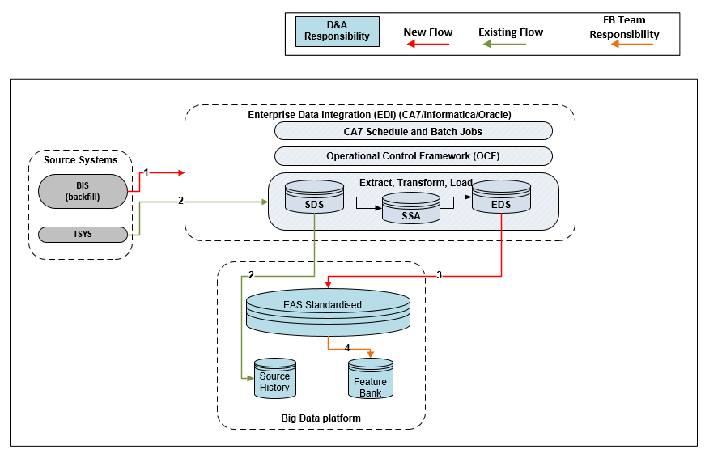
Design: High Level Solution Design – To Be – Feature Bank Uplift
BIS historic data is processed through into EAS Standardised.
TSYS daily and monthly data files landed into Source History.
TSYS daily and monthly data files landed into EAS Standardised.
Daily population of FB (data is derived from EAS).

Slide 12
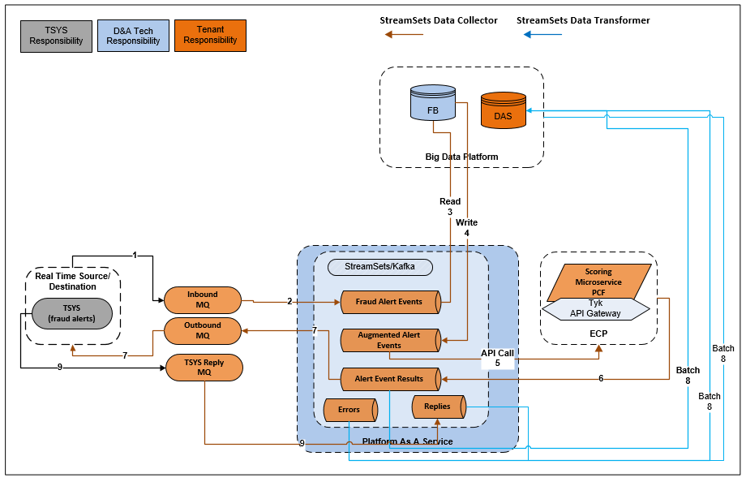
Design: High Level Solution Design – To Be – Real Time Processing
Secured and encrypted, real time messages sent by TSYS and are landed onto the NW receiver channel and forwarded to the Alert queue.
Packets on the queue are consumed by StreamSets DC, transformed into the required format and persisted to an Alert Events topic. If an incoming message cannot be processed, it will be saved to an Errors topic.
StreamSets DC uses JDBC to make an Impala call to FB. This is to augment data with features that are required by the ML model, but were not sent in by TSYS.
Enriched data from FB is persisted to an Augmented topic.
StreamSets DC reads the Augmented topic and makes a request to the ML scoring microservice, on PCF with the enhanced data payload. Tyk API Gateway will be used here.
The Machine Learning process responds with a score and persists the data to a Results topic.
A SS Data Collector job reads the scoring from the Results topic and writes it to the Outbound MQ, for routing back to TSYS.
At end of day, a Streamsets Transformer job reads the Results, Errors, Replies topics and persists the data to the DAS (hive tables). This data will be used for model retraining, audit records and MI reporting purposes.
Acknowledgement of successful receipt of the NW message from TSYS.

Slide 13
Design: High Level Solution Design – To Be – Model operations
Periodic requests for Features data for Model development/ retraining purposes.
Input data sets retrieved from DAS.
Model is deployed onto internal Cloud.
DAS also holds the model scoring results.
Business and Model development teams utilise DAS for MI purposes using Tableau
Model source code and other development artefacts stored in our Artifactory repository.

Slide 14
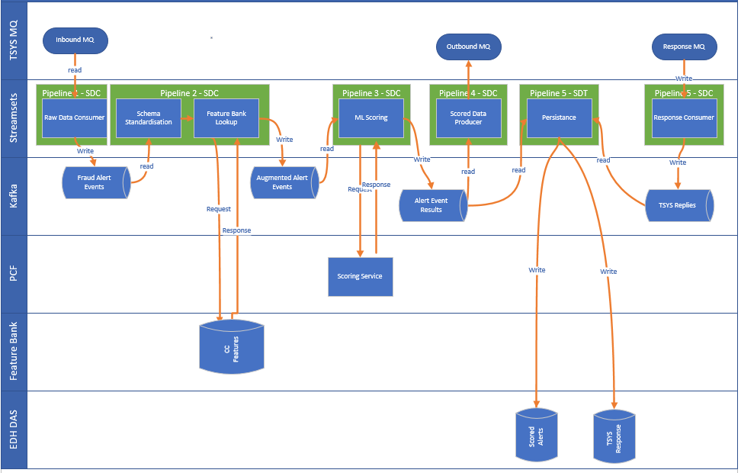
Design: High Level Solution Design – To Be – Physical View: E2E

Slide 15
Design: High Level Solution Design - Considerations
Feature Bank will only hold derived data. It is not a simple copy of EAS Standardized.
TSYS fraud alert message data will be augmented via Impala read on FB, using JDBC.
To cope with increased message loads and higher latency requirements, a Mongo DB cache may be utilised in the future.
Model deployment will be done manually, using the PCF, Command Line Interface.
The models will be stored as .pkl files in our Artifactory repository.
As TSYS data is of an Enterprise concern and the daily volumes are very small, the existing SpeedZone infrastructure will be utilised for all the real time processing.
When TAAS is available, the solution can be migrated to that way of working.
EDW is no longer seen as the strategic source for FB and the technical debt needs to be remediated at some point. However, this HLD does not cover the issue of strategic or tactical sourcing of data for FB.
All the required TSYS data has been found to be already present in EDI and thus there is no need for fresh data sourcing.
This design is not looking to update the existing contents of FB, for entities like Party, Agreement, Events that are currently sourced from EDW.
It was decided to use BIS as a source of the historic data as its data scope and quality is acknowledged to be better than that held in EDW.

Slide 16
Design: High Level Solution Design – Considerations- Kafka/EDH Resiliency
Scenario | Potential Mitigation options
How to ensure individual component errors do not bring down the whole application stack and impact other T1/T2 apps on the MQ infrastructure? | Micro-service which picks up messages from MQ (TSYS traffic is asynchronous) Set a 10 seconds timeout on the micro-service which writes to the Fraud Alert Events topic and use error counters. Move to an Errors topic if counter/time thresholds breached. In case of Kafka issues, StreamSets can fail if either source or target topics are unreachable. Should be no impact on TSYS/MQ as MQ can buffer the incoming messages until StreamSets is restored. Incident should be raised and ML processing jobs should be put on hold. Hadoop/spark down. TSYS/MQ keeps operating. The expected latency of 60 seconds is not met. Messages are persisted to Kafka but scoring cant take place as the FB lookup pipeline will fail. Business decision tbc if we should rerun pipeline? All pipelines are paused during planned maintenance (with prior notification to TSYS). Incoming messages from TSYS can continue. Business decision if we rerun on maintenance completion. Data Science workload to run in Zone 8 with Data Collector and Transformer under high availability mode, provided by control hub load balancer, within the primary site with failover and failback capabilities across primary and secondary sites. MM(2 Transformer nodes) , MG (1 Transformer node). Manual triggering of DR. Control hub components to be provisioned as one cluster stretched across MM/MG in an Active-Active configuration Monitoring/Alerting to be implemented on some of the critical metrics on StreamSets (Tivoli, ServiceNow) Need to test Impala lookups on FB in NFT, to identify any bottlenecks that impact latency. For influx of messages, we are confident that Kafka scalability is sufficient as a buffer.

Slide 17
Design: High Level Solution Design – Considerations- MQ Resiliency
Scenario | Potential Mitigation options
What happens if model goes down and stops reading messages? | Messages arrive on the alert queue and keep getting added to it. If queue fills up i.e. 1000 messages (3-4 days) messages won’t go anywhere until model picks them up. Queue can send an incident notification once queue hits 70% of threshold volume i.e. circa 750 messages Service now should send a notification that model is down by way of an incident ticket. On the TSYS side, if alert messages keep queueing with no response from the model AND queue exceeds 1000 messages TSYS can go up to a threshold of 5000 messages.
What happens to queued messages once model is up and reading messages after model downtime? | MQ team have the CapExpire function to expire any message with an age of more than 3.5 days. This is not turned on by default and needs to be requested by the Delivery team. Note that message deletion will leave no audit trail, regardless of message type and whole queue gets deleted. Currently for all Tier 3 systems the SLA is 4 hours and 24 hours as a worst case scenario. Probability that model will be down for 3-4 days is low.
How are application workloads isolated in the MQ environment? | NW Group MQ utilises Coupling Facility Structures on z/OS queue managers, to facilitate Queue Sharing within a Queue Sharing Group [QSG], of which NW Group currently have six servicing a large number of project and have been doing so for many years. MQ messages between TSYS and Commercial Cards application are segregated from other workloads e.g. Mobile banking. This this has been achieved by creating separate queues and channels on both sides. Thus, failures in one application will not impact any other applications. New Coupling Facility Structures been assigned to Commercial Cards and these do not suffer from DB2 insert delay due to excessive volume throughput, as seen last year. Thorough testing of the Coupling Facility has been performed within the z/OS and it has been running without incident for over 12 months.

Slide 18
Design: High Level Solution Design – Considerations- Model Resiliency
Scenario | Potential Mitigation options
If model is down and If we have messages with age between 1 – 4 hours, what does Business/MLOPs want to happen to these messages? | Model performance is monitored actively by ML Ops team. ServiceNow incident ticket raised and sends notifications that Model is down. If Model recovers within 4 hours then resume alerts processing. If not, see notes for MQ above on MQ Resiliency.
What happens if model cannot return results within 60 seconds? | Tbc with Business if we still send delayed responses to TSYS If YES, do we log this as a ‘failed SLA response’ to aid in model retraining/infra improvements? If NO, do we still score the alert and save the response to our DAS?
Disruption to Model unrelated to issues in PCF | Tivoli monitoring is in place on Servers from memory/CPU usage
TSYS sends in significantly more daily alerts than anticipated (i.e. > 350) or sends them all in one push instead of spread out across the day. | tbc based on results of performance testing Define SLA with TSYS to set limits on number of daily requests Set model limit to only process say 1000 requests per day RACI is in development
Suspected, large scale volume attack detected by Fraud team. | Switch off ML processing Inform relevant teams

Slide 19
Capacity, Volumes and Performance
Application Component / Infrastructure Component | Measurable Metric | Current volumes | Day 1 requirement | 12 month requirement | 3 year requirement
3 years of Historic TSYS data from BIS | Size | n/a | 3TB | 0 | 0
Daily Loads from EDI to EAS | Size | 250MB
TSYS | Message Requests | ~ 300 per day

Slide 20
Assumptions, Constraints and Dependencies
What are the Technology Constraints that have impacted the Design?
Availability of StreamSets Transformer in Zone 8
Model management will be adopted as and when available
Model deployment onto PCF is currently manual. Wil look to automate in the future.
What are the other non-Technology Constraints that have impacted the Design?
The initial approach was to source the TSYS historic data from EDW as there was a project underway to land those datasets into EDW. However, this project is currently on hold, hence the decision to source directly from BIS.
What Assumptions have underpinned your design?
Model deployment will be manual
Model management will be by the ML Ops team
mlFlow not to be used in this phase of model monitoring/storing etc
Release of new models onto PCF will be via PCF push – we can either have a separate endpoint to serve the model file, or just push all code.
No changes are required to the existing connectivity between TSYS and NW which uses Message Queue (XMLM) i.e. configure one of the existing queues between TSYS and NW.
The Nat West MQ channel can handle the required, daily traffic volumes.
All Event processing will be hosted on the existing Speedzone platform.
PAN will be hashed in transit by TSYS if present, but is not needed by the ML model anyway.
NW will be able to utilise the existing message schema, format/fields used to communicate over MQ between TSYS and NW.
NW MQ channels will be able to handle the expected alert volumes
It is expected that an Impala read on FB will be performant enough for the volume and latency requirements of this solution.
Tenant teams are in place to take ownership of the solution after the warranty period expires.
Are there any dependencies in your design?
We are using the Functions Services Analytics tenancy.
An exercise is underway to model the data (for Cards, Events, Authorisations and Alerts) to the NW LDM and needs to be signed off before data loads into EAS can begin.
Authorisation Event is not an existing entity in the current NW LDM and may require additions and further governance by the LDM Board.
Streamsets Transformer availability in Zone 8 are beyond the go live dates of the project (in the interim, Project will use Transformer in Zone 7)
NW to inform TSYS which message formats they will use for the near real time messaging traffic.
New, inbound and outbound Queues need to be setup between TSYS and NW to enable data transfers.
Firewalls need to be opened up between Zone 7 and Zone 8 to enable cross zone interactions that will be needed in this Design.
Readiness of DR capability across the StreamSets ecosystem.

Slide 21
Open Risks
Design Risks:
There is a risk that the admissibility of BIS as a Golden Source may be questioned however the EDW platform owner is comfortable with using BIS data due to its quality and coverage of TSYS data.
The end to end performance requirements may not be adequately testable in the development environments.
StreamSets Transformer will only have manual failover across MM and MG sites. The means that the Application will need to perform manual recovery in case of failed Spark jobs.

Slide 22
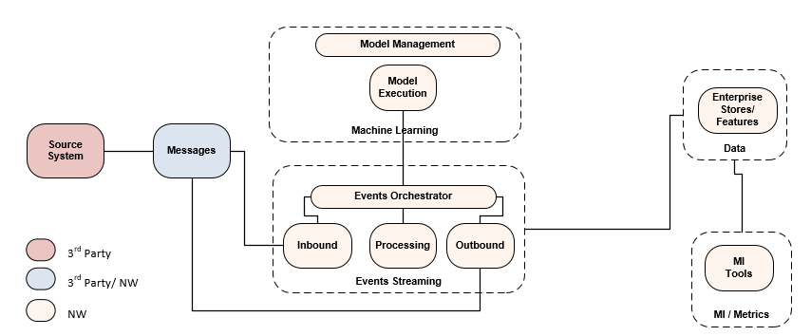
Design: HLD– To Be – Logical View

Slide 23
Appendix:

