Slide 1
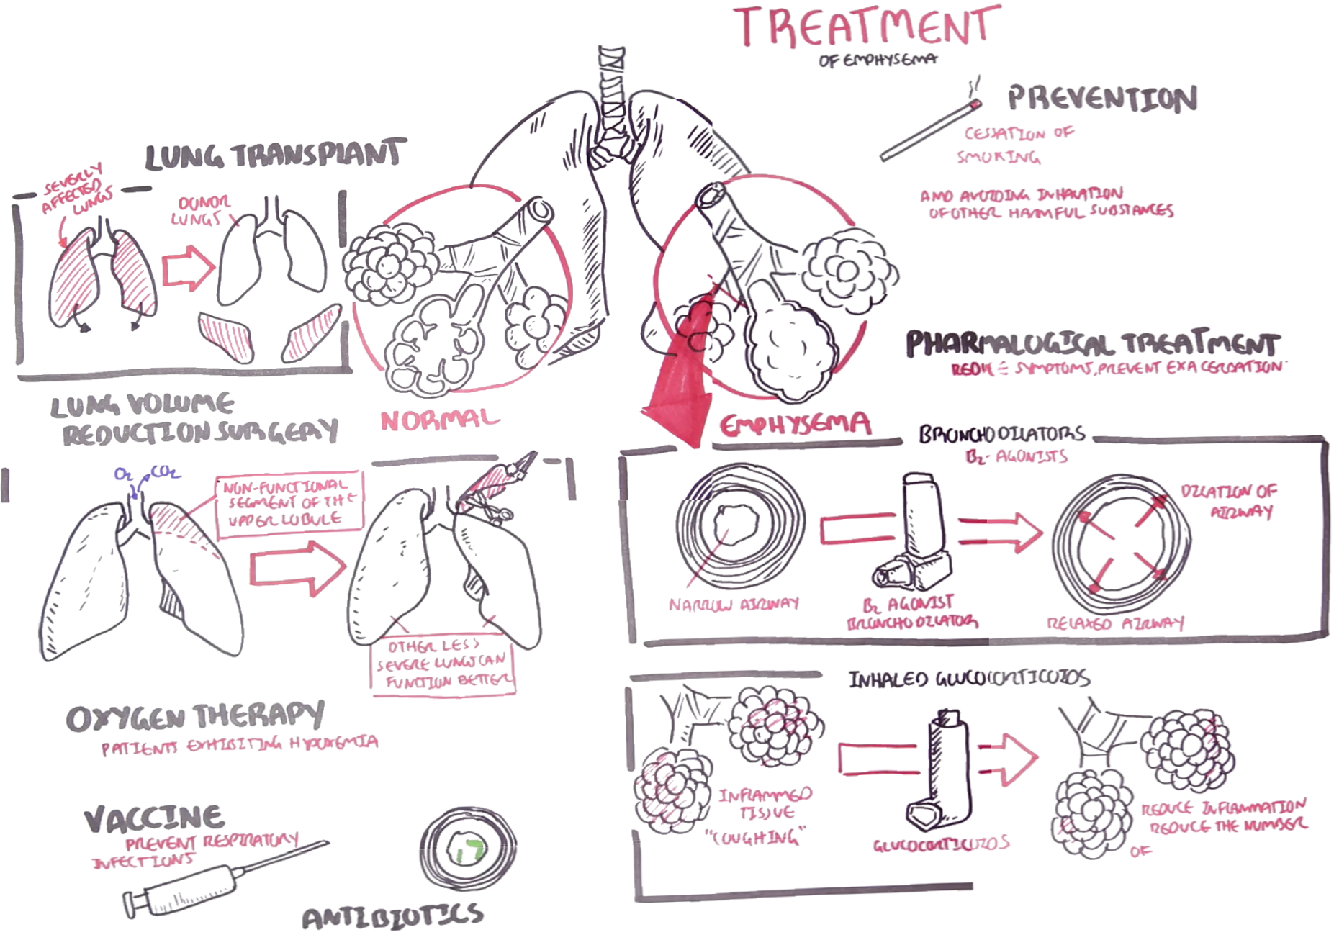

Slide 2
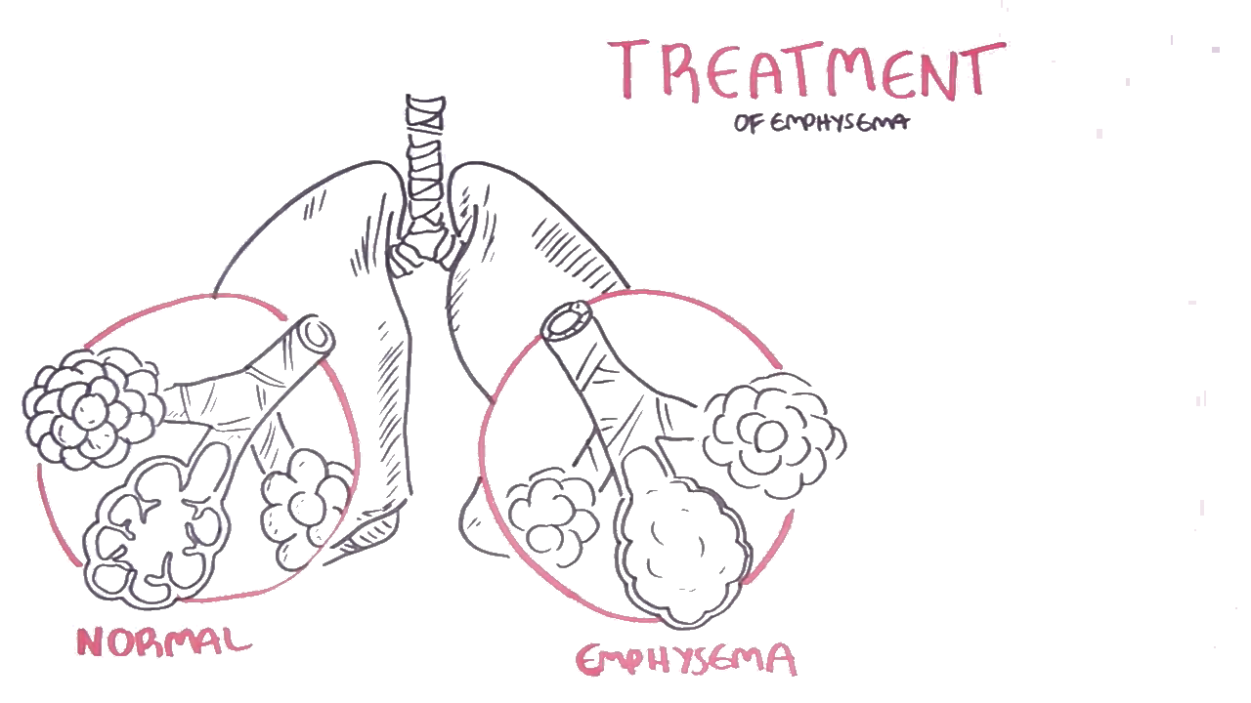
Emphysema is a type of lung disease that causes shortness of breath. In a person with emphysema, the alveoli are damaged. The alveoli walls, the elastic fibers are damaged and lost.
Here are normal alveoli. It is not damaged. It still contains the alveoli walls.
Alveoli with emphysema, on the other hand, are damaged. The walls are damaged. The elastic fibers are lost, and this makes breathing difficult and uncomfortable.
Now, emphysema is usually not a disease by itself. Many people with emphysema also have chronic bronchitis. A combination of the two lung diseases is commonly called chronic obstructive pulmonary disease or COPD. Lung damage from emphysema emphysema and COPD is irreversible. The quality of life for a person suffering diminishes as the disease progresses, which is quite sad.

