Slide 1
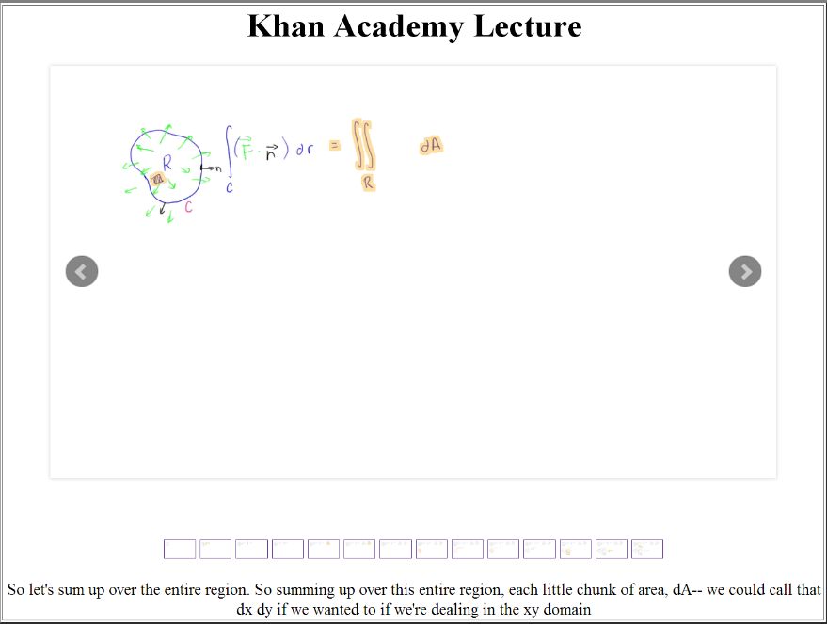
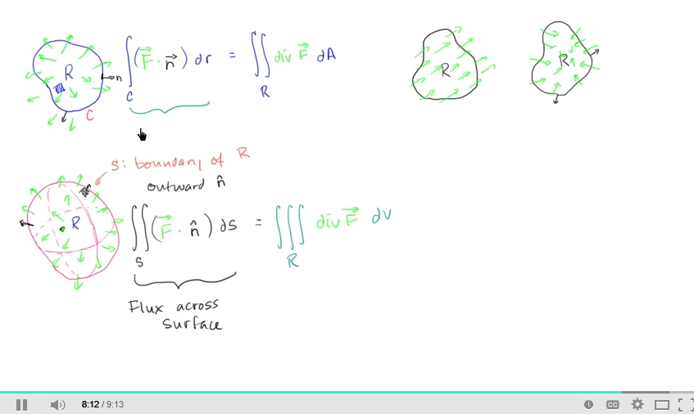
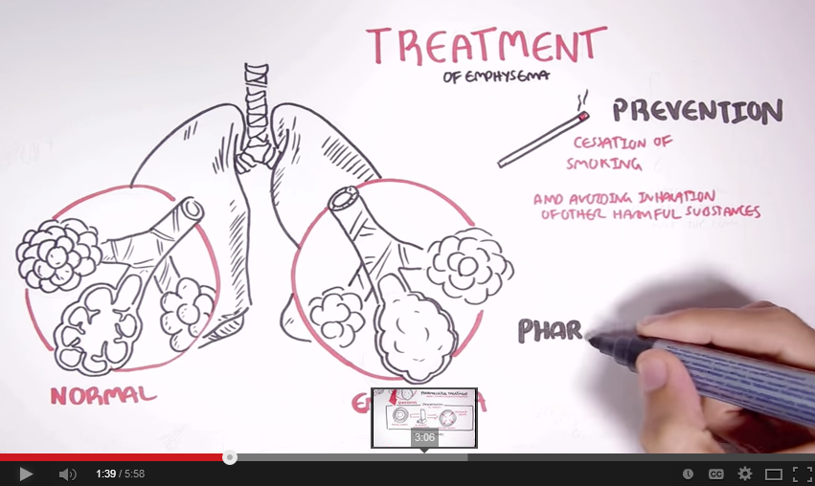
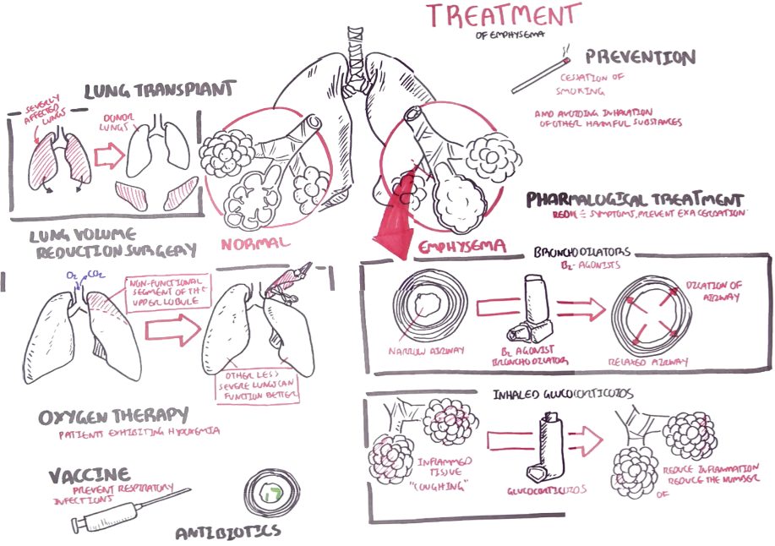
Video Lecture Summarization
Bonzai: Easier Editing of GoPro Video Footage
Reid Oda, Mira Dontcheva, Eli Shechtman, Michael Rubin
Abstract
GoPro cameras have become very popular for capturing outdoor activities and weekend adventures. There is social value in sharing the footage, but editing the footage can be time consuming, and many people opt to not do it. Our goal is create an editing experience where the user indicates "interesting points" in the video, and the system automatically determines the clip start and end points, as well as a pleasing ordering of the final clips. Using this system, the final video will be completed within minutes, rather than hours or days.
Valentina Shin
advised by Floraine Berthouzoz & Wilmot Li
Abstract Educational videos are becoming very popular online. So far, content browsing is very limited: either view just the title and the description(if they are provided) or watch the full content. Our goal is to create visual, interactive summaries of educational videos that accommodate different learner tasks and learning styles.
Highlight new parts of slide
Prev / Next
Transcript
Slide show view
Handwritten blackboard style lectures
Panoramic view
Characteristics of visual summary
Level of detail
Content dependent structure (hierarchical, sequential, map etc.)
Interactive

