Slide 1
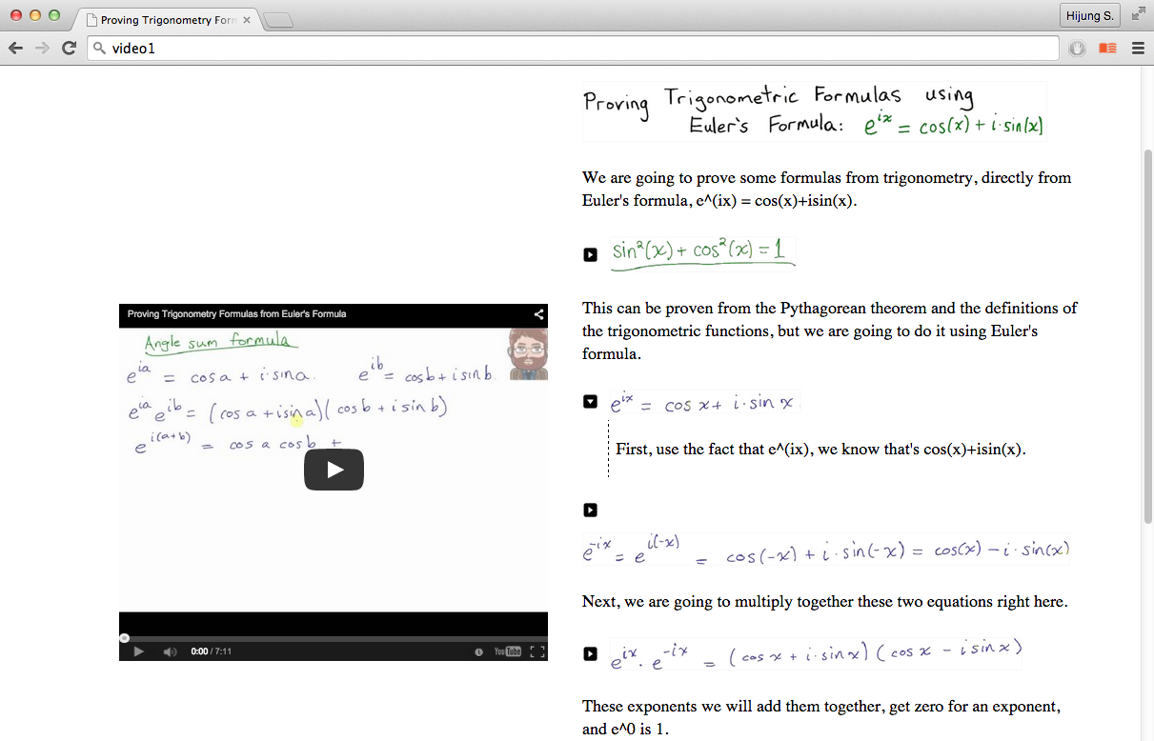
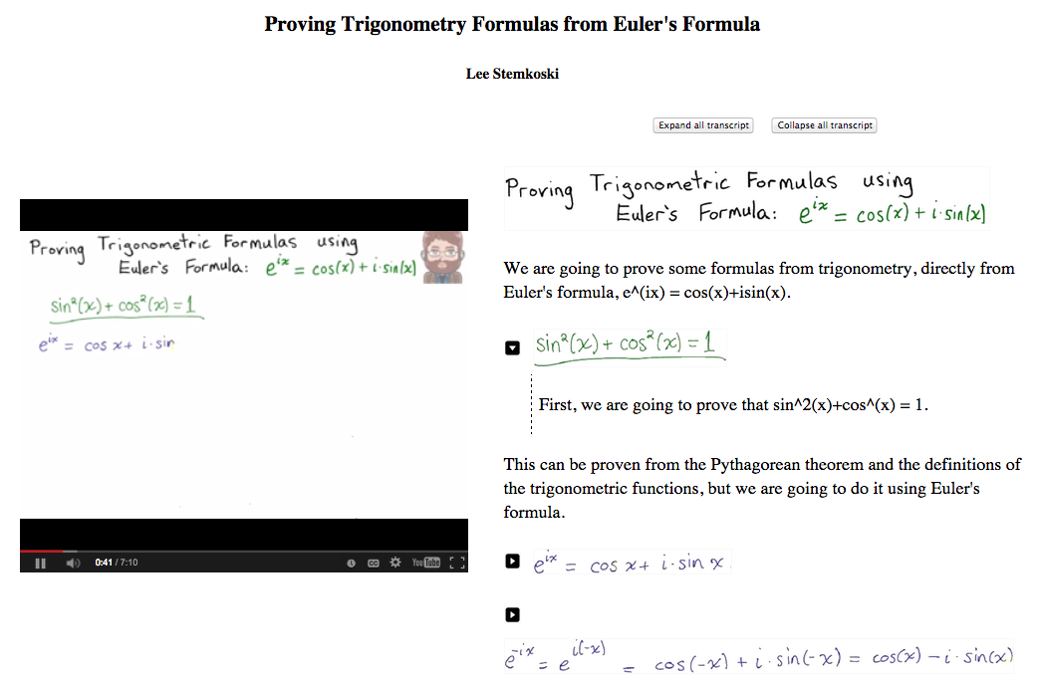

Slide 2



Slide 3
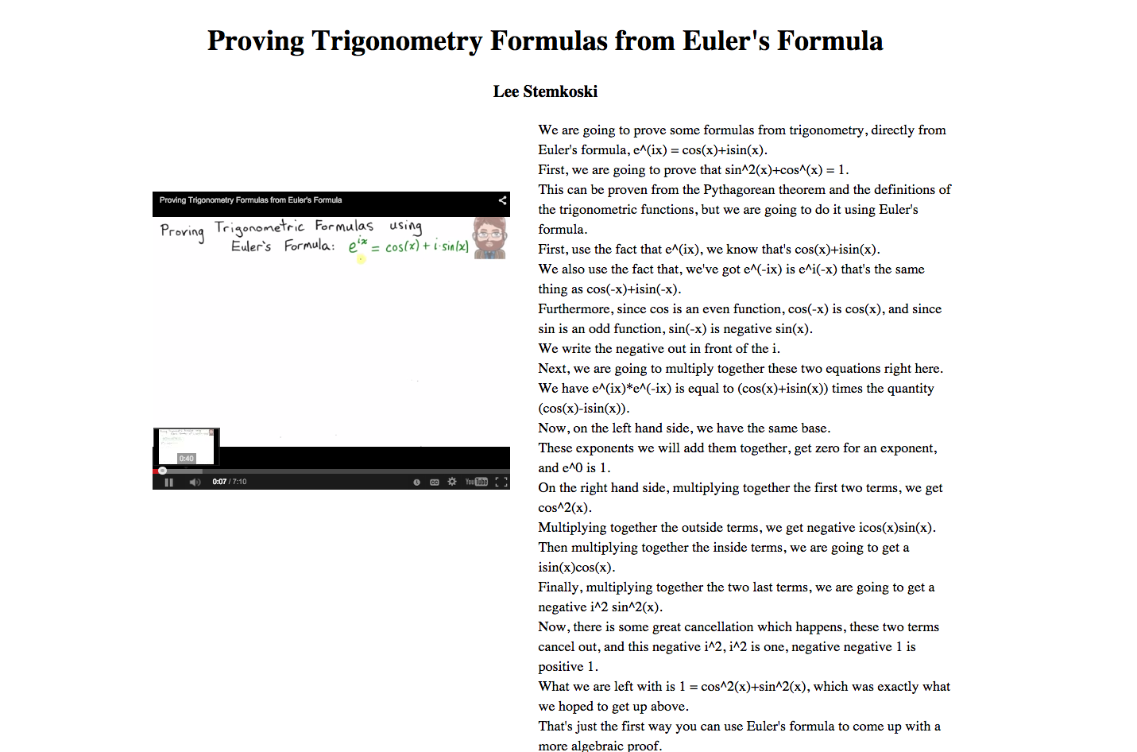
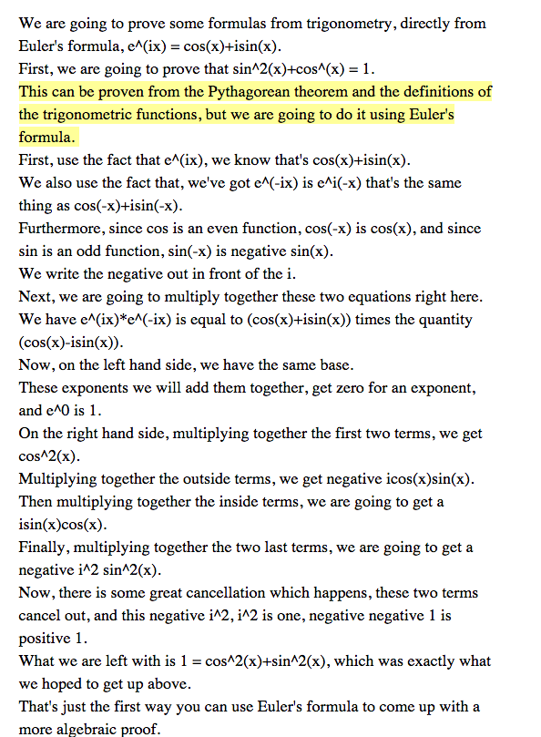

Play Speed Setting
Thumbnail preview
Pause/Play
Timeline clicking and dragging
Transcript/Interactive Transcript

Slide 4
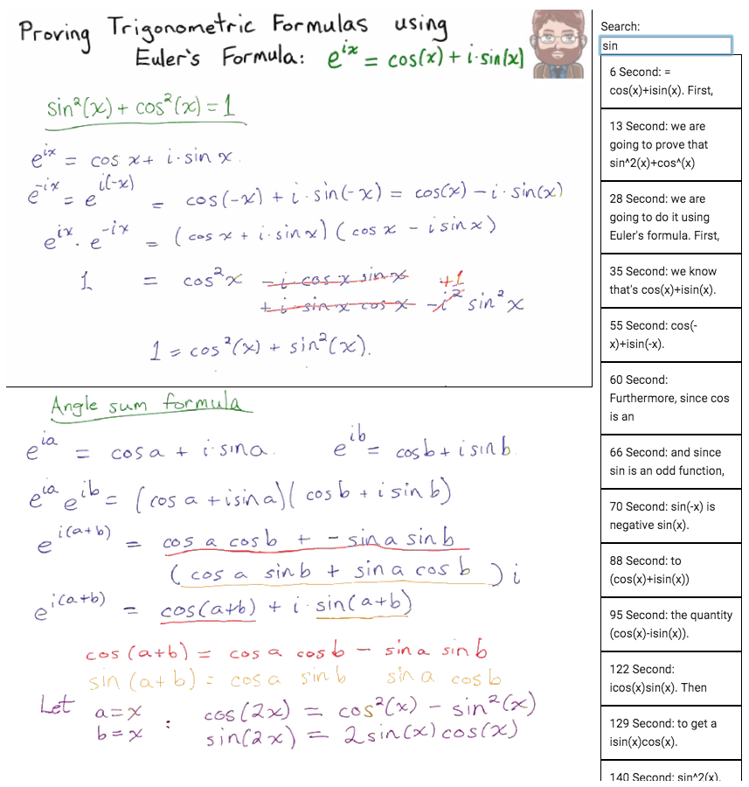
Panoramic
video board
Transcript search
Interactive
visuals

Slide 5
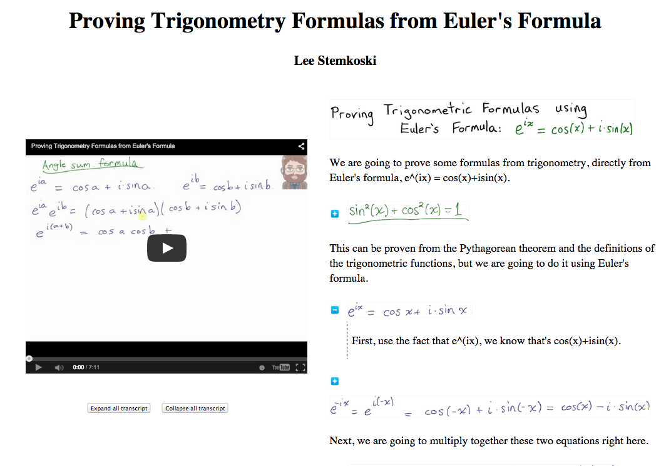
Transcript figure
Transcript expand/collapse
Transcript Text

