Slide 1
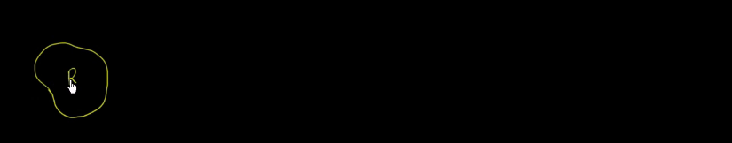
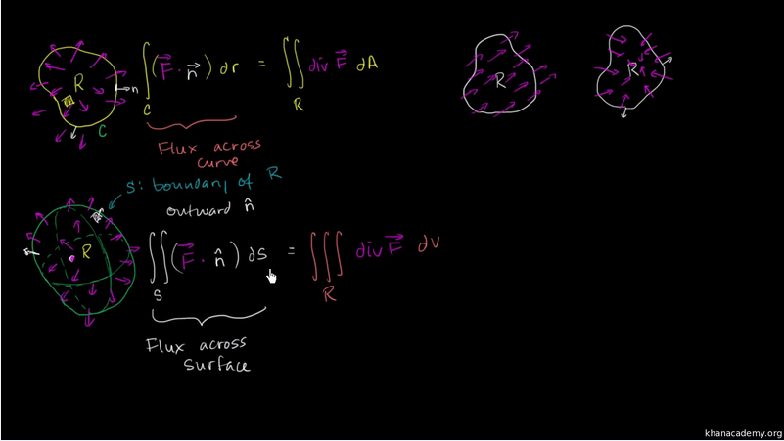
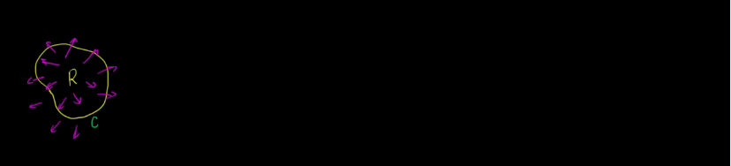
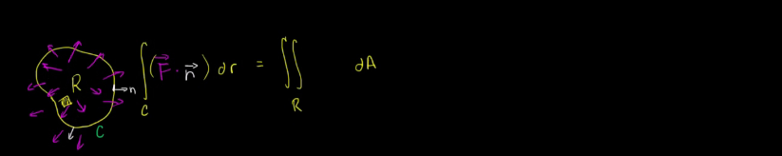
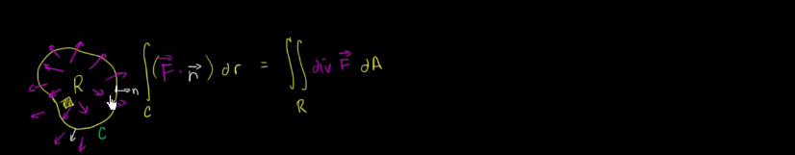
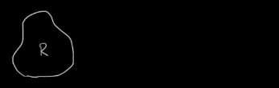
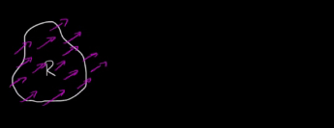
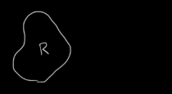
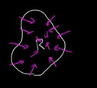
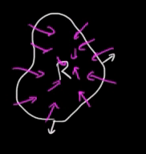
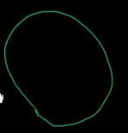
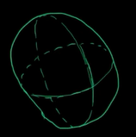
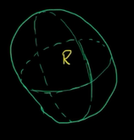
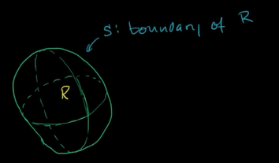
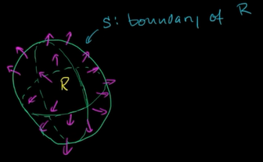
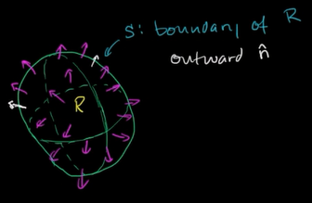
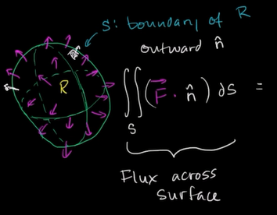
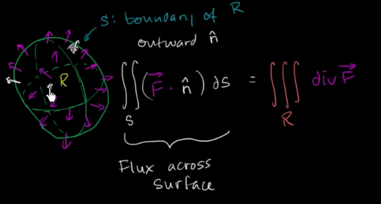
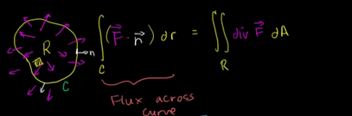
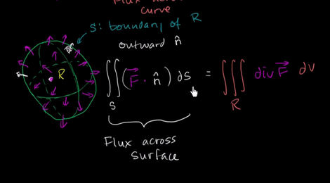
We've already explored a two-dimensional version of the divergence theorem.
If I have some region-- so this is my region right over here.
We'll call it R. And let's call the boundary of my region, let's call that C. And if I have some vector field in this region, so let me draw a vector field like this.
If I draw a vector field just like that, our two-dimensional divergence theorem, which we really derived from Green's theorem, told us that the flux across our boundary of this region-- so let me write that out.
The flux across the boundary, so the flux is essentially going to be the vector field.
It's going to be our vector field F dotted with the normal outward-facing vector.
So the normal vector at any point is this outward-facing vector, So our vector field, dotted with the normal-facing vector at our boundary times our little chunk of the boundary.
If we were to sum them all up over the entire boundary-- let me write that a little bit neater-- that's the same thing as summing up over the entire region.
So let's sum up over the entire region.
So summing up over this entire region, each little chunk of area, dA-- we could call that dx dy if we wanted to if we're dealing in the xy domain right over here, but each little chunk of area times the divergence of F, which is really saying, how much is that vector field pulling apart?
So it's times the divergence of F. And hopefully, it made intuitive sense.
The way that I drew this vector field right over here, you see everything's kind of coming out.
You could almost call this a source right here, where the vector field seems like it's popping out of there.
This has positive divergence right over here.
And so because of this, you actually see that the vector field at the boundary is actually going in the direction of the normal vector, pretty close to the direction of the normal vector, so it makes sense.
You have positive divergence, and this is going to be a positive value.
The vector field is going, for the most part, in the direction of the normal vector.
So the larger this is, the larger that is.
So hopefully, some intuitive sense.
If you had another vector field-- so let me draw another region-- that looked like this, so I could draw a couple situations.
So one where there's very limited divergence, maybe it's just a constant. The vector field doesn't really change as you go in any given direction.
Over here you'll get positive fluxes. I don't know what the plural of flux is. You'll get positive fluxes, because the vector field seems to be going in roughly the same direction as our normal vector. But here, you'll get a negative flux.
So stuff is coming in here. If you imagine your vector field is essentially some type of mass density times volume, and we've thought about that before, this is showing how much stuff is coming in, and then stuff is coming out. So your net flux will be close to zero.
Stuff is coming in, and stuff is coming out. Here, you're just saying, hey, stuff is constantly coming out of this surface. So hopefully, this gives you a sense that here you have very low divergence, and you would have a low flux, total aggregate flux, going through your boundary.
Here you have a high divergence, and you would have a high aggregate flux.
I could draw another situation.
So this is my region R. And let's say that we have negative divergence, or we could even call it convergence.
Convergence isn't an actual technical term, but you could imagine if the vector field is converging within R, well, the divergence is going to be negative in this situation.
So the divergence is negative in this situation.
And also the flux across the boundary is going to be negative.
Because as we see here, the way I drew it, across most of this boundary, the vector field is going in the opposite direction.
It's going in the opposite direction as our normal vector at any point.
So hopefully, this gives you a sense of why there's this connection between the divergence over the region and the flux across the boundary.
Well, now we're just going to extend this to three dimensions, and it's the exact same reasoning.
If we have a-- and I'll define it a little bit more precisely in future videos-- a simple, solid region. So let me just draw it.
And I'm going to try to draw it in three dimensions. So let's say it looks something like that. And one way to think about it is this is going to be a region that doesn't bend back on itself. And if you have a region that bends back on itself-- well, we'll think about it in multiple ways.
But out of all the volumes of three dimensions that you can imagine, these are the ones that don't bend back on themselves.
And there are some that you might not be able to imagine that would also not make the case. But even if you had ones that bent back on themselves, you could separate them out into other ones that don't. So here is just a simple solid region over here. I'll make it look three dimensional.
So maybe if it was transparent, you would see it like that.
And then you see the front of it like that.
So it's this kind of elliptical, circular, blob-looking thing.
So that could be the back of it.
And then if you go to the front, it could look something like that.
So this is our simple solid region.
I'll call it-- well, I'll call it R still.
But we're dealing with a three dimensional.
We are now dealing with a three-dimensional region.
And now the boundary of this is no longer a line.
We're now in three dimensions.
The boundary is a surface.
So I'll call that S. S is the boundary of R. And now let's throw on a vector field here.
Now, this is a vector field in three dimensions.
And now let's imagine that we actually have positive divergence of our vector field within this region right over here.
So we have positive divergence.
So you can imagine that it's kind of-- the vector field within the region, it's a source of the vector field, or the vector field is diverging out.
That's just the case I drew right over here.
And the other thing we want to say about vector field S, it's oriented in a way that its normal vector is outward facing, so outward normal vector.
So the normal, it's oriented so that the surface-- the normal vector is like that.
The other option is that you have an inward-facing normal vector.
But we're assuming it's an outward-facing N. Well, then we just extrapolate this to three dimensions.
We essentially say the flux across the surface.
So the flux across the surface, you would take your vector field, dot it with the normal vector at the surface, and then multiply that times a little chunk of surface, so multiply that times a little chunk of surface, and then sum it up along the whole surface, so sum it up.
So it's going to be a surface integral.
So this is flux across the surface.
It's going to be equal to-- if we were to sum up the divergence, if we were to sum up across the whole volume, so now if we're summing up things on every little chunk of volume over here in three dimensions, we're going to have to take integrals along each dimension.
So it's going to be a triple integral over the region of the divergence of F. So we're going to say, how much is F?
What is the divergence at F at each point?
So it's going to be a triple integral over the region of the divergence of F. So we're going to say, how much is F?
What is the divergence at F at each point?
And then multiply it times the volume of that little chunk to sense of how much is it totally diverging in that volume.
And then you sum it up. That should be equal to the flux. It's completely analogous to what's here.
Here we had a flux across the line. We had essentially a two-dimensional-- or I guess we could say it's a one-dimensional boundary, so flux across the curve. And here we have the flux across a surface. Here we were summing the divergence in the region. Here we're summing it in the volume. But it's the exact same logic.
If you had a vector field like this that was fairly constant going through the surface, on one side you would have a negative flux. On the other side, you would have a positive flux, and they would roughly cancel out.
And that makes sense, because there would be no diverging going on.
If you had a converging vector field, where it's coming in, the flux would be negative, because it's going in the opposite direction of the normal vector. And so the divergence would be negative as well, because essentially the vector field would be converging. So hopefully this gives you an intuition of what the divergence theorem is actually saying something very, very, very, very-- almost common sense or intuitive. And now in the next few videos, we can do some worked examples, just so you feel comfortable computing or manipulating these integrals. And then we'll do a couple of proof videos, where we actually prove the divergence theorem.

