Slide 1
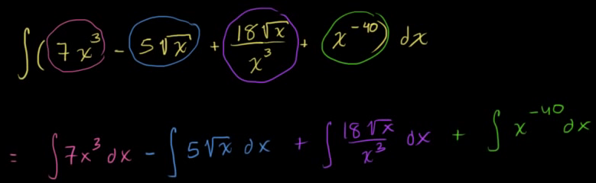
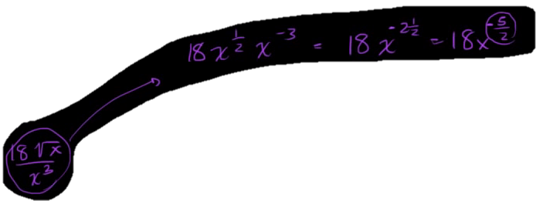
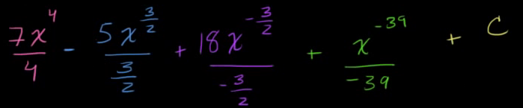
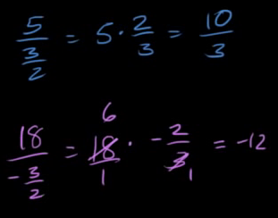
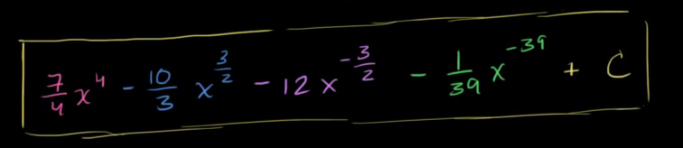
So, our goal in this video is to take the antiderivative of this fairly crazy looking expression. Or another way of saying it is to find the indefinite integral of this crazy looking expression.And the key realization right over here is that you, this expression is made up of a bunch of terms. And the indefinite integral of the entire expression is going to be equal to the indefinite integral of each of the terms.
So this is going to be equal to, we could look at this term right over here and just take the indefinite, take the indefinite integral of that. 7 x to the 3rd dx. And then from that we can subtract the indefinite integral of this thing. So we can say this is, and then minus. The indefinite integral of 5 times the square root of x d x. And then we can look at this one right over here. So then we can say plus the indefinite integral of 18 square root of x. Square roots of x over x to the third, dx and then finally, and I'm running out of colors here. Finally, I need more colors in my thing. We can take the anti derivative of this. So plus the anti derivative of x to the negative 40th power dx. So, I've just rewritten this and color coded things. So, let's take the anti derivative of each of these and you'll see that'll we'll be able to do it. Using our whatever we wanna call the inverse of the power rule or the anti power rule. Whatever you might wanna call it. So lets look at the first one. So we have, we have, what I'm gonna do is I'm just gonna find the antiderivative without the constant and just add the constant at the end for the sake of this. So we just make sure we get the most general anti derivative.
So here the exponent is a 3. So we can increase it by 1. So it's going to be x to the 4th. It's gonna be that same purple color. Or that pink color. It's going to be x to the 4th. And we're gonna divide x to the 4th. So it's x to the 4th over 4 is the antiderivative of x to the 3rd, and you just had this scaling quantity. The 7 out front. So we can still just have 7 out front. So we get 7x to the 4th over 4. Fair enough. From that, we're going to subtract the antiderivative of this. Now, at first, this might not be obvious that this, you could use our inverse power rule or anti-power rule here. But then you just need to realize that 5 timesthe principal root of x is the same thing as. So, this is the same thing as 5 x X to the 1 half power. And, so, once again, the exponent here is one half, we can increment it by 1. This is going to be X to the 3 halves. And then, divide by the incremented exponent. So, divide by Three halves and of course we had this five out front so we still want to have the five out front.Now this next expression looks even wackier but once again we can simplify a little bit. This is the same thing. Let me do it right over here. This is the same thing as 18 times x to the one half times x to the negative three power. X to the third in the denominator is the same thing as x to the negative three. We have the same base, we can just add the exponent so this is going to be equal to 18 times x to the 2 and a half power, 2 and a half power or another way of thinking about it, this is the same thing as 18 times x, 18 times x to the 5 halves power. Two the 5 halves power. Did I do that right? Yeah, negative 3, oh sorry, this is negative 2 and a half let me make this very clear and this is going to be the negative 5 half power. X to the negative 3 is the same thing as x to the negative 6 halves, negative six halves plus 1 half is negative 5 halves. So once again we just have to increment this exponent. So negative 5 halves, plus 1 is going to be negative 3 halves. So you're going to have x, x to the negative 3 halves, and then you divide by what your exponent is when you increment, so divide it by negative, divide it by negative 3 halves. And then you have the 18 out front. And we obviously are going to have to simplify this. And then finally, our exponent in this term, let me not use that purple any more, the exponent, in this term right over here is negative 40, if we increment we get x to the negative 39 power, all of that over negative 39. And now we can add our constant. Now we can add our constant C, and all we need to do is simplify all of this craziness.
So the first one is fairly simplified. We can write it as seven fourths. X to the 4th. Now this term right over here is essentially 5 divided by 3 halves, so 5 over three halves is equal 5 times two thirds, which is equal to 10 over 3. So this thing right over here simplifies to negative 10 over 3X to the three halves. And then we have all of this craziness. Now 18 divided by negative three halves. 18 divided by negative 3 halves is equal to 18 times. Negative two thirds, which is equal to, well, we can, we can simplify this a little bit. This is the same thing as 6. This is the same thing as 6 times negative 2 which is equal to negative 12. So, this expression right over here, is negative 12 x to the negative 3 halves. And then finally this one right over here, we can just rewrite it as. If we want, we could, well, we could just write negative one thirty-ninths x to the negative 39. Plus, plus C, and we're done. We found the indefinite integral of all of this craziness. And I encourage you to take the derivative of this, and you can do it using really just the power rule, to take the derivative of this and verify that it does indeed equal this expression that we took, that we took the anti-derivative of.

Slide 2
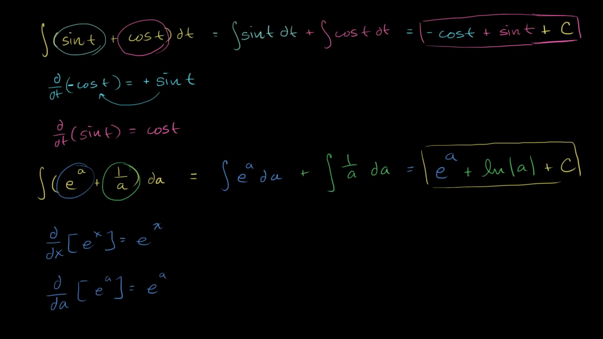
I thought I would do a few more examples of taking antiderivatives, just so we feel comfortable taking antiderivatives of all of the basic functions that we know how to take the derivatives of. And on top of that, I just want to make it clear that it doesn't always have to be functions of x.
Here we have a function of t, and we're taking the antiderivative with respect to t. And so you would not write a dx here. That is not the notation. You'll see why when we focus on definite integrals. So what's the antiderivative of this business right over here?
Well, it's going to be the same thing as the antiderivative of sine of t, or the indefinite integral of sine of t, plus the indefinite integral, or the antiderivative, of cosine of t.
So let's think about what these antiderivatives are. And we already know a little bit about taking the derivatives of trig functions. We know that the derivative with respect to t of cosine of t is equal to negative sine of t. So if we want a sine of t here, we would just have to take the derivative of negative cosine t. If we take the derivative of negative cosine t, then we get positive sine of t. The derivative with respect to t of cosine t is negative sine of t. We have the negative out front. It becomes positive sine of t. So the antiderivative of sine of t is negative cosine of t. So this is going to be equal to negative cosine of t.
And then what's the antiderivative of cosine of t? Well, we already know that the derivative with respect to t of sine of t is equal to cosine of t. So cosine of t's antiderivative is just sine of t-- so plus sine of t. And we're done. We've found the antiderivative.

