Slide 1
Chronikis: A language and compiler for Bayesian time-series models
Kevin S. Van Horn | Senior Data Science Engineer
© 2019 Adobe Inc.

Slide 2

English: time series. Greek: χρονική σειρά
https://git.corp.adobe.com/vanhorn/tsa-platform/tree/v0.1

Slide 3
Chronikis is…
A language for defining statistical time-series models
A compiler that generates code for model estimation and prediction
An R package of utility functions

Slide 4


Statistical time-series models
…are probability distributions over sequences $y_{1},y_{2},⋯$
Predictive distribution: $p\left(y_{n+1},⋯,y_{n+k} | y_{1},⋯,y_{n},θ\right)$
Examples:
AR($p$): $y_{t}=\sum_{i=1}^{p}{φ_{i}y_{t−i}}+ε_{t}$
MA($q)$: $y_{t}=μ+\sum_{i=1}^{q}{φ_{i}ε_{t−i}}+ε_{t}$
ARMA($p,q$)
DLMs:
SSMs
GPs: $\left(y_{1},⋯,y_{N}\right)\sim \text{Normal}\left(μ\left(N\right),Σ(N)\right)$
$$y_{t}=Z_{t}α_{t}+ε_{t}$$
$$α_{1} \sim \text{Normal}\text{(}a_{1},P_{1})$$
$$α_{t+1}=T_{t}α_{t}+η_{t}$$

Slide 5
Applications
Forecasting
Predictive distribution upper bound, lower bound
KPIs (probability of hitting target) sum of future values
Capacity planning max of future values
Anomaly detection
Decomposition into components
Smoothed level and trend
Periodicity
Noise, possibly correlated

Slide 6
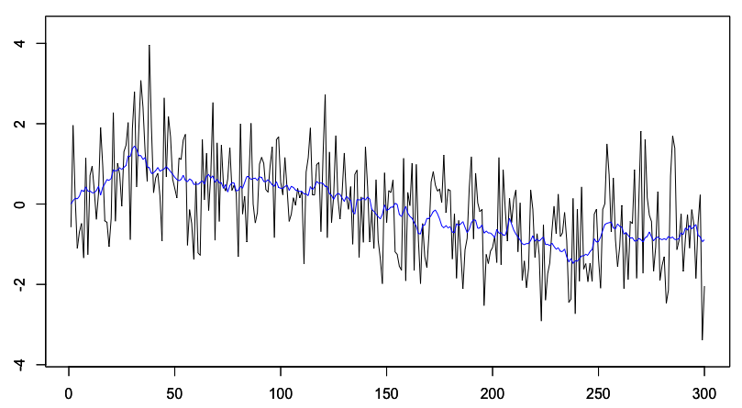
Example: Local Level

Slide 7
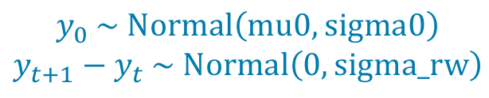
Example: Local Level
def main(mu0: real, sigma0: real{0.0,},
scale_rw, scale_err: real{0.0,})
=
sigma_rw ~ half_cauchy(scale_rw);
sigma_err ~ half_cauchy(scale_err);
accum(wn(sigma_rw), mu0, sigma0)
+ wn(sigma_err)
$$y_{0} \sim \text{Normal}\left(\text{mu}\text{0},\text{sigma}\text{0}\right)$$
$$y_{t+1}−y_{t} \sim \text{Normal}\left(0,\text{sigma}\text{_}\text{rw}\right)$$

Slide 8
Example: Local Level
def main(mu0: real, sigma0: real{0.0,},
scale_rw, scale_err: real{0.0,})
=
sigma_rw ~ half_cauchy(scale_rw);
sigma_err ~ half_cauchy(scale_err);
accum(wn(sigma_rw), mu0, sigma0)
+ wn(sigma_err)

Slide 9
Example: Local Level
def main(mu0: real, sigma0: real{0.0,},
scale_rw, scale_err: real{0.0,})
=
sigma_rw ~ half_cauchy(scale_rw);
sigma_err ~ half_cauchy(scale_err);
accum(wn(sigma_rw), mu0, sigma0)
+ wn(sigma_err)

Slide 10
Example: Local Level
def main(mu0: real, sigma0: real{0.0,},
scale_rw, scale_err: real{0.0,})
=
sigma_rw ~ half_cauchy(scale_rw);
sigma_err ~ half_cauchy(scale_err);
accum(wn(sigma_rw), mu0, sigma0)
+ wn(sigma_err)

Slide 11
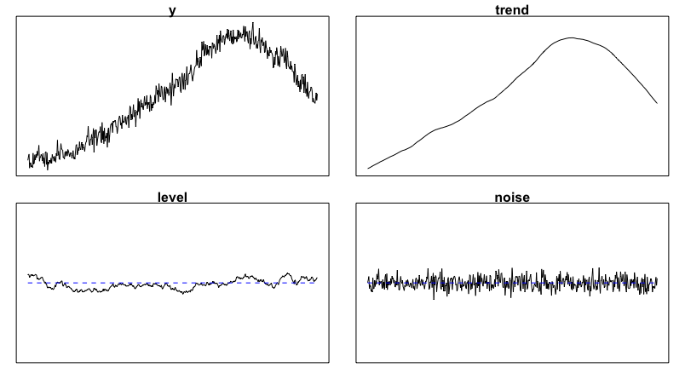
Example: Local Linear Trend

Slide 12
Example: Local Linear Trend
def main(mu0: real, sigma0: real{0.0,},
scale_l0, scale_t0: real{0.0,}) =
phi_l ~ uniform(0.0, 1.0);
phi_t ~ uniform(0.0, 1.0);
sigma_err ~ half_cauchy(scale_err);
sigma_l0 ~ half_cauchy(scale_l0);
sigma_t0 ~ half_cauchy(scale_t0);
sigma_l = sqrt(1 – phi_l^2) * sigma_l0;
sigma_t = sqrt(1 - phi_t^2) * sigma_t0;
accum(ar1(phi_t,sigma_t,sigma_t0), mu0, sigma0)
+ ar1(phi_l, sigma_l, sigma_l0)
+ wn(sigma_err)

Slide 13
Example: Local Linear Trend
def main(mu0: real, sigma0: real{0.0,},
scale_l0, scale_t0: real{0.0,}) =
phi_l ~ uniform(0.0, 1.0);
phi_t ~ uniform(0.0, 1.0);
sigma_err ~ half_cauchy(scale_err);
sigma_l0 ~ half_cauchy(scale_l0);
sigma_t0 ~ half_cauchy(scale_t0);
sigma_l = sqrt(1 – phi_l^2) * sigma_l0;
sigma_t = sqrt(1 - phi_t^2) * sigma_t0;
accum(ar1(phi_t,sigma_t,sigma_t0), mu0, sigma0)
+ ar1(phi_l, sigma_l, sigma_l0)
+ wn(sigma_err)

Slide 14
Example: Local Linear Trend
def main(mu0: real, sigma0: real{0.0,},
scale_l0, scale_t0: real{0.0,}) =
phi_l ~ uniform(0.0, 1.0);
phi_t ~ uniform(0.0, 1.0);
sigma_err ~ half_cauchy(scale_err);
sigma_l0 ~ half_cauchy(scale_l0);
sigma_t0 ~ half_cauchy(scale_t0);
sigma_l = sqrt(1 – phi_l^2) * sigma_l0;
sigma_t = sqrt(1 - phi_t^2) * sigma_t0;
accum(ar1(phi_t,sigma_t,sigma_t0), mu0, sigma0)
+ ar1(phi_l, sigma_l, sigma_l0)
+ wn(sigma_err)

Slide 15
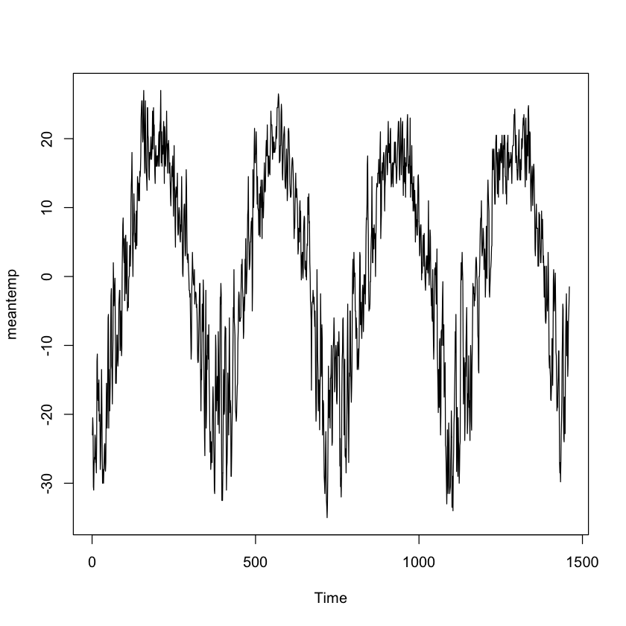
Temperature data

Slide 16
Model with periodicity
def main(…) =
…
qp(365.24, 0.7, 0.0, sigma_p) +
ar1(phi_ar1, rho_ar1 * sigma_ar1, sigma_ar1) +
constp(mu_mean, sigma_mean) +
wn(sigma_h)

Slide 17
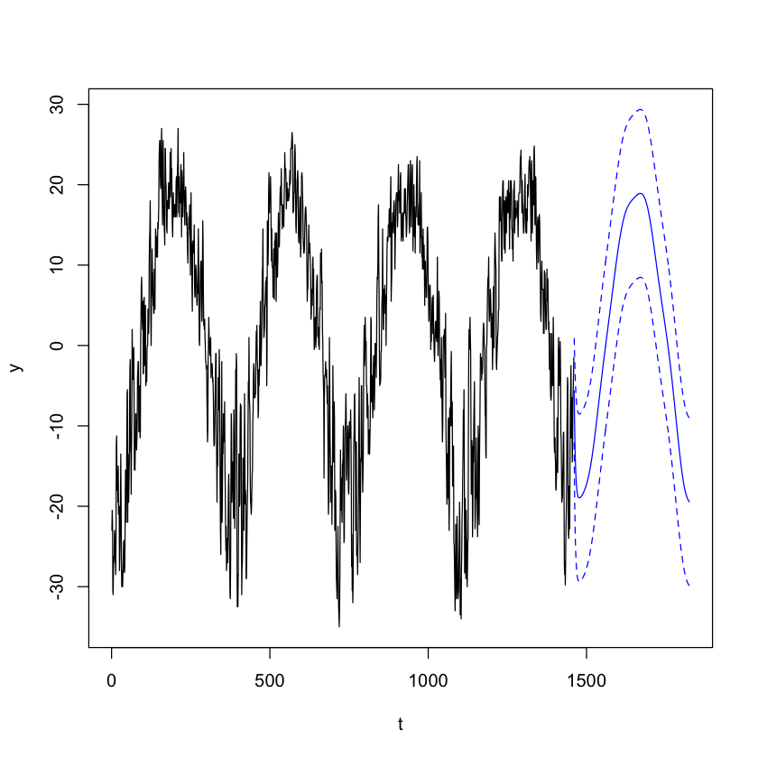
Periodicity---forecast

Slide 18
Implementation Overview
Compiler
Written in Haskell
Target: Stan model for estimation (.stan)
Target: source-able R code to create SSMs from estimated parameters
R package
Call compiler and Stan from R
Smooth or decompose time series
Forecast
Built on dlm package

Slide 19
Using the chronikis R package: estimation
sm <- cksCompile("my_model.cks", "createSSMs")
source("my_model.R")
margs <- mdlArgs(model, arguments, go, here, ...)
sma <- setArgs(sm, margs)
fit <- hmc_estimate(ytrain, sma)
post <- posterior_sample(fit)
models0 <- createSSMs(margs, post, npost)
filtered0 <- filter_models(ytrain, models0)
models <- update_models(filtered = filtered0)

Slide 20
Using the chronikis R package: forecasting
fi <- forecast_intervals(models, nsteps, 0.10,
drop=TRUE)
# fi$mean : predictive mean
# fi$lower, fc$upper : prediction intervals
fs <- forecast_sample(models, nsteps, ndpm)
# fs : nsteps x nd matrix of predictive draws

