Slide 1

OSCAL Compliance Tool – Executive Demo
A comprehensive Overview of Compliance documents management (SSP/SOA/CCM)
Notes:
---

Slide 2
Introduction
Notes:
Purpose of the Session

Slide 3

Purpose of the Session
Purpose of OSCAL Tool
The OSCAL Compliance Tool addresses evolving demand and simplifies compliance processes bring efficiency via automation.
Evolution of the Solution
Our solution evolved from a demand of SSP in OSCAL for Singapore IM8 Compliance. (Attempt from Excel to OSCAL Convertor to this state)
Prototype Compliance Tool
The tool takes OSCAL inputs and generates OSCAL outputs, evolving into a full compliance tracking solution.
Strategic Importance of OSCAL
OSCAL adoption enhances regulatory compliance and operational excellence in SSA implementations.
Leadership Engagement
Seeking input on internal integration versus open-source contribution to align with Adobe Managed Services Goals.
Notes:
This session aims to introduce a prototype compliance tool developed to address the growing need for OSCAL (Open Security Controls Assessment Language) adoption in Adobe's SSA implementations. The tool was initially designed to convert Excel inputs into OSCAL outputs but has evolved into a comprehensive solution for compliance tracking and control documentation management. The purpose is to demonstrate its capabilities, explain the strategic importance of OSCAL, and seek leadership input on whether to integrate internally or contribute to the open-source community. This initiative aligns with Adobe's commitment to regulatory compliance and operational excellence, ensuring that SSA implementations across regions meet stringent standards efficiently and effectively.

Slide 4
Story Time for Problem Statement

Slide 5

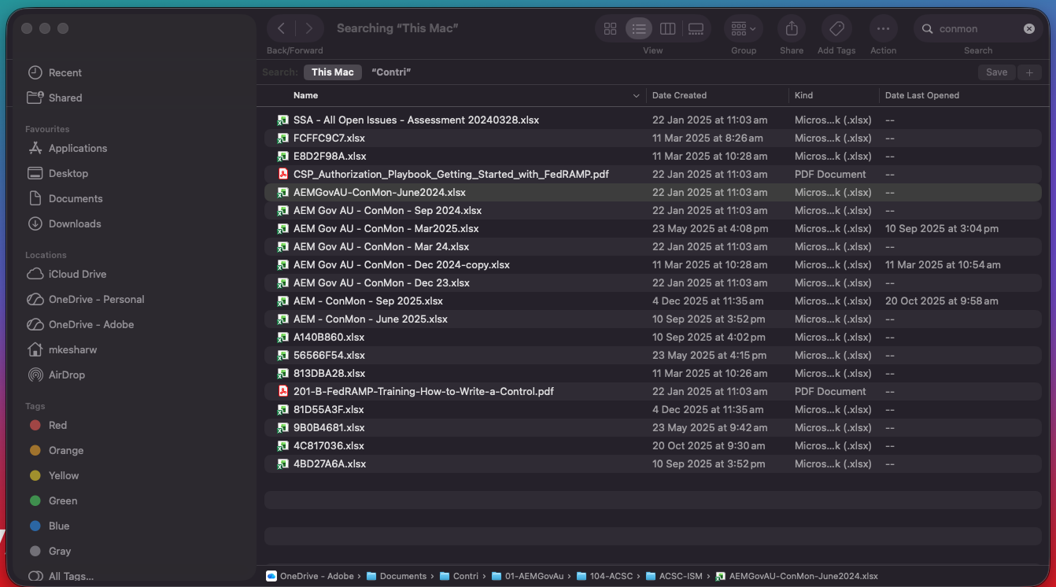
What Problem We are solving
Process what is showed in next 5mins must be repeated by all the consumers security risk management team to identify the risk and manage risk coming from solution.
At the inception or changes to the solution ( Major change from Third Party Tools/services or inhouse Components).
AEMGovAu-CCM/SSP/SOA , AWS – CCM/SSP/SOA, SPLUK IRAP Report, Okta IRAP Report, Trend Micro IRAP Report
Objective is get Gap Assessment for Identifying the potential overhead or risks
Periodic Change by Standard Publishers (NIST, ACSC, CIS, CCCS etc.)
ACSC ISM Sep 2024 Release, ACSC ISM Dec 2024 Release, ACSC ISM Mar 2025 Release, etc.
Leads to

Slide 6
Background on OSCAL
Notes:
This slide references information from the following file: https://pages.nist.gov/OSCAL/,https://fedtechmagazine.com/article/2025/02/what-is-oscal-perfcon,https://securityboulevard.com/2024/12/leveraging-nist-oscal-to-provide-compliance-automation-the-complete-guide/ What is OSCAL and Why It Matters

Slide 7
What is OSCAL and Why It Matters
OSCAL (Open Security Controls Assessment Language) is a NIST initiative to standardize the representation of security controls and compliance data.
Modernizing Compliance Processes
OSCAL modernizes security and compliance by using machine-readable formats like XML, JSON, and YAML.
Reducing Audit Duration
OSCAL reduces audit times from months to days by automating documentation and assessment workflows.
Enabling Interoperability
OSCAL supports interoperability across tools and frameworks, improving compliance efficiency and scalability.
Driving Global Standards
OSCAL is adopted by regulatory bodies like FedRAMP, ACSC, Singapore Gov. aiming to become a global compliance automation standard.
Continuous Compliance Automation
Enables AMS to automate assessments and maintain compliance with evolving standards.
Notes:
This slide references information from the following file: https://pages.nist.gov/OSCAL/,https://fedtechmagazine.com/article/2025/02/what-is-oscal-perfcon,https://securityboulevard.com/2024/12/leveraging-nist-oscal-to-provide-compliance-automation-the-complete-guide/ OSCAL, or Open Security Controls Assessment Language, is a NIST-led initiative designed to modernize and automate security and compliance processes. It provides machine-readable formats such as XML, JSON, and YAML to represent security controls and compliance data. This approach replaces traditional manual documentation methods, reducing audit durations from months to minutes, minimizing human error, and enabling automation. OSCAL supports interoperability across tools and frameworks, making compliance processes more efficient and scalable. Its adoption is driven by regulatory bodies like FedRAMP and is expected to become a global standard for compliance automation. By transitioning to OSCAL, organizations can streamline workflows, maintain up-to-date control information, and automate monitoring and assessment of system security posture. This positions Adobe to lead in compliance innovation and meet evolving regulatory requirements with agility.

Slide 8
Existing Tools in Adobe
Notes:
Current Compliance Management Approach

Slide 9

Current Compliance Management Approach
Current Tools and Limitations
TechGRC leverage Paramify; but Paramify supports only FedRAMP, limiting broader compliance coverage.
Manual Documentation Challenges
Compliance processes rely on spreadsheets and word processors, causing slow and error-prone documentation.
Need for Automation
Lack of automation and multi-standard support results in operational overhead and delays in regulatory compliance.
Notes:
Adobe currently uses TechGRC for governance and risk management and has consulted Paramify for OSCAL support. However, Paramify's capabilities are limited to FedRAMP standards and do not extend to other frameworks. Compliance documentation processes largely rely on manual methods, such as spreadsheets and word processors, which are time-consuming and prone to errors. These limitations hinder scalability and efficiency, especially as SSA implementations expand globally. The lack of automation and multi-standard support creates operational overhead and delays in meeting regulatory requirements. This context underscores the need for a more robust, automated solution that can handle diverse compliance frameworks and streamline documentation processes.

Slide 10
Challenges Faced
Notes:
Key Pain Points in Current Process

Slide 11

Key Pain Points in Current Process
Limited Compliance Support
Current tools lack support for compliance standards beyond FedRAMP, limiting scalability and adaptability. Growing requirements for OSCAL-compliant SSP and SoA documents reveal gaps.
Manual Document Generation
Excessive manual effort is required to generate SSP and SoA documents, leading to inefficiency and errors.
Lack of Automation
Absence of automation for ongoing compliance tracking causes increased risk and difficulty in scaling.
Tool Integration Issues
Missing integrated tools for managing control documentation creates gaps in traceability and consistency.
Transparency and Accuracy Issues​
Manual processes hinder tracking changes, version control, and increase risk of inaccuracies and audit findings.
Notes:
The primary challenges include limited support for compliance standards beyond FedRAMP, excessive manual effort in generating SSP and SoA documents, and lack of automation for ongoing compliance tracking. These issues result in inefficiencies, increased risk of human error, and difficulty scaling compliance processes for multiple SSA implementations across regions. Additionally, the absence of integrated tools for managing control documentation and assessments creates gaps in traceability and consistency. Addressing these challenges is critical to maintaining Adobe's leadership in regulatory compliance and ensuring timely delivery of secure solutions to customers.

Slide 12

Key Pain Points in Current Process (AEMGOvau Usecase)
High Manual Effort​
Maintaining ACSC ISM documentation requires about 100 person-days annually, diverting skilled resources from strategic tasks.​
Frequent Regulatory Changes​
Quarterly updates introduce new controls, requiring constant interpretation and implementation effort.​
Limited Continuous Assurance​
Point-in-time compliance checks provide snapshots but limit proactive risk management and ongoing assurance.​
Scenario​ | Annual Effort (Person-Days)​ | Annual Effort (Hours)​
Manual Process​ | 100​ | ~800​
OSCAL Automation (Range)​ | 40–50​ | ~320–400​
Savings​ | 50–60​ | ~400–480​
Notes:
High manual effort: Updating ACSC ISM documentation requires ~100 person-days annually across multiple teams.
Frequent regulatory changes: Quarterly updates from Australian Government agencies create constant workload pressure.
Point-in-time assessments: Current approach focuses on snapshot compliance rather than continuous assurance.
Limited transparency: Manual processes make it hard to track changes and demonstrate compliance effectively.
Risk of inaccuracies: Manual documentation increases chances of errors and inconsistencies.
Resource drain: Skilled staff spend significant time on repetitive documentation instead of higher-value tasks.

Slide 13
Future Scope and Benefits
Notes:
This slide references information from the following file: https://securityboulevard.com/2024/12/leveraging-nist-oscal-to-provide-compliance-automation-the-complete-guide/,https://www.ignyteplatform.com/blog/compliance/what-oscal-why-matter/ Opportunities with OSCAL Adoption

Slide 14

Opportunities with OSCAL Adoption
Global OSCAL Adoption
OSCAL adoption is increasing worldwide with key regulatory bodies endorsing machine-readable compliance standards.
Automation and Accuracy
OSCAL automates SSP and SoA creation, enhances documentation accuracy, reduces manual effort, and improves transparency.
Continuous Compliance Tracking
Enables ongoing compliance monitoring for faster, higher-quality assessments and reduced operational overhead.
Integration and Future Enhancements
Prototype integration with existing workflows and planned support for multiple standards and governance tools along with dashboard for metrics collection.
Industry Leadership Potential
Adopting OSCAL positions Adobe as a leader in compliance automation and global regulatory readiness.
Notes:
This slide references information from the following file: https://securityboulevard.com/2024/12/leveraging-nist-oscal-to-provide-compliance-automation-the-complete-guide/,https://www.ignyteplatform.com/blog/compliance/what-oscal-why-matter/ Adopting OSCAL offers significant benefits, including automation of SSP and SoA generation, continuous compliance tracking, and improved accuracy in documentation. It reduces operational overhead by eliminating manual processes and enables faster, higher-quality assessments. The tool prototype developed internally demonstrates potential for integration into Adobe's compliance workflows and could also contribute to the open-source community, enhancing industry-wide adoption. Future enhancements may include support for multiple standards, integration with existing governance tools, and advanced features for real-time compliance monitoring. These capabilities will position Adobe as a leader in compliance automation and strengthen its ability to meet global regulatory requirements efficiently.

Slide 15
Why Investment Matters
Notes:
This slide references information from the following file: https://pages.nist.gov/OSCAL/contribute/roadmap/,https://www.nist.gov/document/presentation-what-oscal-and-who-needs-it Strategic Importance for Adobe

Slide 16

Strategic Importance for Adobe
Establishes Adobe as a trailblazer in compliance automation.
Compliance with Regulations
Adopting OSCAL ensures Adobe meets regulatory mandates like FedRAMP, ACSC ISM, CCCS and Singapore IM8 effectively and accurately.
Operational Efficiency
Using OSCAL reduces audit timelines and streamlines compliance processes, enhancing Adobe's operational efficiency.
Competitive Advantage
Integrating OSCAL positions Adobe as an innovator in compliance automation, boosting reputation and market position.
Scalable Global Compliance
OSCAL enables Adobe to scale compliance globally while maintaining accuracy and transparency across operations.
Notes:
This slide references information from the following file: https://pages.nist.gov/OSCAL/contribute/roadmap/,https://www.nist.gov/document/presentation-what-oscal-and-who-needs-it Investment in OSCAL-based solutions is crucial as regulatory bodies increasingly mandate OSCAL formats for compliance documentation. This trend is evident in frameworks like FedRAMP and Singapore IM8, which require SSP and SoA in OSCAL format. By adopting OSCAL, Adobe can ensure compliance with these standards, reduce audit timelines, and improve operational efficiency. Furthermore, it positions Adobe as an innovator in compliance automation, enhancing its reputation and competitive advantage. The ability to scale compliance processes globally while maintaining accuracy and transparency will support Adobe's strategic objectives and safeguard its multi-billion-dollar portfolio against regulatory risks.

Slide 17
Demo and Next Steps
Notes:
Prototype Overview and Action Plan

Slide 18

Prototype Overview and Action Plan
Prototype is available at https://keekar.ddns.net
Prototype Tool Features
Supports conversion of compliance data into OSCAL format with tracking and documentation management features.
Leadership Inputs & Decisions
Plan leadership review, feedback gathering, integration decisions, and roadmap for SSA compliance automation. Your feedback will guide decisions on open-source contribution or internal adoption for SSA
Collaboration and Goals
Collaboration across leadership to align priorities and resources to enhance compliance efficiency and reduce risks.
Strategic Alignment
Engagement ensures alignment with compliance roadmap and investment priorities.
Notes:
The prototype tool can be explored at https://keekar.ddns.net/. It currently supports conversion of compliance data into OSCAL format and offers features for ongoing compliance tracking and control documentation management. Next steps include organizing a leadership review session to gather feedback, deciding on internal integration versus open-source contribution, and planning a roadmap for SSA compliance automation. This initiative will require collaboration across AMS leadership to align on priorities and resource allocation. The goal is to leverage this tool to enhance compliance efficiency, reduce operational risks, and support Adobe's global regulatory commitments.

Slide 19
Tool ARCHITECTURE
Notes:
Prototype Overview and Action Plan

Slide 20
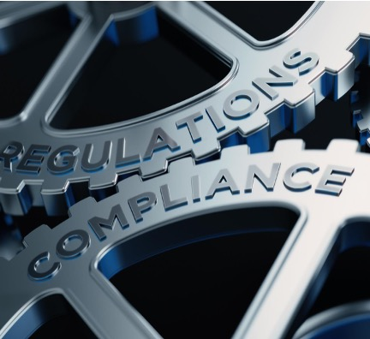
SYSTEM DESIGN OVERVIEW
Frontend Interface
The React-based frontend offers an intuitive user interface for managing compliance workflows efficiently.
Backend Services
Node.js backend manages API endpoints for generating compliance documents like SSP, Statement of Applicability (SoA), and Cloud Control Matrix (CCM).
Catalog Integration
The system integrates with external OSCAL catalogues like NIST SP 800-53 and ACSC ISM for compliance data.
Extensibility and Export
Supports export in JSON, Excel, PDF formats and future enhancements including GRC integration and collaboration.
Monitoring Integration
Designed to leverage the existing APIs to fetch the real-time metrices for automated control monitoring and testing without storing credentials in tools.
Notes:
This slide references information from the following file: https://pages.nist.gov/OSCAL/contribute/roadmap/,https://www.nist.gov/document/presentation-what-oscal-and-who-needs-it Investment in OSCAL-based solutions is crucial as regulatory bodies increasingly mandate OSCAL formats for compliance documentation. This trend is evident in frameworks like FedRAMP and Singapore IM8, which require SSP and SoA in OSCAL format. By adopting OSCAL, Adobe can ensure compliance with these standards, reduce audit timelines, and improve operational efficiency. Furthermore, it positions Adobe as an innovator in compliance automation, enhancing its reputation and competitive advantage. The ability to scale compliance processes globally while maintaining accuracy and transparency will support Adobe's strategic objectives and safeguard its multi-billion-dollar portfolio against regulatory risks.

Slide 21
Q&A ?
Notes:
Prototype Overview and Action Plan

Slide 22
Thankyou
Notes:
Prototype Overview and Action Plan

