Slide 1


Deploy with Cloud Manager
Chunlong Zhang
Senior Instructor, Adobe Digital Learning Services
Kathy Jo Nelson
Senior Instructor, Adobe Digital Learning Services

Slide 2


Introducing Your Adobe Digital Learning Services Instructor
Chunlong Zhang
Senior Instructor, Adobe Digital Learning Services
16 years' experience in Adobe Experience Manager, mixed in different roles:
Developer
Consulting
Support
Training
Adobe Certified Expert: Adobe Experience Manager Developer
Adobe Certified Master: Adobe Experience Manager Architect
Certified Adobe Multi-Solution Implementor
3

Slide 3


Introducing Your Adobe Digital Learning Services Instructor
Kathy Jo Nelson
Senior Instructor, Adobe Digital Learning Services
Four years ago, rented my house out for a year and toured the U.S. in my Mini Cooper
Adobe Certified Master: Adobe Experience Manager Architect
Official scorekeeper for the World Salsa Summit in Miami
4

Slide 4
Deploy with Adobe Cloud Manager
This is a technical session to help Administrators, DevOps and Developers have a better understanding of how to use Cloud Manager to self-manage AEM as a Cloud Service
What we will cover:
Explore the Cloud Manager interface
Understand key changes to code structure and deployment practices
Learn how to manage Cloud Manager programs, environments, and pipelines
Learn how to execute Cloud Manager pipelines and review the results
Briefly review the Cloud Manager API and developer console
5

Slide 5



Agenda
Introduce Cloud Manager
Prepare the Deployment with Cloud Manager
Execute the Deployment Using Cloud Manager
What is Cloud Manager?
How to manage programs, environments, and pipelines using Cloud Manager
Create AEM Project using Archetype 24
Work with non-production pipelines
Understand the Maven Project structure
Work with production pipelines
Git & Cloud Manager
Understand the pipeline execution stages and results
6

Slide 6
Difficulty Level
Expert
Advanced Intermediate
Beginner Discovery
7

Slide 7
Introduce Cloud Manager

Slide 8



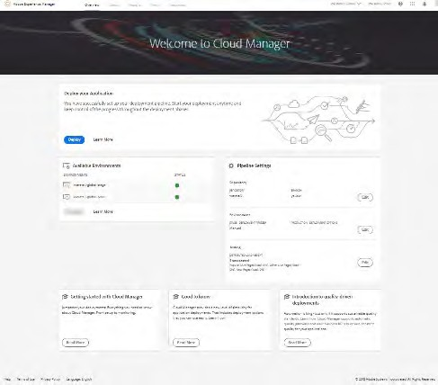

What Is Cloud Manager?
Self-Service Portal
Easily access & manage the cloud environment and CI/CD pipeline
CI/CD Pipeline
Code inspection, performance testing, and security validation
Flexible Deployments
Schedule code deployments during specified time frames
Autoscaling
Detects the need for additional capacity during unexpected spikes
9

Slide 9


Cloud Manager Entities
Programs
Environments
CI/CD Pipelines
A set of environments and associated pipelines that support a logical grouping of customer initiatives, typically corresponding to a purchased Service Level Agreement (SLA)
A set of Adobe Experience Author, Publish, and Dispatcher services
A set of deployment steps which are executed in sequence
Cloud Manager programs typically have one stage environment and production environment pair and one or more non-production environments
Comes in two flavors:
Non-production pipeline
Production pipeline
Adobe Experience Manager applications (Sites, Assets) with associated GitHub code repository
10

Slide 10
Environment Types
Production and Stage
Development
Available as a duo
Used for development and testing
Used for testing and production
Associated with non-production pipelines
11

Slide 11
CI/CD Pipelines
Automates code scanning, unit tests, functional tests, UI tests and performance tests
Provides comprehensive test results and logs
Are of two types:
Enables implementation teams to quickly test and deploy your project codes
Provide details on what’s going wrong and how to fix problems
Increase deployment efficiency
Non-production pipeline
Gain visibility into potential impact on Key Performance Indicators (KPIs)
Identify critical issues that are expensive to fix after deployment
Production pipeline
12

Slide 12


It’s Demo Time!
In this demo:
Explore the Cloud Manager user interface
Create a program
Create a non-production environment
Create a production environment
13

Slide 13
Prepare the Deployment with Cloud Manager

Slide 14
Maven AEM Project Archetype 24
Strongly recommended for any AEM project
Creates a minimal, best-practices-based project structure
Built in support for AEM as a Cloud Service
Built in SPA support Separation of content and code
Single content package cannot deploy both mutable and immutable content
Application must separate code and content into different packages for deployment Deploys single AEM package:
Package contains embedded sub-packages for code, configuration, and any supporting baseline content
©¹2⁵ 021 Adobe. All Rights Reserved
15
Adobe Digital Learning Services

Slide 15
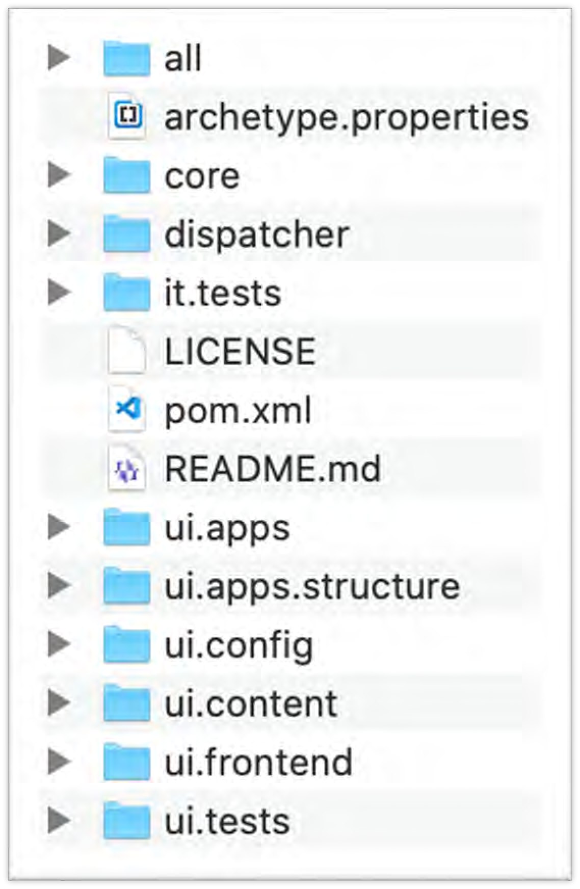
Maven Project Structure
Deploy modules as a single artifact
Application Java code
Integration tests bundles
Dispatcher configuration
OSGi
configurations:
/apps/osgiconfig
Application code:
/apps
Application content:
/content, /conf
Repository roots into which code packages in this project deploy
Client library files and resources
Generated from Maven AEM Project Archetype 24
16

Slide 16
AEM Package Structure
core
bundle
.jar
Java
JS & CSS
ui.frontend
JS & CSS
/apps,
/oak:index
ui.apps
ui.apps.zip
ui.config
/apps/…/osgiconfig
ui.config.zip
/content,
/conf
ui.content
ui.content.zip
all.zip
all
17

Slide 17
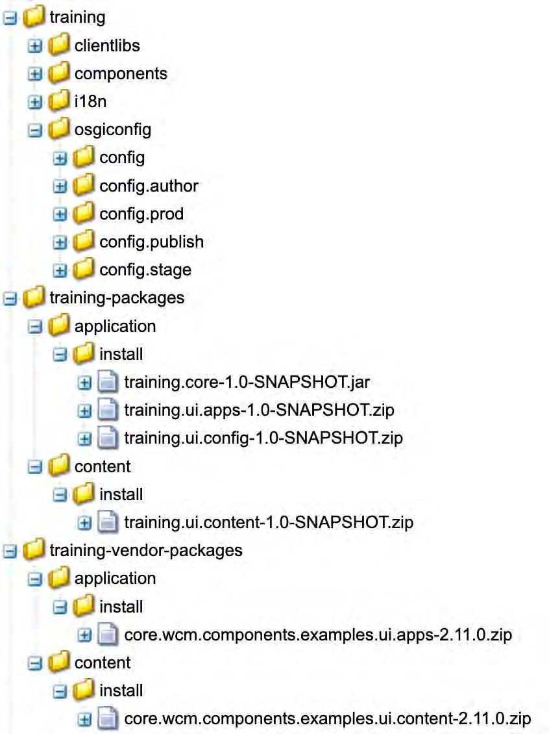
Project Deployment Result in AEM
Key changes:
A separate ui.config module
Java OSGi bundle directly deployed
OSGi configuration
OSGi bundle installation
18

Slide 18
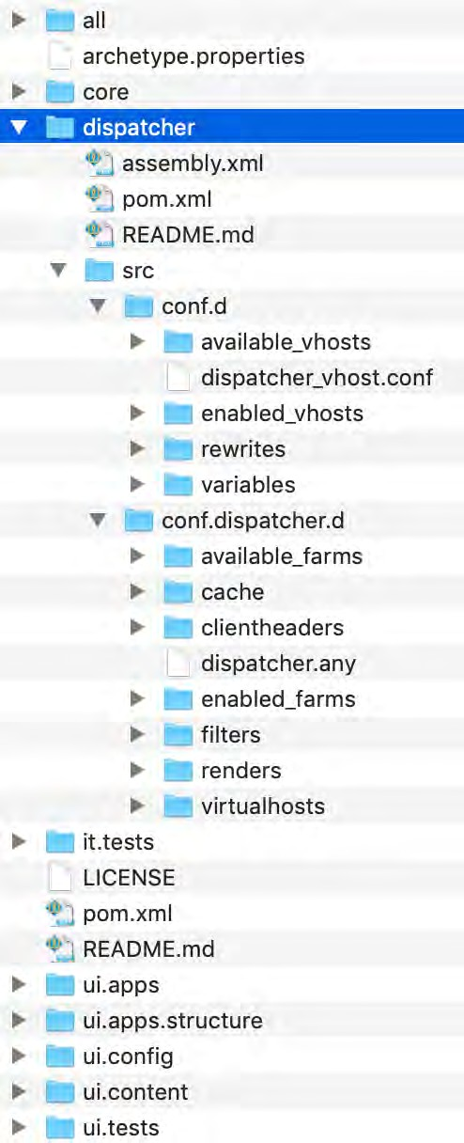
Dispatcher Configurations
Dispatcher module
Dispatcher assembly instructions
Web services configuration
Deploy web server and dispatcher configuration files from the Cloud Manager GitHub repository
Dispatcher configuration
19

Slide 19

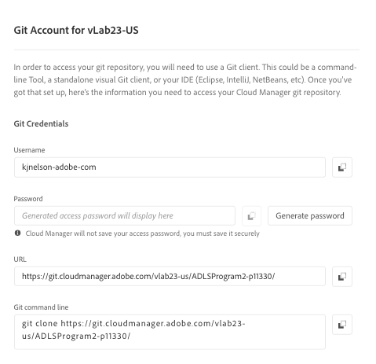
Git Integration with Adobe Cloud Manager
Adobe Cloud Manager comes provisioned with a single Git repository for each program
Used to deploy code using Cloud Manager’s CI/CD pipelines
Options for use:
Use the git repository as it comes out of the box
Integrate a customer-managed Git repository with Cloud Manager
20

Slide 20









Cloud Manager Code Flow
Program
Dev Environment(s) Author Publish
LB
Developers
git code
git code
Dispatcher
browser
Clou
d Manager
Customer
Stage Environment
LB
Prod Environment
LB
21

Slide 21
It’s Demo Time!
In this demo:
Project structure from Archetype 24
Review the “all” module pom.xml
Review the “ui.apps” module pom.xml
Review the “ui.core” module pom.xml
Review the “ui.config” module pom.xml
Review the installed structure
22

Slide 22
Execute the Deployment Using Cloud Manager

Slide 23




Traditional AEM Deployment Workflow
QA
Operations
Developer
Dev/QA
Staging
Production
UAT
Many times per day
Many times per sprint
Once per sprint
Once per release

Slide 24









How Does Cloud Manager Fit In?
QA
Operations
Pull
Push
Customer Git Repo
Cloud Manager Git Repo
Dev/QA
Staging
Production
UAT
Cloud Manager
develop/release
master

Slide 25




AEM Cloud Service: Deployment Architecture
Customer Code Changes
Adobe Release Orchestration
Custom Code CI/CD
Customer Building/Testing
Non-Production Environment
Baseline AEM Releases
Image Building
Stage Deployment
AEM Release Validation
Security Testing
Staging Environment
Adobe Code CI/CD
Regression testing
Performance Testing
Adobe Code Changes
Production Deployment
Production Environment
Several Times a Day

Slide 26
Create and Configure Non-Production Pipelines
Select the Pipeline Type: Code Quality or Deployment
Configure the Pipeline Trigger and Failure Behavior
Select Git Branch

Slide 27

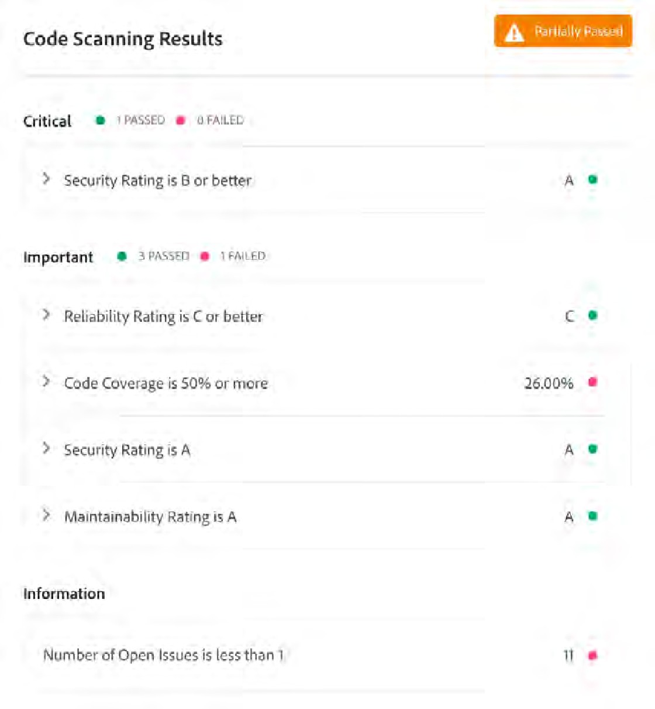
Non-Production Pipeline
Cloud Manager executes the following tests for non-production pipeline (for both code quality and development types):
Build & unit testing
Code scanning
Code scanning is separated into three severity levels:
Critical: Fails the pipeline. Must be fixed to continue
Important: Pauses the pipeline. Can be overridden or ignored
Information: No impact on the pipeline execution

Slide 28


Unit Testing
JUnit tests:
Build-time tests written in Java
JUnit tests located in core/src/test/java/ in your Maven project
Used to test the actual Java classes in core/src/main/java/
Validates the output of a method against expected results

Slide 29

Code Scanning Using SonarQube
Groups issues into four categories:
Code Smell (Maintainability domain)
Bug (Reliability domain)
Vulnerability (Security domain)
Rules executed:
Squid: Standard SonarQube Java rules
Sonar plugins
AEM: AEM Rules (By Cognifide)
CQ: AEMaaCS Rules (By Adobe)

Slide 30

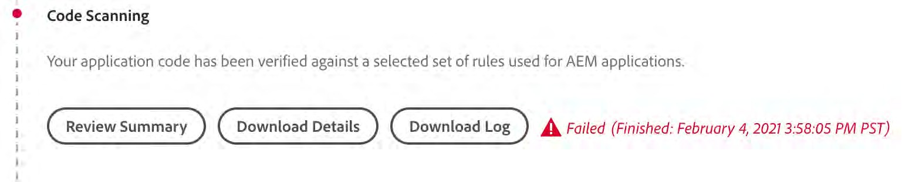
Understand the SonarQube Rules
Code is not deployed into Adobe Experience Manager as a Cloud Service if there are critical issues, thus best practices are enforced
SonarQube rules documentation:
SonarQube rules : https://rules.sonarsource.com/java
AEM custom rules : https://experienceleague.adobe.com/docs/experience-manager-cloud- manager/using/how-to-use/custom-code-quality-rules.html
Cognifide AEM rules : https://github.com/wttech/AEM-Rules-for-SonarQube

Slide 31

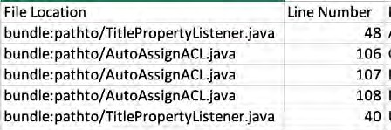

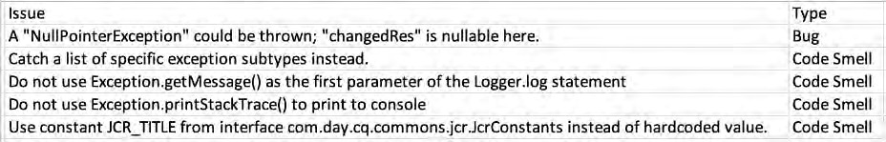

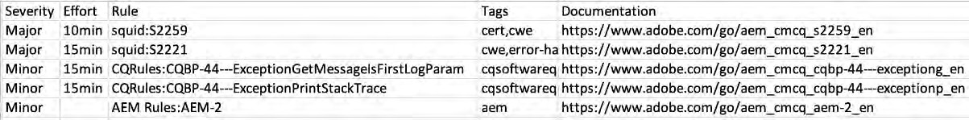
Understand Your Test Results
Exact file, line #, what to fix and how long
Full categorization (Type, Severity, Rule, Tags)
Quick documentation links

Slide 32
It’s Demo Time!
In this demo:
Create a non-production code quality pipeline
Create a non-production deployment pipeline
Understand the SonarQube rules
Review the failed code quality pipeline result
Review the non-production deployment pipeline result

Slide 33
Create and Configure Production Pipeline
Configure the Pipeline Trigger, Options, and Failure Behavior
Configure the Experience Audit
Select Git Branch

Slide 34

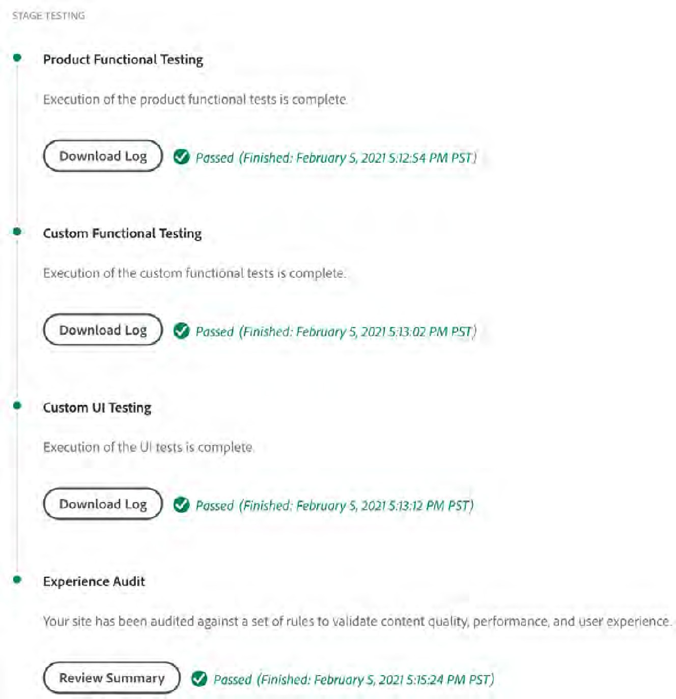
Production Pipeline
Cloud Manager executes the following tests for production pipeline:
Build & Unit Testing
Code Scanning
Product Functional Testing
Custom Functional Testing
Custom UI Testing
Experience Audit

Slide 35

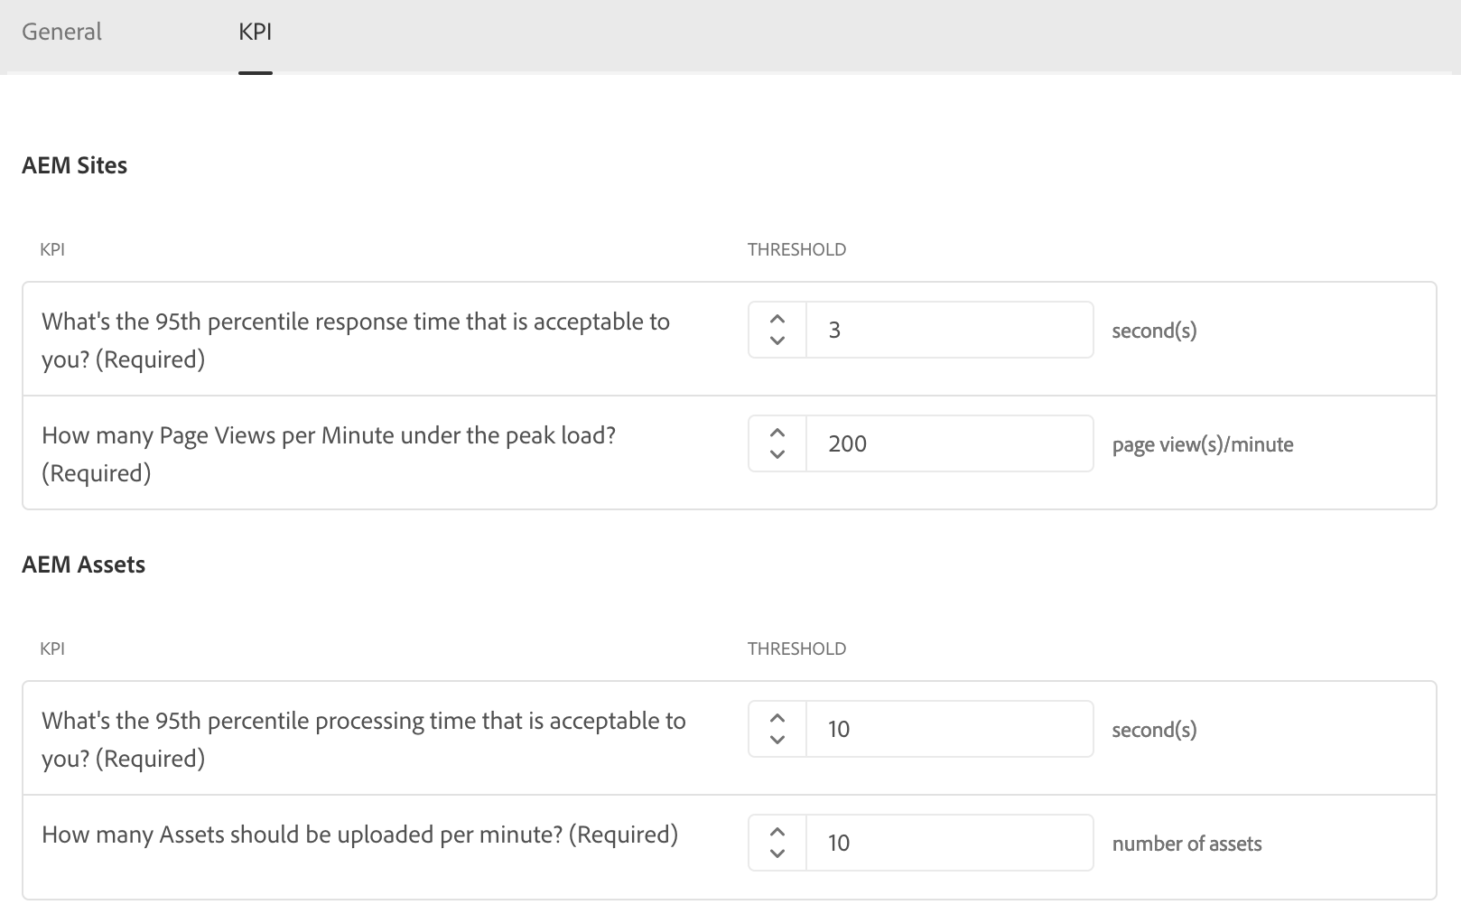
Define the Performance KPI
On the program level – for the performance tests:
Define the Sites KPI metrics
Define the Assets KPI metrics

Slide 36

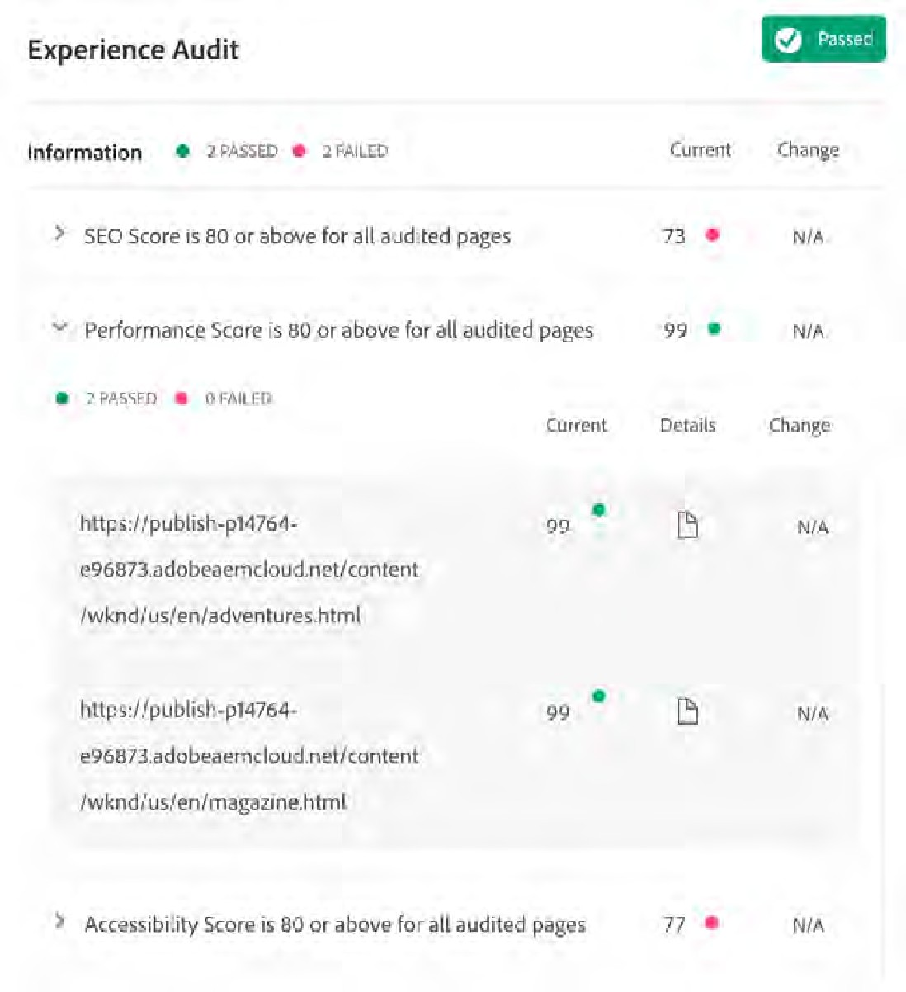

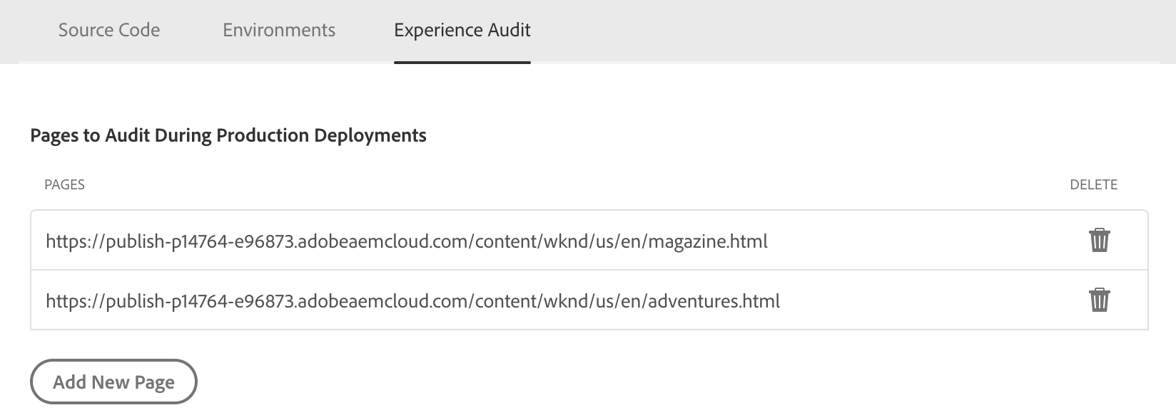
Configure the Production Pipeline Experience Audit
Define the pages to audit

Slide 37
It’s Demo Time!
In this demo:
Create a production pipeline
Review the production pipeline execution result

Slide 38


Cloud Manager API
Allows access to Cloud Manager programs, pipelines, & environments by an authorized technical account
Allows for integration of the Cloud Manager CI/CD Pipelines with other systems
Composed of two components:
Inbound HTTP-based API: Reads and manipulates the state of CI/CD pipelines
Outbound event system: Receives events when key events happen in CI/CD pipelines

Slide 39
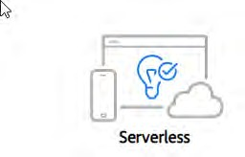
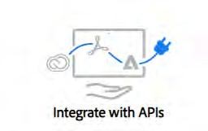
Adobe I/O
Adobe developer’s portal: Serverless platform
Integrates and extend Adobe’s cloud platform
Allows to securely access Adobe’s APIs
Allows to respond to events across the platform

Slide 40

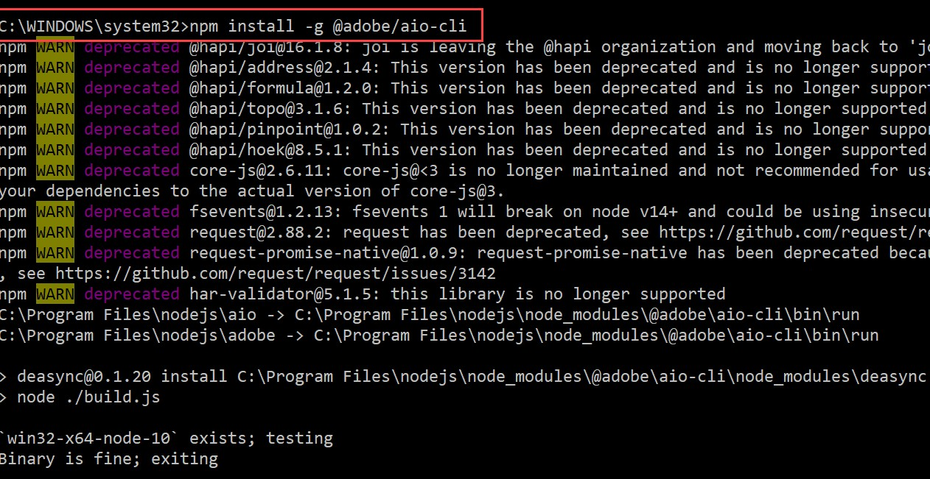
Adobe I/O CLI (aio) with Cloud Manager
Installation
$npm install -g @adobe/aio-cli
$ aio plugins:install @adobe/aio-cli-plugin-cloudmanager

Slide 41
Some Example aio-cli-plugin-cloudmanager Commands
aio cloudmanager
aio cloudmanager:list-environments aio cloudmanager:list-pipelines
aio cloudmanager:list-programs
aio cloudmanager:advance-current-execution PIPELINEID aio cloudmanager:cancel-current-execution PIPELINEID
aio cloudmanager:delete-environment ENVIRONMENTID aio cloudmanager:delete-pipeline PIPELINEID
aio cloudmanager:delete-program PROGRAMID
aio cloudmanager:get-current-execution PIPELINEID

Slide 42

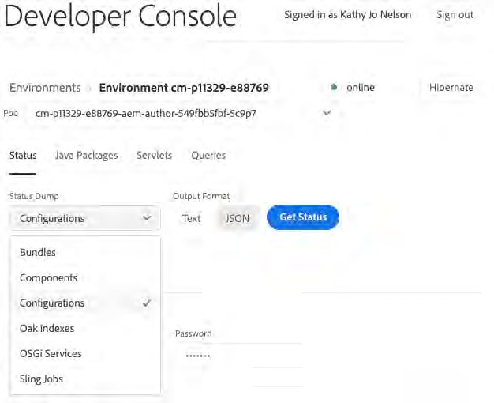

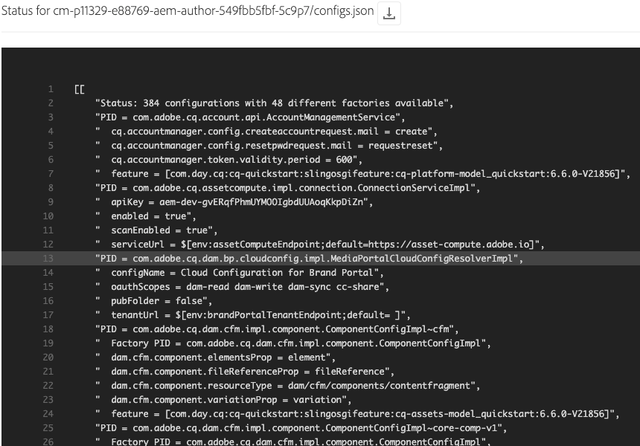
Cloud Manager Developer Console
Exposes various details of the running AEM service that are helpful in debugging

Slide 43
Summary
Introduce Cloud Manager
Prepare the Deployment with Cloud Manager
Execute the Deployment Using Cloud Manager
What is Cloud Manager?
How to manage programs, environments, and pipelines using Cloud Manager
Create AEM Project using Archetype 24
Work with non-production pipelines
Understand the Maven Project structure
Work with production pipelines
Git & Cloud Manager
Understand the pipeline execution stages and results

Slide 44





Adobe Digital Learning Services
A global network of experienced, industry-leading instructors with real-world experience
Most complete, up-to-date training through close ties with Adobe product engineering & consulting teams
Multiple training modalities that provide flexibility for you to learn with access to our hands-on environments
A proven track record of delivering success, our services are highly rated by customers*
Contact us
adlsamer@adobe.com

Slide 45




Where to Learn More
Experience League Online Documentation
AEM Project Archetype
Introduction to Cloud Manager
Implementing Applications for AEM as a Cloud Service
Adobe Digital Learning Services
DevOps for AEM as a Cloud Service 3-day, instructor-led course
Extend and Customize AEM as a Cloud Service 3-day, instructor-led course
ADLS on-demand learning subscription
Visit learning.adobe.com

Slide 46



Thank You!
© 2021 Adobe. All Rights Reserved 47 Adobe Digital Learning Services
© 2021 Adobe. All Rights Reserved

Slide 47



