Slide 1
Adobe Target Masters 2024: Technical Sales Workshop Template
January 2024

Slide 2

Agenda
[TELL/SHOW/TELL]
Desired Outcomes
1
2
3
4
Identify customer's objectives & pain points
Share your vision and qualify the customer’s interest
Present a hypothesis on how Adobe and show the demo
Align on clear next steps to progress the opportunity
Use the conversation as an opportunity to learn about, validate, and document what outcomes are most important to the customer and write down discovery questions
Educate customer by providing an introductory solution overview. This is not intended to be a product deep dive, but a high-level pitch to qualify the customer's interest
Have a position on what the customer should do (solutions, use cases, tactics) to realize their objectives.
End meeting by agreeing on tangible next steps such as a full demo, deeper discovery, technical case development, etc.

Slide 3
[CUSTOMIZE TO CLIENT]
Today’s challenges
Future of customer personalization
Scale ‘selective’ A/B testing that sources companywide insights for value creation
Define a Revenue Proposition based on impact tests have on audiences Personalized experiences to every visitor on new homepage without overwhelming users
Diverse B2B and B2C product portfolio with thousands of digital assets and products/services
Established ‘Experimentation as a Product’ business model with auto-test creation via APIs
Standardized teams, infrastructure, and implementation across CX, Analytics, and Dev New ‘Recommended Row’, pulling 70+ tiles from lower homepage content
Recommendations filter for web visitors to customize their own experience

Slide 4



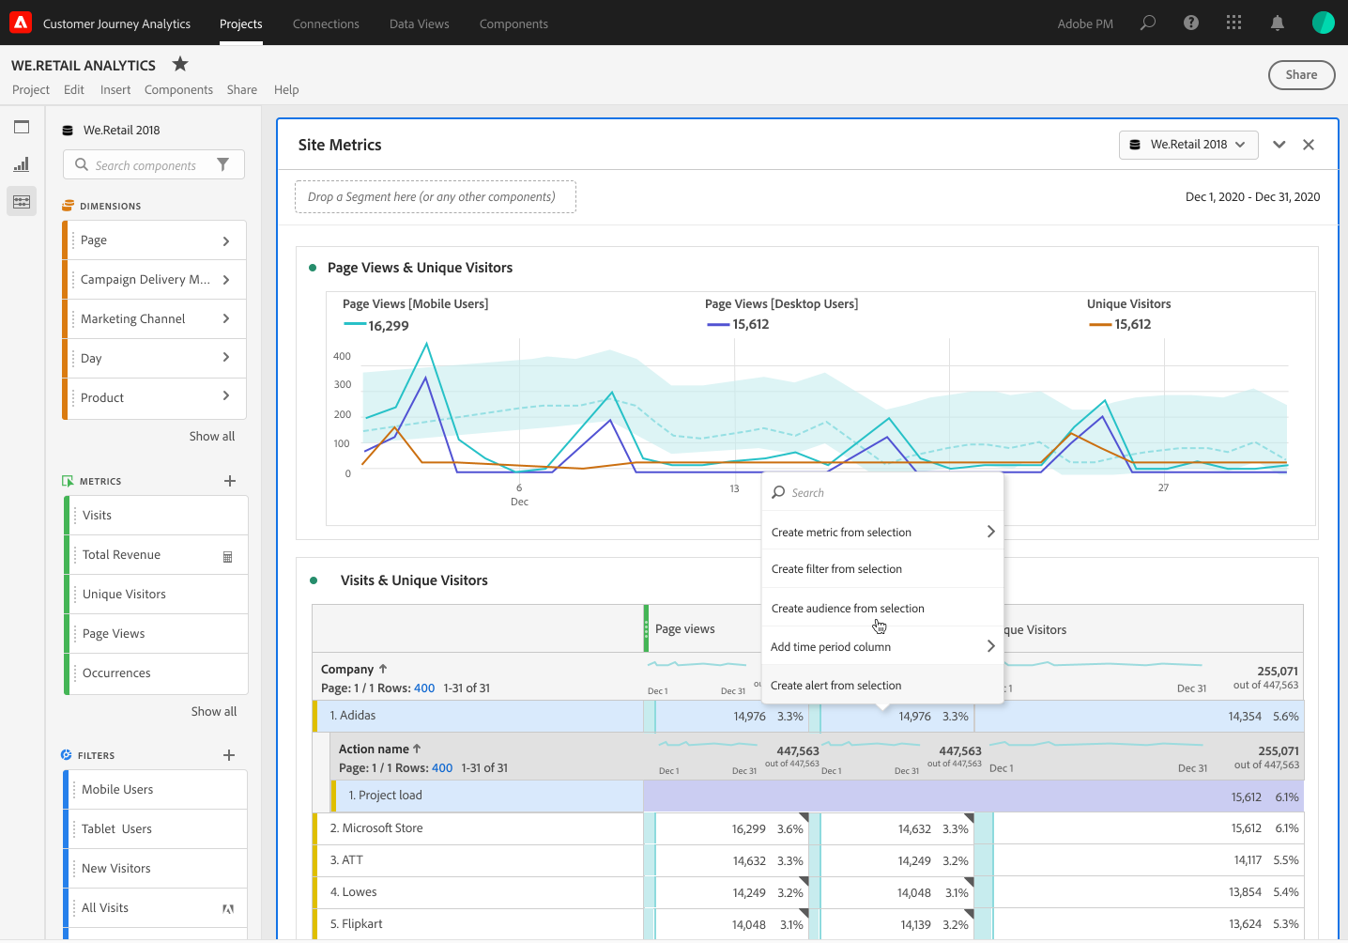


Turning insights into action with Adobe
[SOLUTION EXAMPLE]
Customer Journey Analytics
Audience Publishing
Real-Time Customer Profile
Activation & Orchestration
Governance
Identity
Advertising Ecosystem
Paid Media
People-Based Destinations
Create Audiences Based On:
Journey Paths (online to offline, digital to call center)
Events (offline purchase, support call, in-person event)
Behaviors (page view, feature use, content download, video view)
Profile Attributes (VoC, CRM, Loyalty)
Personalization
On-site Personalization
In-app Personalization
Orchestration
SMS/In-App Notifications/Push
Email
Segmentation
AI/ML
Notes:
Now Available
Create audiences based on a set of rule definitions and containers such as:
People who have taken specific actions or events (visits, conversions, abandons, support calls, purchases, returns), dimensions of those actions (Page Name, product name, support call reason, date range, geo)
Publish “one time” or “refreshing” Audiences (new capability)
Publish and refresh Audiences in minutes (new capability)
Audience Analytics & Discovery: Report on Audience sizes, Audience limits, and the ability to combine multiple Audience filters into a single Audience definition
New service for “stitched” datasets that allow audience publishing compatibility with cross-device, cross-channel datasets (new capability)
*Note that CJA cannot ingest segments from AJO or CDP, yet.
Segment = A set of rules that, when evaluated over a set of profiles in the Unified Profiles Service, produce an audience. Segments are defined and maintained within the Adobe Experience Platform.
Audience = A set or list of identities that have both a namespace and a specific ID related to that namespace. Audiences are transportable from the Adobe Experience Platform and applications that sit on top of it (such as CJA). Audiences can contain mixed namespaces.
Filter = A set of rules that, when evaluated over a set of data for a time period, produce a subset of data. A filter can be used in the process of creating an audience when coupled with other supporting services. Filters are defined and maintained in CJA.
https://experienceleague.adobe.com/docs/analytics-platform/using/cja-components/cja-filters/filters-overview.html?lang=en

Slide 5
DEMO
[SHOW THE SOLUTION]

Slide 6

Adobe Experience Platform: A Next-Generation Platform for Real-Time Analysis & Actionable Profiles
[HIGHLIGHT APPLICATIONS]
Adobe Experience Cloud
CLOUD
Content & Commerce
Data Insights & Audiences
Customer Journeys
Marketing Workflow
CATEGORIES
Adobe Experience Manager
Adobe Commerce
Adobe Analytics
Adobe Customer Journey Analytics
Adobe Real-Time CDP
Adobe Audience Manager
Adobe Target
Adobe Campaign
Adobe Journey Optimizer
Adobe Marketo
Engage
Adobe Workfront
APPLICATIONS
SERVICES
Identity
Profile
Segmentation
Ingestion
Query
AI/ML
Privacy & Governance
Destination
PLATFORM
Adobe Experience Platform
Data | Sensei | Content

Slide 7
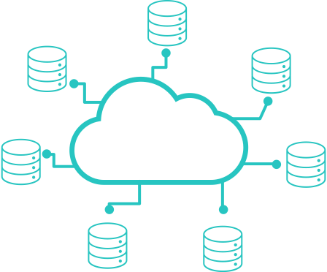
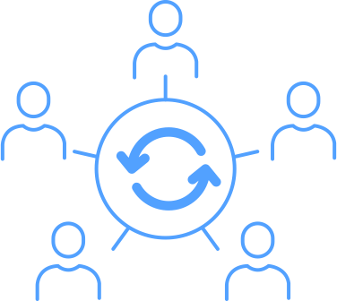
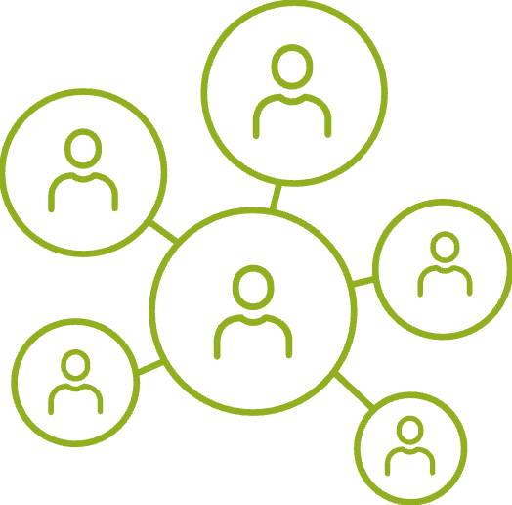


Adobe Target empowers teams to become more…
[SUMMARY/NEXT STEPS]
Confident
Collaborative
Responsible
Agile
Intelligent
Up-to-date unified customer attributes and engagements
Consolidated audience definitions eliminate data siloes
Patented data governance controls provide a toolkit for compliance
Personalize across systems fast enough to deliver timely relevant experiences
Democratized AI/ML and rich insights for quicker, smarter analysis
Notes:
Key Takeaway: With Real-Time CDP, your teams will have the right tools to improve their data management practice and drive business results.
Adobe Real-Time CDP helps your teams deliver more value to your business related to customer data management
It helps your team become more
Confident in the accuracy of your data because real-time customer profiles are kept current based on recent engagement and updated attributes
Collaborative across teams because data is consolidated in one tool and the entire marketing organization is working from the same audience definition to deliver great customer experiences
Responsible marketers because data is labeled, policies are created, and those policies are enforced with our patented governance framework to ensure compliance with organizational and regional requirements
Agile in delivering personalized experiences thanks to real-time customer profiles and real-time prebuilt integrations to deliver updated audiences to experience destinations, and on channels you might not have had access to beforehand
Smart in terms of insights and workflows because AI/ML is helping your teams save time and surfacing valuable customer insights that may have otherwise been missed and using data you didn’t have beforehand

Slide 8





Adobe Target Edge Decisioning with client-side Web SDK
Datastream Environment ID
XDM data Target profile & entity data
Customer ID (optional)
Web
Edge Network
Edge Network
Edge Services
Customer ID
IDs, cookie, authentication & Personalization requests
Identity
Geolocation
Segment Sharing / Audience Library
1
2
Consent
Device Info
Visitor Context
ECID, Consent, Geo/Device
Segment fetch
1
Target Edge
Experience Platform
Data Layer
Load Web SDK
Prehide Page BODY
4
Real-Time Customer Profile
3
Visitor Context
Data
XDM data Target profile & entity data Customer ID
Profile Scripts Execution
Target
Profile Storage
Activity & Experience Qualification
Cookies
ECID, consent cookie, cookie check, session ID
6
Query Service
Data Science
Workspace
Intelligent Services
Cookies
5
Data Lake
6
Personalized Content + Prefetched Views
Unhide Test Elements
Personalize Content
Unhide Page BODY
Hide Test Elements
Content Selection
Consent & Governance
Device
Personalization Response
Target A4T details are forwarded from Experience Edge to Analytics Edge
Prefetched Views
7
Analytics Edge
In-memory Cache
Visitor ID ECID
XDM data Target A4T Data Activity, Experience, Metric, and other Activity Metadata
Notes:
Device loads Web SDK. Web SDK sends a request to Edge Network with XDM data, Datastreams Environment ID, passed-in parameters, and Customer ID (optional). Page (or containers) is pre-hidden.
Edge Network sends the request to the Edge Services to enrich it with Visitor ID, Consent, and other visitor context info such as Geolocation and Device friendly names.
Edge Network sends the enriched Personalization request to Target Edge with Visitor ID and passed-in parameters.
Profile scripts execute and then feed into Target Profile Storage. Profile Storage fetches segments from the Audience Library (e.g., segments shared from Adobe Analytics, Audience Management, Experience Platform).
Based on URL request parameters and profile data, Target decides which activities and experiences for the visitor for the current page and future prefetched views. Target then sends this back to the Edge Network.
a. Edge Network sends Personalization Response back to the page, optionally including profile values for additional personalization. Personalized content on the current page is revealed as quickly as possible without flicker of default content. b. Personalized content for views that are shown as a result of user actions in a SPA is cached so it can be instantly applied without an additional server call when the views are triggered. c. Edge Network also sends Visitor ID and other values such as Consent, Session ID, etc. in cookies (identity, consent, cookie check, personalization, etc.)
Edge Network forwards Target A4T details (activity, experience, conversion metadata) to Analytics Edge for stitching with Personalization request and data collection

