Slide 1
Adobe Masters 2023: Technical Sales Workshop Template
March 2023

Slide 2

Agenda
[TELL/SHOW/TELL]
Desired Outcomes
1
2
3
4
Identify customer's objectives & pain points
Share your vision and qualify the customer’s interest
Present a hypothesis on how Adobe and show the demo
Align on clear next steps to progress the opportunity
Use the conversation as an opportunity to learn about, validate, and document what outcomes are most important to the customer and write down discovery questions
Educate customer by providing an introductory solution overview. This is not intended to be a product deep dive, but a high-level pitch to qualify the customer's interest
Have a position on what the customer should do (solutions, use cases, tactics) to realize their objectives.
End meeting by agreeing on tangible next steps such as a full demo, deeper discovery, technical case development, etc.

Slide 3
[CUSTOMIZE TO CLIENT]
Today’s challenges
Future of customer insights
Disconnected data with inconsistent metrics; siloed view of the customer journey
Not enough data expertise; delayed time-to-insight and action
Channel optimization to inform next best offer
Single, cross-channel view of the customer journey with consistent metrics
Analysis and insights accessible to the business user for immediate action
Journey-based insights to inform next best experience

Slide 4



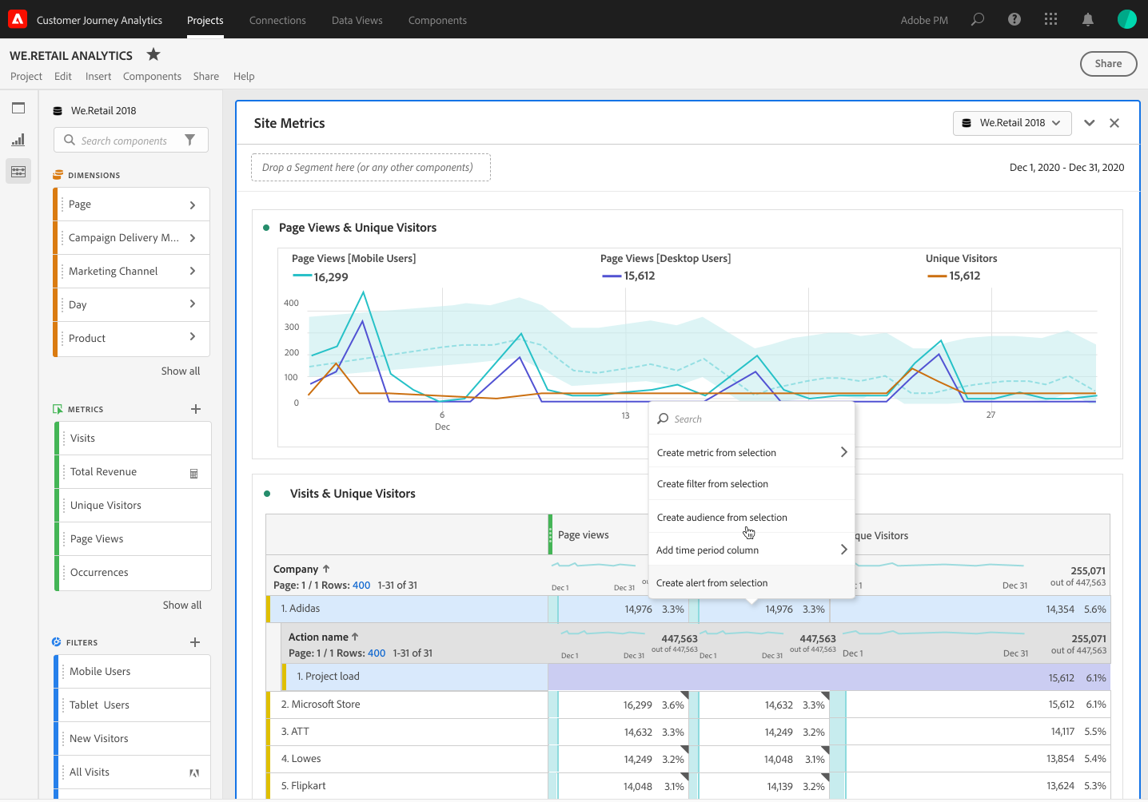


Turning insights into action with Adobe
[SOLUTION EXAMPLE]
Customer Journey Analytics
Audience Publishing
Real-Time Customer Profile
Activation & Orchestration
Governance
Identity
Advertising Ecosystem
Paid Media
People-Based Destinations
Create Audiences Based On:
Journey Paths (online to offline, digital to call center)
Events (offline purchase, support call, in-person event)
Behaviors (page view, feature use, content download, video view)
Profile Attributes (VoC, CRM, Loyalty)
Personalization
On-site Personalization
In-app Personalization
Orchestration
SMS/In-App Notifications/Push
Email
Segmentation
AI/ML
Notes:
Now Available
Create audiences based on a set of rule definitions and containers such as:
People who have taken specific actions or events (visits, conversions, abandons, support calls, purchases, returns), dimensions of those actions (Page Name, product name, support call reason, date range, geo)
Publish “one time” or “refreshing” Audiences (new capability)
Publish and refresh Audiences in minutes (new capability)
Audience Analytics & Discovery: Report on Audience sizes, Audience limits, and the ability to combine multiple Audience filters into a single Audience definition
New service for “stitched” datasets that allow audience publishing compatibility with cross-device, cross-channel datasets (new capability)
*Note that CJA cannot ingest segments from AJO or CDP, yet.
Segment = A set of rules that, when evaluated over a set of profiles in the Unified Profiles Service, produce an audience. Segments are defined and maintained within the Adobe Experience Platform.
Audience = A set or list of identities that have both a namespace and a specific ID related to that namespace. Audiences are transportable from the Adobe Experience Platform and applications that sit on top of it (such as CJA). Audiences can contain mixed namespaces.
Filter = A set of rules that, when evaluated over a set of data for a time period, produce a subset of data. A filter can be used in the process of creating an audience when coupled with other supporting services. Filters are defined and maintained in CJA.
https://experienceleague.adobe.com/docs/analytics-platform/using/cja-components/cja-filters/filters-overview.html?lang=en

Slide 5
DEMO
[SHOW THE SOLUTION]

Slide 6

Adobe Experience Platform: A Next-Generation Platform for Real-Time Analysis & Actionable Profiles
[HIGHLIGHT APPLICATIONS]
Adobe Experience Cloud
CLOUD
Content & Commerce
Data Insights & Audiences
Customer Journeys
Marketing Workflow
CATEGORIES
Adobe Experience Manager
Adobe Commerce
Adobe Analytics
Adobe Customer Journey Analytics
Adobe Real-Time CDP
Adobe Audience Manager
Adobe Target
Adobe Campaign
Adobe Journey Optimizer
Adobe Marketo
Engage
Adobe Workfront
APPLICATIONS
SERVICES
Identity
Profile
Segmentation
Ingestion
Query
AI/ML
Privacy & Governance
Destination
PLATFORM
Adobe Experience Platform
Data | Sensei | Content

Slide 7

[SUMMARY/VALUE/NEXT STEPS]
The business value of Customer Journey Analytics
Discovering
Researching
Dealer Experience
Researching
Purchasing
Selling
Key touchpoints:
In-person purchase
Personalized emails to drive satisfaction and upsell
Email nurture campaigns
In-person experiences – dealer, etc.
Browsing for car buying sites
Paid advertising
Researching on a website
Identity exchange
Additional browsing and buying research
Customer survey to understand intent and CSAT
Authentication
New experience for selling
Mobile app adoption
Mobile app tools for additional research – building, pricing, financing
Customer Journey Analytics stitches data from digital analytics to CRM and other disparate data sources giving context to marketing channel effectiveness and optimization.
Customer Journey Analytics unifies behavioral data and VoC data to help you understand what digital behaviors lead to conversion or poor CSAT.
Customer Journey Analytics stitches together time-series data from devices and channels to help you discover new audience segments for improved personalization.
Customer Journey Analytics delivers journey-based insights across devices (mobile app) and channels (email) to identify experience gaps and inform the next best experience.
Customer Journey Analytics stitches together offline purchase and channel data from digital analytics to understand the full journey helping you understand LTV.
Customer Journey Analytics can address questions spanning the entire customer lifecycle without reliance on BI expertise helping you reduce costs and dependence on centralized BI teams.

