Slide 1


Email spam filtering
Presentations
Week 6
Session 5
Artjoms Dobiss (sharing GitHub repository with Charalampos Spanias)

Slide 2
Objective
Create a spam filter that is good from the cybersecurity perspective
As the result FN have much bigger effect than FP

Slide 3
Dataset
5,693 labelled emails
Unbalanced dataset (positive class is minority – 1/3)
Raw text – feature extraction required

Slide 4
Why XGBoost?
Weighted loss function (easy to assign more weight to positive class)
Feature scaling not required for tree-based algorithms
Collinearity is not an issue
Good for sparse datasets
L1 regularisation can be easily implemented as boosted algorithms are sensitive to outliers (i.e. prediction is far from actual class)
Fast (but slower than LightGBM)

Slide 5
Dataset & feature extraction
CountVectorizer bag of words was used to create a sparse matrix
Each datapoint (email) ended up having the same feature vector length as the result which is good for tree-based algorithms
Word ‘Subject’ was removed, punctuation was removed, accented characters were kept
37k features
Top 500 features selected based on occurrence frequency
Notes:
Because of how ‘flexible’ the algorithm is feature engineering can be simplified and still produce good results

Slide 6
Hyperparameters
N_estimators: 50
Max depth: 8 (industry default)
Learning rate: 0.3
Positive class weight: 3 (inverse of the class distribution)
L1 & L2 regularisation: 5
KFolds: 10
Notes:
Hyperparameters were selected mostly through trial and error using industry standards as starting point

Slide 7
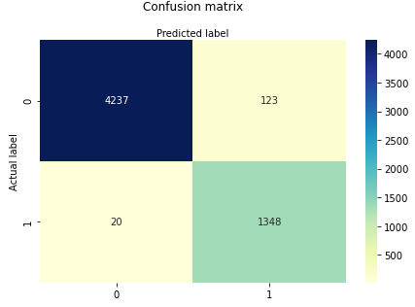
Model evaluation
Mean accuracy score (training): 0.99
Mean accuracy score (testing): 0.98
Mean precision score (training): 0.96
Mean precision score (testing): 0.92
Mean recall score (training): 1.00
Mean recall score (testing): 0.99
Mean ROC AUC score (training): 1.00
Mean ROC AUC score (testing): 1.00
False Positive Rate (testing): 0.03
False Negative Rate (testing): 0.01
Specificity (testing): 0.96
Sensitivity (testing): 0.99
Precision (testing): 0.92
Notes:
Low bias/ low variance

Slide 8
Conclusion
The model is good at catching spam (99% will end up in spam folder)
but a little too cautious as 3-4% of legitimate emails will also end up in spam folder
Notes:
Objective reached

Slide 9
Future improvements
Feature selection/ reduction can potentially be significantly improved as feature correlation is high judging by a feature correlation map (not included in the presentation)
Hyperparameter tuning can be automated to yield better results (e.g. GridSearchCV)

Slide 10
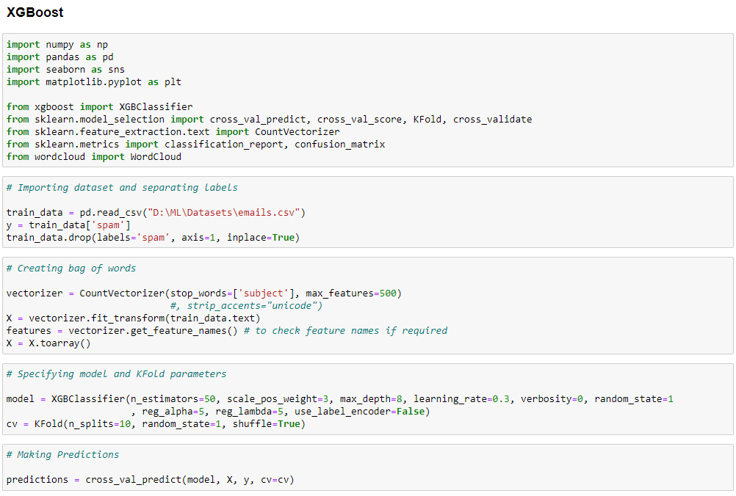
Script

Slide 11
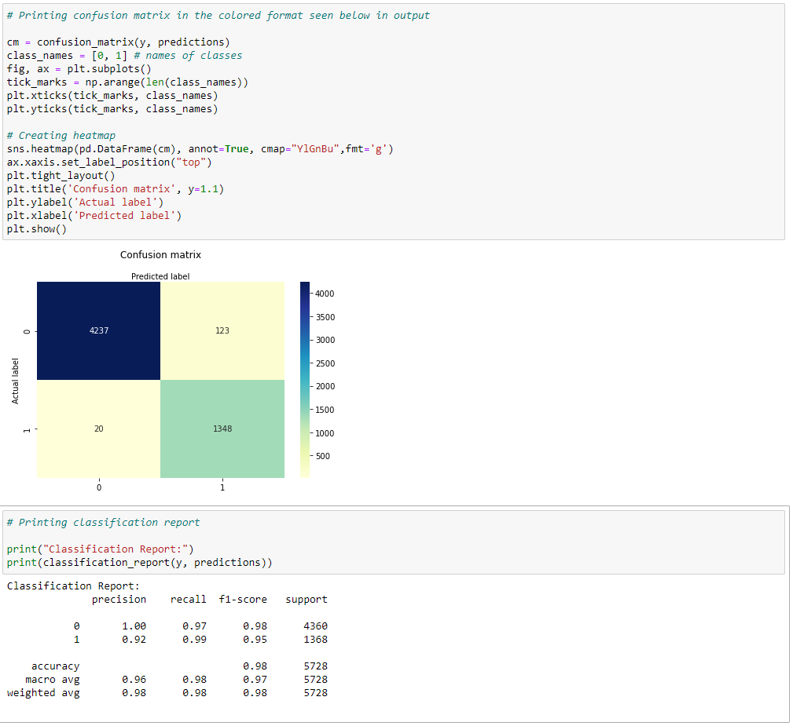
Script

Slide 12
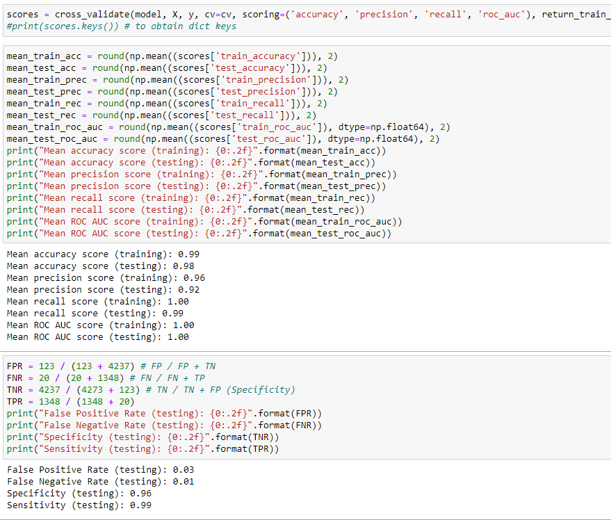
Script

Slide 13
Thank you!

