Slide 1



Azure Pipelines using Templates

Slide 2

Agenda
What are YAML templates
Why use YAML template
Using Variable, Step, Job and Stage templates
Passing parameters to a Template
Demo “realworld use”
Q&A

Slide 3

What are YAML templates?
Allow us to define reusable content
Allow us to define reusable parameters
We can in fact include templates within templates
Great way of sharing common logic in a centralized way with minimal duplication
Stage templates to define a set of stages of related jobs
Job templates to define a collection of steps run by an agent
Step templates to define a linear sequence of operations for a job
Variable templates as an alternative to hard-coded values or variable groups
azure pipelines currently support up to 100 template files for each pipeline and no more than 20 level of nesting

Slide 4
Why use YAML template?
Provide boundaries within the pipeline such as alignment to architecture, security or development practices
Higher consistency
Pipeline changes become very easy to implement
Simpler pipeline definitions focusing only on the application specific tasks and operations.
Shorten the development period for pipelines.
We can define reusable code in different templates

Slide 5
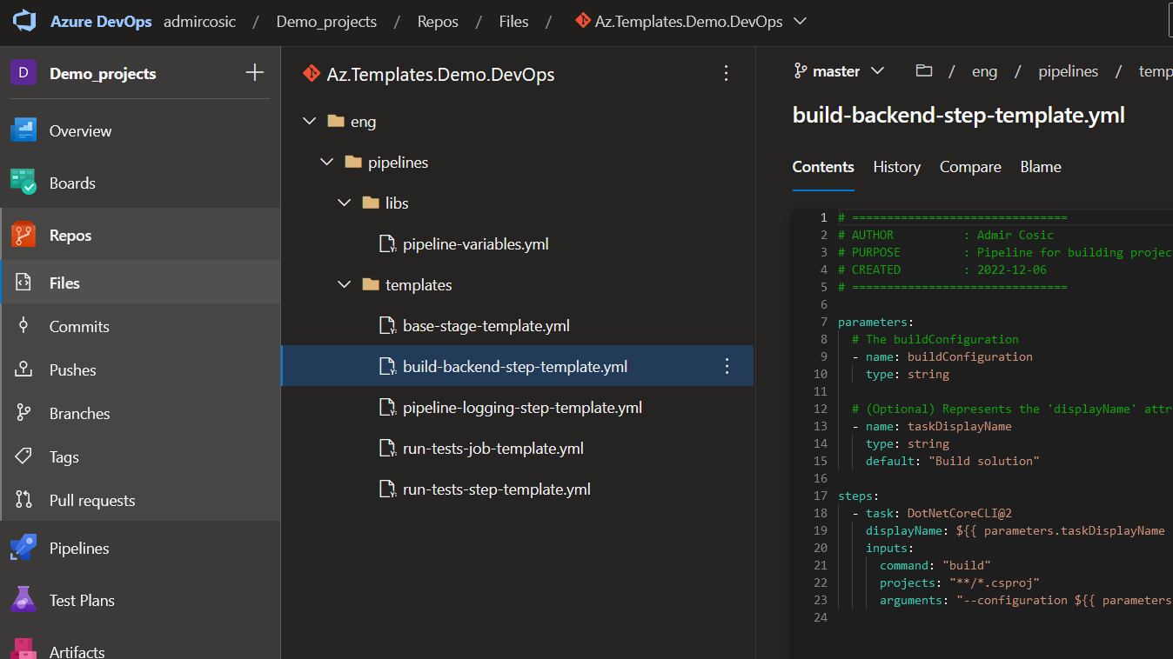
Using Variable, Step, Job and Stage templates

Slide 6
Passing parameters to a Template
We can specify parameters both in templates and in the pipeline
Parameters have data types such as number, object and string
Parameters can be restricted to a subset of values
The parameters section in a YAML file defines what parameters are available
Parameters are only available at template parsing time
We can also use parameters as part of conditional logic if/else

Slide 7

Demo

Slide 8

Questions?

Slide 9
Links
Github repo containing examples used during the “Usage of Variable, Step, Job and Stage templates” slide. https://github.com/adodado/azure_pipeline_templates_knowledge_sharing_session
Azure devops pipeline cheat sheet https://nickkell.medium.com/azure-devops-pipeline-cheatsheet-b7401f8eb2e7
Official MS Azure pipeline documentation https://learn.microsoft.com/en-us/azure/devops/pipelines/?view=azure-devops
Official MS Azure pipelines Yaml schema reference https://learn.microsoft.com/en-us/azure/devops/pipelines/yaml-schema/?view=azure-pipelines&tabs=schema&viewFallbackFrom=azure-devops

