Slide 1
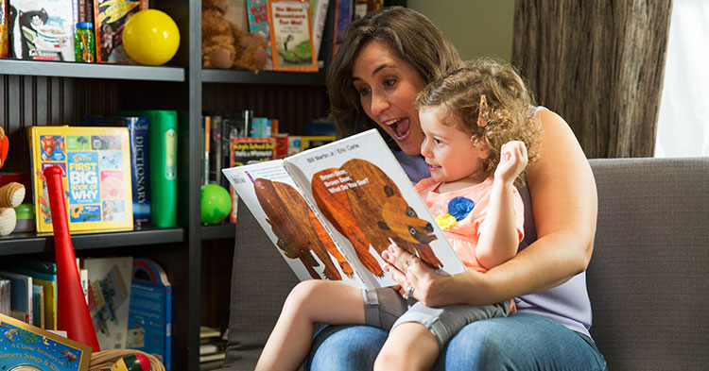
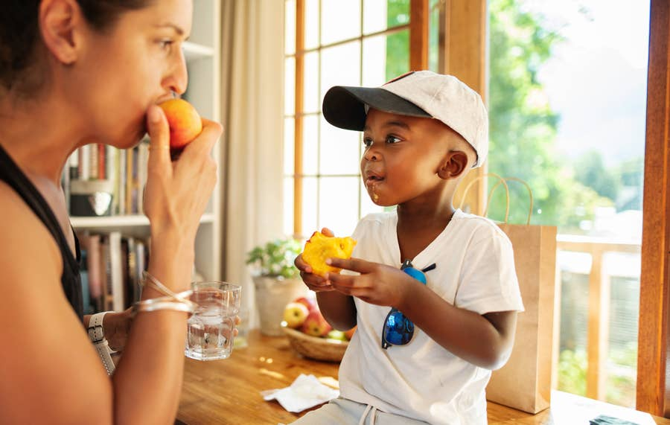
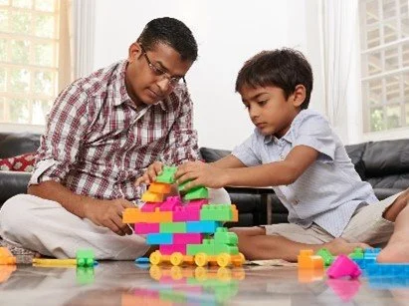
Question-Elicited Speech Across Naturalistic Language Learning Environments
Adaora Mbanefo, Dr. Anastasia Stoops, Dr. Jessica Montag
Learning and Language Lab | Undergraduate Research Symposium
Notes:
Good afternoon everyone, and thank you for being here. My name is Adaora Mbanefo, and I work in the Learning and Language Lab. Today I'll be talking about how caregiver questions shape the speech that young children produce, specifically across different naturalistic language learning environments like free play, snack time, and picture book reading.

Slide 2
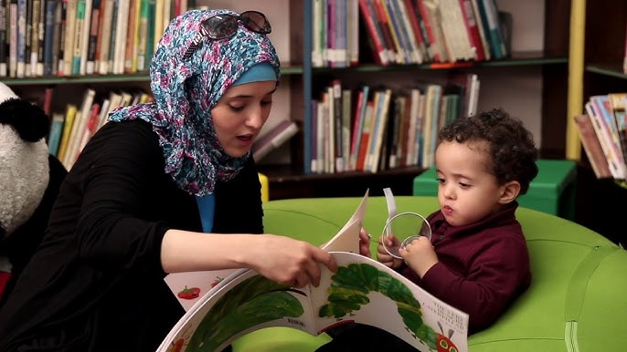

Why Questions Matter
✂ ADD PHOTO: Caregiver reading to child, pointing at book, asking questions
✂ ADD PHOTO: Natural/active reading (child engaged, relaxed)
Do questions actually elicit more complex child speech?
→
Dialogic reading interventions (Whitehurst et al., 1988; Rowe et al., 2016)
Active reading may be equally effective (Noble et al., 2020)
Minimal evidence that questions in fact elicit more complex child speech. This is our motivation.
Notes:
So, why do we care about caregiver questions? For decades, researchers have argued that questions are a key mechanism for getting children to talk. This idea has shaped real interventions. Many programs, like dialogic reading, actively train parents to ask questions while reading picture books with their children. But here's the thing: there is minimal evidence that these questions reliably produce more complex child speech. In fact, recent work by Noble and colleagues in 2020 suggests that simply engaging with books in a natural, active way may be just as effective as formal question-asking strategies. So that raises an important question for us: what is it about these interactions that drives child language production?

Slide 3
What We Already Know
Prior Finding (Stoops et al., 2024)
The Shift
10 hrs child-caregiver speech (Bates, 1988)
20 hrs home recordings (StoopsMontag, 2024)
If not the quantity of turns...
Turn-taking counts:
↓
✗ Not the most turns!
What about the QUALITY of the questions?
Free Play
Snack
Book
Not all turns are created equal!
The type of question may matter more than the number of exchanges
Notes:
Our lab has been studying this. In prior work, we looked at turn-taking across different activities. Using the Bates 1988 lab corpus, which includes free play and snack time, and the StoopsMontag 2024 home corpus, which includes 20 hours of book reading, we found that turn-taking counts during book reading were not higher than in other activities. This was surprising, because a lot of people assume that books generate the most back-and-forth conversation. So that shifted our thinking. If it's not the sheer quantity of turns, maybe it's the quality of the exchanges that matters. And that's where this study comes in. We wanted to move beyond counting turns and look at what kinds of questions caregivers are asking, and whether certain question types, specifically wh-questions, pull longer, more complex responses from children.

Slide 4

Research Question
Do wh-questions elicit more complex child speech?
?
"What's that?" "Where did it go?" "Why is she sad?"
Across free play, snack, and book reading
In both lab and home settings
Notes:
So our central research question is: do wh-questions, things like "what's that?", "where did it go?", "why is she sad?", elicit more complex speech from children compared to other question types? And we wanted to test this across different naturalistic contexts, not just book reading. It makes sense that open-ended questions are what allow children to produce more complex speech, and those are precisely what wh-questions are.
Note: Opened ended discussion: The more precise framing is that wh-questions are content-demanding — they require the child to retrieve and produce a specific piece of information, whereas yes/no questions can be answered with a nod, "yeah," or "uh huh" without generating any new content. Tag and interjection questions are similar — they don't demand the child contribute anything substantive.

Slide 5
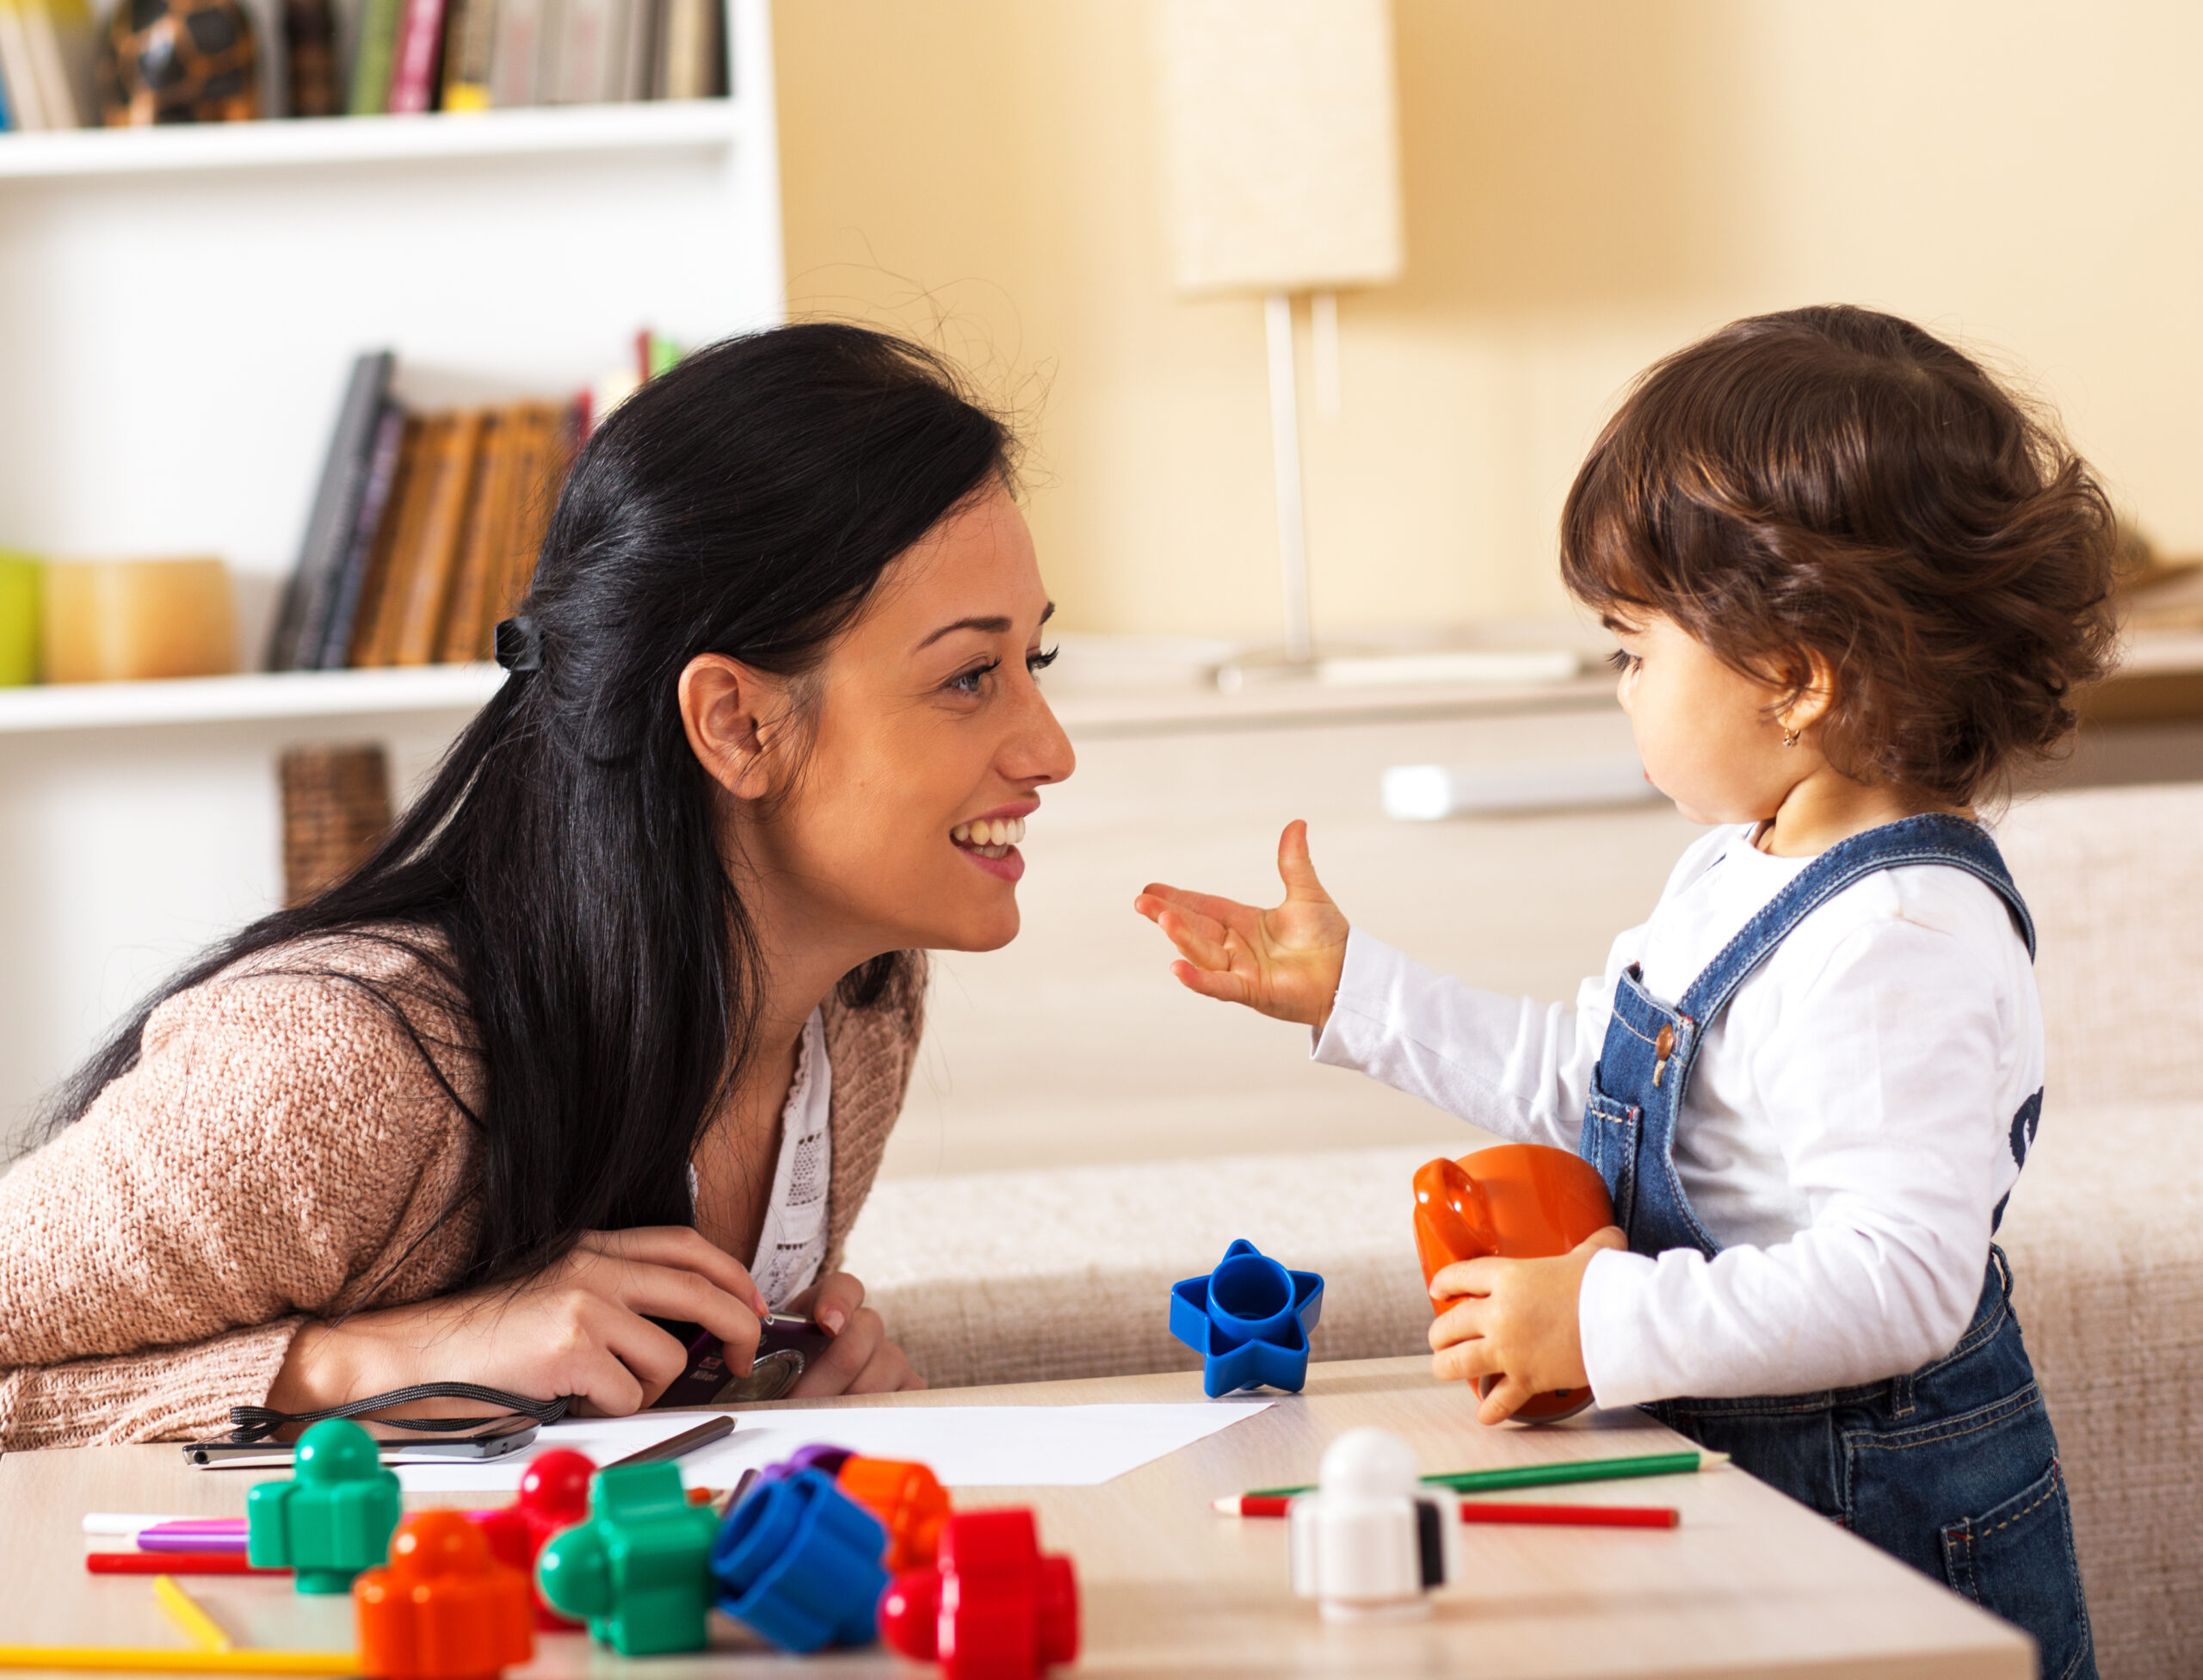

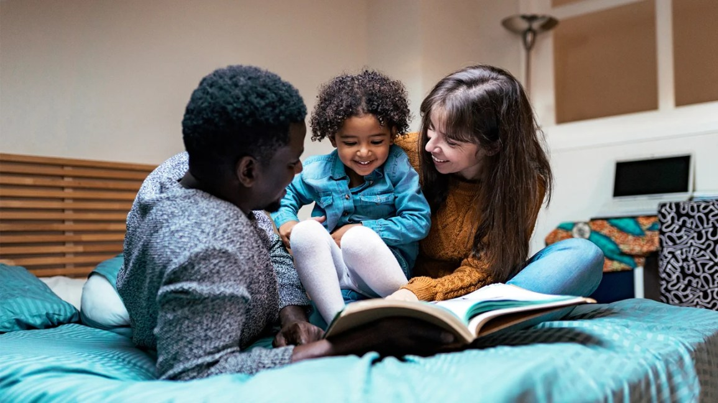
Corpus & Method
12
3
1,832
Also compared to:
Caregiver-Toddler Dyads
Activity Contexts
Total Questions
StoopsMontag Corpus on CHILDES (2024) 20 hrs home-based recordings 12 families age 24–36 mo
Bates (1988) Lab Corpus • CHILDES Repository • Children aged 28 months
✂ ADD PHOTO: Book Reading (caregiver + child + book)
Free Play
Snack
Book Reading
Notes:
To answer this, we used the Bates 1988 corpus, which is available through the CHILDES repository. This corpus includes 28 children but we selected a 12 caregiver-toddler dyads filtered for gender and age. The children were all 28 months old, and they were recorded in a lab setting across three different activities: free play with toys, snack time, and picture book reading. Across these sessions, we identified 1,832 total questions. We also compared these patterns to our home-based corpus from Stoops et al. to see if the lab findings generalise to naturalistic settings.

Slide 6
Question Types
We coded every question by type:
Type | Code | Example | Expected Response
WH | 1 | "What's that?" "Where did it go?" | Open-ended → longer response
Yes/No | 2 | "Do you want more?" "Is that a dog?" | Closed → yes/no
Choice | 3 | "Do you want milk or juice?" | Select one option
Tag | 4 | "That's a big one, isn't it?" | Confirmation
Interjection | 5 | "Hm?" "Huh?" | Brief acknowledgment
Focus on WH questions: the only open-ended type that demands a substantive response. The others can be answered with a simple yes, no, or "uh huh."
Notes:
We coded every question by type. WH questions are things like "what's that?" or "where did it go?". They're open-ended and demand a substantive response. Yes/No questions like "do you want more?" can be answered with just a yes or no. Choice, Tag, and Interjection questions are even more constrained. For the sake of time, I'll focus on WH questions because they're the only type that truly requires an open-ended response from the child. All the other types, yes/no, choice, tag, interjection, can be answered with a single word or even just "uh huh." WH questions are the ones that push children to produce language.

Slide 7
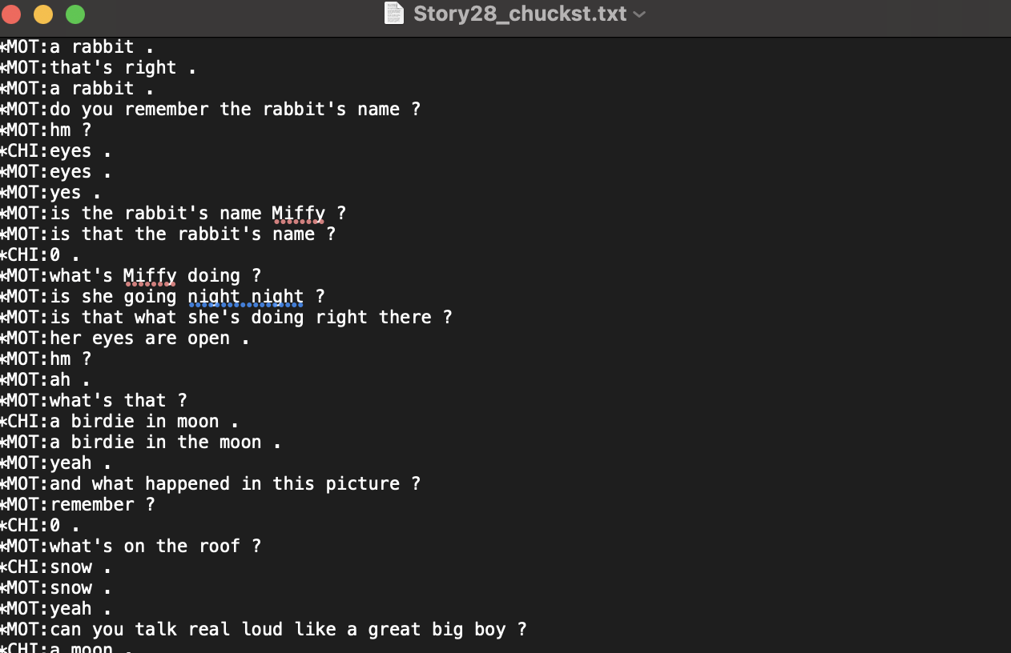
What the Data Look Like
MOT = Mother (caregiver)
CHI = Child
WH: "what's that?" "what's on the roof?"
Y/N: "do you remember the rabbit's name?"
Each question-answer pair extracted and coded
Bates (1988) corpus — CHILDES format
Notes:
Before I get into results, I want to show you what this data actually looks like. This is a transcript from one of the book reading sessions in the Bates corpus. You can see the mother, labelled MOT, asking questions like "what's that?" and "do you remember the rabbit's name?" And then the child, CHI, responding with short answers like "eyes" or "snow." This is the raw material we're working with. Each question-answer pair is extracted and coded.

Slide 8
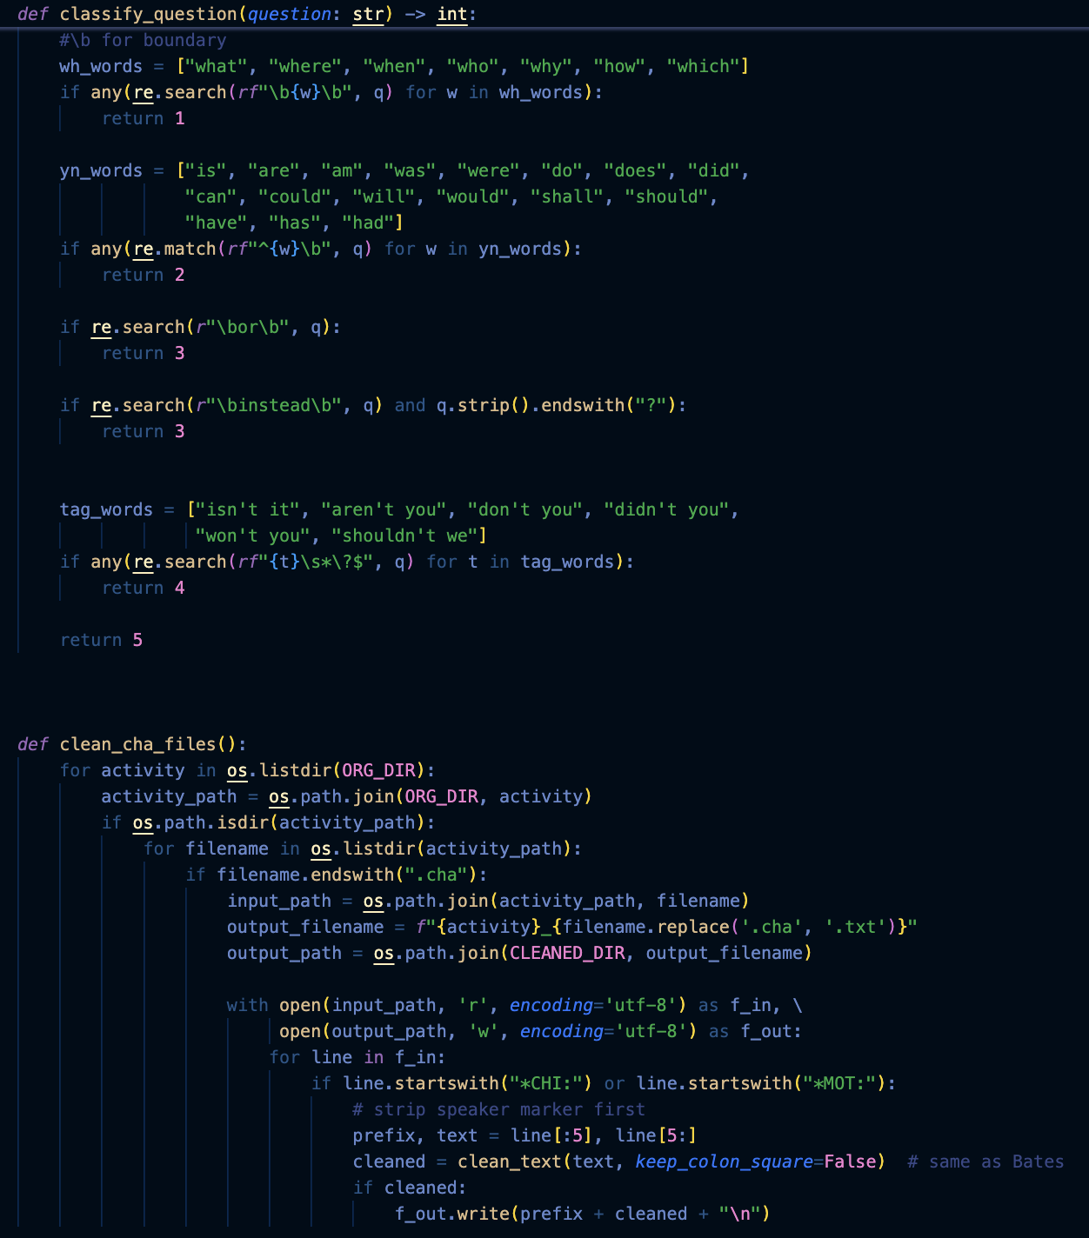
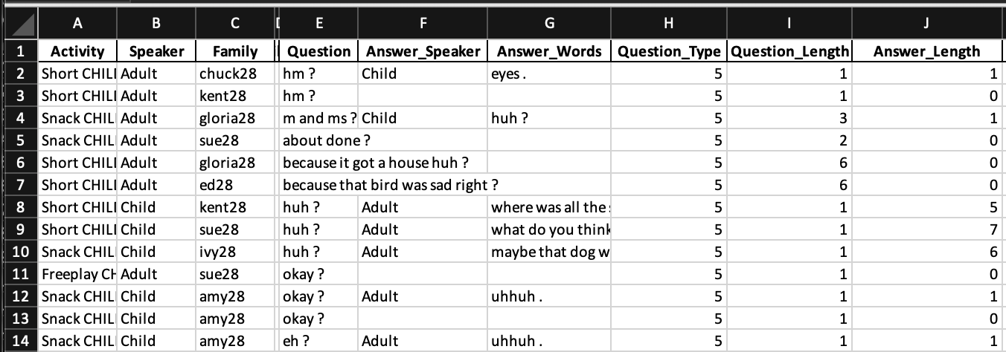
Our Pipeline
Raw CHILDES Transcripts (.cha files)
Python Cleaning Script
Coded CSV (questions, types, answer lengths)
Analysis & Visualisation (Python)
→
→
→
Notes:
Here's our analysis pipeline. We start with raw CHILDES transcripts in .cha format. We wrote Python scripts to clean the data, extract every question-answer pair, code each question by type, and compute response lengths. The output is a structured CSV that we then use for analysis and visualisation. This code is reusable and could be applied to other corpora.

Slide 9
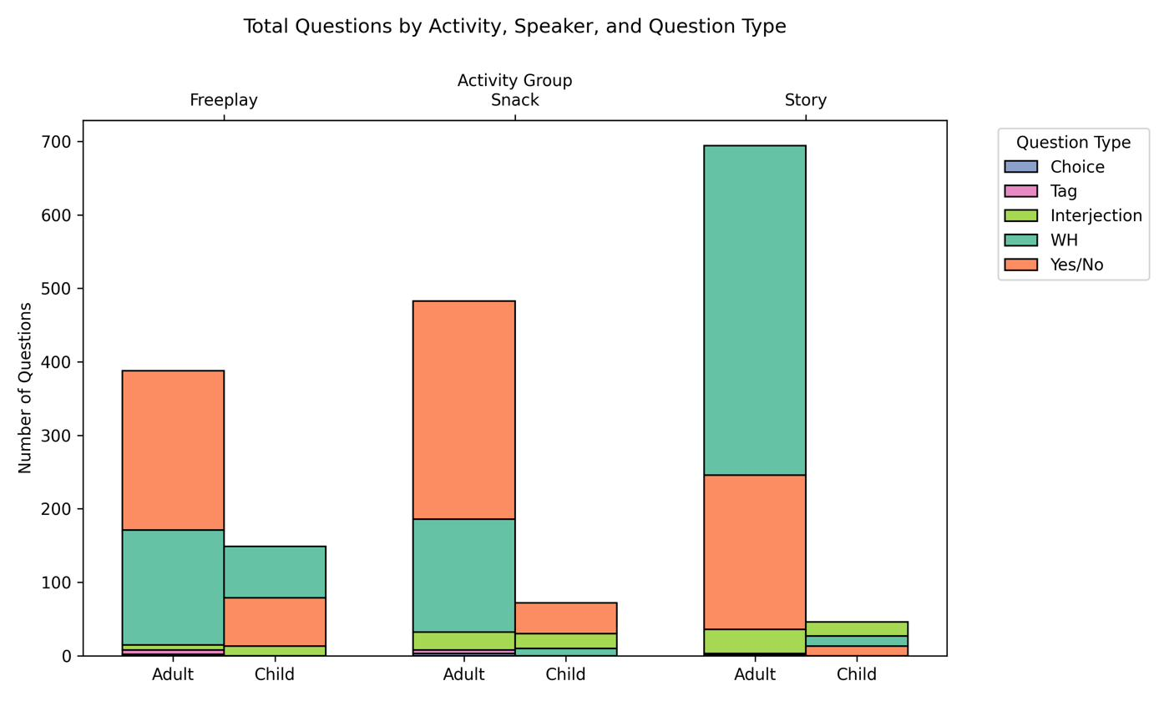
Book Reading Drives WH Questions
448
of 758 total wh-questions were in book reading
= 59%
Note: Children ask more Qs in free play, but our question is about their responses.
Notes:
Now, the first thing we looked at was the distribution of question types across activities. And this graph tells a really clear story. Look at the Story column on the right. You can see that massive teal bar, that's wh-questions. In book reading, caregivers produced 448 wh-questions out of 758 total across all activities. That's 59 percent. Compare that to free play and snack, where yes/no questions, the orange bars, dominate. So book reading isn't just generating more questions overall. It's generating a fundamentally different type of question. Despite the fact that conversational turns are not the highest during book reading, the book is a really great source for specifically open-ended questions. In terms of children asking questions, they ask more during free play, which makes sense. Two-year-olds are curious and talk more freely there. Parents also adjust their speech based on context, which is what the smart adult does. During snack, you see more yes/no questions like "you want this?" which makes sense. But in terms of book reading, books are the most conducive to open-ended questions. But remember, our research question is not about how many questions children ask, but about what happens when they respond to caregiver questions. So now let's look at that.

Slide 10
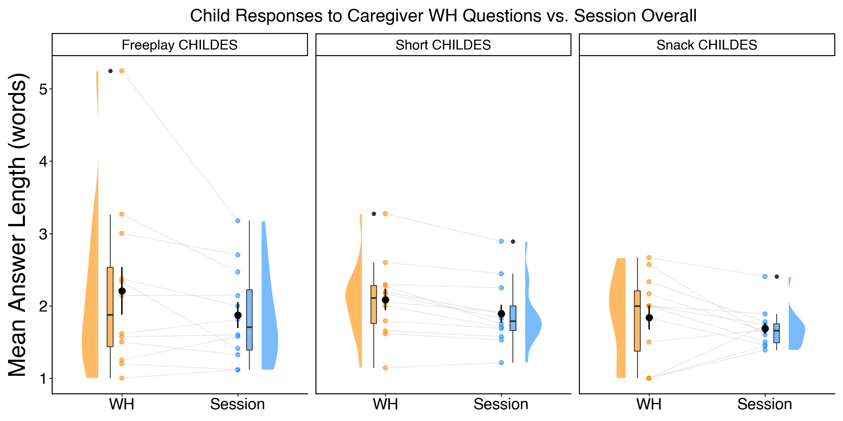
WH Responses Across Activities
🟠 Orange = Child MLU in response to WH questions 🔵 Blue = Child MLU for that session overall
Notes:
Now let's look at children's speech. On the Y axis, I'm plotting mean answer length in words. On the X axis, we have children's responses to caregiver WH questions in orange, and their overall session MLU in blue. The key thing to notice: in each activity, free play, book reading, and snack, the orange WH responses tend to sit higher than the blue overall. The WH questions consistently pull longer responses from children. If you look at the box plots, you can see the quartiles, and that center line shows the median. The black dots show the mean with standard error bars. In general, the WH response distributions are shifted upward compared to overall responses. This pattern is remarkably consistent across all three contexts.

Slide 11
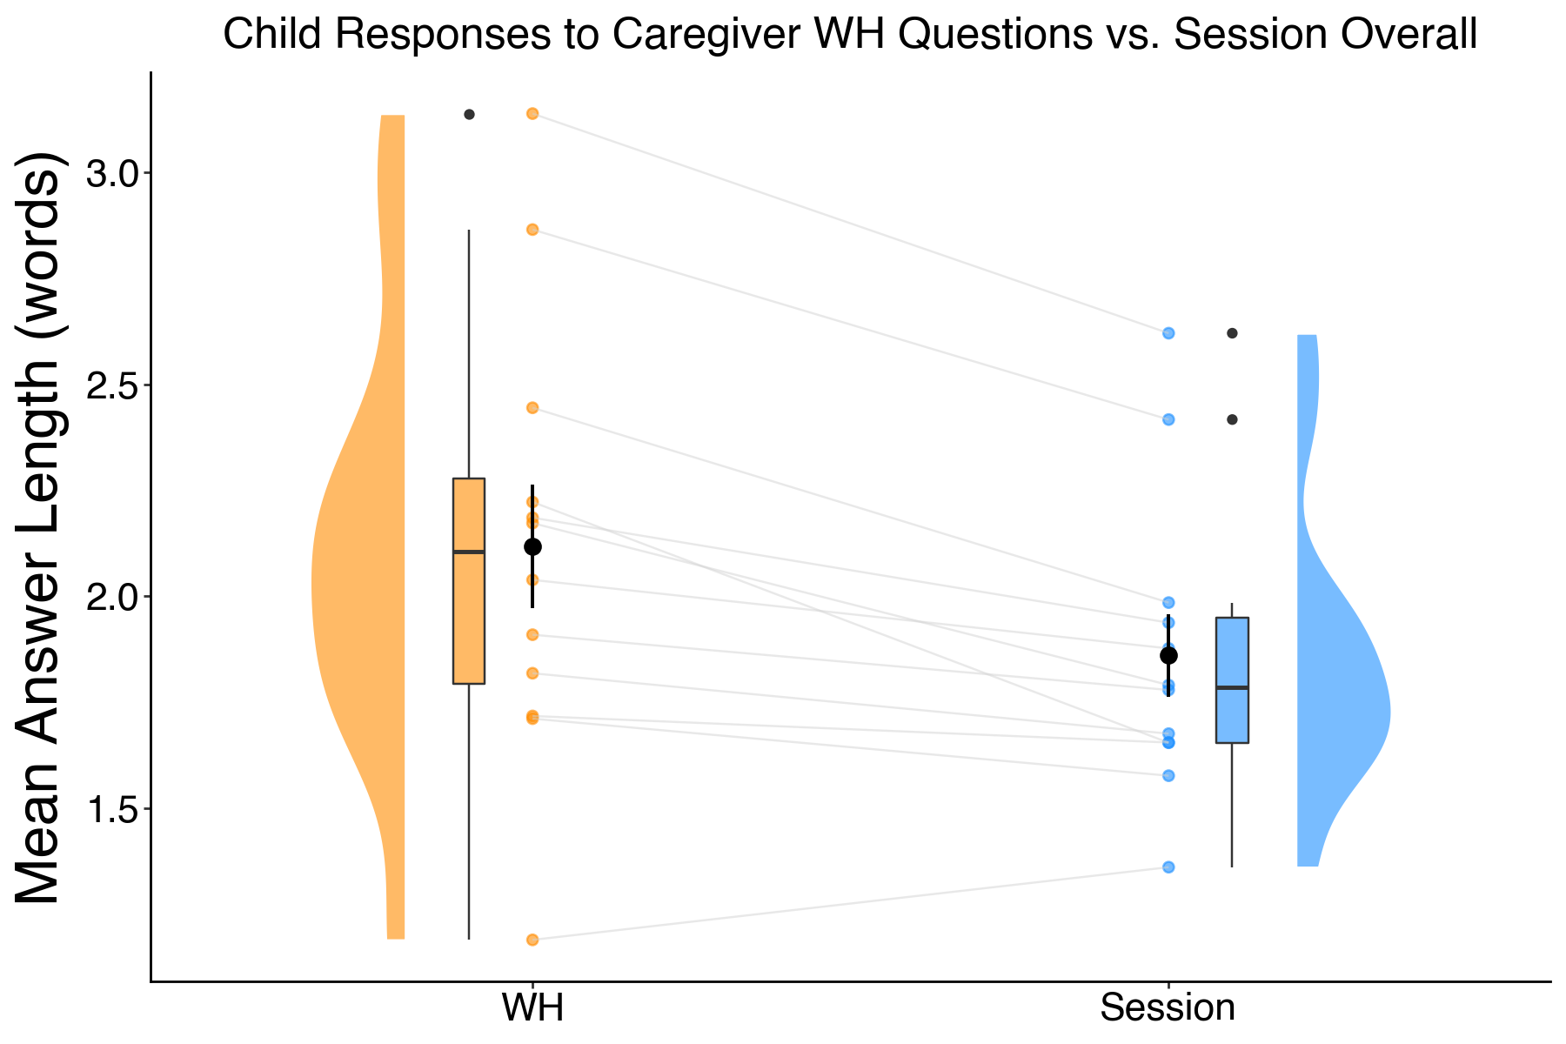
Overall: WH Questions Elicit Longer Responses
M = 2.15
words per response to wh-questions
vs.
M = 1.87
words per response overall session average
For 28-month-olds, going from ~2 words to 2+ words represents a meaningful increase in utterance complexity.
Notes:
This is the key finding collapsed across all activities. On the left, in orange, you're looking at children's response length specifically to caregiver wh-questions. On the right, in blue, is their overall response length across all interactions in the session. Each grey line connects the same child across the two conditions. Children produced an average of 2.15 words per response to wh-questions, compared to 1.87 words overall. Now, that difference might sound small, but for 28-month-olds, going from roughly two words to just over two words represents a meaningful increase in complexity. These kids are in the early stages of combining words, so every additional word reflects a more complex utterance structure.

Slide 12
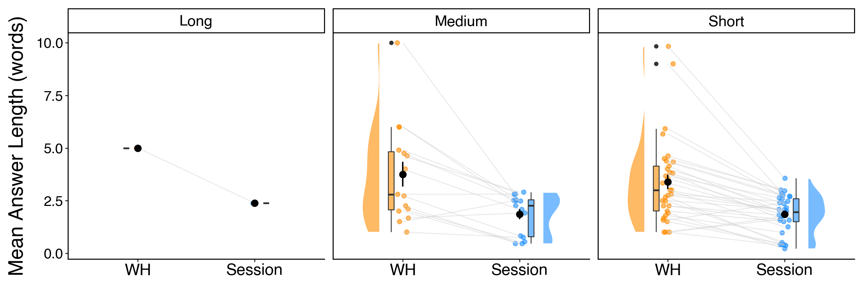
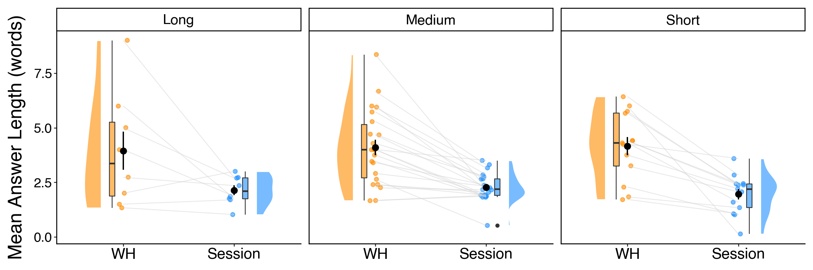
The same can be seen in StoopsMontag:
Child Responses to Caregiver WH Questions vs Session Overall
Short = < 500 words; Medium = 500-1000 words; Long = >1000 words
OWNED
M = 3.53
M = 1.87
vs.
NEW
M = 4.09
M = 2.15
words per response to wh-questions
words per response overall session average
Notes:
We also wanted to see whether these lab-based patterns hold up in more naturalistic settings. Here we show the same analysis using the StoopsMontag home corpus, where 12 families were recorded reading picture books at home with children aged 24 to 36 months. On the left you see new books. Children responded to caregiver WH questions with an average of 4.09 words, compared to a session overall of 2.15 words. On the right, for owned or familiar books, children produced 3.53 words in response to WH questions versus 1.87 overall. The effect is even stronger at home. Children at home are more comfortable and produce longer utterances in general, but when they respond to WH questions, the responses are nearly double their session average. This is true for both new and familiar books, and across short, medium, and long books. This convergent evidence across lab and home gives us confidence that wh-questions are genuinely driving more complex child speech, not just in controlled settings but in the everyday reading interactions that families naturally have.
Parents at that age don't like reading long books to their child.

Slide 13
What This Means
WH Questions → Longer Speech
Books = Most WH Questions
Consistent Across Settings
✓
59%
Lab ✓ Home ✓
M = 2.15 vs. 1.87
No special training needed
Bates + Stoops et al.
Takeaway for parents:
Just pick up a book and engage with your child. The questions come naturally, and those questions help your child produce richer, more complex language.
Notes:
So what does this all mean? First, this is the first concrete evidence that wh-questions are a particularly effective mechanism for eliciting child speech. It seemed obvious, but nobody had actually counted it systematically, so we did. Children produce longer, more complex responses when asked "what," "where," "why" questions compared to yes/no or other types. Second, book reading naturally generates the most wh-questions. 59 percent of all caregiver wh-questions in our data came from the book reading sessions. And this happens without any special training. Parents don't need to learn dialogic reading techniques. The act of reading a picture book together naturally prompts these kinds of questions. Third, this pattern is consistent. It holds across free play, snack, and book reading in the lab, and it aligns with what we see in home-based recordings. The effect is even stronger at home, which makes sense because children are more comfortable in their own environment. Now, stepping back, it's worth noting that WH questions are just one of many ways that book reading differs from other conversational contexts. We already know that books expose children to more unique and rare words, longer caregiver utterances, and more complex syntax than typical child-directed speech. For a long time, people assumed that the reason we tell parents to read to kids is because the questions during reading elicit child speech. But our data suggests something richer than that. Book reading is a uniquely rich linguistic environment across multiple dimensions, and WH questions are one measurable marker of that richness. They may be one of several mechanisms through which books naturally create better language learning opportunities. Think of different environments as different vitamins that support different aspects of development. Each activity, whether it's free play, snack, or book reading, develops different language abilities. But if you want to boost complex language, complex syntax, rare words that children will not encounter anywhere else, read a book. So the practical takeaway for parents is simple: just pick up a book and engage with your child. Choose a book they're interested in, that's key. They need to be interested or it's all boredom. Read at the end of the day as a calm-down activity, or whenever they want. The questions will come naturally, and those questions will help your child produce richer language. You don't need dialogic reading training. That's the shift in the field right now, from dialogic reading to active reading, supportive reading. Just go with what your child wants to do. If anyone in the audience has younger siblings, nieces, nephews, or will be a parent someday, be the good sport: give them a book as a present and read it to them. It's such an easy way to build complex language.

Slide 14




Thank You!
Questions?
Mentors: Dr. Jessica Montag & Dr. Anastasia Stoops
Learning and Language Lab
Acknowledgments
This work was supported by NIH Grant R03 HD096157, NSF Grant BCS-1749594, and a James S. McDonnell Foundation Scholar Award.
Notes:
Thank you very much. I'd like to acknowledge my mentors Dr. Jessica Montag and Dr. Anastasia Stoops in the Learning and Language Lab, and our funding from NIH, NSF, and the James S. McDonnell Foundation. I'm happy to take any questions.

