Slide 1
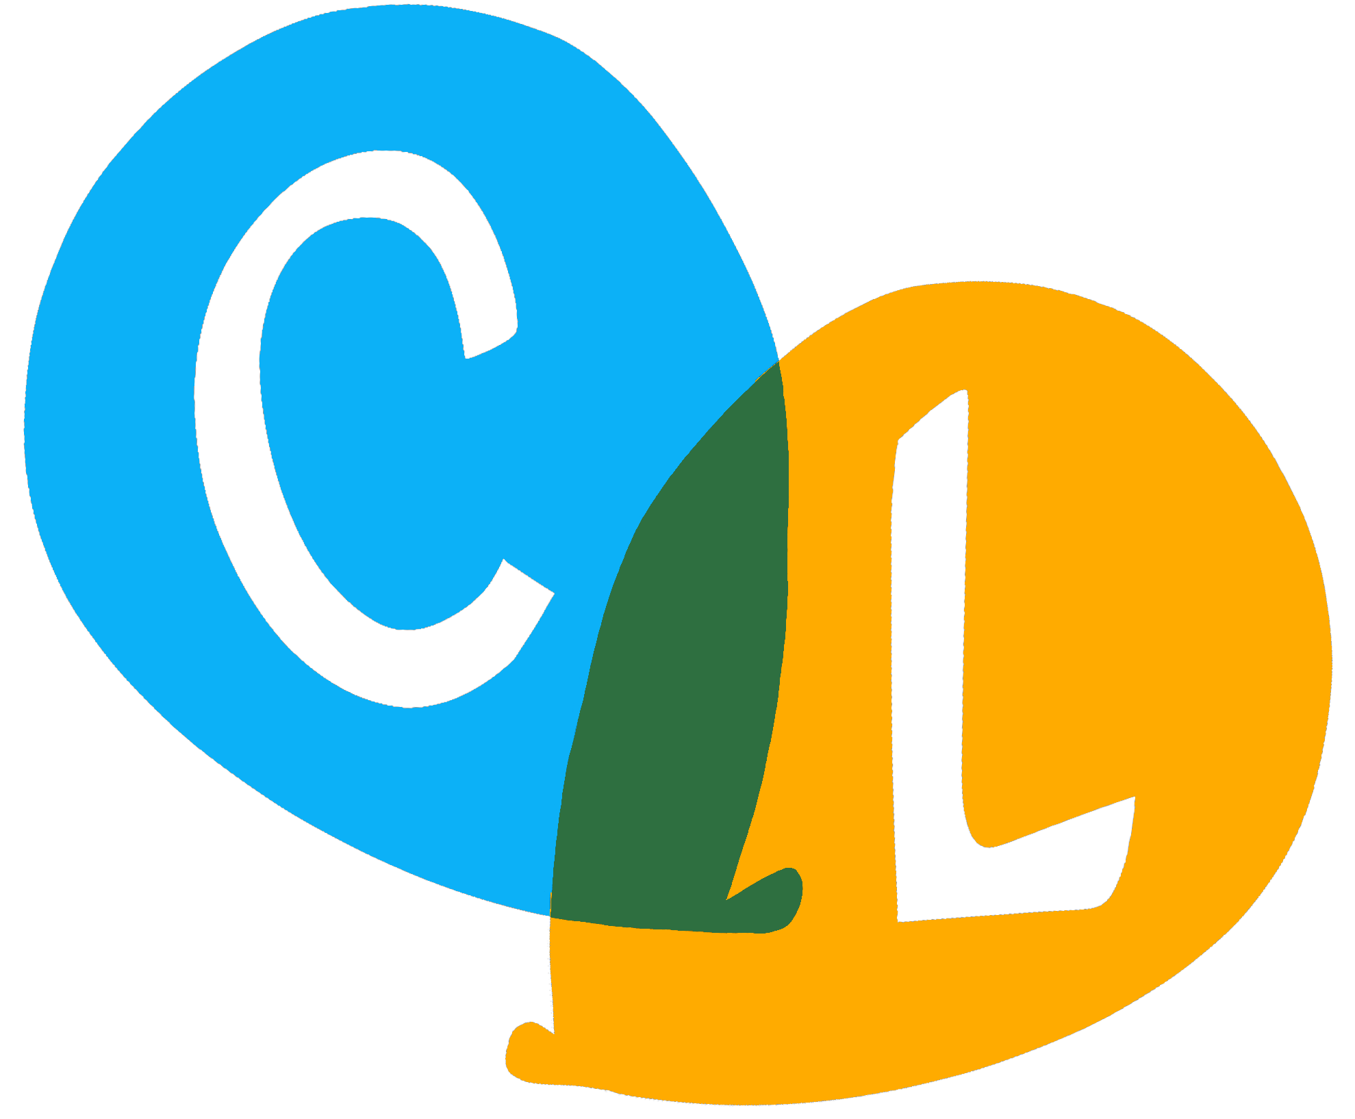
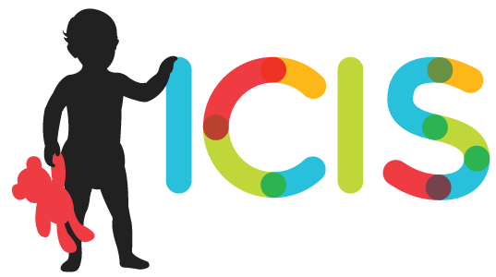

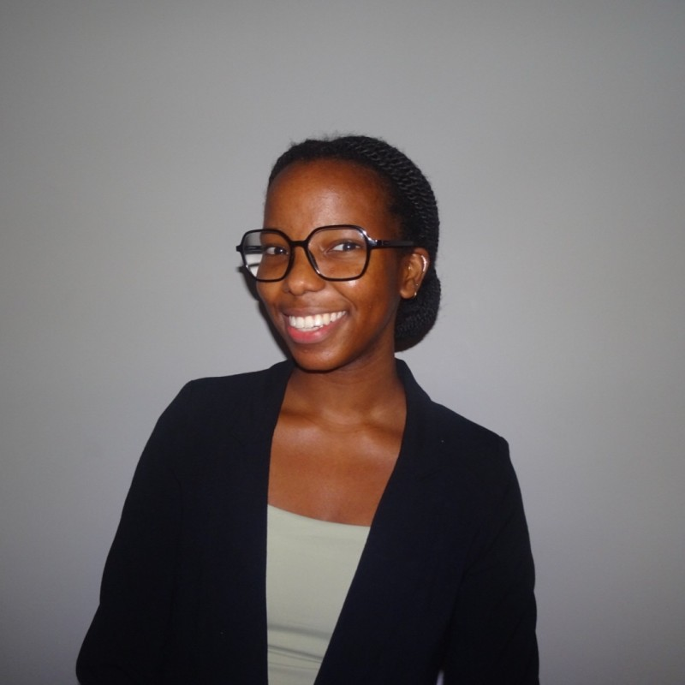
ICIS FOUNDING GENERATION INTERNSHIP SYMPOSIUM · SEPTEMBER 2026
Detecting Children’s Entry into Multiparty Talk with Linguistic Alignment
Adaora Mbanefo
ChatterLab, University of Chicago · University of Illinois Urbana-Champaign
Adaora Mbanefo
Fellow

Slide 2
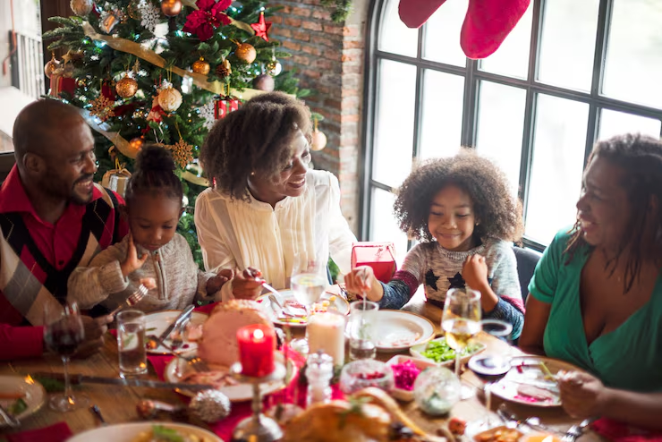
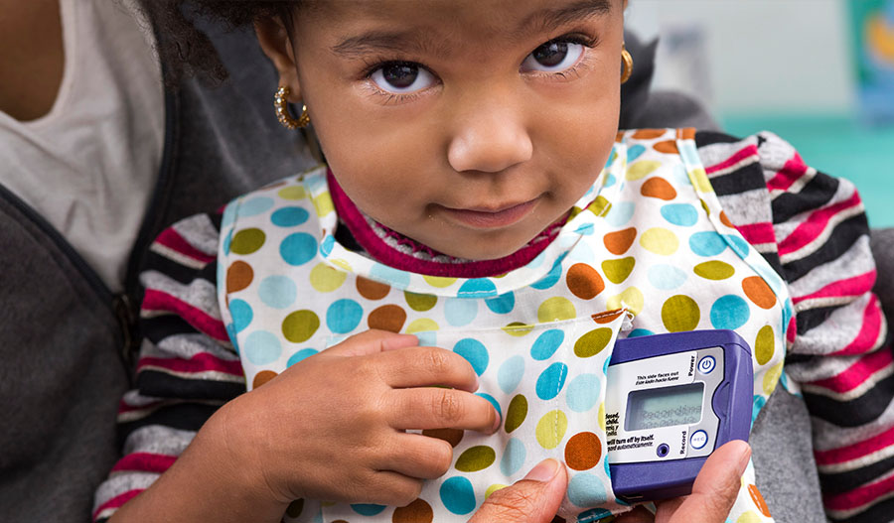
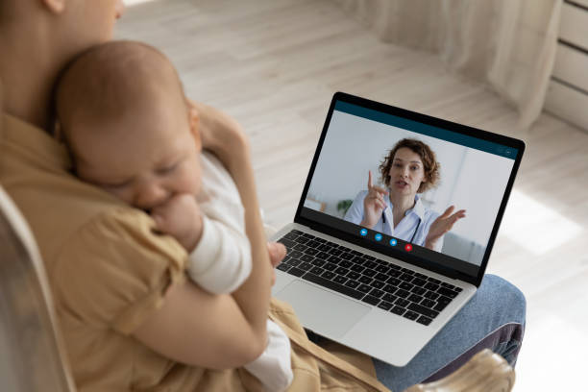

How do children become participants in multiparty talk?
1,377
5-minute clips, randomly sampled
114+
hours, transcribed by hand
Daylong home recordings, transcribed, timestamped and speaker-labelled. Nothing marks where the multiparty talk is, or whether the child is in it.
Question: can we detect multiparty talk with the child in it, automatically, from the transcript?
Notes:
How do children become participants in multiparty talk, that is, conversation involving three or more people? Children grow up around multiparty talk, whether that's parents and a sibling at the dinner table, or a caregiver on a call with another child in the room. Toddlers barge into it and get better at it with age, and children have to learn to become active participants in these interactions. So how can we investigate the developmental change in their participation?
One way is through daylong home recordings. Our lab has many of these recordings, transcribed by hand, so we can see children's language across the developmental trajectory. What we don't have is any marking of where the multiparty talk is, or whether the child is even involved. And hand-coding it all isn't an option, so a corpus this size needs an automated way to pick up on multiparty interactions.
And that's what this presentation is about. It's ongoing work on using semantic alignment to detect multiparty talk that includes the target child.

Slide 3
One way to detect multiparty talk: semantic alignment
a clear case: the child echoes the caregiver
1
Calculate alignment score
MA1 here comes a red one
Each child turn vs. every speaker’s most recent turn, using BERTScore (meaning, not exact words)
· · ·
CHI here comes a red one
· · ·
Compare to chance
2
CHI here comes a red one
· · ·
Only alignment beyond what unrelated turns would produce counts
CHI here comes a red one
· · ·
CHI here comes a red one
3
Decide
· · · = turns by other speakers. Four echoes over 15 turns: full alignment. Most alignment is subtler than this.
Multiparty with the child included = the child aligns above chance with 2+ different speakers in one stretch
Notes:
Semantic alignment is a way of measuring how similar two speakers are in what they say. In this example on the left, the child is exactly repeating what the adult said. Usually it's not such a perfect overlap, but this is the signal we're looking for.
So how do we use it? Three steps. First, we score every child turn to see how semantically similar it is to the prior turn from another speaker. Then we compare that alignment score to chance. And then we decide whether that's enough evidence for multiparty talk. A clip counts as multiparty talk including the child when the target child aligns above chance with two or more different speakers in one stretch.
One thing to note before the results. Alignment can only score words, so a child who is babbling or silent gives it nothing to work with.
To test it, I hand-labelled about 200 clips for one thing only, whether the target child is engaged in multiparty talk. The results here are on a 94-clip subset, 32 yes and 62 no.

Slide 4
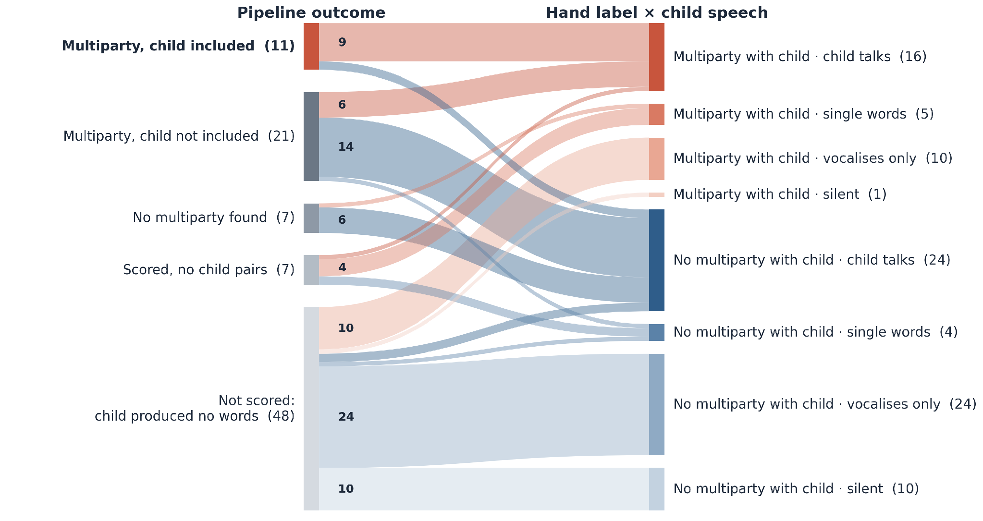
How well does the pipeline perform? 94 hand-labelled clips
Hand labels mark only whether the child is engaged in multiparty talk; “no multiparty with child” clips may still contain multiparty talk among others.
82%
precision
Notes:
As a reminder, the goal here is to see whether semantic alignment can tell us which clips have multiparty conversations including the child and which don't. This alluvial chart compares the pipeline's outcome on the left with my hand labels on the right as the gold standard. Each strand is a set of clips, and its width represents the number. The strands run from what the pipeline decided to what was actually in the clip, so you can follow each decision across and see whether it was right.
Let's start at the top with the 11 clips the pipeline dubbed multiparty with the child. Nine of these, that straight red strand, I had labelled exactly that. Two, that thin blue strand, I had not. So when the pipeline says the child is in multiparty talk, it's right 9 times out of 11, which is a precision of 82%.
Below that we have the block, multiparty talk, child not included, this is where the interesting mix is. Fourteen of those clips are blue, and correctly so. There is multiparty talk in them, but it's among the adults and siblings, not with the child. Six are red. The child was engaged, but didn't clear the bar of two partners in turns long enough to score. Those are the misses.
And then the bottom forty-eight clips. Half the sample, were never scored at all, because the child produced no words. Every strand there comes from the single-word, vocalising, or silent children on the right.

Slide 5
A closer look at the errors
False alarms were mostly label errors. 3 of 5 were real multiparty talk on re-listening.
Misses were real engagement, but in turns too short to score.
Half the clips can’t be judged at all, because the child produced no words.
On the 39 clips it can judge: 56% hit rate, 9% false alarm, 77% accuracy vs. 59% baseline. Next: hand-verified test on 277 random clips from 63 families.
Notes:
Looking closer at the errors, three things stand out. The false alarms were mostly label errors. Three of the original five turned out to be real multiparty talk when I re-listened. The misses were real engagement, but in turns too short to score. And the biggest issue is that half the clips can't be judged at all, because the child produced no words. That's a limit of any transcript-based measure.
One caveat on all of these numbers. They come from a sample that was picked because it was rich in multiparty talk, so a critical next step is testing the rule on clips that aren't biased towards it. That's what we're working on right now. We have 277 random clips from 63 families across all age ranges, and each one needs to be hand-verified

Slide 6
FUTURE WORK
How do we best capture multiparty talk in linguistic transcripts?
By combining temporal and semantic alignment measures: neither is enough alone.
PRIOR APPROACH · timing only
CURRENT APPROACH · alignment only
sees every speaker, words or not
lumps overlapping talk, splits across pauses
checks whether turns actually cohere
blind to children without words
Back to the question we started with:
how does a child’s place in multiparty talk change as they grow?
Notes:
So how do we best capture multiparty talk in linguistic transcripts? By combining temporal and semantic alignment measures, because neither one is enough on its own.
The lab's prior approach is temporal. Turns that fall close together in time are grouped as one interaction, and a long gap splits them. That works on any speaker, words or not, but it has two pitfalls, and they're the reason I looked at alignment in the first place. Firstly, two separate exchanges that overlap in time get lumped together, and the other is when one conversation with a pause in the middle gets split in two, because timing never looks at what's being said. The current approach, alignment, does look, but it can't work on a child who has few or no words yet. Each one fails where the other holds. So the next step is to combine them, using timing to propose where the interactions are, alignment to check them, and the two together to reach the children that neither can reach alone.
And that brings us back to the question we started with. How does a child's place in multiparty talk change as they grow? Combining these measures is what will let us put a corpus this size to work on that question, and this project is the first step.

Slide 7

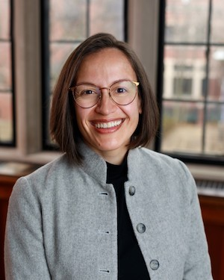
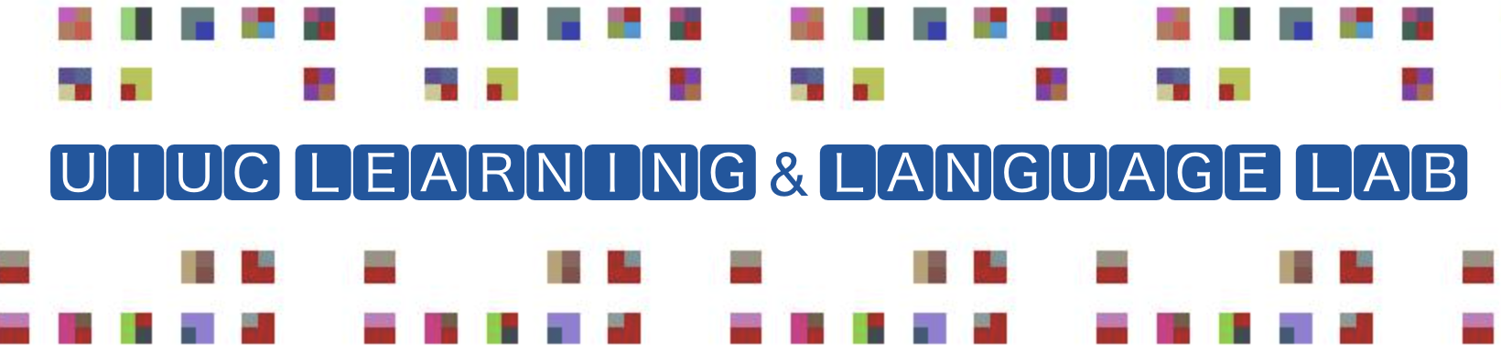
Thank you!
Questions?
Subin Kim
Dr. Casillas
Notes:
Thank you to my mentors at the ChatterLab, Dr. Casillas and Subin Kim; to the ICIS Founding Generation Fellowship for this opportunity; to Dr. Stoops and Dr. Montag at the Learning and Language Lab for sharing the fellowship with me and giving me the tools to succeed; and to my family, without whom I would not be here. Questions?

