Slide 1





AJAX Explained
Brian LeGros
Adogo - September 2008
http://www.brianlegros.com/blog

Slide 2
synchronous
function findUrlForAddress(address) {
var resource = new Resource();
var url = resource.generateUrl(address);
console.log(“URL has been generated”);
console.log(“Method complete”);
}

Slide 3
asynchronous
function findUrlForAddress(address) {
var resource = new Resource();
resource.generateUrl(address, printFinish);
console.log(“Method complete”);
}
//callback function
function printFinish() {
console.log(“URL has been generated”);
}

Slide 4


HTTP
http://www.google.com?q=adogo
HTTP Request
Message
HTTP Response
Message
Message
Headers
*.js
*.pdf
*.html
*.css
*.jpg
…
Body

Slide 5
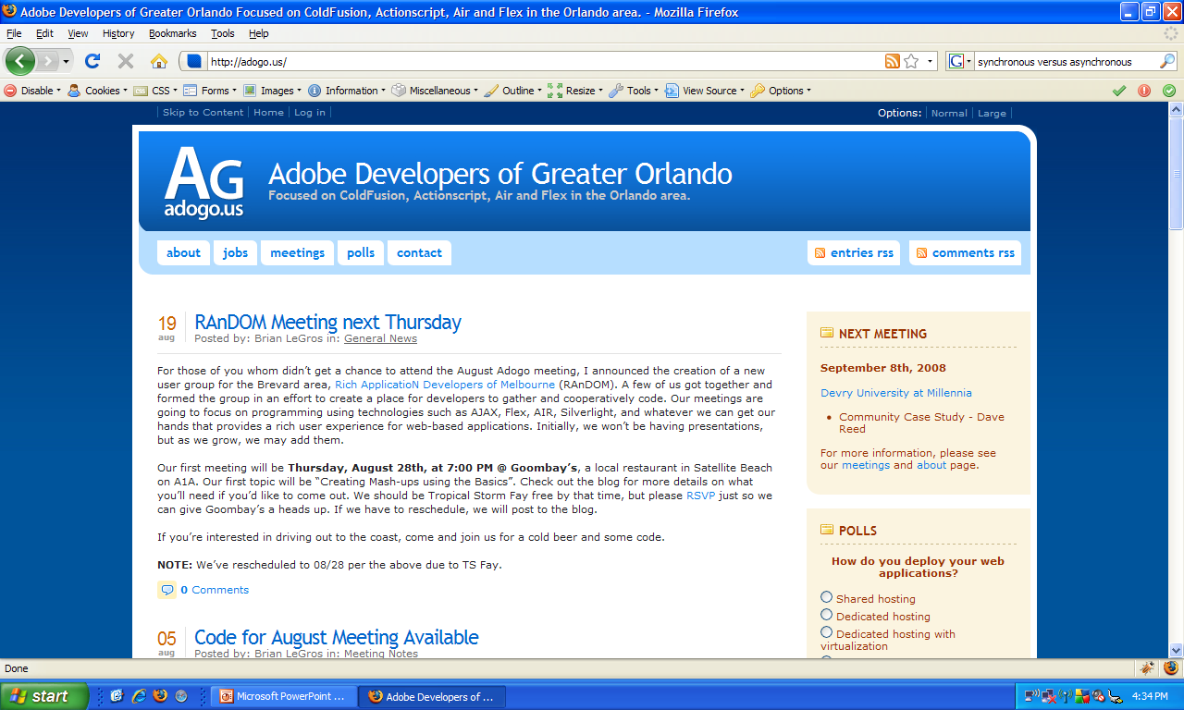

HTTP via JavaScript
manipulates
HTTP/S
myscript.js
XmlHttp
Request
writes
uses

Slide 6
XmlHttpRequest - native
+onreadystatechange : function //callback function
+readyState : int (0 .. 4)
+responseText : string
+responseXml : DOM
+ open (method, url, async, username, password)
+ setRequestHeaders (label, value)
+ send (content : string | DOM)
+ abort ()
+ getResponseHeader(label) : string

Slide 7
rich clients
XmlHttp
Request
JSON
XML
HTML
data
structures
Custom
HTTP/S
Your domain

Slide 8
mashups
Your domain
<img>
<iframe>
<script>**
Not your domain
** Used in JSONP

Slide 9
native XmlHttpRequest examples

Slide 10
jQuery + AJAX
$.ajax(options)
$.load(url, data, callback)
$.get(url, data, callback, type)
$.getJson(url, data, callback)
$.post(url, data, callback, type)
*All except “load” return an XmlHttpRequest object
** jQuery natively supports JSONP

Slide 11
jQuery + AJAX events
$.ajaxComplete(callback)
$.ajaxError(callback)
$.ajaxSend(callback)
$.ajaxStop(callback)
$.ajaxSuccess(callback)
** All events can be managed per request and globally

Slide 12
jQuery + AJAX helpers
$.serialize() : string
$.serializeArray() : array

Slide 13
jQuery examples

Slide 14
data push (COMET)
jQuery
COMET
plug-in
Bayeux Protocol
Topic-based
Publish/Subscribe
dojox
.cometd
Current
Implementations:
Jetty
Tomcat

Slide 15

BlazeDS AJAX bridge
HTML
FDMS.js
XML
AMF
FABridge
.js
Flash
Bridge
HTTP/S
BlazeDS

Slide 16
BlazeDS example

Slide 17
done

