Slide 1
Minimal RAG Architecture
A Deep Dive into Design & Components

Slide 2
What is Retrieval-Augmented Generation?
Combines the power of LLMs with external data.
Solves 'hallucination' and 'outdated knowledge' problems.
Two Main Phases:
- Retrieval (Find relevant info)
- Generation (Synthesize answer)

Slide 3
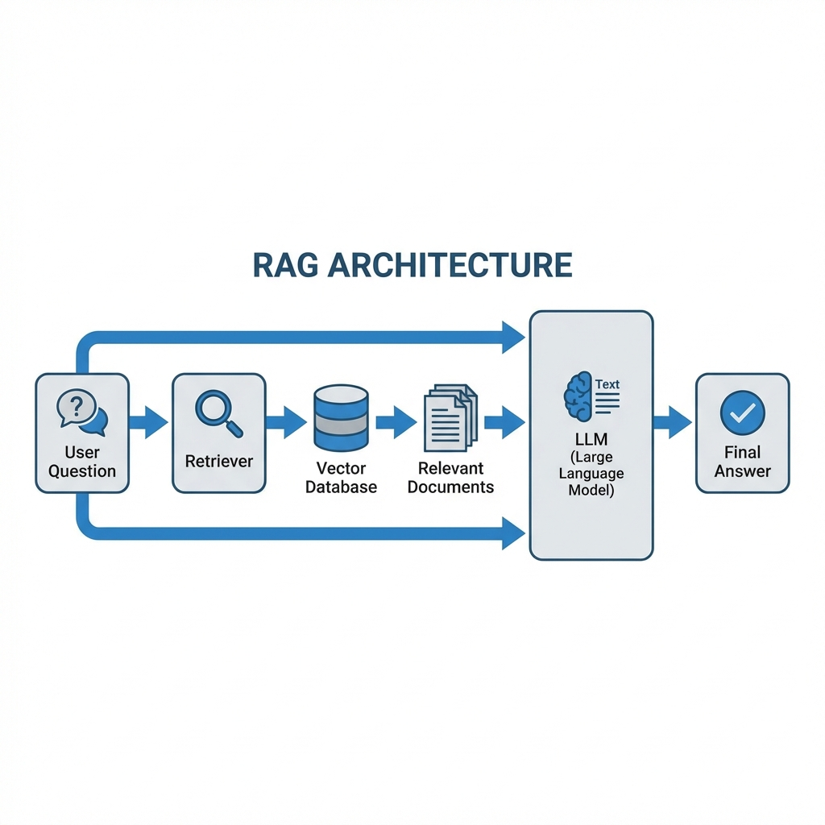
High-Level Architecture

Slide 4
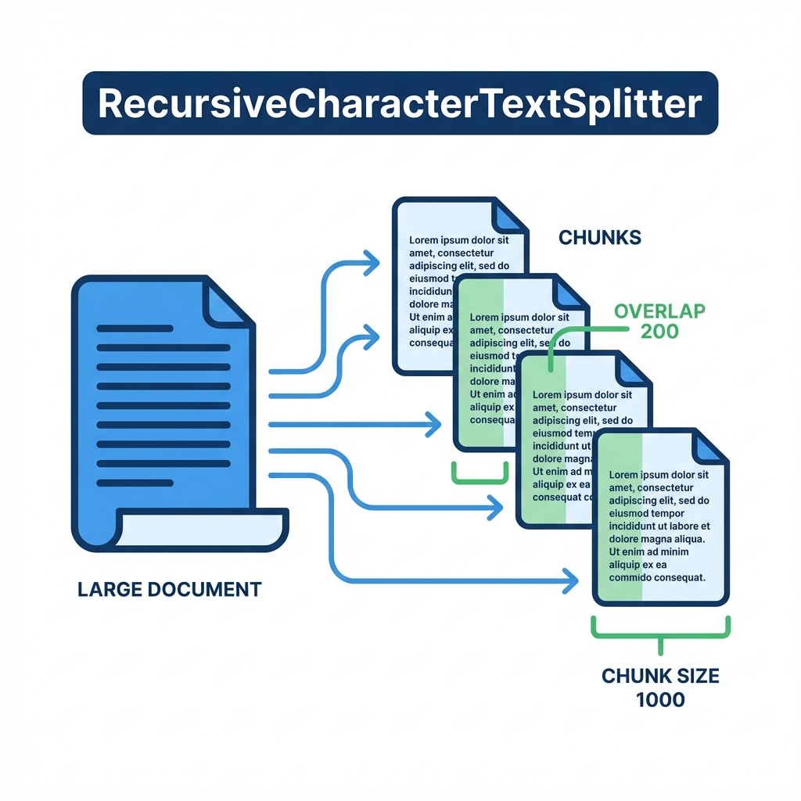
Step 1: Ingestion & Splitting

Slide 5
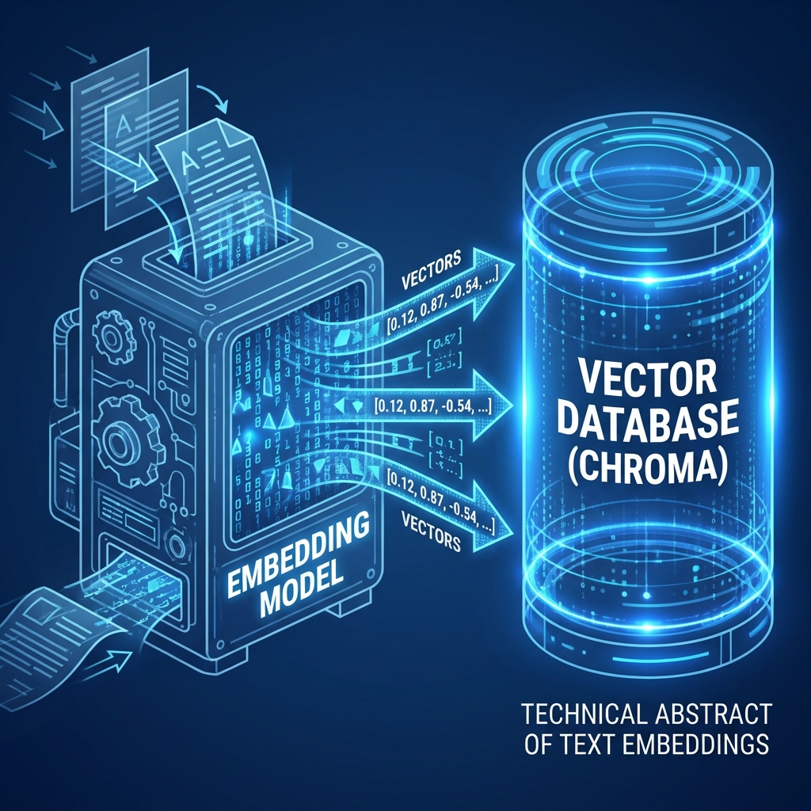
Step 2: Embeddings & Storage

Slide 6
Step 3: Retrieval
User Query is embedded into a vector.
Similarity Search runs against ChromaDB.
Top-K results (Context) are retrieved.
'k=3' is used to balance context vs noise.

Slide 7
Step 4: Generation
Prompt Template constructs the final input.
- Context: {The 3 retrieved chunks}
- Question: {User Query}
LLM: Ollama (Llama 3.2)
Result: Accurate, grounded answer.

Slide 8
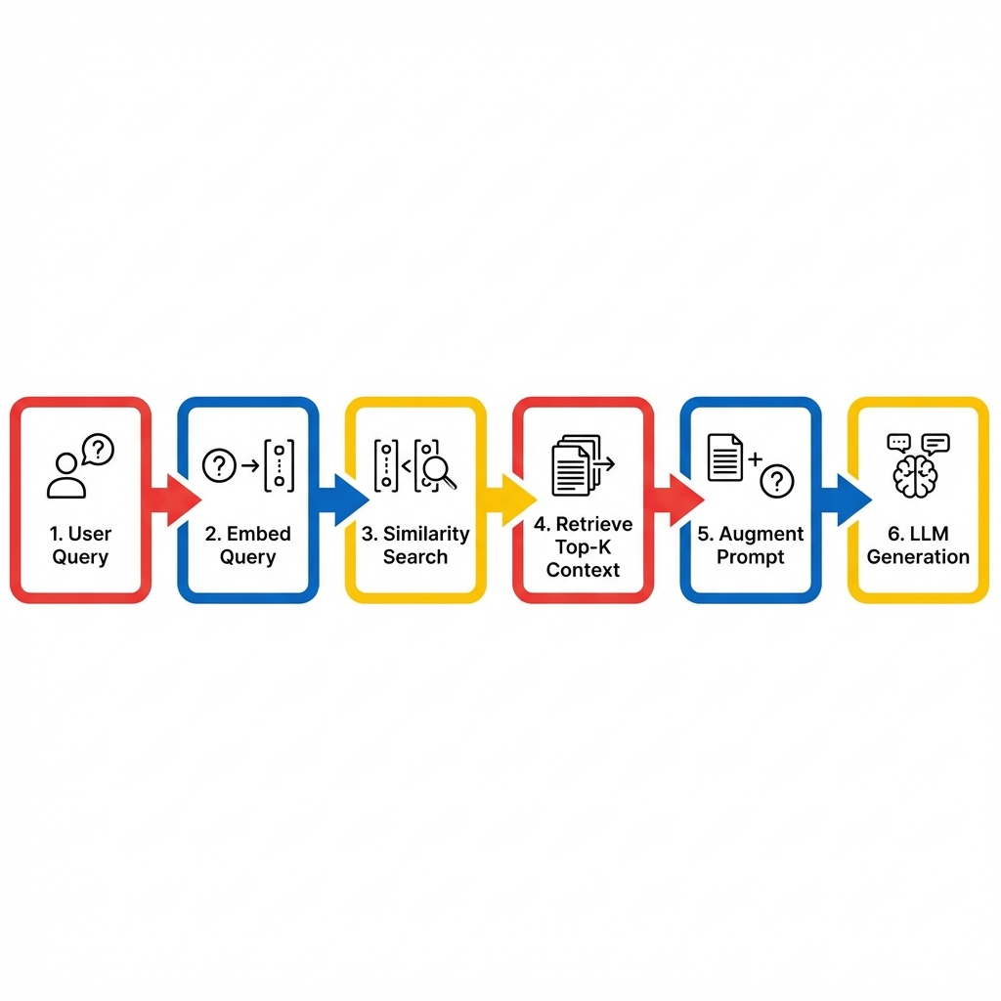
Logic Flow

Slide 9
Implementation Details
splitter.py: Recursive Character Splitting.
vectorstore.py: ChromaDB + HuggingFace Embeddings.
rag.py: LCEL Chain Definition.
langchain: Orchestration Framework.

Slide 10
Key Design Choices
Local-First: Privacy, Zero Cost (Ollama).
LangChain: Standardized, scalable interfaces.
Recursive Splitting: Preserves semantic context better than naive splitting.

Slide 11
Future Roadmap
Hybrid Search (Keyword + Vector).
Re-ranking step for higher precision.
Multi-Modal support (Images/Tables).
Automated Evaluation (Ragas).

Slide 12
Thank You
Questions & Discussion

