Slide 1
Minimal RAG Architecture
Data Flow: Ingest ➔ Chunk ➔ Store ➔ Augment

Slide 2
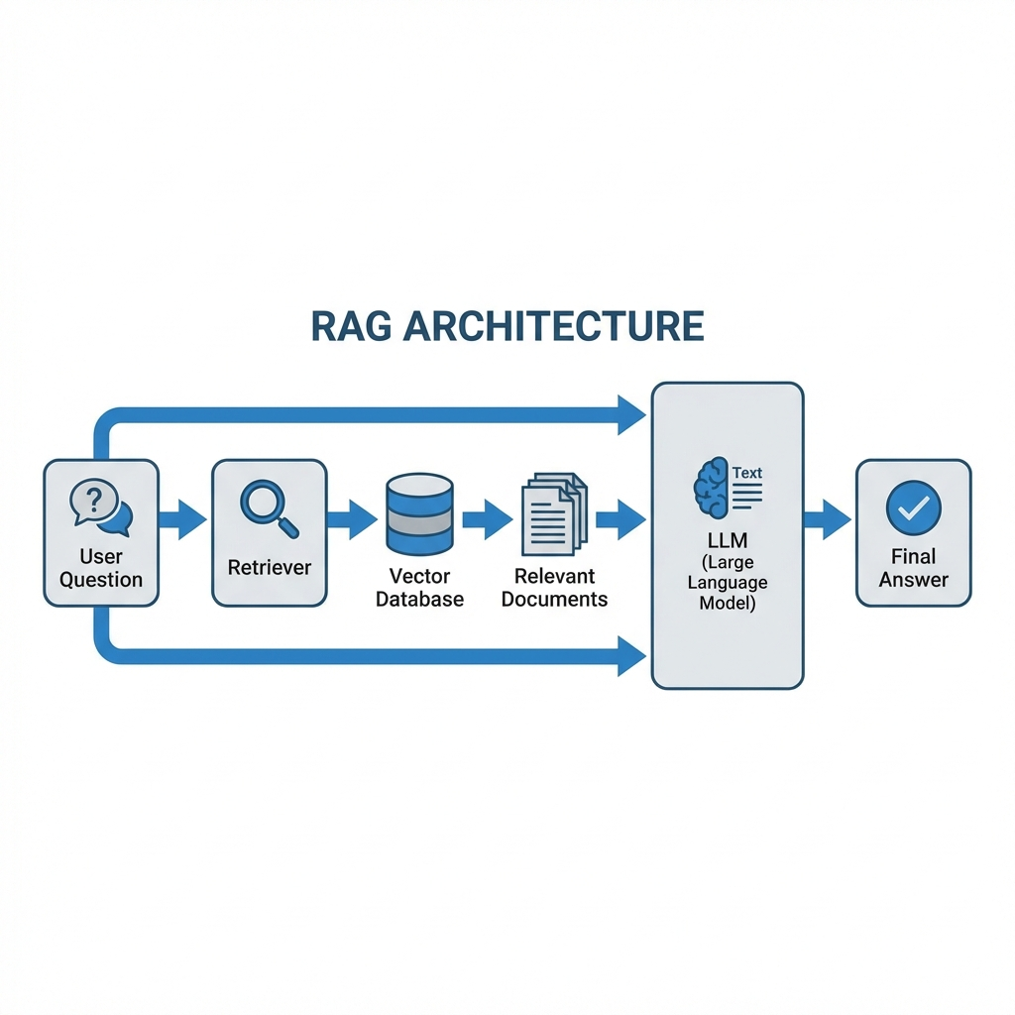
Architecture Overview

Slide 3
Step 1: Ingest Data
Goal: Load raw knowledge from various sources.
Sources: text files, PDFs, Wikipedia, etc.
In our codebase: `rag_solution.ipynb` uses `wikipedia` loader.
Challenge: Data is unstructured and variable length.

Slide 4
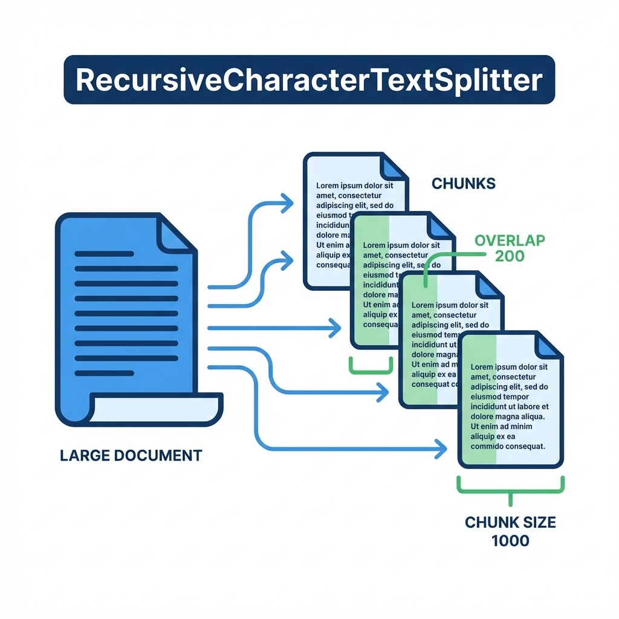
Step 2: Text Splitting - Chunking
Challenge: LLMs have finite context windows.
Solution: Break large texts into smaller 'chunks'.
Tool: RecursiveCharacterTextSplitter.
Config: Size=1000, Overlap=200.
Benefit: Preserves semantic context across boundaries.

Slide 5
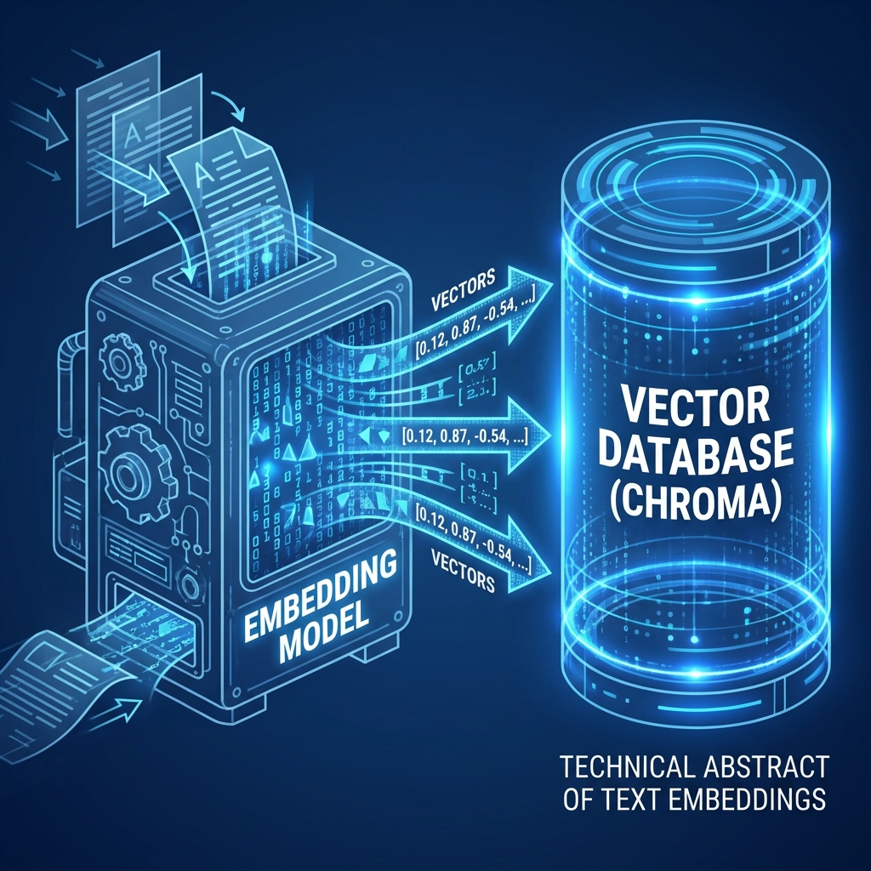
Step 3: Vectorize and Store
Process: Convert text chunks into numerical vectors.
Model: HuggingFace embeddings (`all-MiniLM-L6-v2`).
Storage: ChromaDB (Vector Database).
Enables: Semantic search based on meaning, not just keywords.

Slide 6
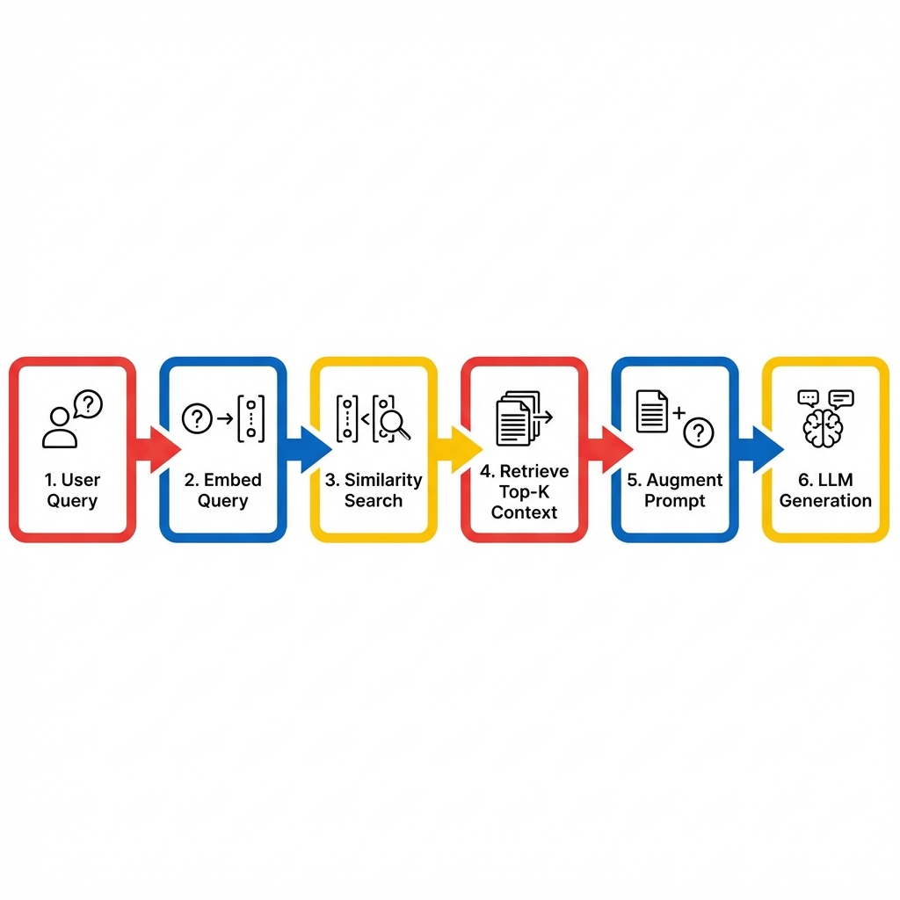
Step 4: Augmented Generation
This is the retrieval loop.
1. User asks question.
2. System retrieves top-k relevant chunks (retriever).
3. Prompt = Question + Retrieved Chunks.
4. LLM generates final answer based on facts.

Slide 7
Implementation Recap
1. Ingest: Loaders (Wikipedia)
2. Chunk: `splitter.py`
3. Vectorize: `vectorstore.py`
4. Generation: `rag.py`

Slide 8
Thank You

