Slide 1
Mental Health Risk Prediction System
Results Presentation
By
Tony Adole

Slide 2
Project Overview
• Goal: Predict mental health risks using machine learning
• Key Features:
- Automated risk assessment
- Data-driven predictions
• Benefits:
- Early risk detection
- Objective assessment
- Efficient screening process

Slide 3
Project Overview
• ML model selection Table
Model | Complexity Handling | Interpretability | Computational Cost | Accuracy Potential
Logistic Regression | Low | High | Low | Moderate
Decision Trees | Moderate | Moderate | Moderate | High (prone to overfitting)
Random Forests | High | Moderate | High | High
Gradient Boosting | High | Moderate | High | Very High
Neural Networks | Very High | Low | Very High | Very High

Slide 4

Methodology
• Data Collection:
- Demographic information
- Lifestyle factors
- Medical history
• Technical Approach:
- XGBoost machine learning algorithm
- Hyperparameter optimization
- Cross-validation for reliability

Slide 5
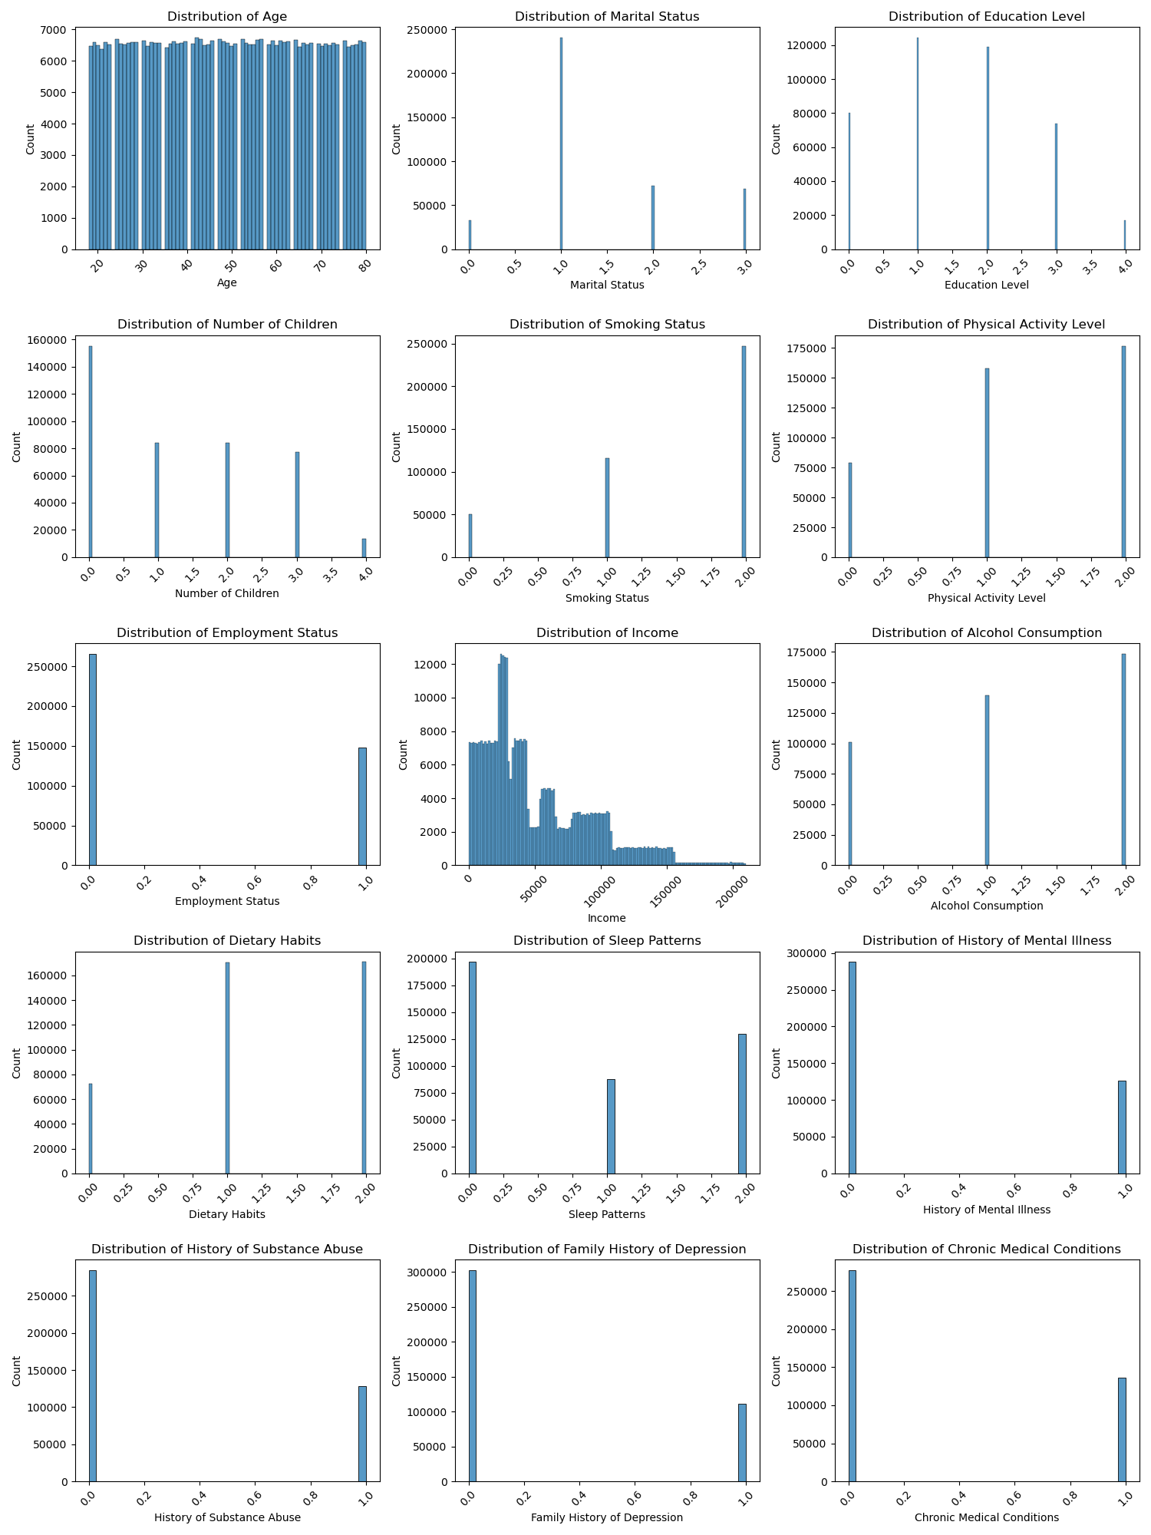
Feature Distributions

Slide 6
Feature Distributions

Slide 7
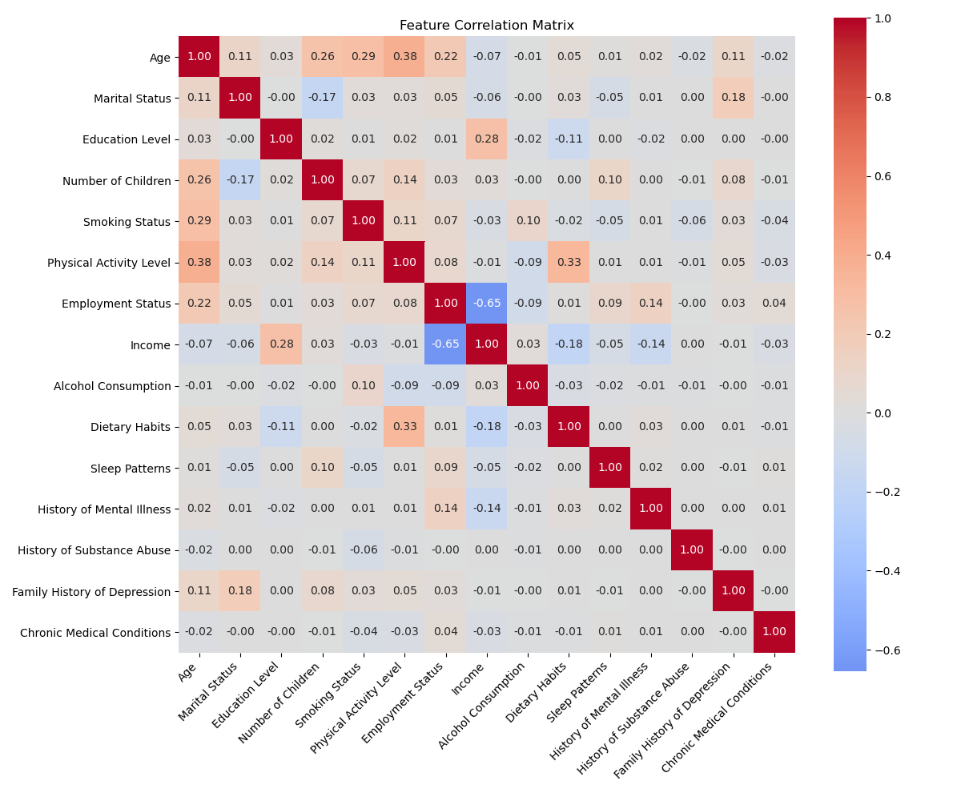
Feature Correlations

Slide 8
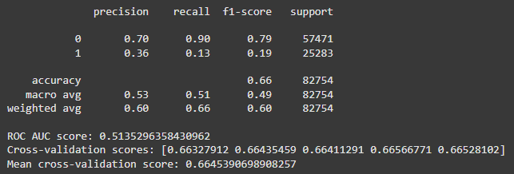
Results and Performance
• Model Accuracy:
Key Findings using XGBoost:
- Successful risk prediction
- Identified important factors
- Validated through testing
• Performance Metrics using XGBoost :
- High reliability
- Fast processing time
- Consistent results
XGBOOST | Random Forest Classifer
69.44%

Slide 9
Next Steps
• System Implementation:
- Deploy to production environment
- Integration with existing systems
• Future Enhancements:
- Continuous model improvement
- Additional feature development
- User feedback incorporation

