Slide 1
ROS-Turtlebot
Motion Control and Navigation

Slide 2
Introduction

Slide 3
Contents
1. Motion Control
2. Navigation & Localization
3. Android control

Slide 4
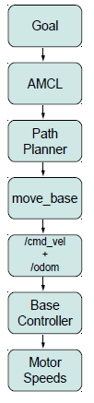
Levels of Motion Control
1. Motors, Wheels and Encoders
2. Motor Controllers and Drivers
3. The ROS Base Controller
4. Frame-Base Motion using the move base ROS Package
5. SLAM using the gmapping and amcl ROS Packages
6. Semantic Goals

Slide 5
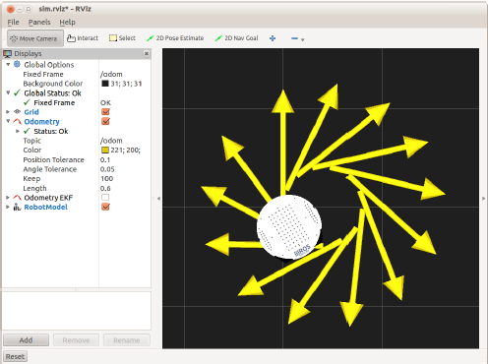
Twisting and Turning with ROS
ROS uses the Twist message type (see details below) for publishing motion commands to be used by the base controller. The base controller node subscribes to the /cmd_vel topic and translates Twist messages into motor signals that actually turn the wheels.
$rosmsg show geometry_msgs/Twist
geometry_msgs/Vector3 linear
float64 x
float64 y
float64 z
geometry_msgs/Vector3 angular
float64 x
float64 y
float64 z
$rostopic pub -r 10 /cmd_vel geometry_msgs/Twist ’{linear: {x: 0.15, y: 0, z: 0}, angular: {x: 0, y: 0, z: -0.4}}’

Slide 6
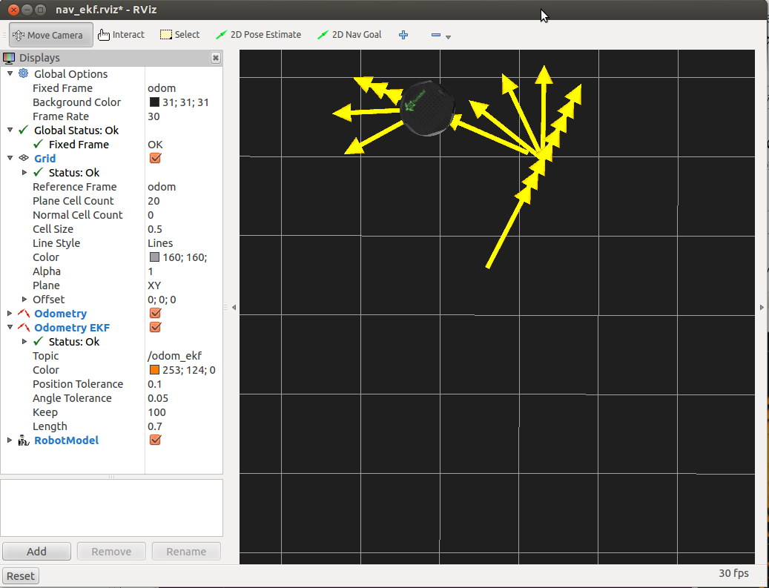
Goal 1 : Basic Motion of Mobile Base
Algorithm 1: Time and Speed based out and back (
$rosrun rbx1_nav timed_out_and_back.py)
rate = 50
goal_distance = 1.0 m
linear_speed = 0.2m/s
linear_duration = goal_distance / linear_speed;
angular_speed = 1.0
goal_angle = pi
angular_duration = goal_angle / angular_speed;
A: Repeat step 1 to 6 twice
1. ticks = linear_duration / rate
2. while(t < ticks)
robot will walk 1 meter straight
3. robot will sleep 1 cycle
4. ticks = goal_angle * rate
5. while(t<ticks)
robot rotates 180*
6. robot will sleep 1 cycle
B: Program Terminates

Slide 7
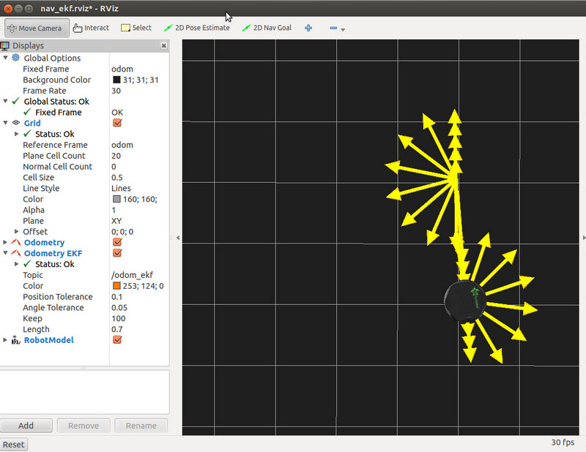
Goal 2 : Advanced Motion of Mobile Base
Algorithm 2: ODOMETRY based out and back (odom_out_and_back.py)
rate = 50
goal_distance = 1.0 m
linear_speed = 0.2m/s
linear_duration = goal_distance / linear_speed;
angular_speed = 1.0
goal_angle = pi
angular_duration = goal_angle / angular_speed;
A: Repeat step 1 to 6 twice
1. get initial position
2. while distance < goal_distance
robot will go at a speed set by linear_speed
sleep 1 cycle
get new linear position from ODOMETRY
calculate new distance from new position and old position
3. stop the robot
Set last_angle = rotation
turn_angle = 0
4. while (turn_angle < goal_angle)
start rotating
sleep 1 cycle
get new rotation position from ODOMETRY
delta_angle = (rotation - last_angle)
turn_angle += delta_angle
last_angle = rotation
5. stop the robot 1 cycle before next run
B: Program Terminates

Slide 8
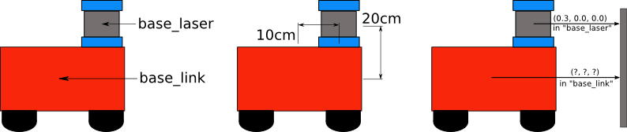
Goal 2 : Advanced Motion of Mobile Base
Turtlebot Odometry data we use to move the robot. While the /base link frame corresponds to a real physical part of Controlling a Mobile Base robot, the /odom frame is defined by the translations and rotations encapsulated in the odometry data.

Slide 9
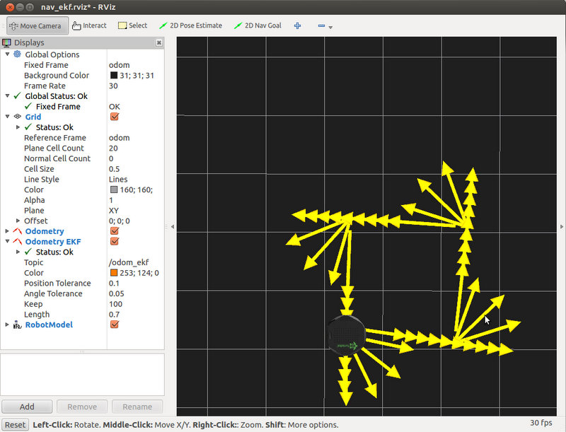
Goal 3 : Navigating a Square using Twist+Odometry
The difference is that it we now send the robot along four 1 meter legs using 90 degree rotations instead of two 1 meter
legs using 180 rotations.
At the end of the run, we can see that the errors accumulated in odometry are visible, it didn’t move in a perfect square.

Slide 10
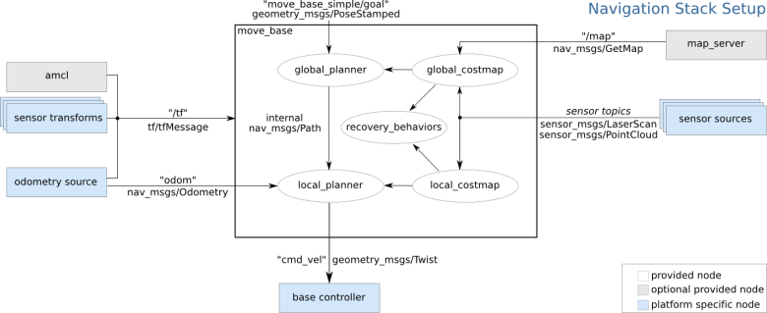
Goal 4: Navigation with Path Planning -> move_base
This package includes a node also called move_base, which subscribes to the topic /map of the node map_server, and to other topics as /odom, /tf (sensor transforms) and to the probabilistic localization system amcl (adaptive Monte Carlo localization approach), to control the robot movement and publishes to /cmd_vel topic

Slide 11
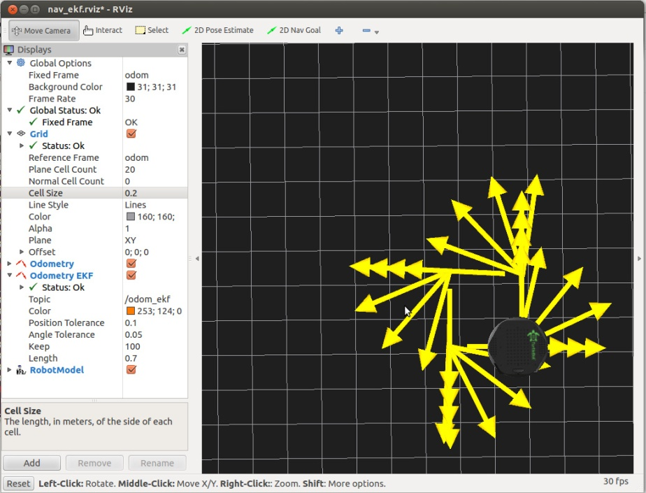
Goal 4: Navigation with Path Planning -> move_base
Move base nodes requires four configuration files before it can run. These files defines a number of parameters related to the cost of running into obstacle, the radius of the robot, the range of velocities, the resolution of the map, the robot base frame and how far the path planner should look.
The four configuration files can be found in the config subdirectory of the rbx1 nav package and are called:
- base local planner params.yaml
- costmap common params.yaml
- global costmap params.yaml
- local costmap params.yaml

Slide 12
Goal 4: Navigation with Path Planning -> move_base
The move_base package, which includes a path planner and is linked to the base_local_planner, a package that uses odometry besides global and local cost maps to define the path. With the move_base package it is possible to set a target position and orientation of the robot using a reference frame, and it will try to move the robot to the goal avoiding obstacles.
The move_base package uses messages of type MoveBaseActionGoal and includes sub-messages of type PoseStamped. This type of sub-message encompass a header and a pose, which contains a position and an orientation, given by a point of coordinates x, y, z and a quaternion of coordinates x, y, z, w, respectively.
Header header
uint32 seq
time stamp
string frame_id
actionlib_msgs/GoalID goal_id
time stamp
string id
move_base_msgs/MoveBaseGoal goal
geometry_msgs/PoseStamped target_pose
Header header
uint32 seq
time stamp
string frame_id
geometry_msgs/Pose pose
geometry_msgs/Point position
float64 x
float64 y
float64 z
geometry_msgs/Quaternion orientation
float64 x
float64 y
float64 z
float64 w

Slide 13
Android Control
Pairing and Demonstration

Slide 14
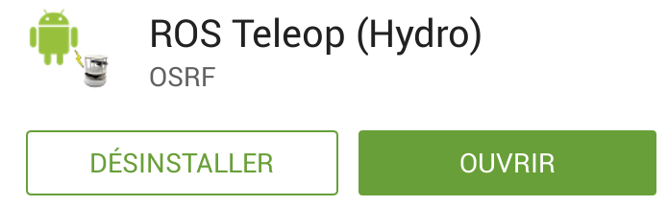
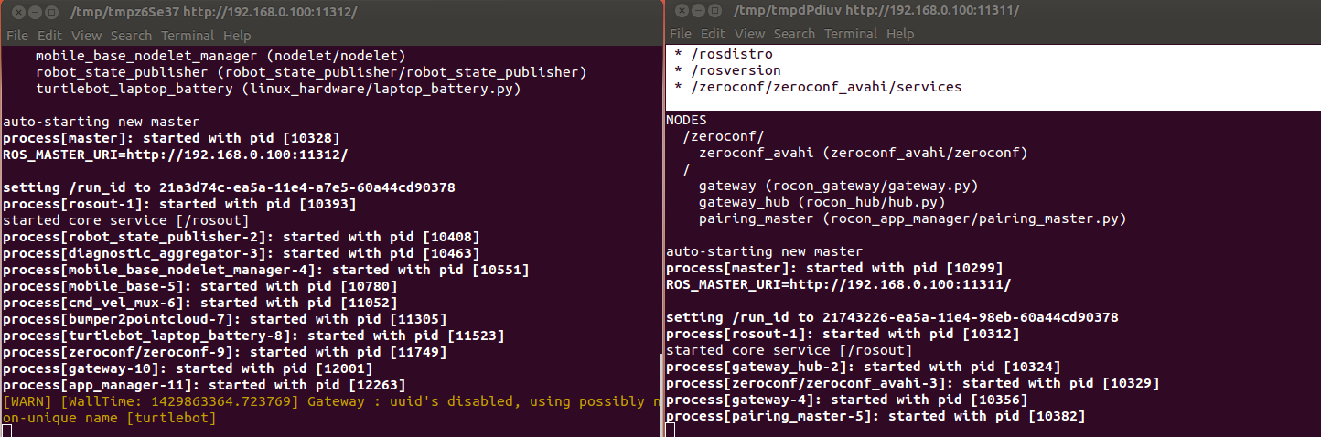
Pairing
Connect on the same Network
Download ROS Teleop (Hydro)
Bringup with concert file

Slide 15
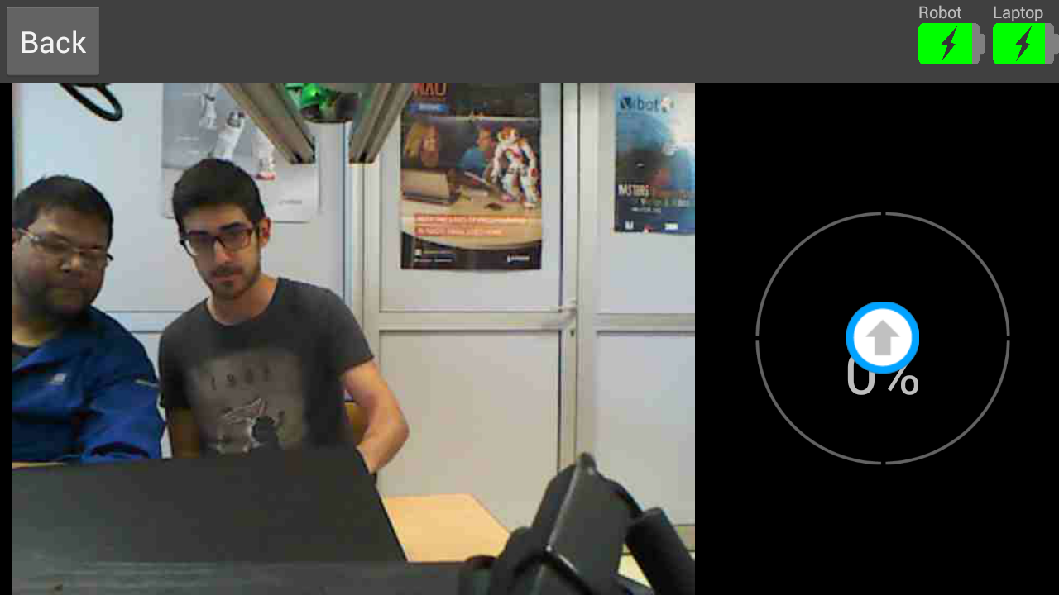
Demonstration
https://www.youtube.com/watch?v=pBYmtod4o18

Slide 16
Conclusion
Time spent on android code and home made concert file

