Slide 1
ROS-Turtlebot
Motion Control and Navigation

Slide 2
Introduction

Slide 3
Contents
1. Motion Control
2. Navigation & Localization
3. Android control

Slide 4
Android Control
Pairing and Demonstration

Slide 5
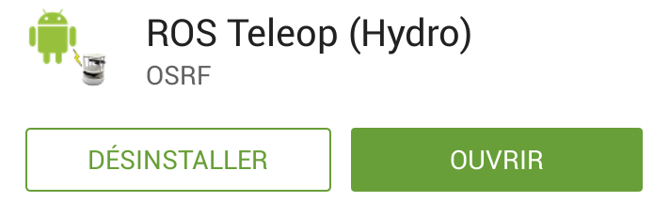
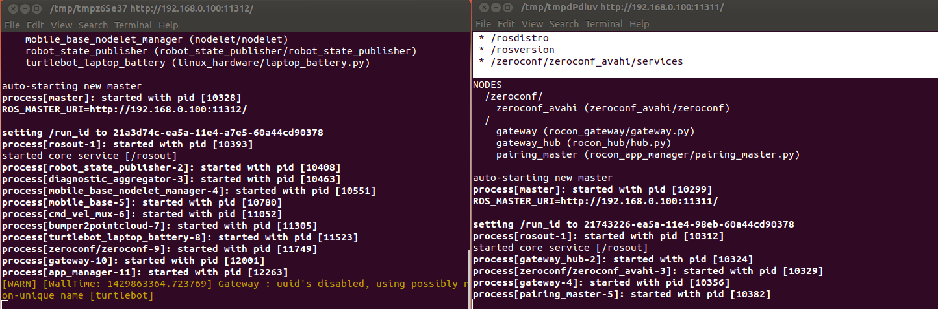
Pairing
Connect on the same Network
Download ROS Teleop (Hydro)
Bringup with concert file

Slide 6
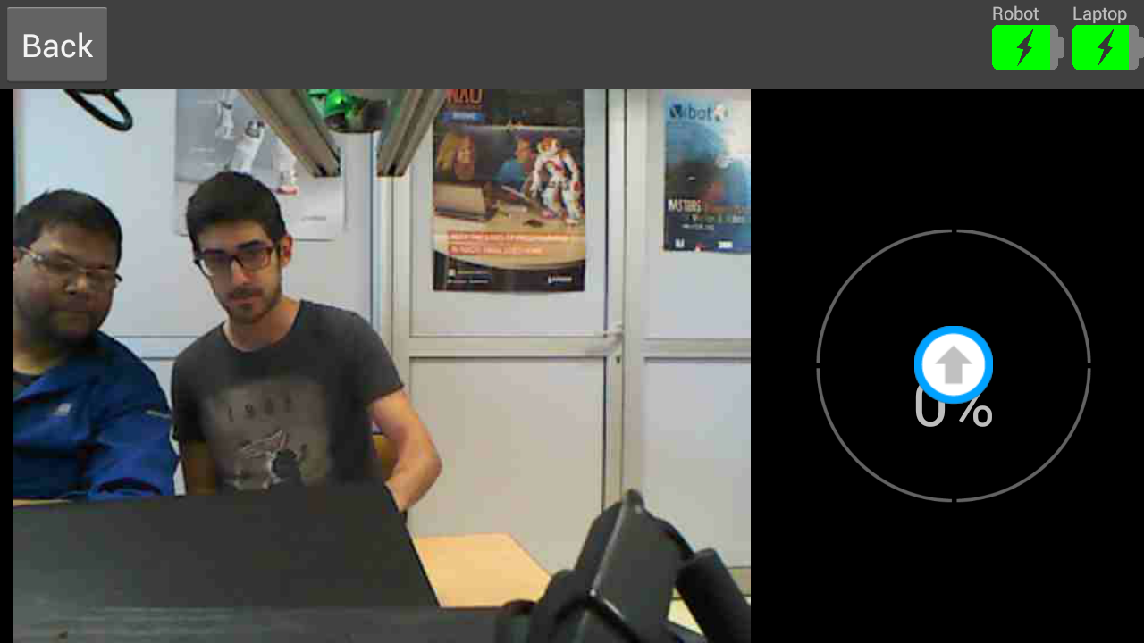
Demonstration
https://www.youtube.com/watch?v=pBYmtod4o18

Slide 7
Conclusion
Time spent on android code and home made concert file

