Slide 1
ROS-Turtlebot
Motion Control and Navigation

Slide 2
Introduction

Slide 3
Contents
1. Motion Control
2. Navigation & Localization
3. Android control

Slide 4
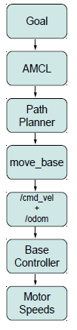
Levels of Motion Control

Slide 5
Levels of Motion Control
1.2.1 Motors, Wheels and Encoders
Turtlebot uses Encoders to drive it’s motors or wheels. Encoder registers certain number of ticks per revolution for a wheel. Knowing the diameter and distance between the wheels, from these ticks we can find distance traveled by the robot. To compute speed, these values are simply divided by the time interval between measurements. This internal motion data is known as odometry. Due to Environmental and other errors this data is not generally accurate. We need to use other motion data sources to get better estimation.
1.2.2 Motor Controllers and Drivers
At the lowest level of motion control, a driver for the robot’s motor controller turns the wheels at a desired speed, usually using internal units such as encoder ticks per second or a percentage of max speed.
1.2.3 The ROS Base Controller
At this level of abstraction, the desired speed of the robot is specified in real-world units such as meters and radians per second. It also commonly employs some PID control (Proportional Integral Derivative), which in layman terms generally does it’s best to move the robot in the way we have requested.
The driver and PID control are combined inside a single ROS node called base controller.
The base controller node typically publishes odometry data on the /odom topic and listens for motion commands on the /cmd vel topic.
Also a transform from the /odom frame to the base frame—either /base link or /base footprint (Turtlebot) is done depending on the robot types.
Once we have our base controller with a ROS interface our programming can focus purely on the desired
linear and angular velocities in real-world units.

Slide 6
Levels of Motion Control
1.2.4 Frame-Base Motion using the move base ROS Package
The move base package is a very sophisticated path planner and combines odometry data with both local and
global cost maps when selecting a path for the robot to follow.
1.2.5 SLAM using the gmapping and amcl ROS Packages
At an even higher level, ROS enables our robot to create a map of its environment using the SLAM gmapping
package.
Once a map of the environment is available, ROS provides the amcl package (adaptive Monte Carlo localization)
for automatically localizing the robot based on its current scan and odometry data.
1.2.6 Semantic Goals
Finally, at the highest level of abstraction, motion goals are specified semantically such as ”go to the kitchen and
bring me a beer”, or simply, ”bring me a beer”. These are generally segmented into smaller tasks and passed to
lower levels.

Slide 7
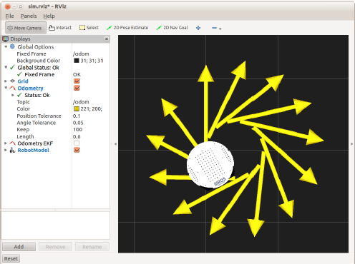
Twisting and Turning with ROS
ROS uses the Twist message type (see details below) for publishing motion commands to be used by the base controller. The base controller node subscribes to the /cmd_vel topic and translates Twist messages into motor signals that actually turn the wheels.
$rosmsg show geometry_msgs/Twist
geometry_msgs/Vector3 linear
float64 x
float64 y
float64 z
geometry_msgs/Vector3 angular
float64 x
float64 y
float64 z
$rostopic pub -r 10 /cmd_vel geometry_msgs/Twist ’{linear: {x: 0.15, y: 0, z: 0}, angular: {x: 0, y: 0, z: -0.4}}’

Slide 8
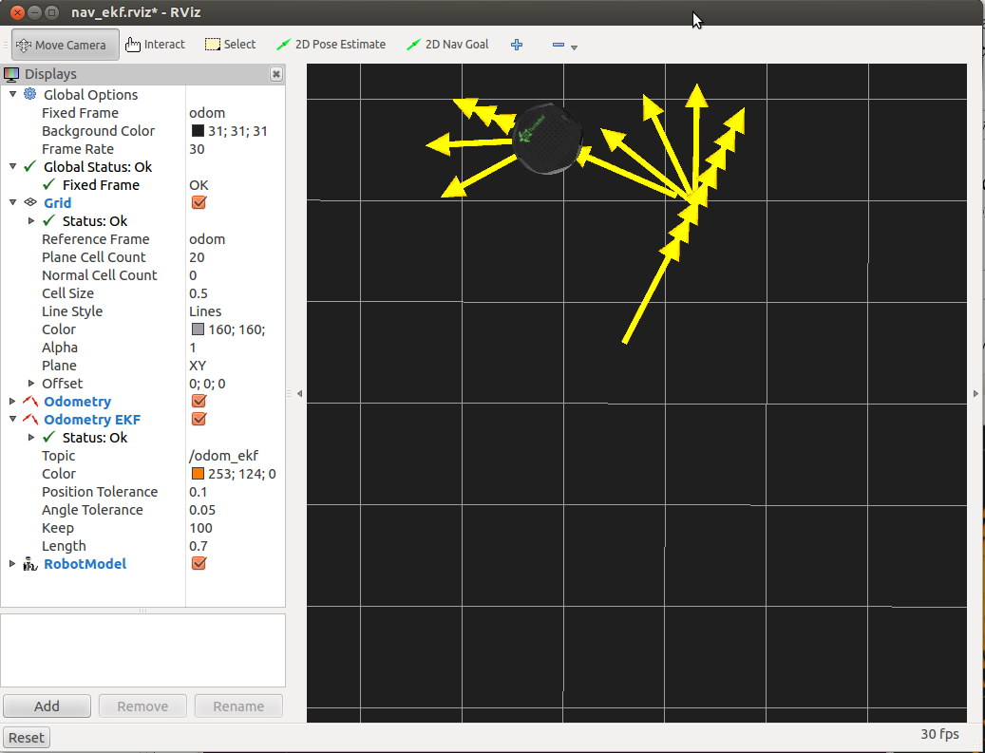
Goal 1 : Basic Motion of Mobile Base
Algorithm 1: Time and Speed based out and back (
$rosrun rbx1_nav timed_out_and_back.py)
rate = 50
goal_distance = 1.0 m
linear_speed = 0.2m/s
linear_duration = goal_distance / linear_speed;
angular_speed = 1.0
goal_angle = pi
angular_duration = goal_angle / angular_speed;
A: Repeat step 1 to 6 twice
1. ticks = linear_duration / rate
2. while(t < ticks)
robot will walk 1 meter straight
3. robot will sleep 1 cycle
4. ticks = goal_angle * rate
5. while(t<ticks)
robot rotates 180*
6. robot will sleep 1 cycle
B: Program Terminates

Slide 9
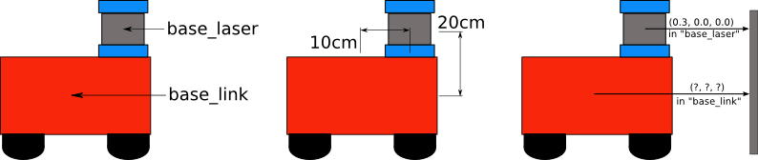
Goal 2 : Advanced Motion of Mobile Base
Such is the case for the turtlebot Odometry data we use to move the robot. While the /base link frame corresponds to a real physical part of Controlling a Mobile Base robot, the /odom frame is defined by the translations and rotations encapsulated in the odometry data. These transformations move the robot relative to the /odom frame. In ROS if we see the nav msgs/Odometry message structure, /odom is used as the parent frame and
/base_footprint (for turtlebot) as the child frame id. The transformation between these two frames, is with the help of tf library.

Slide 10
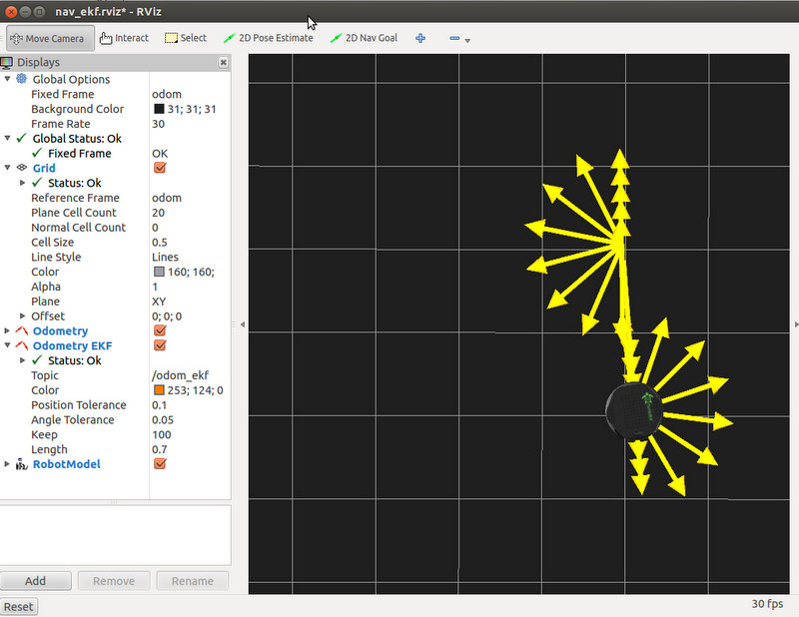
Goal 2 : Advanced Motion of Mobile Base
Algorithm 2: ODOMETRY based out and back (odom_out_and_back.py)
rate = 50
goal_distance = 1.0 m
linear_speed = 0.2m/s
linear_duration = goal_distance / linear_speed;
angular_speed = 1.0
goal_angle = pi
angular_duration = goal_angle / angular_speed;
A: Repeat step 1 to 6 twice
1. get initial position
2. while distance < goal_distance
robot will go at a speed set by linear_speed
sleep 1 cycle
get new linear position from ODOMETRY
calculate new distance from new position and old position
3. stop the robot
Set last_angle = rotation
turn_angle = 0
4. while (turn_angle < goal_angle)
start rotating
sleep 1 cycle
get new rotation position from ODOMETRY
delta_angle = (rotation - last_angle)
turn_angle += delta_angle
last_angle = rotation
5. stop the robot 1 cycle before next run
B: Program Terminates

Slide 11
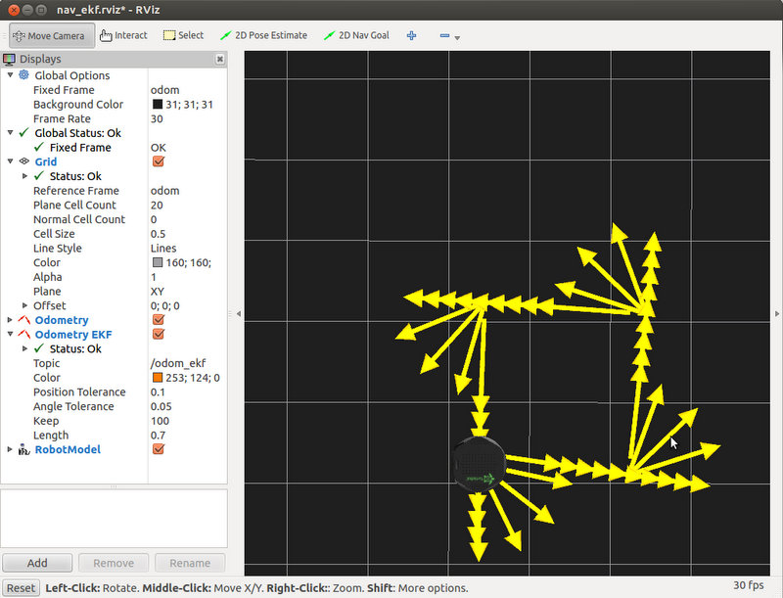
Goal 3 : Navigating a Square using Twist+Odometry
The nav square.py algorithm is nearly identical to the odometry-based out-and-back algorithm. The only
difference is that it we now send the robot along four 1 meter legs using 90 degree rotations instead of two 1 meter
legs using 180 rotations.
At the end of the run, we can see that the errors accumulated in odometry are visible, it didn’t move in a perfect square.

Slide 12
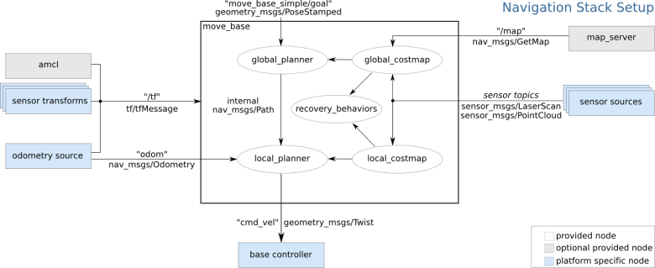
Goal 4: Navigation with Path Planning -> move_base
This package includes a node also called move_base, which subscribes to the topic /map of the node map_server, and to other topics as /odom, /tf (sensor transforms) and to the probabilistic localization system amcl (adaptive Monte Carlo localization approach), to control the robot movement and publishes to /cmd_vel topic

Slide 13
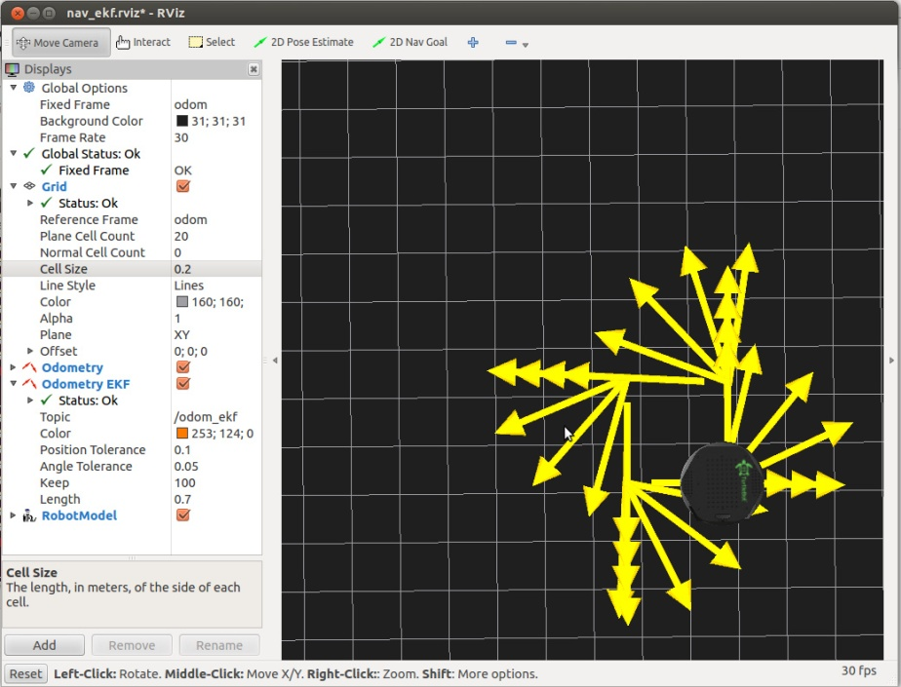
Goal 4: Navigation with Path Planning -> move_base
Move base nodes requires four configuration files before it can run. These files defines a number of parameters related to the cost of running into obstacle, the radius of the robot, the range of velocities, the resolution of the map, the robot base frame and how far the path planner should look.
The four configuration files can be found in the config subdirectory of the rbx1 nav package and are called:
- base local planner params.yaml
- costmap common params.yaml
- global costmap params.yaml
- local costmap params.yaml

Slide 14
Goal 4: Navigation with Path Planning -> move_base
The move_base package, which includes a path planner and is linked to the base_local_planner, a package that uses odometry besides global and local cost maps to define the path. With the move_base package it is possible to set a target position and orientation of the robot using a reference frame, and it will try to move the robot to the goal avoiding obstacles.
The move_base package uses messages of type MoveBaseActionGoal and includes sub-messages of type PoseStamped. This type of sub-message encompass a header and a pose, which contains a position and an orientation, given by a point of coordinates x, y, z and a quaternion of coordinates x, y, z, w, respectively.
Header header
uint32 seq
time stamp
string frame_id
actionlib_msgs/GoalID goal_id
time stamp
string id
move_base_msgs/MoveBaseGoal goal
geometry_msgs/PoseStamped target_pose
Header header
uint32 seq
time stamp
string frame_id
geometry_msgs/Pose pose
geometry_msgs/Point position
float64 x
float64 y
float64 z
geometry_msgs/Quaternion orientation
float64 x
float64 y
float64 z
float64 w

Slide 15
Android Control
Pairing and Demonstration

Slide 16
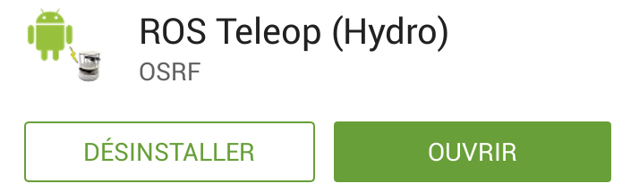
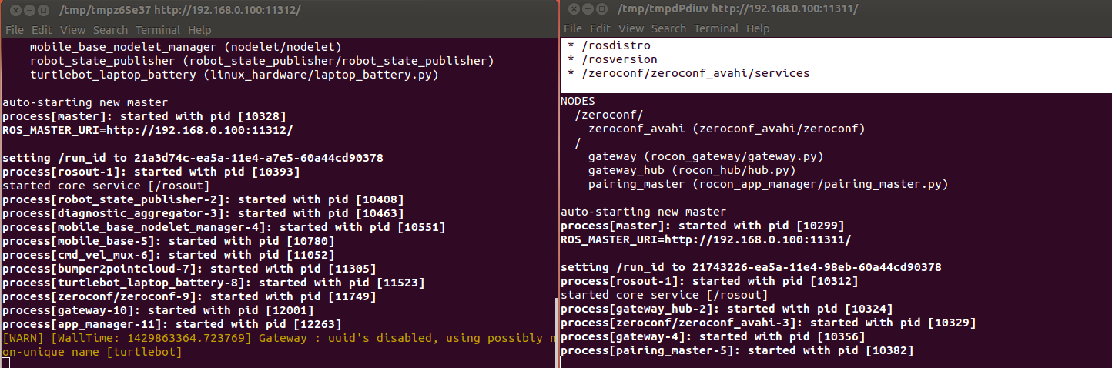
Pairing
Connect on the same Network
Download ROS Teleop (Hydro)
Bringup with concert file

Slide 17
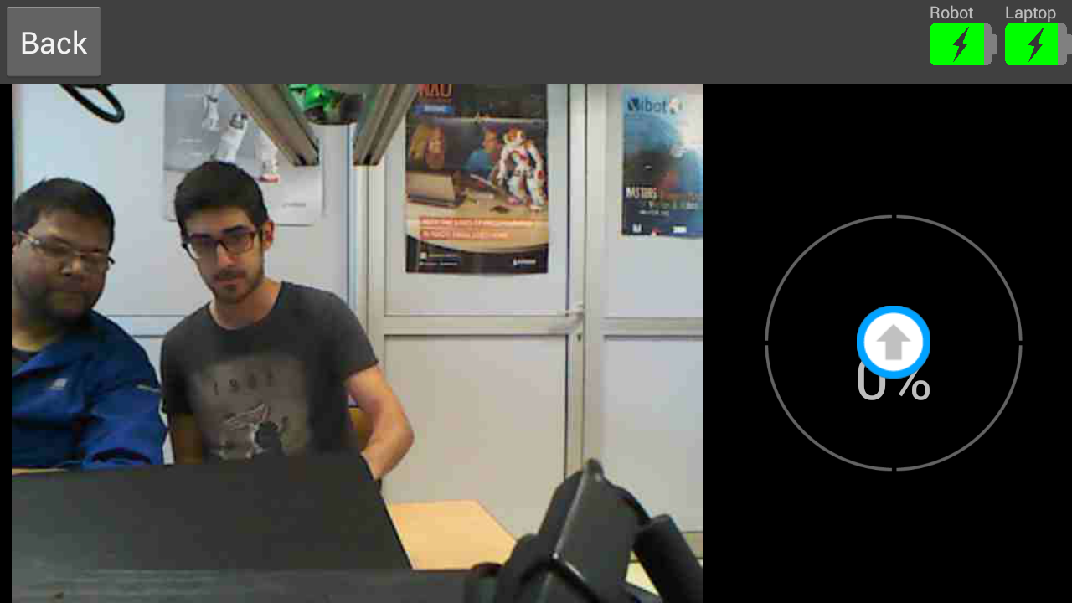
Demonstration
https://www.youtube.com/watch?v=pBYmtod4o18

Slide 18
Conclusion
Time spent on android code and home made concert file

