Slide 1
Untitled
Adolfo Alvarez

Slide 2
R Markdown
This is an R Markdown presentation. Markdown is a simple formatting syntax for authoring HTML, PDF, and MS Word documents. For more details on using R Markdown see http://rmarkdown.rstudio.com.
When you click the Knit button a document will be generated that includes both content as well as the output of any embedded R code chunks within the document.

Slide 3
Slide with Bullets
Bullet 1
Bullet 2
Bullet 3

Slide 4
Slide with R Output
## 84

Slide 5
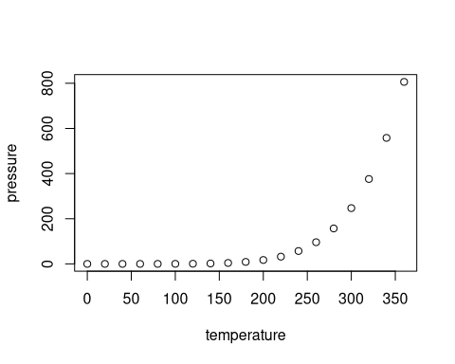
Slide with Plot

