Slide 1
Introduction to functions
Adolfo Alvarez

Slide 2
Definition:
A function $f$ assigns to each element $x$ in some set $S$ a unique element in a set $T$
The set $S$ is called the domain of $f$ or $Dom(f)$
For $x$ in $Dom(f)$, $f(x)$ is called the image of $x$ under $f$
The set of all images $f(x)$ is a subset of $T$ called the image of $f$, or $Im(f)$
$$Im(f)=f(x):x∈Dom(f)$$

Slide 3
Some examples
$f_{1}(x)=x^{2}$
$f_{2}(x)=\sqrt{(}x)$
$f_{3}(x)=log(x)$
$f_{4}(x)=sin(x)$
Are you familiar with them?
x is a variable, or input
$f(x)$ is the output, which has to be uniquely determined!
You need to know what values of x are allowed

Slide 4
Graphs
The graphical representation of the previous functions are:

Slide 5
Square function
$f(x)=x^{2}$

Slide 6
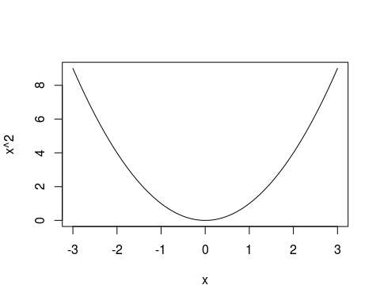

Slide 7
Square root function
$f_{2}(x)=\sqrt{(}x)$

Slide 8
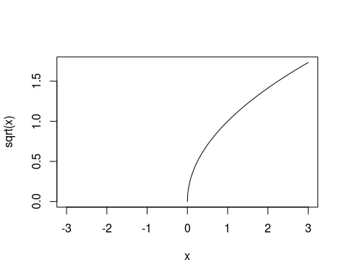

Slide 9
Logarithmic function
$f_{3}(x)=log(x)$

Slide 10
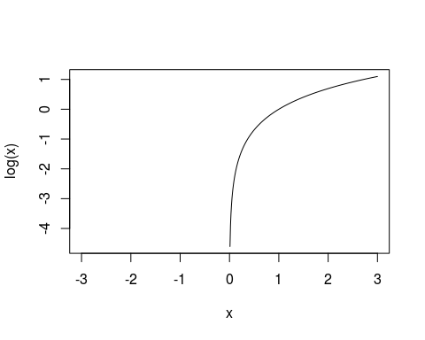

Slide 11
Exponential function
$f_{4}(x)=exp(x)$

Slide 12
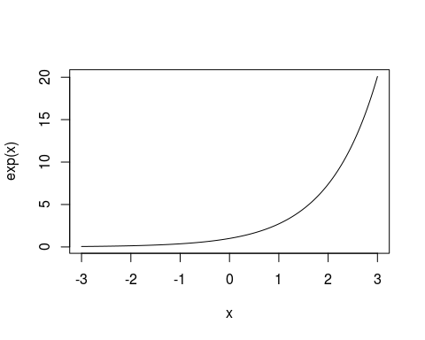

Slide 13
Sine function
$f_{5}(x)=sin(x)$

Slide 14
