Slide 1
btcTrackr : Finding and Displaying Clusters in Bitcoin
Aaron Doll, S Chagani,
Michael Kranch, and Vaidhyanath Murti

Slide 2
Overview
Michael
Motivation (Fistful of Bitcoins)
btcTrackr
Parser
Database
Website
Demonstration
Evaluation
Future Work

Slide 3
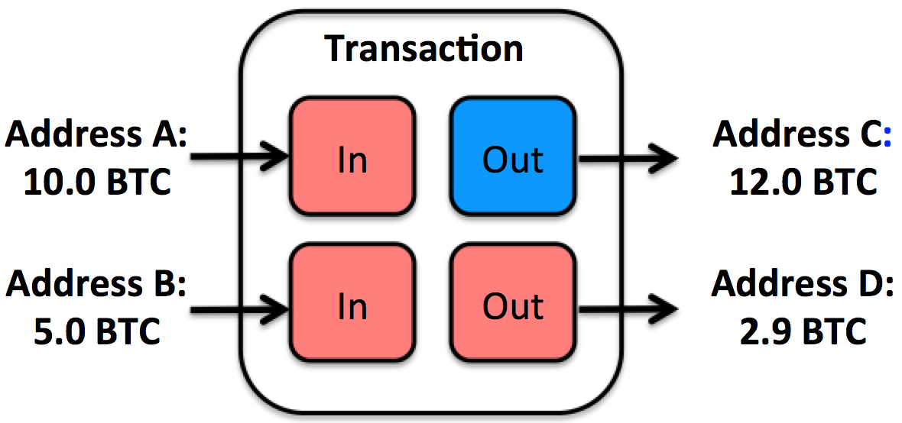
Fistful of Bitcoins
MICHAEL
Improve upon Existing Address Clustering
Heuristic 1 – All inputs
Heuristic 2 – Change Addresses
Current Implementation
Need significant by hand cleaning
Not in real-time

Slide 4
Motivation
MICHAEL
Issues Znort Parser
Resource Requirement
Time
System Goals
Real-time implementation
Responsive user interface
Setup for additional features

Slide 5
btcTrackr
Aaron
Parser
Libbitcoin

Slide 6
btcTrackr
SHAHEED
Database

Slide 7
btcTrackr
VAIDHY
Website

Slide 8
btcTrackr
AARON
Parser
Libbitcoin

Slide 9
DEMO

Slide 10
Evaluation
SHAHEED
BitIodine

Slide 11
Future Work
AARON
OpenFlow Protocol
Header
Bootstrapping a Controller

