Slide 1
btcTrackr : Finding and Displaying Clusters in Bitcoin
Aaron Doll, S Chagani,
Michael Kranch, and Vaidhyanath Murti

Slide 2
Overview
Michael
Motivation (Fistful of Bitcoins)
Challenges and Goals
btcTrackr System
Parser
Database
Website
Demonstration
Evaluation
Future Work

Slide 3
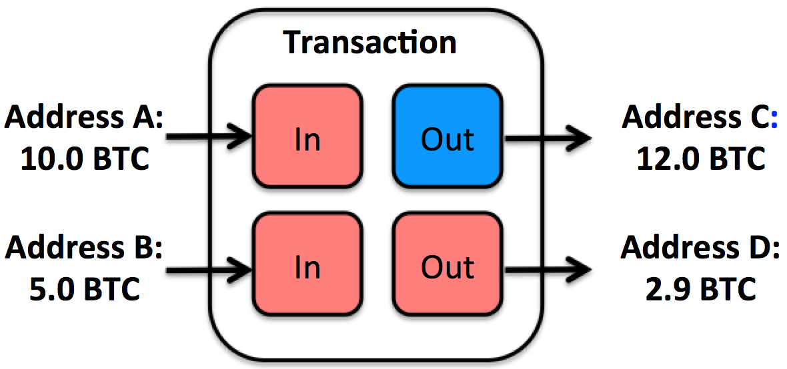
Motivation (Fistful of Bitcoins)
Improve upon Existing Address Clustering
Heuristic 1 – All inputs
Heuristic 2 – Change Addresses
Current Implementation
Need significant by hand cleaning
Not in real-time
Znort Parser

Slide 4
Goals / Challenges
MICHAEL
Challenges
Resource management
Continually updating information
Legacy block chain information
Integration of systems
System Goals
Real-time responses
Accurate
Expandable

Slide 5
btcTrackr
Aaron
Parser
Libbitcoin

Slide 6
btcTrackr
SHAHEED
Database

Slide 7
btcTrackr
VAIDHY
Website

Slide 8
btcTrackr
AARON
Parser
Libbitcoin

Slide 9
DEMO

Slide 10
Evaluation
SHAHEED
BitIodine

Slide 11
Future Work
AARON

