Slide 1
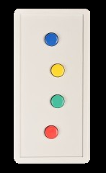
You are about to watch a 8 minute long TV episode by Alfred Hitchcock
Lie back, relax, and enjoy the show!
Pay close attention as we will be asking you a few questions at the end…
Press this button when you are ready!

Slide 2
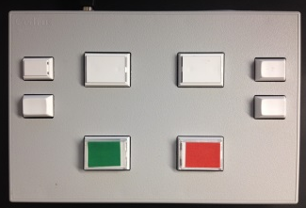
You are about to watch a 8 minute long TV episode by Alfred Hitchcock
Lie back, relax, and enjoy the show!
Pay close attention as we will be asking you a few questions at the end…
Press this button when you are ready!

Slide 3
You are about to watch a 20-minute long TV episode by Alfred Hitchcock
Lie back, relax, and enjoy the show!
Press this button when you are ready!

Slide 4
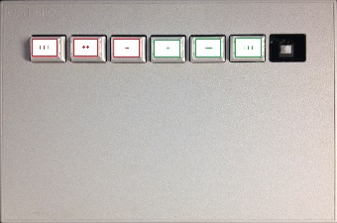
You are about to watch a 8 minute long TV episode by Alfred Hitchcock
Lie back, relax, and enjoy the show!
Pay close attention as we will be asking you a few questions at the end…
Press this button when you are ready!

Slide 5

You are about to watch a 8 minute long TV episode by Alfred Hitchcock
Lie back, relax, and enjoy the show!
Pay close attention as we will be asking you a few questions at the end…
Press 1
when you are ready

Slide 6
Now some questions!
You are going to answer 7 multiple-choice questions about the movie you just watched
For example:
In what country is the movie taking place?
France
USA
England
Germany
Use this button to select the next choice (it will get highlighted in blue)
Use this button to confirm your answer (the one that is currently blue)
Press this button when you are ready!
You will get feedback: the answer you selected will turn green if it was correct, and red if it was incorrect

Slide 7

Now some questions!
You are going to answer 7 multiple-choice questions about the movie you just watched
For example:
In what country is the movie taking place?
France
USA
England
Germany
Use this button to select the next choice (it will get highlighted in blue)
Use this button to confirm your answer (the one that is currently blue)
Press 1
when you are ready
You will get feedback: the answer you selected will turn green if it was correct, and red if it was incorrect

Slide 8
Now some questions!
You are going to answer 7 multiple-choice questions about the movie you just watched
For example:
In what country is the movie taking place?
France
USA
England
Germany
Use this button to select the next choice (it will get highlighted in blue)
Use this button to confirm your answer (the one that is currently blue)
Press this button when you are ready!
You will get feedback: the answer you selected will turn green if it was correct, and red if it was incorrect

Slide 9
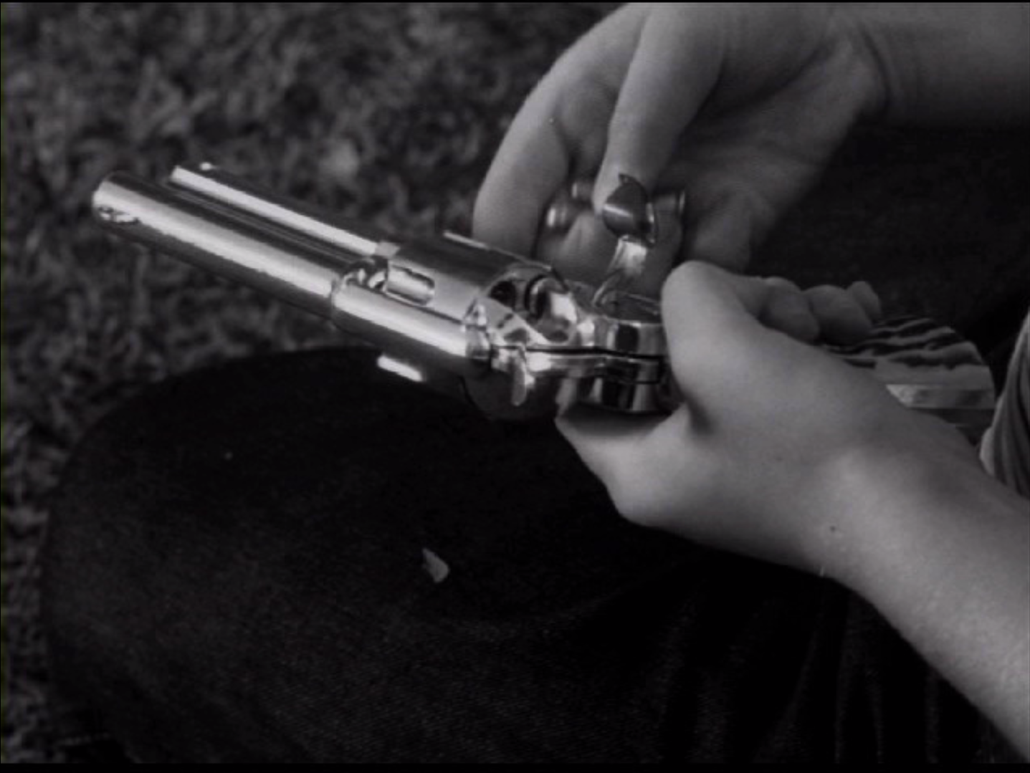
A little memory game
You are going to see 40 images, 20 of which were extracted from the movie you just saw. Your task is to indicate whether each image was in the movie or not.
For example:
Use this button if the image was PRESENT in the movie (OLD)
OLD
??
NEW
Use this button if the image was ABSENT from the movie (NEW)
Press this button when you are ready!

Slide 10
A little memory game
You are going to see 40 images, 20 of which were extracted from the movie you just saw. Your task is to indicate whether each image was in the movie or not.
For example:
Use this button if the image was ABSENT from the movie (NEW)
NEW
??
OLD
Use this button if the image was PRESENT in the movie (OLD)
Press this button when you are ready!

Slide 11

A little memory game
You are going to see 40 images, 20 of which were extracted from the movie you just saw. Your task is to indicate whether each image was in the movie or not.
For example:
Use this button if the image was PRESENT in the movie (OLD)
OLD
??
NEW
Use this button if the image was PRESENT in the movie (OLD)
Press 1
when you are ready

Slide 12
A little memory game
You are going to see 40 images, 20 of which were extracted from the movie you just saw. Your task is to indicate whether each image was in the movie or not.
For example:
Use this button if the image was ABSENT from the movie (NEW)
NEW
??
OLD
Use this button if the image was ABSENT from the movie (NEW)
Press 1
when you are ready

Slide 13
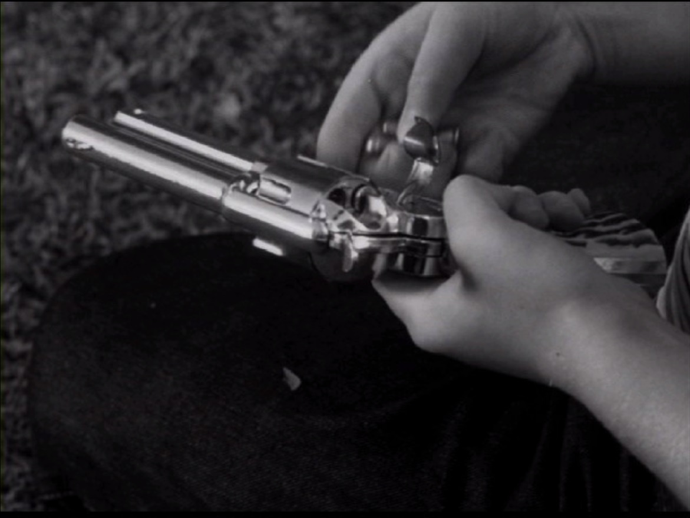
A little memory game
You are going to see 40 images, 20 of which were extracted from the movie you just saw. Your task is to indicate whether each image was in the movie or not.
For example:
Use this button if the image was PRESENT in the movie (OLD)
OLD
??
NEW
Use this button if the image was ABSENT from the movie (NEW)
Press this button when you are ready!

Slide 14
A little memory game
You are going to see 40 images, 20 of which were extracted from the movie you just saw. Your task is to indicate whether each image was in the movie or not.
For example:
Use this button if the image was ABSENT from the movie (NEW)
NEW
??
OLD
Use this button if the image was PRESENT in the movie (OLD)
Press this button when you are ready!

Slide 15
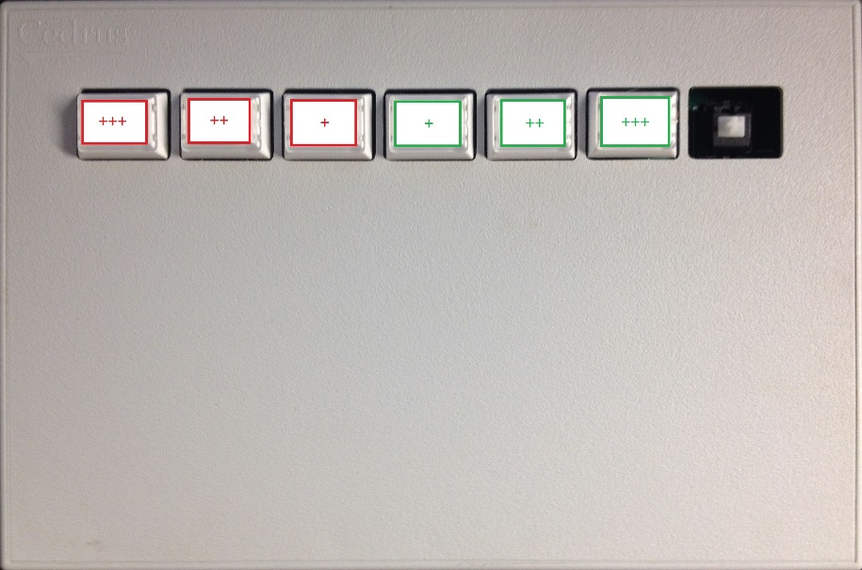
A little memory game
You are going to see 40 images, 20 of which were extracted from the movie you just saw. Your task is to indicate whether each image was in the movie or not, and how confident you are.
For example:
OLD
??
NEW
OLD NEW
GUESSING
OLD
UNSURE
NEW
UNSURE
OLD
SURE
NEW
SURE
Press this button when you are ready!

Slide 16
A little memory game
You are going to see 40 images, 20 of which were extracted from the movie you just saw. Your task is to indicate whether each image was in the movie or not, and how confident you are.
For example:
NEW
??
OLD
NEW OLD
GUESSING
NEW
UNSURE
OLD
UNSURE
NEW
SURE
OLD
SURE
Press this button when you are ready!

Slide 17
A little memory game
You are going to see 40 images, 20 of which were extracted from the movie you just saw. Your task is to indicate whether each image was in the movie or not, and how confident you are.
For example:
OLD
??
NEW
OLD NEW
GUESS GUESS
OLD
UNSURE
NEW
UNSURE
OLD
SURE
NEW
SURE
Press 1
when you are ready

Slide 18
A little memory game
You are going to see 40 images, 20 of which were extracted from the movie you just saw. Your task is to indicate whether each image was in the movie or not, and how confident you are.
For example:
NEW
??
OLD
NEW OLD
GUESS GUESS
NEW
UNSURE
OLD
UNSURE
NEW
SURE
OLD
SURE
Press 1
when you are ready

