Slide 1
Barcode scan processing decision
Why scans feel slower in the new web workflow
The current Loading flow protects backend consistency, but it creates a short busy window that can miss rapid back-to-back scans.
2-3 sec
1 at a time
50?
Typical full scan cycle
Current processing model
Management queue decision
Goal: decide how much scan-ahead behavior production should support.
Notes:
Open with the business point: this is not a scanner hardware problem. It is a workflow and architecture decision about how much scan-ahead behavior we want to support.

Slide 2
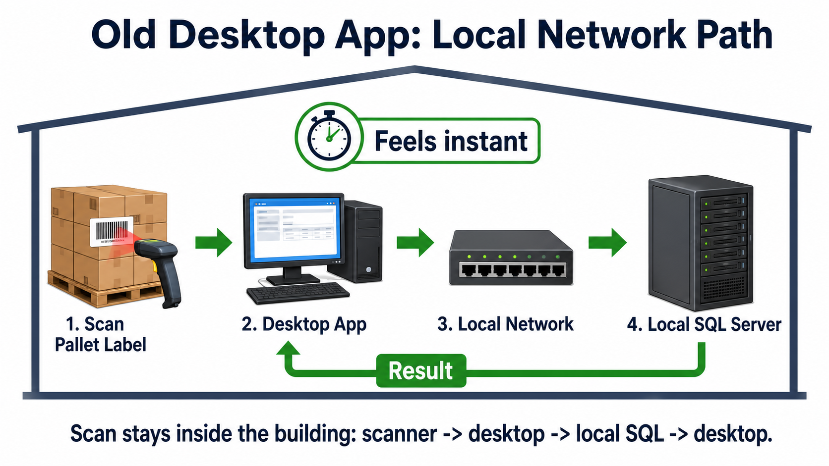
Notes:
The old app feels instant because the scan stays inside the building. The desktop app talks to local SQL across the LAN and the result comes straight back.

Slide 3
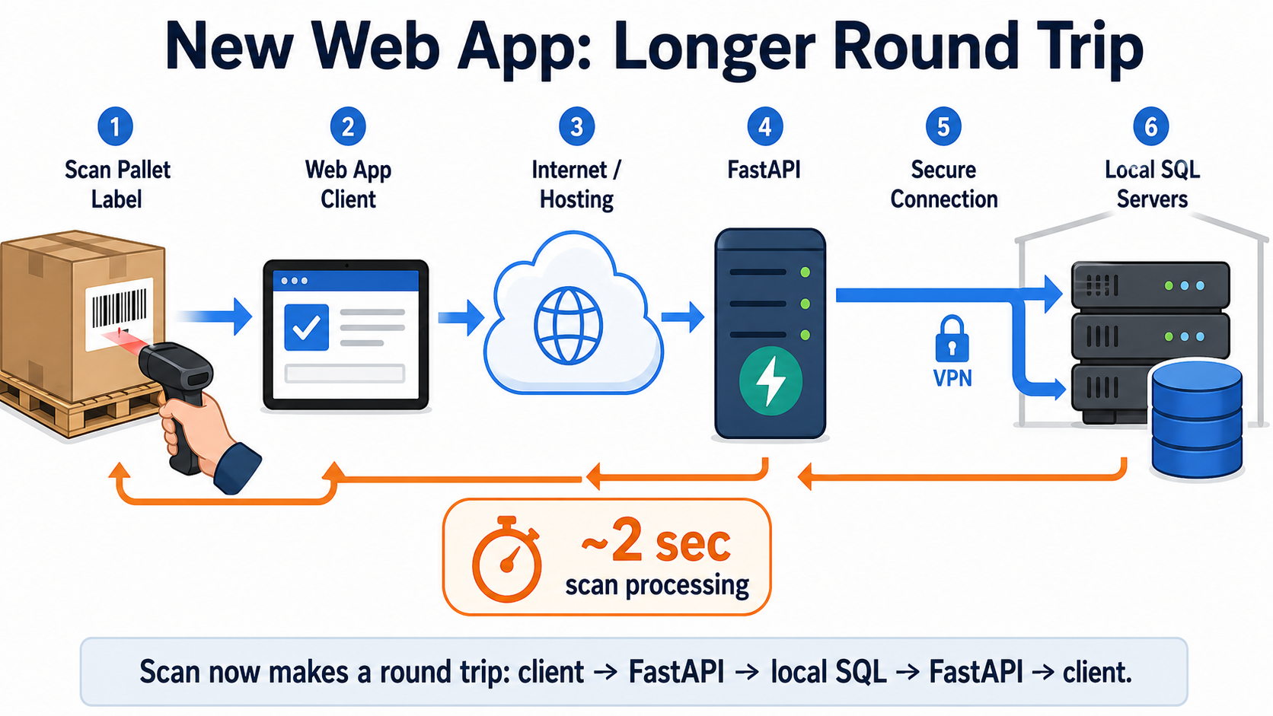
Notes:
The new web workflow has more hops. The client sends the scan to FastAPI, FastAPI reaches back to the local SQL servers, and the response returns to the client.

Slide 4
What happens after one Loading scan
The app waits for the full backend cycle before it is clearly ready for the next label.
1. Scan accepted
->
2. Backend work
->
3. Data refresh
Scanner input submits one barcode into the Loading page.
App waits for the FastAPI scan response from the SQL-backed process.
Loading data refreshes, then the input is ready again.
In real use, that full cycle could take around 2-3 seconds. During that window, the scanner input was effectively busy.
Notes:
This slide explains the real bottleneck. We were processing one scan at a time: accept scan, wait for backend response, refresh loading data, then accept the next scan.

Slide 5
Why operators experienced lag
The issue was most visible when labels were scanned back-to-back quickly.
Busy window
Missed label risk
While one scan was processing, another scan could arrive too early.
If a second label arrived during that window, the app could ignore or miss it.
No busy signal
No queue visibility
There was no clear on-screen state showing the app was unable to accept the next scan.
Operators could not see which scans were waiting, processed, or failed.
Barcode reality
Old workflow perception
If a scan is missed, operators cannot reliably know which barcode needs to be repeated.
The old app let operators keep scanning without noticing the same dead time.
Notes:
The operator experience matters: this felt like a scanner or app problem. The higher-risk case is fast batch scanning, because a missed barcode is hard to identify afterward.

Slide 6
What the queue change is meant to fix
A queue does not make the backend instant. It protects scans entered while the app is busy.
Scan ahead
Visible queue
One-by-one backend
->
->
Operator can scan while the prior label is still processing.
The app holds waiting scans and shows pending, processed, and failed states.
The backend still processes in order, reducing missed scans without changing core scan behavior.
The first queue size was conservative at 5: enough for small bursts, not enough for fast larger batches.
Notes:
The key distinction: a queue is not a performance optimization by itself. It is a reliability and operator-flow improvement. It prevents scans from disappearing while the backend is busy.

Slide 7
Decision needed: how much scan-ahead should production allow?
The queue size is a business risk choice, not only a technical setting.
Option
What it helps
Tradeoff
5
Small bursts; lowest behavior change from current production.
Still exposes larger fast batches to missed-scan risk.
50
Supports real scan-ahead behavior for production batch work.
Requires clear visible queue states and operator guidance.
Recommended direction: approve a larger visible queue for Loading, with pending / processed / failed status visible on screen.
Notes:
Close with the decision. If management wants operators to scan like they did before, a larger visible queue is the practical direction. If they prefer minimal behavior change, keep 5 and accept that it only handles small bursts.

