Slide 1
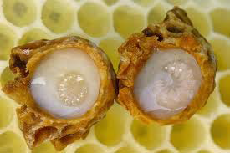
Changes of Physicochemical and Bioactive Properties of Royal Jelly During Storage and Determination of 10-hydroxy-2-decenoic Acid as Quality Parameter
Assoc. Prof. Dr. Osman Gül
Dr. Murat Emir

Slide 2
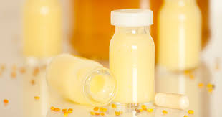
Introduction
Royal jelly (RJ) is secreted from the hypopharyngeal and mandibular glands of young worker honey bees of Apis mellifera to feed the queen larva.
Royal jelly (RJ) is a viscous, whitish to yellow nutritious food.

Slide 3
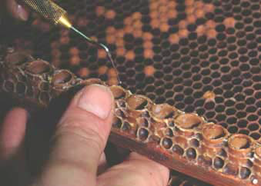
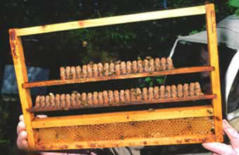
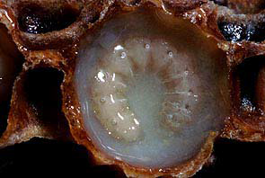
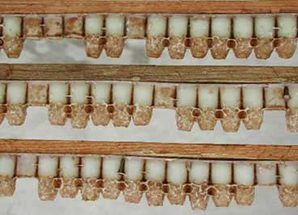
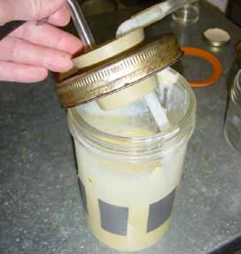
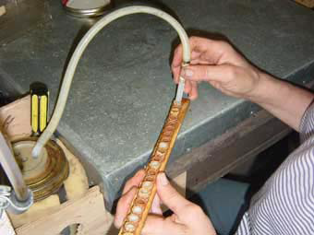
Royal jelly production steps
Introduce drop of royal jelly in each artificial cell (image 1).
Take a young larvae (less than three days old) from a comb and place it in the cell (image 1). Introduce frame in
the hive. The bees start raising the queens: Images 2, 3.
After 3-4 days the maximum amount of RJ is produced. The
queen larvae is in a cell full of RJ. About 0.3 g of RJ is in the cell, ready for harvest: Image 4.
The RJ is sucked off with a pipette and filtered (filter mesh-size 0.2 mm). Store clean RJ in a cool dark place:
Images 5 and 6

Slide 4
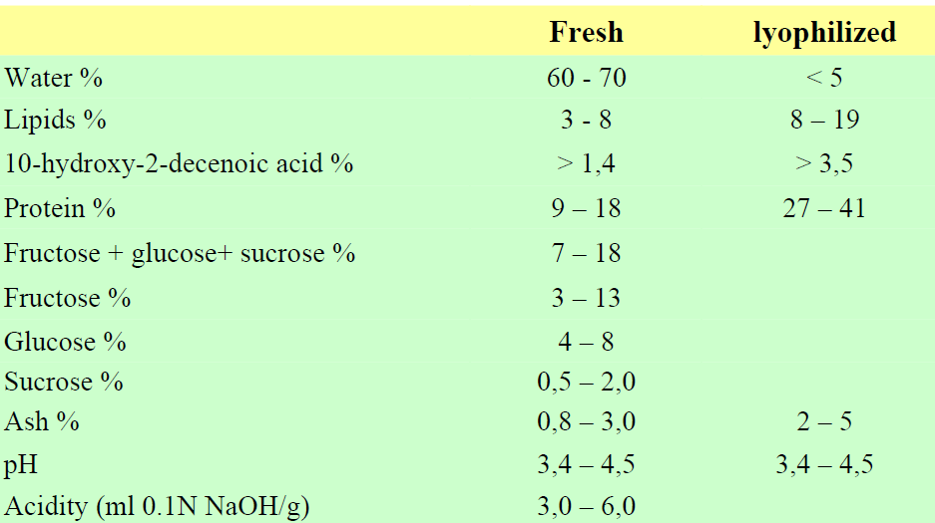
Composition of Royal Jelly

Slide 5
Health-Beneficial Properties
It has been reported that RJ has antitumor (Nakaya et al., 2007; Izuta et al., 2009), antibacterial (Fujiwara et al., 1990), cardioprotective (Krylov et al., 2006), hypotensive (Tokunaga et al., 2004), antiinflammatory (Kohno et al., 2004), antifatigue (Kamakura et al., 2001), hypoglycaemic activity (Fujii et al., 1990) and estrogenic effect (Mishima et al., 2005).
Furthermore, RJ has anti-inflammatory activity (Fujii et al., 1990), liverprotecting activity (Karadeniz et al., 2011; Kanbur et al., 2009) and promotes collagen production (Koya-Miyata et al., 2004).

Slide 6
The main objective of this study is to determine the changes in the;
physicochemical properties
antioxidant activity
phenolic content
10-HDA content in Royal jelly during one year of storage at different temperature.

Slide 7
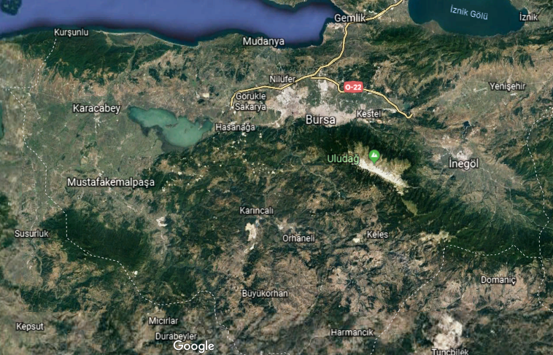
Material and Methods
Samples: The royal jelly samples investigated in this study were supplied by beekeepers from the western parts of Turkey (Bursa).

Slide 8
Material and Methods
Moisture content: Moisture content was determined by gravimetric analysis after drying at 105 °C to constant weight.
pH analysis: The pH measurement was carried at 25ºC by calibrated pH meter
Total phenolic content: The total phenolic content in samples was determined with Folin-Ciocalteu method.

Slide 9
Material and Methods
Determination of 10-HDA
Extraction
About 2.5 g of RJ was dissolved by sonication in 100 ml of a methanol solution (50:50 v/v with ultrapure water) adjusted at pH=2.5 with phosphoric acid.
Determination of 10-HDA content
The 10-HDA content of RJ was determined by high performance liquid chromatography with diode array detection (HPLC-DAD).
Column | Shimadzu, 150 x 4.0 mm x 5 μm
Flow rate | 0.5 mL/min
Detector | 225 nm
Mobile phase | Methanol/water (45:55 v/v) pH 2.5

Slide 10
Analytical technique | 10-HDA concentration (mg/L) | Regression equation | r² | Mean Recovery±SD
HPLC | 10-1000 | Y=0.2931x-0.9434 | 0.9999 | 97.06±1.54
Table 1. HPLC calibration curve parameters

Slide 11
Results and Discussions
Total solid and pH values
Figure 2. Variation of total solid contents and pH values of royal jelly samples during storage

Slide 12
Results and Discussions
Total phenolic content
Storage (Month) | Samples | -18ºC | 4ºC
1 | A | 14.69±0.11 | 14.39±0.21
 | C | 16.46±0.09 | 16.48±0.09
 | E | 14.23±0.04 | 14.10±0.26
3 | A | 14.50±0.11 | 12.55±0.13
 | C | 15.74±0.15 | 14.92±0.03
 | E | 13.88±0.22 | 13.06±0.21
6 | A | 13.94±0.28 | 10.48±0.15
 | C | 14.12±0.07 | 13.16±0.18
 | E | 13.47±0.16 | 11.82±0.22
9 | A | 13.33±0.14 | 8.43±0.12
 | C | 13.86±0.06 | 11.82±0.17
 | E | 13.11±0.08 | 10.98±0.07
12 | A | 11.65±0.16 | 6.76±0.09
 | C | 11.86±0.21 | 8.74±0.12
 | E | 12.39±0.20 | 8.05±0.11
Table 2. Variation of total phenolic content during storage (mg GAE/g)

Slide 13
Figure 2. Percent change of TPC during storage at different temperature

Slide 14
Results and Discussions
Storage (Month) | Samples | -18ºC | 4ºC
1 | A | 1.208±0.017 | 1.195±0.017
 | C | 1.424±0.011 | 1.386±0.011
 | E | 1.463±0.012 | 1.453±0.012
3 | A | 1.199±0.008 | 1.137±0.009
 | C | 1.416±0.007 | 1.317±0.010
 | E | 1.457±0.011 | 1.416±0.011
6 | A | 1.150±0.016 | 1.078±0.007
 | C | 1.366±0.010 | 1.227±0.011
 | E | 1.378±0.013 | 1.285±0.015
9 | A | 1.135±0.016 | 1.021±0.007
 | C | 1.336±0.011 | 1.126±0.018
 | E | 1.336±0.010 | 1.203±0.006
12 | A | 1.114±0.008 | 0.904±0.009
 | C | 1.242±0.011 | 0.917±0.011
 | E | 1.288±0.016 | 1.048±0.009
Table 2. Variation of 10-HDA content during storage at -18 and 4ºC

Slide 15
Figure 2. Percent change of 10-HDA content (% of fresh matter) during storage at different temperature

Slide 16
Conclusion
pH and total solid contents of samples slightly changed during storage at 4 ºC,
Total phenolic content of samples significantly decreased during storage period.
10-HDA content decreased significantly from 1.38% to 0.96% after storage period at 4 ºC, while it decreased little (from 1.37% to 1.21%) when the RJ was stored at -18 ºC.
The quality and freshness of RJ was significantly influenced by storage time and temperature.

