Slide 1
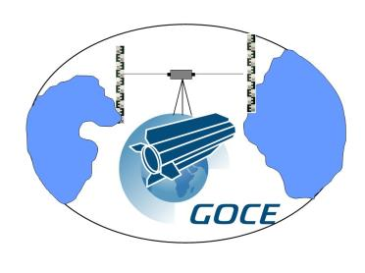
Scientific Roadmap towards Height System Unification with GOCE
Th. Gruber⁽¹⁾, R. Rummel^{(1),} M. Sideris⁽²⁾, E. Rangelova⁽²⁾, P. Woodworth⁽³⁾,
C. Hughes⁽³⁾, J. Ihde⁽⁴⁾, G. Liebsch⁽⁴⁾, A. Rülke⁽⁴⁾, Ch. Gerlach⁽⁵⁾,
R. Haagmans⁽⁶⁾
⁽¹⁾ Institute for Astronomical and Physical Geodesy, Technical University Munich, Germany
⁽²⁾ Department of Geomatics Engineering, University of Calgary, Canada
⁽³⁾ National Oceanography Centre, Liverpool, United Kingdom
⁽⁴⁾ Bundesamt für Kartographie und Geodäsie (BKG), Frankfurt/Main, Germany
⁽⁵⁾ Kommission für Erdmessung und Glaziologie, Bayerische Akademie der Wissenschaften, Munich Germany
⁽⁶⁾ European Space Agency, The European Space Research and Technology Centre, Noordwijk, The Netherlands
ESA Project:
Support to Science Element (STSE) GOCE+ Theme 1: Height System Unification (HSU)
5th International GOCE User Workshop, Paris, 27.11.2014

Slide 2
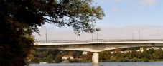

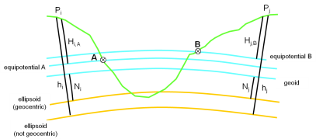
Outline
Problem Overview
Essential Tasks (Scientific Roadmap)
Diagnosis of Height Systems
Global Height System Unification
Ocean Levelling
GNSS/Levelling in well surveyed Land Areas
GNSS/Levelling in sparsely surveyed Land Areas
Conclusions
Upper-Rhine Bridge; Germany – Switzerland:
27 cm height offset applied with wrong sign

Slide 3
Problem Overview
GPS Benchmarks
Local Vertical Datum (Equipotential Surface)
Tide Gauge Benchmark
Local Physical Height
Levelling Network
Local Geoid Height
GOCE Equipotential Surface (long wavelengths)
GOCE Physical Height
GOCE Geoid Height
True Equipotential Surface (short wavelengths)
Omission Error
C
B
A
Vertical Datum C
Vertical Datum B
Vertical Datum A

Slide 4
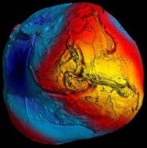
Scientific Roadmap – Essential Tasks
The geopotential and geoid improvements resulting from GOCE are the basis of a reassessment of global height systems
Diagnosis of existing height systems by comparison with GOCE geoid

Slide 5
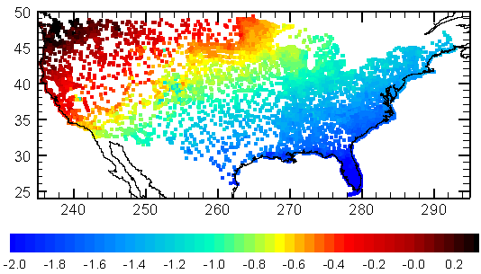
Scientific Roadmap – Diagnosis of Height Systems
Diagnosis of existing Height Systems by Comparison of GPS/Levelling with GOCE Geoid
US GPS/Levelling vs. GOCE-TIM5 Geoid
Australian GPS/Levelling vs. GOCE-TIM5 Geoid
Canadian GPS/Levelling vs. GOCE-TIM5 Geoid
Reference:
Long-wavelength errors of the US vertical datum (Wang et al., 2012)

Slide 6
Scientific Roadmap – Diagnosis of Height Systems
Diagnosis of existing Height Systems by Comparison of GPS/Levelling with GOCE-TIM5 Geoid for some European Countries
France
UK
Germany
40 cm
30 cm
25 cm
Italy
Netherlands
40 cm
5 cm

Slide 7
Scientific Roadmap – Diagnosis of Height Systems
GPS Benchmarks
GOCE Equipotential Surface (long wavelengths)
Tide Gauge Benchmark
GOCE Physical Height
Levelling Network
Regional Height Reference Surface (Geoid?)
Regional Height
C
B
A
Vertical Datum C
Vertical Datum B
Vertical Datum A

Slide 8
Scientific Roadmap – Diagnosis of Height Systems
Diagnosis of existing Height Systems by Comparison of GPS/Levelling with GOCE-TIM5
- before and after subtracting a regional Correction Surface
GPS-Lev. Geoid Differences
Correction Surface
Residual Differences
What causes these systematic differences: GOCE geoid, Levelling or GPS Heights?
GOCE geoid error is below 2 cm globally – cannot be the reason.
Levelling is sensitive to systematic distortions – most likely the main reason.
Observation GPS height error 1-2 cm randomly distributed – cannot be the reason.
But what about the coordinate frames?

Slide 9
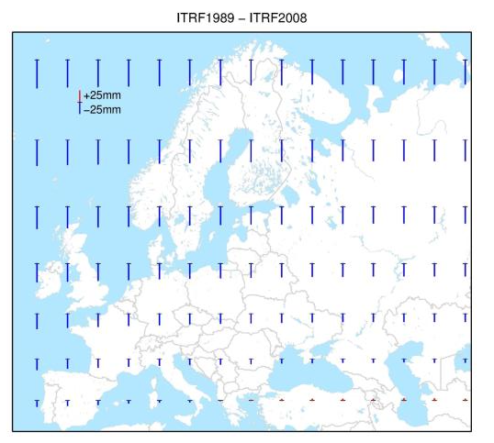
Scientific Roadmap – Diagnosis of Height Systems
Impact of Coordinate Frame Transformations on GPS Heights
(Study performed by G. Liebsch, BKG)
GPS and geoid heights need to be in a consistent frame.
GOCE geoid heights refer to CoM.
GPS heights refer to an ITRFxxxx with a center of origin which is not consistent to CoM.
ITRF2008 is known to be close to CoM.
ITRF1989 (ETRF1989) to ITRF2008 offset is (x,y,z): 2.8 - 3.9 - 10.1 cm
7 parameter Helmert transformation (plus linear trends) result in height change of up to 7 cm in Europe (see figure).
When GPS and GOCE geoid heights are jointly used in GPS-Levelling this needs to be taken into account.

Slide 10
Scientific Roadmap – Essential Tasks
The geopotential and geoid improvements resulting from GOCE are the basis of a reassessment of global height systems
Global Height System Unification
Realization of a globally unified height system but confined to a global set of primary stations (national datum points, fundamental stations, primary tide gauges, primary clocks).
Diagnosis of existing height systems by comparison with GOCE geoid (100 km)

Slide 11
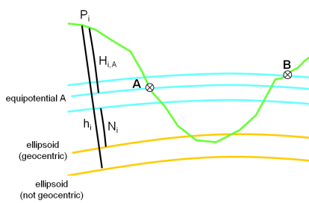
Scientific Roadmap – Global Height System Unification
from spirit levelling referring to height datum A (e.g. tide gauge)
from GNSS positioning referring to a specific ellipsoid
Geoid
Observed Geoid Height referring to vertical Datum A
Computed Geoid Height referring to “mean” Geoid
Observation Equation
Geoid height from GOCE model
Residual geoid height (omission)
Height System Offset wrt. Geoid
Geoid Height Offset of vertical Datum A wrt. “mean” Geoid.

Slide 12
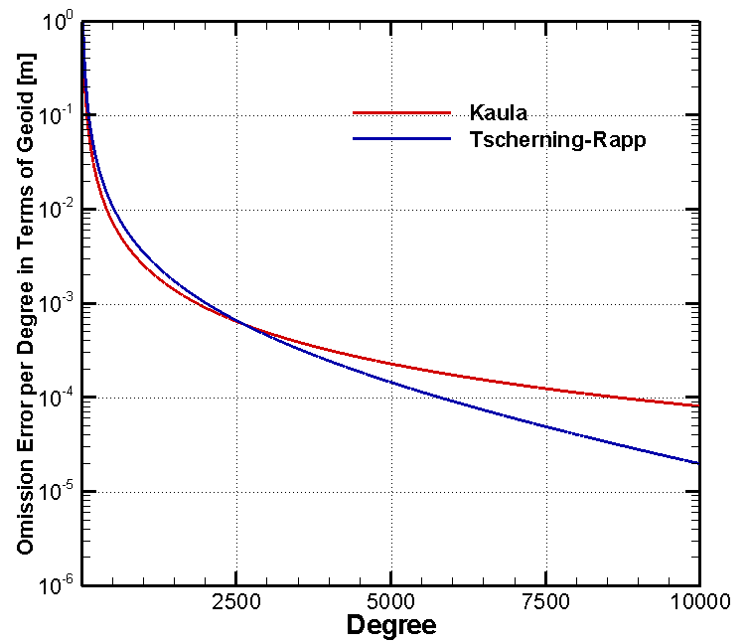
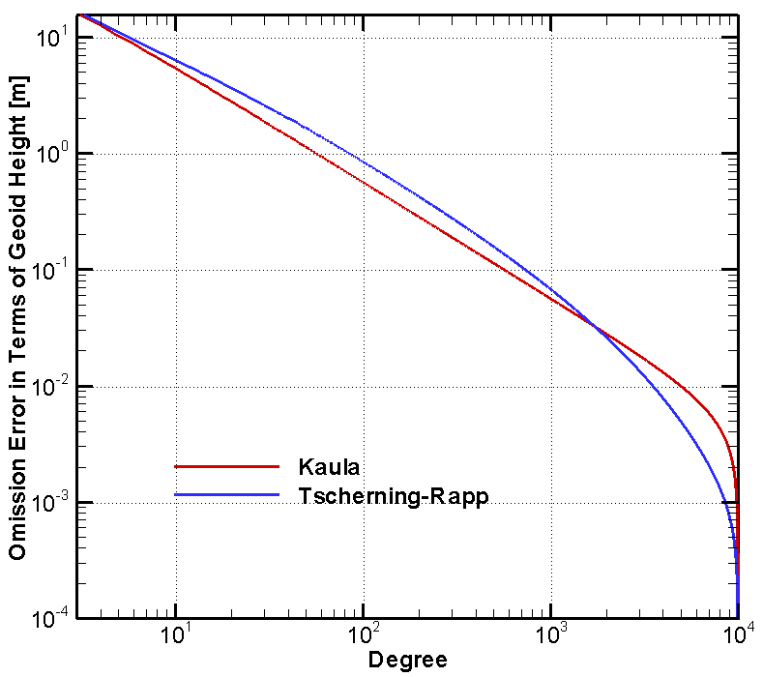
Scientific Roadmap – Global Height System Unification
Omission Error
per degree
from degree (to infinity)
Omission error can be estimated from EGM2008 and/or residual terrain modelling

Slide 13
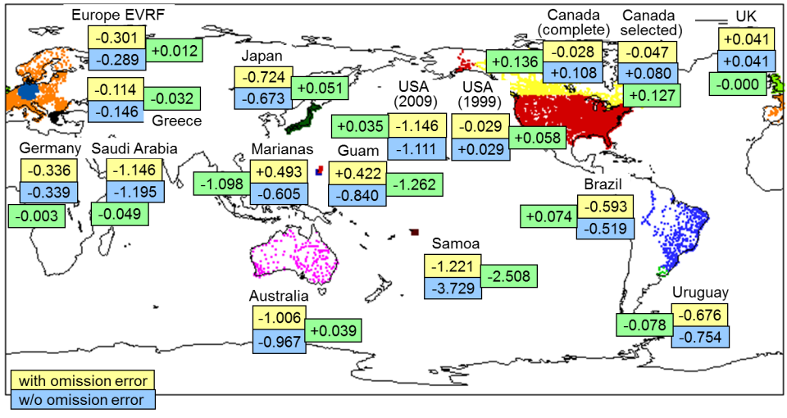
Scientific Roadmap – Global Height System Unification
GOCE –TIM5 Model truncated at D/O 200

Slide 14
Scientific Roadmap – Global Height System Unification
GOCE
Geoid
+4
England
GOCE-TIM5 (0-200) &
EGM2008 (201-2190)
-11
-2
-3
-34
-72
Canada
USA
(1999)
-101
Greece
-59
Australia
(Mainland)
-115
+67
Germany
Brazil
-81
Japan
USA
(2009)
+14
GOCE-TIM5 (0-200)
GOCE
Geoid
+4
+11
+3
Results from Rapp (1994) (Bulletin Geodesique 69, p.26-31) based on JGM-2 / OSU91A and Geoid Heights on Doppler Stations.
England
Canada
USA
(1999)
-15
-34
-67
Greece
-52
-97
-111
Australia
(Mainland)
+63
Germany
+72
Brazil
-77
-76
Japan
USA
(2009)
+14
+4

Slide 15
Scientific Roadmap – Essential Tasks
The geopotential and geoid improvements resulting from GOCE are the basis of a reassessment of global height systems
Global Height System Unification
Realization of a globally unified height system but confined to a global set of primary stations (national datum points, fundamental stations, primary tide gauges, primary clocks).
Diagnosis of existing height systems by comparison with GOCE geoid (100 km)
Realization of a globally consistent model of mean dynamic ocean topography at tide gauges and at sea (Ocean Levelling).
Open Oceans and Coastal Zones

Slide 16
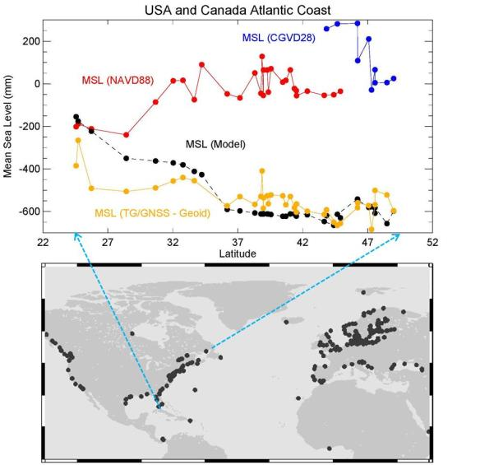
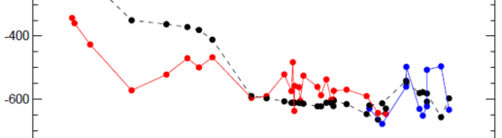
Scientific Roadmap – Ocean Levelling
(Study performed by Phil Woodworth, NOC)
Sea level slope at tide gauges along the east coast of North America from
classical geodetic leveling (top: USA in red, Canada in blue),
from an ocean circulation model (black) and
from GNSS-Levelling based on GOCE DIR5 & EGM2008 (bottom: red & blue)

Slide 17
Scientific Roadmap – Essential Tasks
The geopotential and geoid improvements resulting from GOCE are the basis of a reassessment of global height systems
Global Height System Unification
Well Surveyed Areas (Land)
Realization of a globally unified height system but confined to a global set of primary stations (national datum points, fundamental stations, primary tide gauges, primary clocks).
Regional geoid based on GOCE model. Establishment of national or regional height systems at primary points (first and second order) based on the technique of “GNSS-leveling”.
Diagnosis of existing height systems by comparison with GOCE geoid (100 km)
Realization of a globally consistent model of mean dynamic ocean topography at tide gauges and at sea.
Open Oceans and Coastal Zones

Slide 18
Scientific Roadmap – Well Surveyed Areas
GOCE Equipotential Surface (long wavelengths)
Assumptions:
Network of permanent, high quality GNSS stations. Observation of h
GOCE geopotential/geoid model. Determination of N_{GOCE}
Regional gravity and topographic data.
Refined GOCE geoid model leading to a regional geoid. Determination of N
Consistent reference frames for h and N_{GOCE} / N
GNSS Receiver
GOCE Geoid Height
True Equipotential Surface (short wavelengths)
True Geoid Height
h
H
H = h - N
N_{GOCE}
N
H = h - N_{GOCE}
Omission Error = N - N_{GOCE}

Slide 19
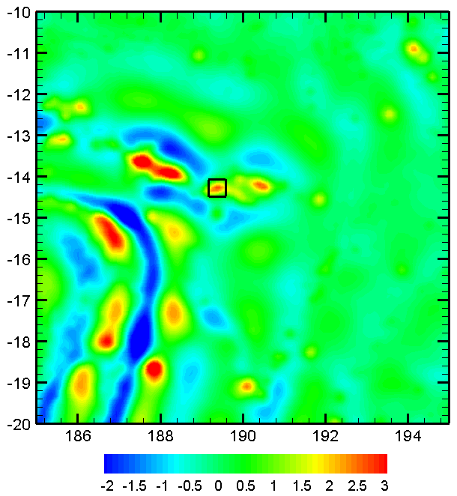
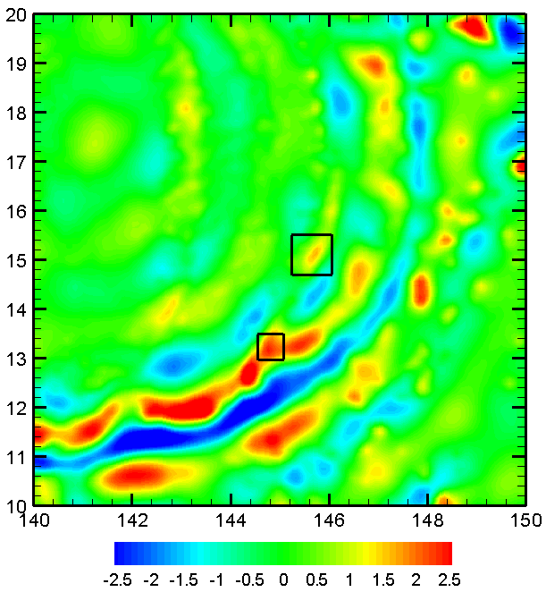
Scientific Roadmap – Well Surveyed Areas
Mean Differences of GOCE TIM5 and GPS-Levelling Geoid Heights & Omission Error from EGM2008 from D/O 181 to 2190
Samoa
Guam & Marianas
-1.221
-3.729
+0.422
-0.840
Guam
Marianas
+0.493
-0.605
w/o omission error (signal)
with omission error (signal)

Slide 20
Scientific Roadmap – Essential Tasks
The geopotential and geoid improvements resulting from GOCE are the basis of a reassessment of global height systems
Global Height System Unification
Well Surveyed Areas (Land)
Realization of a globally unified height system but confined to a global set of primary stations (national datum points, fundamental stations, primary tide gauges, primary clocks).
Establishment of national or regional height systems at primary points (first and second order) based on the technique of “GNSS-leveling”.
Diagnosis of existing height systems by comparison with GOCE geoid (100 km)
Establishment of a master plan:
realization of datum point
first-order GNSS reference points
diagnosis of regional gravity and/or leveling and/or topographic data base
Realization of a globally consistent model of mean dynamic ocean topography at tide gauges and at sea.
Open Oceans and Coastal Zones
Sparsely Surveyed Areas (Land)

Slide 21
Scientific Roadmap – Sparsely Surveyed Areas
Model Equipotential Surface
Height of Mount Everest:
GNSS Receiver
h = 8821.47 m (average from GPS and classical techniques for snow surface)
Model Geoid Height
Ellipsoidal Height
(Chen, J. et al, 2006, Science in China; doi: 10.1007/s11430-006-0531-1
Height above Sea Level
Model geoid height for H=0
N_{GOCE} = -26.58 m
(GOCE-TIM5 d/o 280)
N_{EGM} = -22.90 m
(EGM2008 d/o 2190)
h
N_{GOCE/EGM} = -22.19 m
(GOCE-TIM5 d/o 200 & EGM2008 d/o 201-2190)
H
Model geoid height from height anomaly and correction terms (c.f. Rapp, 1997, JoG).
N_{EGM/Rapp} = -28.50 m
(EGM2008 d/o 2190)
N_{Model}
this leads to heights above sea level:
H_{GOCE} = 8848.05 m
H_{EGM} = 8844.37 m
Large uncertainty in omission error estimate due to lack of gravimetric data.
H_{EGM/Rapp} = 8849.97 m
H_{Chen} = 8847.93 m (based on local geoid)

Slide 22
Conclusions
The GOCE geoid represents a reference for global and regional height systems with unprecedented spatial resolution.
GOCE enables the diagnosis of systematic distortions in existing height systems.
GOCE enables global height system unification if the omission error at height reference stations can be quantified.
The GOCE geoid supports results obtained from ocean models at tide gauges.
GOCE supports GNSS/Levelling.
In well surveyed areas a GOCE based regional geoid and consistent reference frames shall be used.
In sparsely surveyed areas the GOCE geoid in many cases represents the best possible reference surface. Data for regional geoid modelling have to be acquired.

Slide 23

Final Remark
Project results are available at the following web-site:
http://www.goceplushsu.eu

