Slide 1


Slide 2
Flow of the presentation
Explain about the current system – SA, Battery, Dock and shortcomings.
Role in the EPS sub system – interfacing and flowcharts.
Battery charging and discharging analysis.
Possible solutions for the shortcomings.

Slide 3
Responsibilities
Revision of the Power budget
Account for changes made in the cubesat design
Compatibility with other sub systems
Check for power and hardware requirements (Interface and distribution)
Working of the selected EPS sub system
How does the EPS work under different modes of the satellite.

Slide 4
Revision of Power budget
Initially assumed a power budget to commence sizing for battery and solar panels.
Revised requirements as other sub systems matured.
Finalized power budget under different modes of operation.

Slide 5
Compatibility with other sub systems
Sub systems like payload have a range of operational voltages hence require a separate channels.
Payload (5V, 1A-0.42A)
Thermal (3.3V, 1A and 3A)
Antenna (8-18V, 1.3A and 0.6A)
The thermal and the comms sub systems have a higher power requirement during different phases of the mission
Not all systems are COTS or offer interfaces like STACK or FSI connectors.
All power connections are made taking into consideration maximum operating values for the sub systems.

Slide 6
Different operational voltages

Slide 7
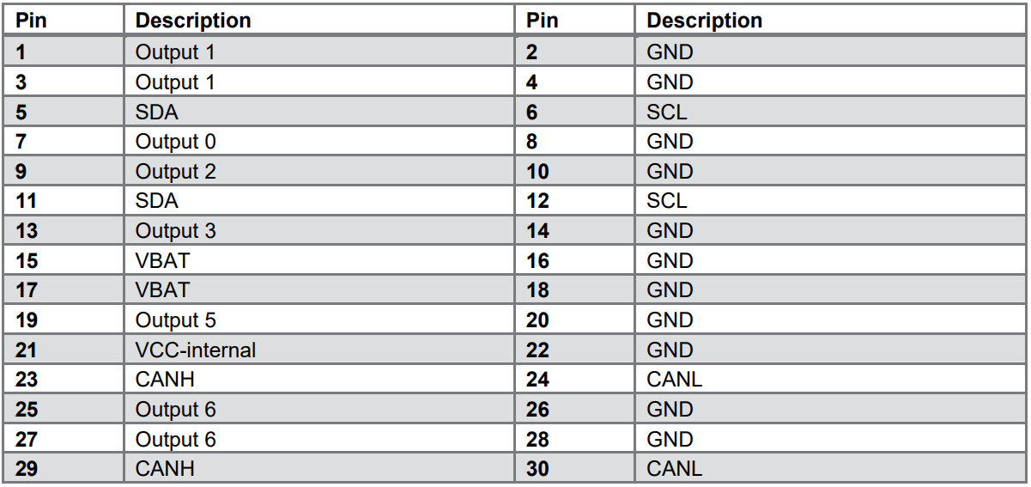
ADCS
Antenna
PAYLOAD
Transceiver
OBC
Thermal Control
Thermal Control

Slide 8
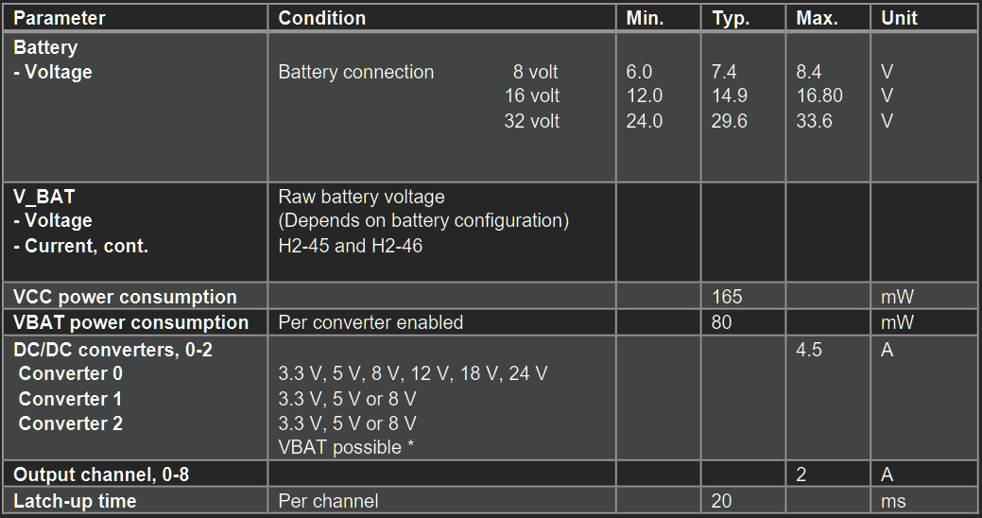

Slide 9
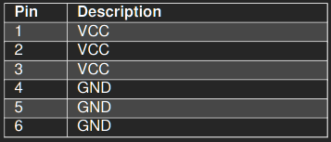
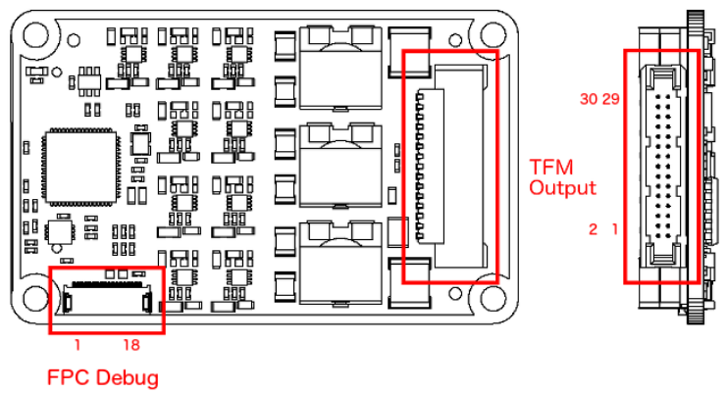
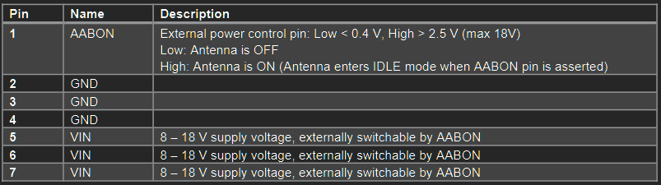
Interfacing
Custom connectors are expected to be made for almost all sub systems.

Slide 10
The PDU comprise of 3 BUCK converters and a HW configuration matrix. The converters are mapped to specific outputs during production and are fixed to a particular voltage. For our use we need voltages ranging from 3.3 to 12V. Except for the motor used to deploy the payload (only once).
As we are restricted with the voltage values assigned to the converters, we club the components operating on the same voltages together.
Notes:
Flowchart picture of the assigned components.

Slide 11
Working of the selected EPS sub system
The finalized set of sub systems cannot all be powered together.
The EPS regulates between them depending on the mode satellite is in. - Internal components of the PDU 3 BUCK Converters.
Each subsystem is integrated in a way that all their power requirements are met during the mission.

Slide 12
Sub systems operating on higher voltages like 12-24V such as motor and ADCS use the CON_0. Later during the Telecom mode 12V is used by the Antenna. As1.5W was initially proposed higher power can be provided to the Antenna to facilitate reliable communication.
The channels are shared between payload and telecom can be controlled using the software running on the PDU.
Notes:
I guess each converter is hard wired to a set of outputs (0-9) and connections are to be made specifically.

Slide 13
For power consuming sub systems – Thermal using upto 3A uses a single converter paired with a low current system OBC. CON_1 each converter can output 4A or 2A for each channel
The transceiver and payload sections are placed on a separate CON_2 that utilize 5V power rails. It serves as a
Notes:
The thermal may require 2 channels to operate as each channel can only provide 2A maximum current.

Slide 14
PDU standby power consumption – 600mW + Converter enabled (80mW*3 = 0.2W)
0.6+0.2 = 0.8W
Current = 0.2A

Slide 15
Shortcomings
Battery voltage too low (7.6V) – maybe the capacity (2100mah) – 27mins science operation - 2s2p batt – 39mins with 1s4p batt.

