Slide 1
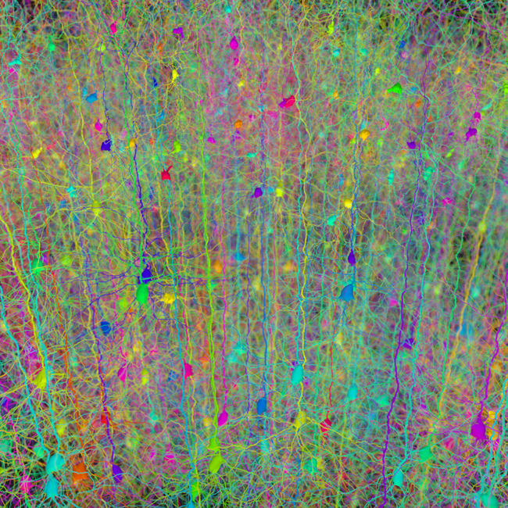
Deep AQAtik Project

Slide 2
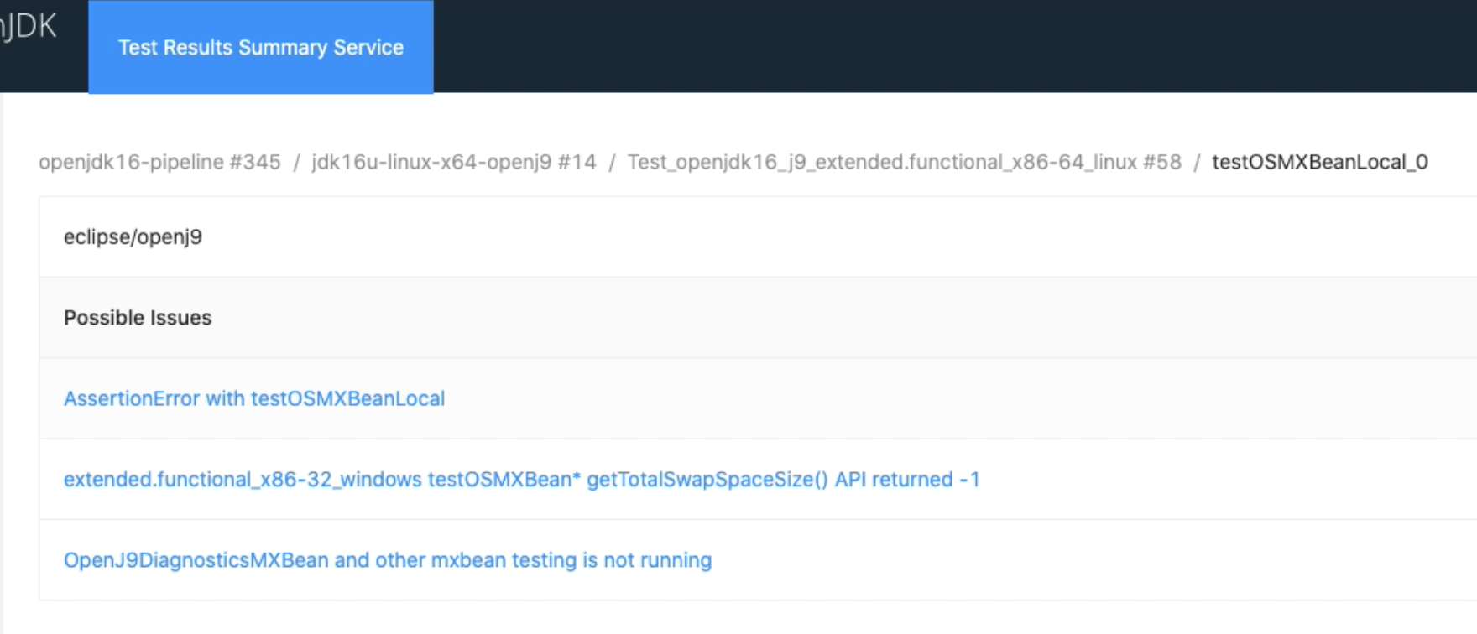
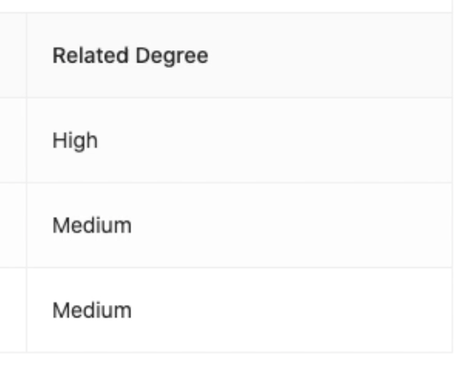
Intro & Motivation
Intelligently analyze test failure and match with possible known issues on GitHub.
Explore and experiment AI pipeline for future projects.
Notes:
Shelley Lambert -
Explore new tools for the toolkit
Continuous improvement
Take past prototypes to a new place
Revive project ‘waiting for better approach’
Fun to build mad skillz

Slide 3




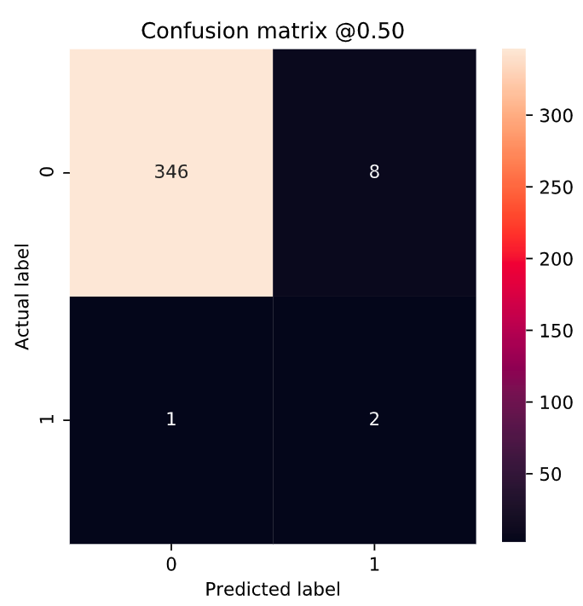






Deep AQAtik Architecture
GitHub Repos
GitHub Issue Contents
Pre-Process
Train and Evaluate ML model
Jenkins build
TRSS (Test Result Summary Service)
Corresponding Jenkins output
TRSS Database
TRSS Failed Tests
Model Training
GitHub Issues Related Degree
Deploy ML Server
Model Deployment

Slide 4
Demo Current Progress
Initial prototype
ML server deployment with Flask
Data collection pipeline for GitHub issues

Slide 5
Future Works
Data pre-processing for GitHub issues.
Corresponding Jenkins output collection.
ML/DL model optimization.
Add user feedback button to collect feedback.
Increase pipeline automation, such as triggering ml training automatically if new GitHub issue is created.
Other ideas listed here: https://github.com/adoptium/aqa-test-tools/issues/412

Slide 6
Thanks for Watching!

