Slide 1
TriageX
Multi-agent voice-first triage system for Smart Nation Singapore
Team Participation Mark | HackRift 2025

Slide 2

The "3-Hour" Bottleneck
Overwhelmed Polyclinics
Resource Drain
Data Fragmentation
Average wait times exceed 3 hours. An aging population is straining our finite healthcare resources
Highly trained nurses spend 1000s of hours on manual data entry instead of patient care
Doctors lack immediate context until consultation actually begins

Slide 3
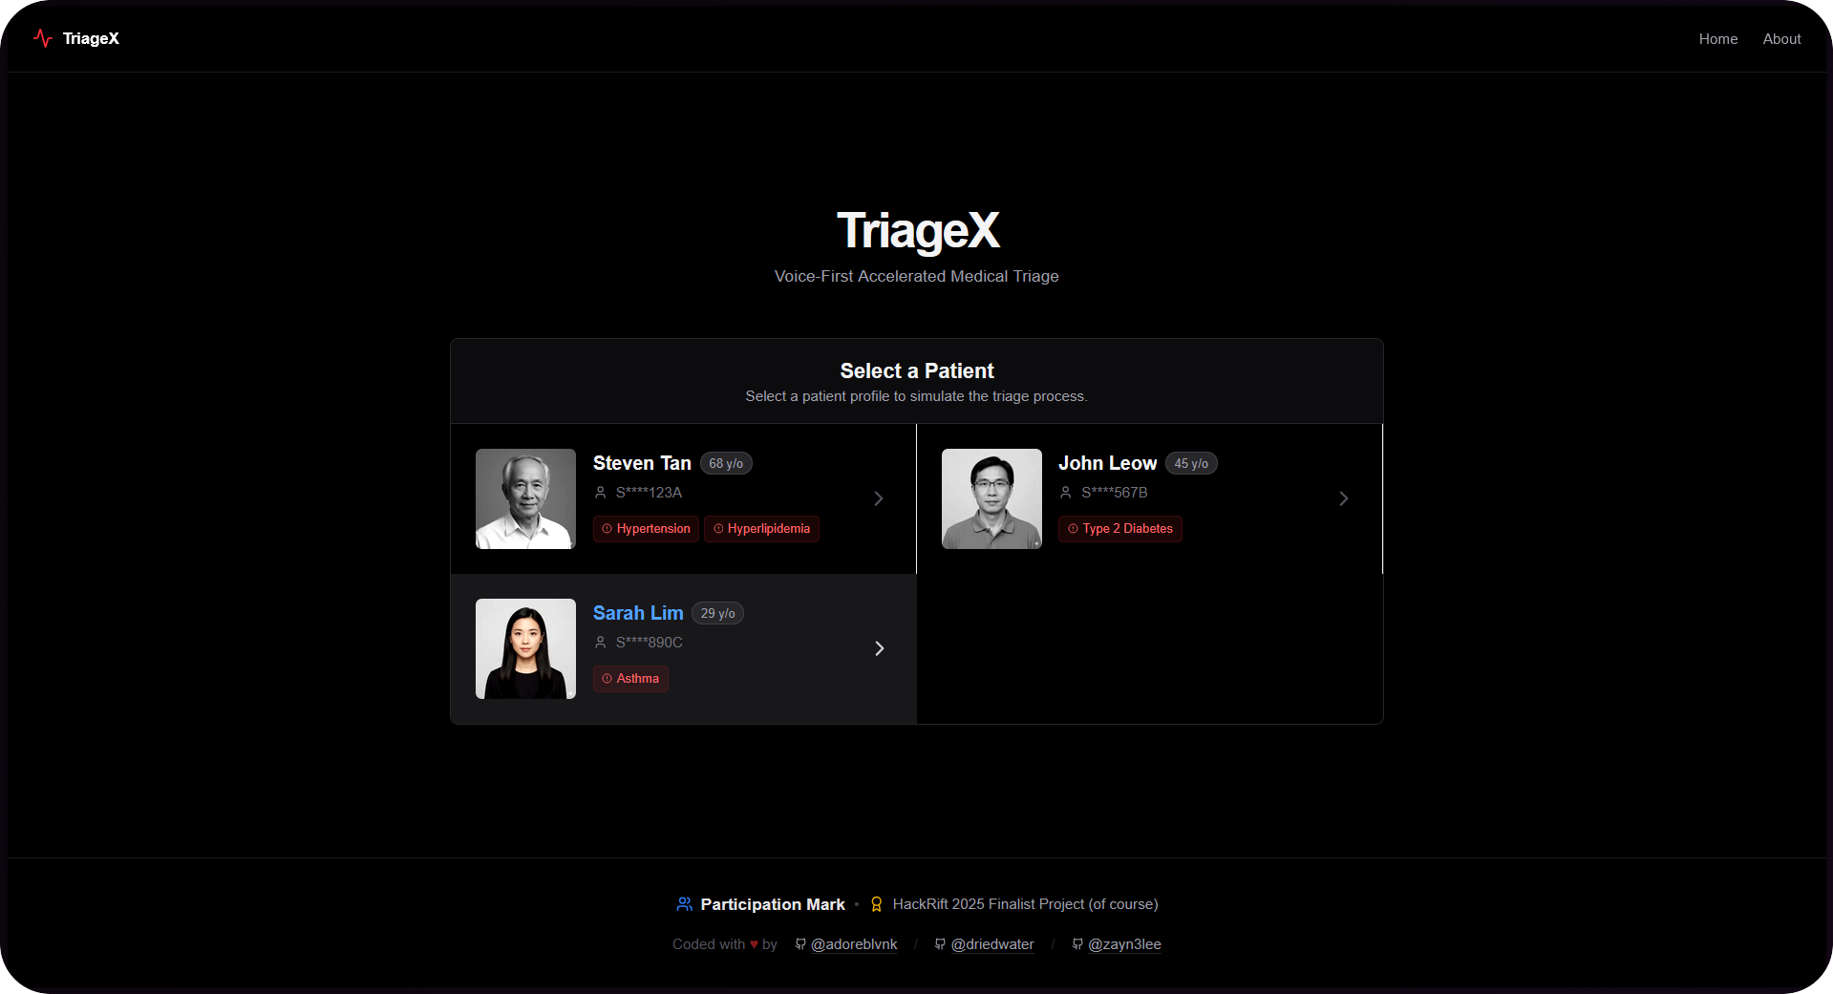
Meet TriageX
An autonomous, voice-first kiosk that interviews patients while they wait.
Accessible: No typing required, just speak naturally
Integrated: Simulates NRIC scanning to pull FHIR (Fast Healthcare Interoperability Resources) medical records instantly

Slide 4
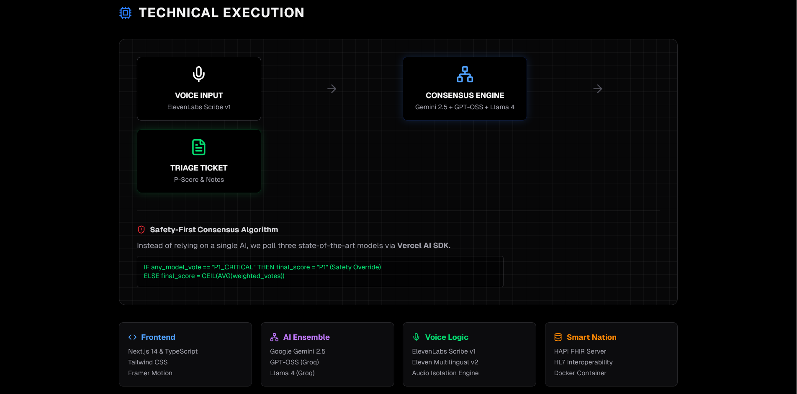
Notes:
NOTES:
tech stack

Slide 5
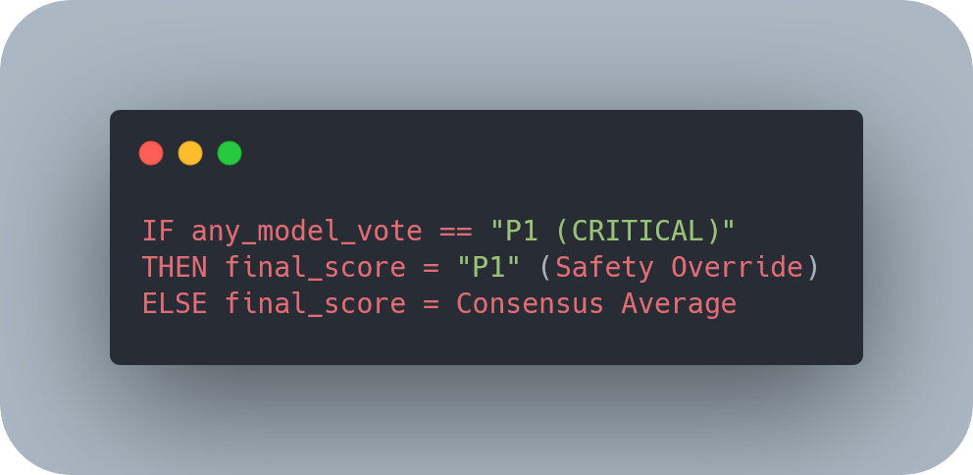
Why 3 models are safer than 1
Models used:
Gemini 2.5
GPT-OSS
Llama 4

Slide 6
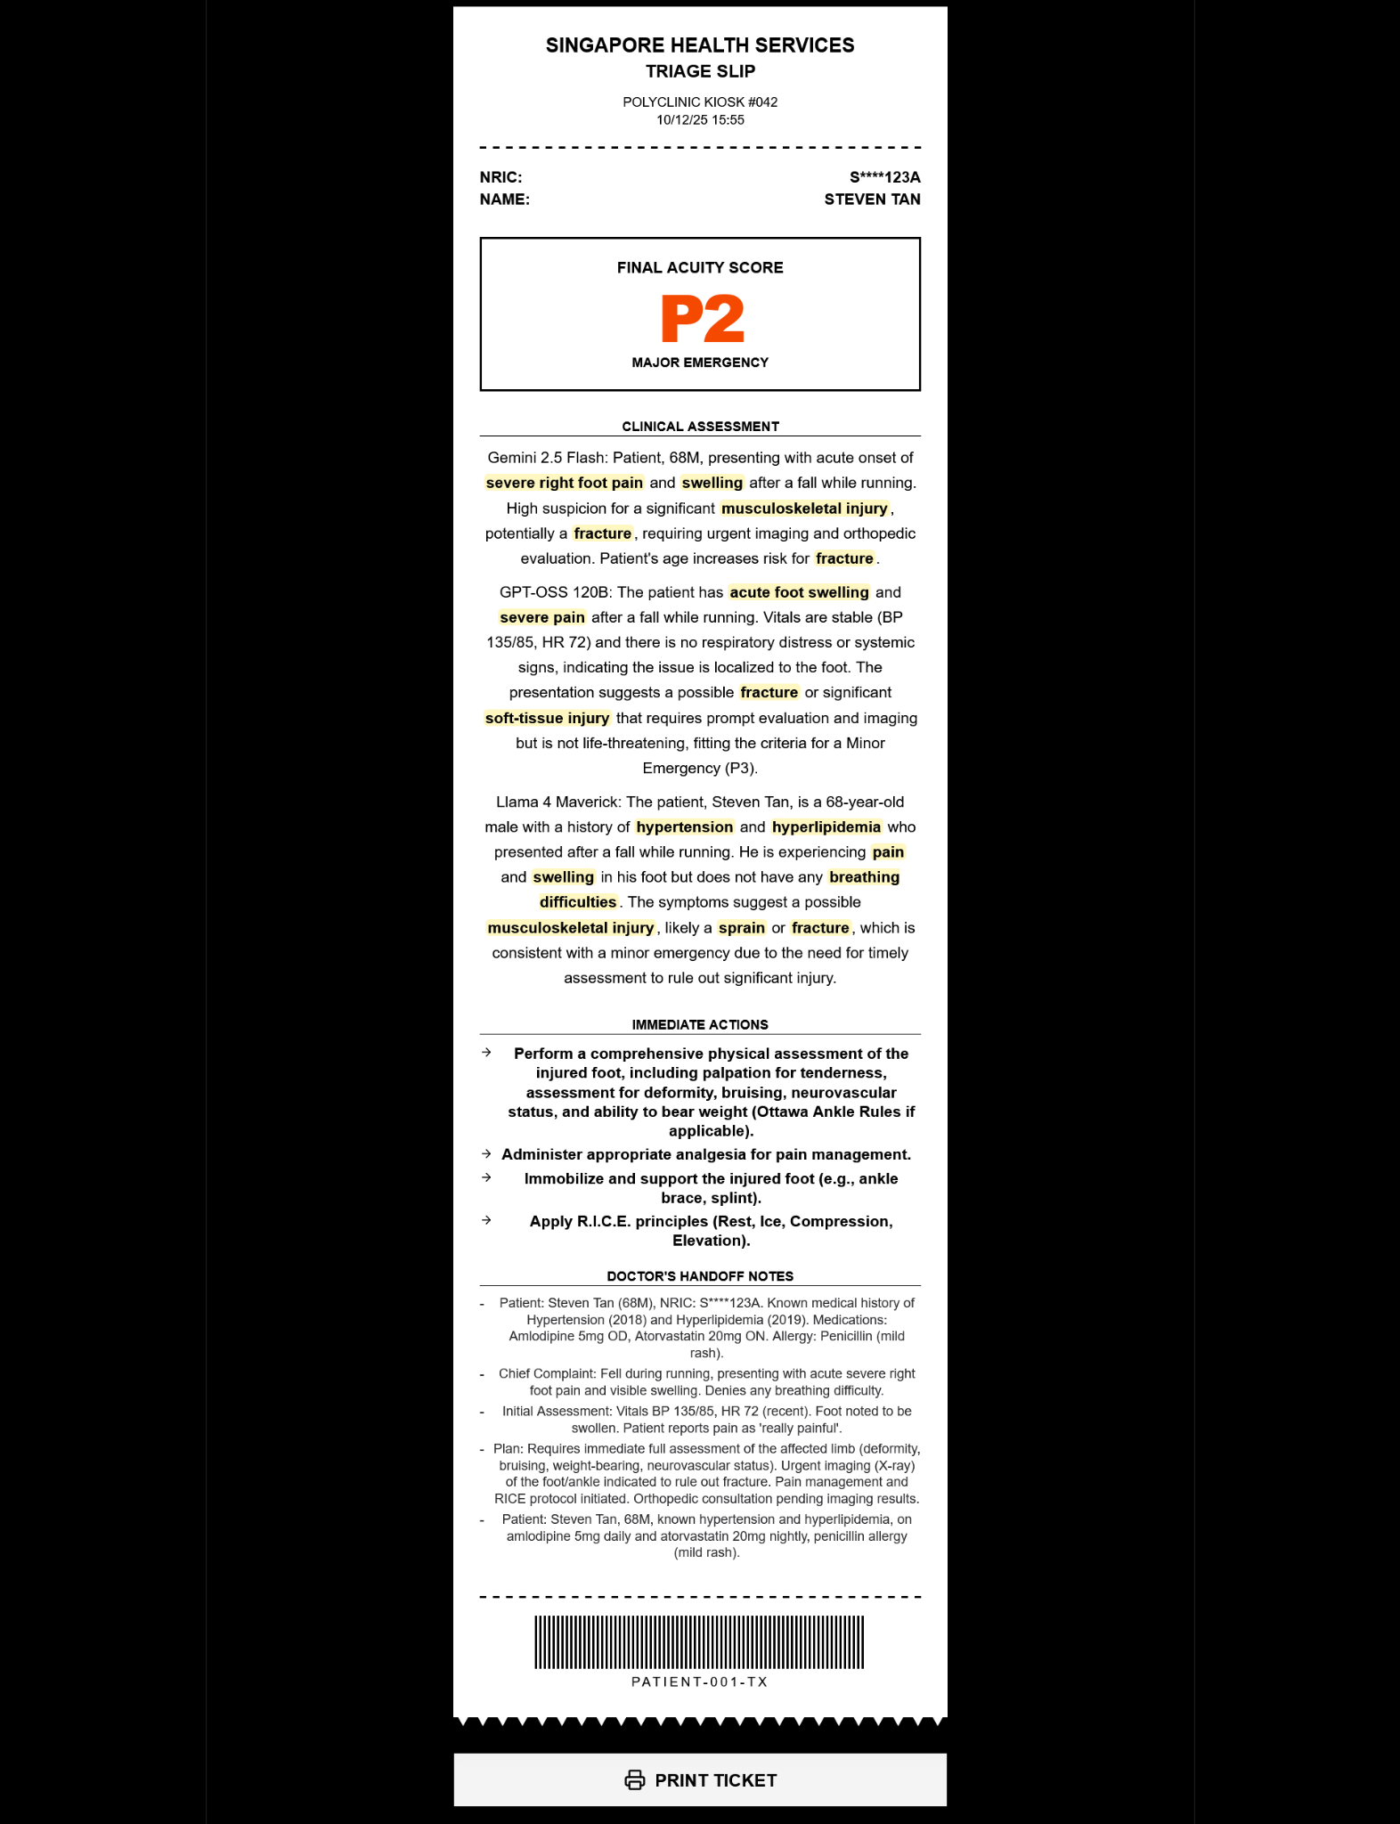
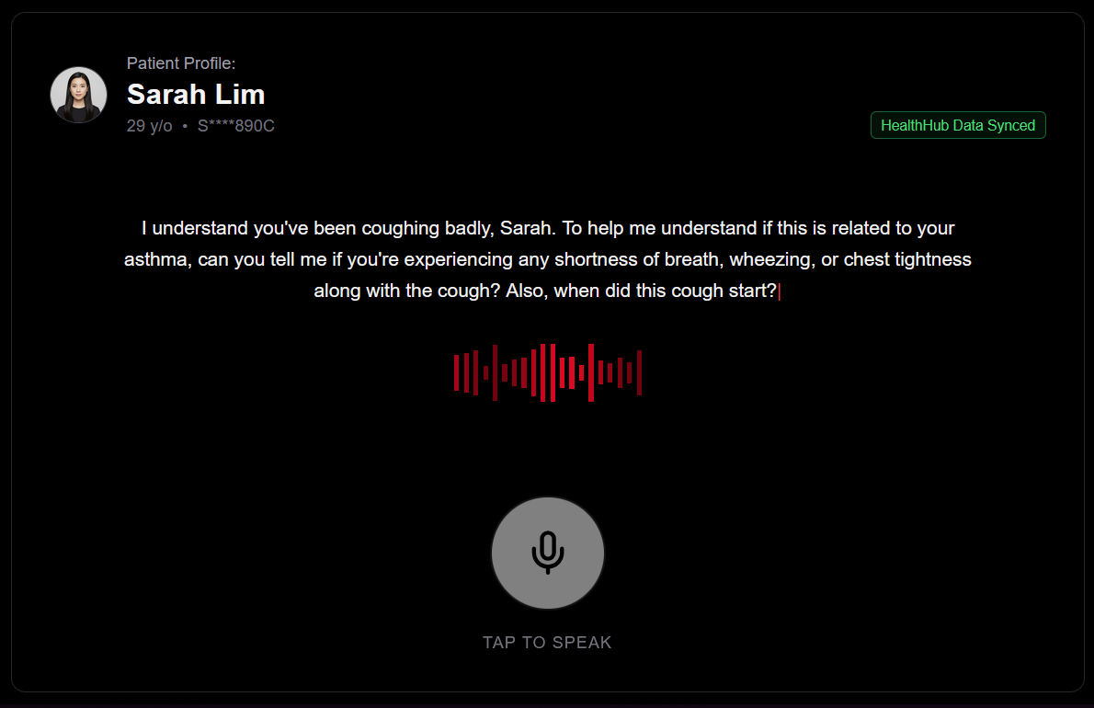
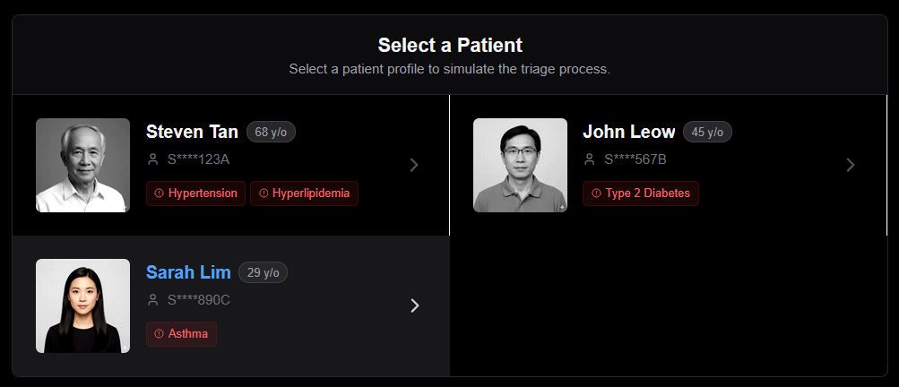
User Journey
Profile Retrieval
Voice Interview
Triage Ticket

Slide 7
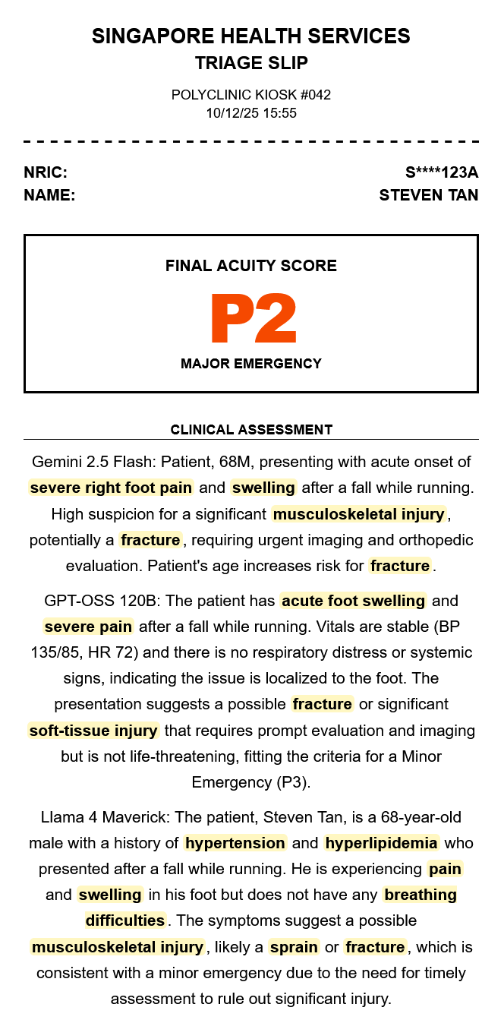
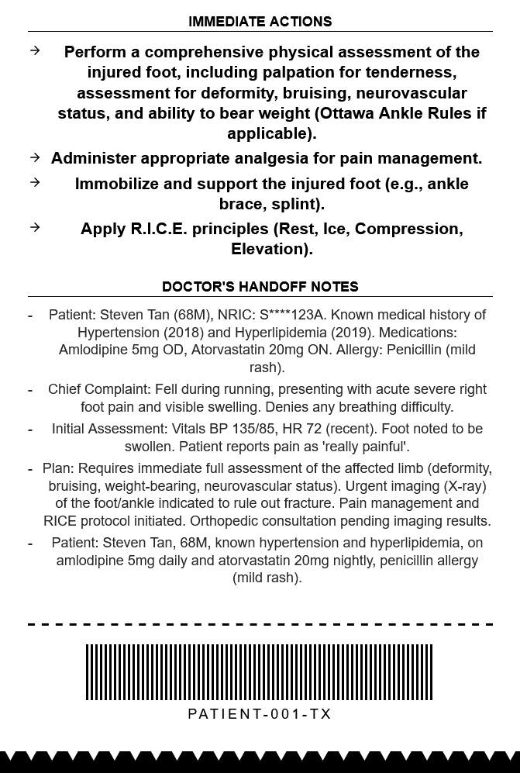

Slide 8
Smart Nation Integration
FHIR Interoperability
HealthHub Ready
Built on HL7 FHIR standards. TriageX connects to NEHR (National Electronic Health Record) simulation to pull chronic health conditions (eg hypertension)
Architecture allows mock profiles to be swapped for OIDC Singpass login for secure patient verification

Slide 9
Impact
&
Metrics
45s Average Triage Time
3 AI Models
100% Safety Protocol Compliance
24/7 Autonomous Operation
10 mins normal triage time
For cross-validating

Slide 10
TriageX
Team:
adoreblvnk
driedwater
Zayne Lee
Repo: https://github.com/adoreblvnk/triageX
Website: https://triagex.vercel.app
The future of autonomous triage

Slide 11
QnA
Q: patients can abuse this P1 / P2 status to see doctor faster
A: TriageX handles the subjective data (eg how patients feel), not objective data (temp, etc). We can use the same cross-validation algorithm to verify the acuity score. Of course, rate of accuracy can always be improved, but this is something the entire industry faces
Q: will AI understand Singlish?
A: we are using SOTA ElevenLabs models (Scribe & Multilingual). For increased accuracy, we can train language models on IMDA National Speech Corpus
Q: doctors already have access to NEHR, why is this necessary?
A: yes, but clicking thru 10 tabs of history in NEHR isn't exactly fast, & having the nurse manually type triage notes isn't fast either. We use Structured Output to return data in a consistent parsable format to integrate with existing systems
Q: could AI exaggerate symptoms?
A: we use a Multi-Agent Ensemble arXiv Paper with a consensus algorithm for increased accuracy

Slide 12
QnA
Q: if a patient is breathless, how can they speak to TriageX?
A: if patient is visibly injured, nurses already send them past triage to the doctors. No change to the current triage system
Q: does this replace nurses?
A: no, nurses still validate the output with objective data (temp, etc) & physically assist patients
Q: polyclinics already have a cap for walk-ins
A: yes, but having patients spend less time in triage stage is always better especially with an aging population

