Slide 1
Coursera Applied Data Science Capstone
IBM Applied Data Science Specialization
Opening a New Gym in Dubai, United Arab Emirates

Slide 2
Business Problem
Location of the Gym is one of the most important decisions that will determine whether the Gym will be a success or a failure
Objective: To analyze and select the best locations in the city of Dubai, UAE to open a new gym
Business question
In the city of Dubai, if a property developer or an investor is looking to open a new gym, where would you recommend that they open it?

Slide 3
Data
Data required
List of communities in Dubai
Latitude and longitude coordinates of the communities
Venue data, particularly data related to Gyms
Sources of data
Wikipedia page for communities (https://en.wikipedia.org/wiki/Category:Communities_in_Dubai)
Geocoder package for latitude and longitude coordinates
Foursquare API for venue data

Slide 4
Methodology
Web scraping Wikipedia page for Communities list
Get latitude and longitude coordinates using Geocoder
Use Foursquare API to get venue data
Group data by Communities and taking the mean of the frequency of occurrence of each venue category
Filter venue category by Gym
Perform clustering on the data by using k-means clustering
Visualize the clusters in a map using Folium

Slide 5
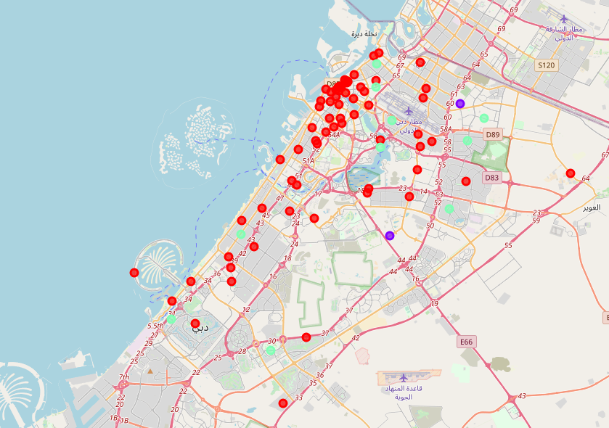
Results
Categorized the Communities into 3 clusters :
Cluster 1: Communities with moderate number of gyms
Cluster 2: Communities with low number to no existence of gyms
Cluster 3: Communities with high concentration of gyms

Slide 6
Discussion
Most of the gyms are concentrated in the newly built areas of the city
Highest number in cluster 2 and moderate number in cluster 3
Cluster 1 has very low number to no gyms in the communities

Slide 7
Conclusion
Answer to the business question: The communities in cluster 1 are the most preferred locations to open a new gym/ Fitness center
Findings of this project will help the relevant stakeholders to capitalize on the opportunities on high potential locations while avoiding overcrowded areas in their decisions to open a new gym

Slide 8
THANK YOU!

