Slide 1
UV Index Exposure Tracker Tool
Capstone Project Presentation
Aric Allen

Slide 2
Client Background
Southern Skin Cancer Treatment Centers of America (Dallas, TX)
Focus: Prevention and treatment of UV-related conditions
Identified need for digital UV exposure monitoring tool

Slide 3
Problem Statement
Patients cannot easily view past/future UV index levels
Weather apps do not support long-term medical monitoring
Organization lacks integrated UV data visualization tools

Slide 4
Project Goals
Develop a web-based UV index tracking prototype
Display 5-day historical + 5-day forecast UV data
Provide interactive visual chart for patient use
Prepare for future integration into client website

Slide 5
Current vs. Future State
Current
No centralized UV monitoring system
Patients rely on scattered, unreliable sources
Future
Automated, accessible UV visualization tool
Improved patient education and decision-making

Slide 6
Options Considered
Backend-driven data storage system
Enterprise weather analytics solutions
Client-side JavaScript app with Open-Meteo API (Chosen)

Slide 7
Technical Architecture
HTML, CSS, JavaScript frontend application
Chart.js for UV trend visualization
Open-Meteo API provides hourly UV index data
GitHub used for version control and hosting

Slide 8
Data & Interface Design
JSON structured API responses
User inputs city name to fetch UV data
Interactive line graph displays 10-day UV trend
Simple, accessible UI for patients

Slide 9
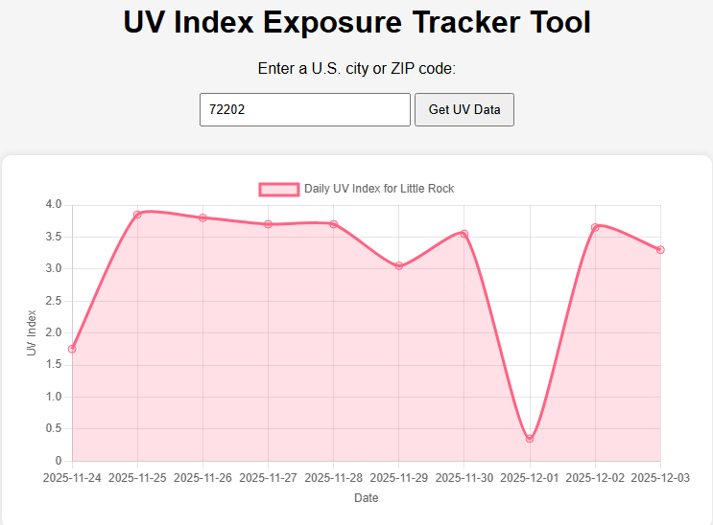

Slide 10
Testing & Validation
Unit tests for API response handling
Integration tests for UI and chart workflow
Performance testing (<3 second load target)
User Acceptance Testing (Sponsor review)

Slide 11
Professional Responsibilities
Guided by ACM Code of Ethics
Emphasis on reliability, transparency, and safety
Secure HTTPS API calls
No personal data collected (low privacy risk)

Slide 12
Solo Teamwork Responsibilities
Performed role of project manager, designer, developer, tester
Self-managed schedule, milestones, deliverables
Coordinated feedback with project sponsor
Resolved technical challenges independently

Slide 13
Support & Future Integration
Integrate into patient education portal
Monitor API availability and reliability
Enhance with user accounts and exposure logs
Add dermatologist reporting features

Slide 14
Conclusions & Lessons Learned
Prototype meets client’s core requirements
Client-side architecture ideal for rapid development
Stakeholder communication improved clarity
Solo project required strong time management

Slide 15
Thank You
Questions?

