Slide 1
Tasks Review Meeting 1: COTS Radar
GROUP2 LI LINZE, SUNYIYU, DENG YICHEN

Slide 2
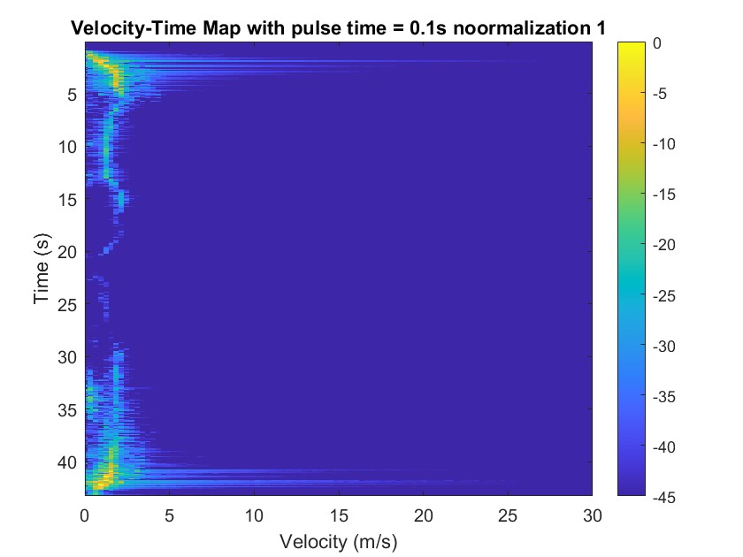
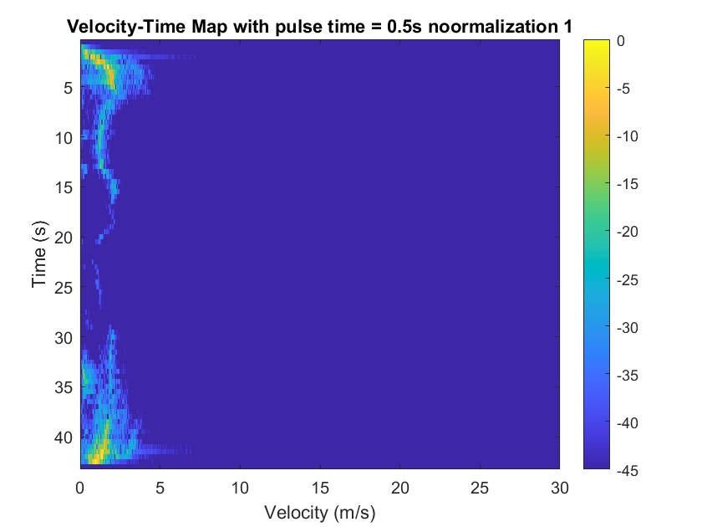

Velocity measurements: Different Tp (noormalization1)

Slide 3
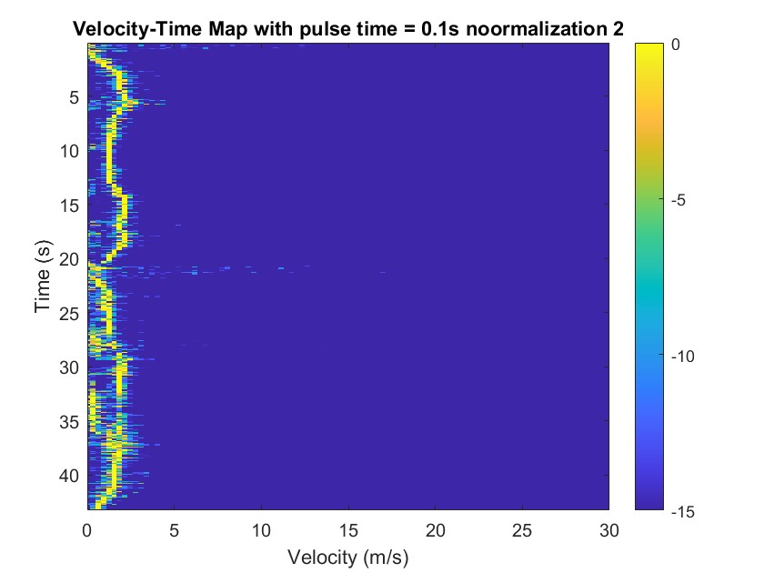
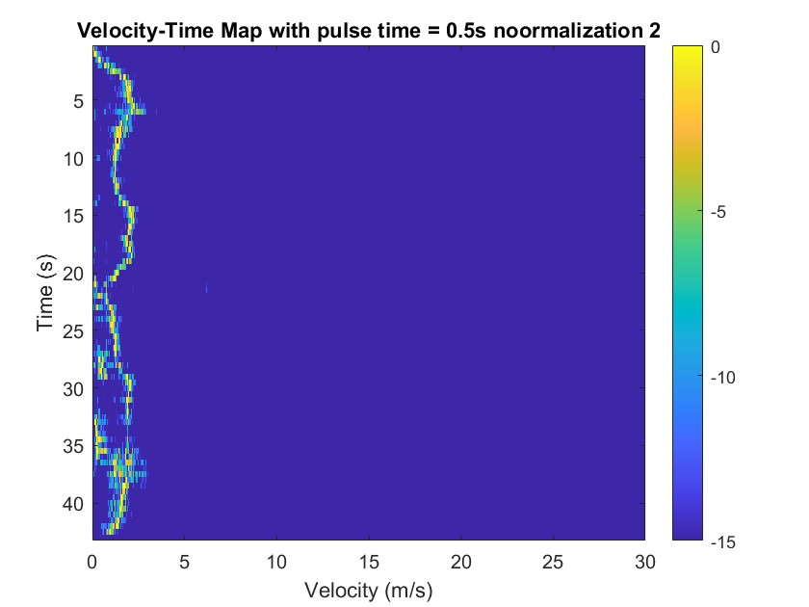
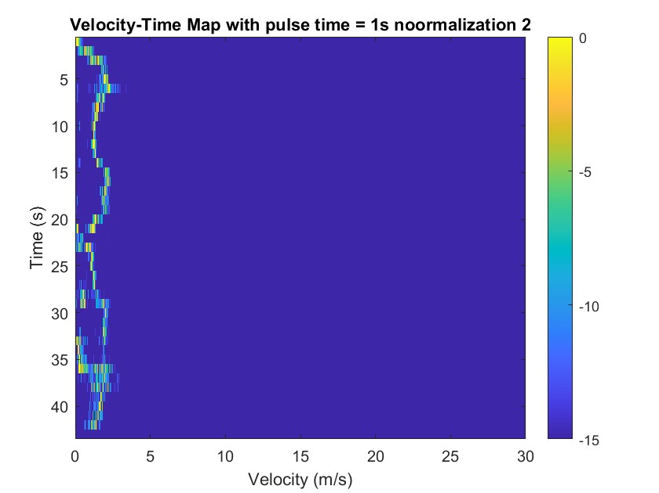
Velocity measurements: Different Tp (noormalization2)

Slide 4
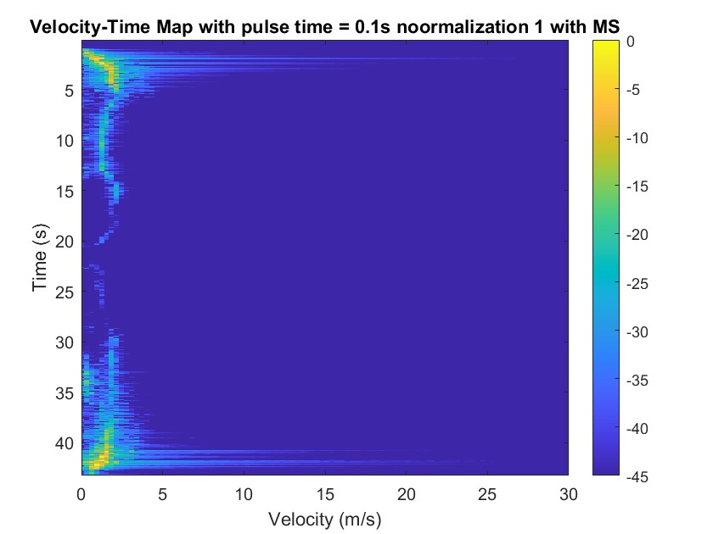

Velocity measurements: with(without) MS (noormalization1)

Slide 5
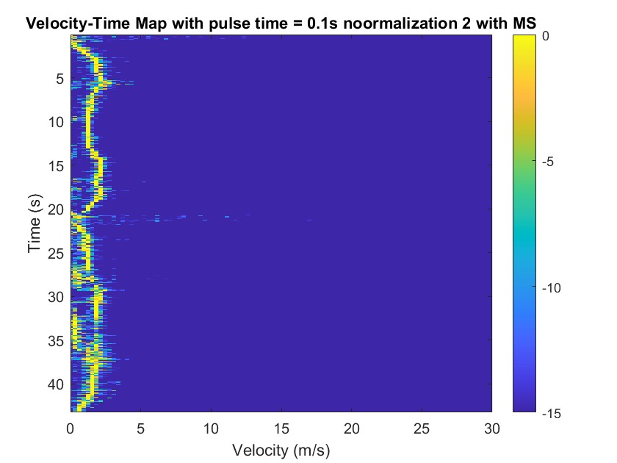

Velocity measurements: with(without) MS (noormalization2)

Slide 6

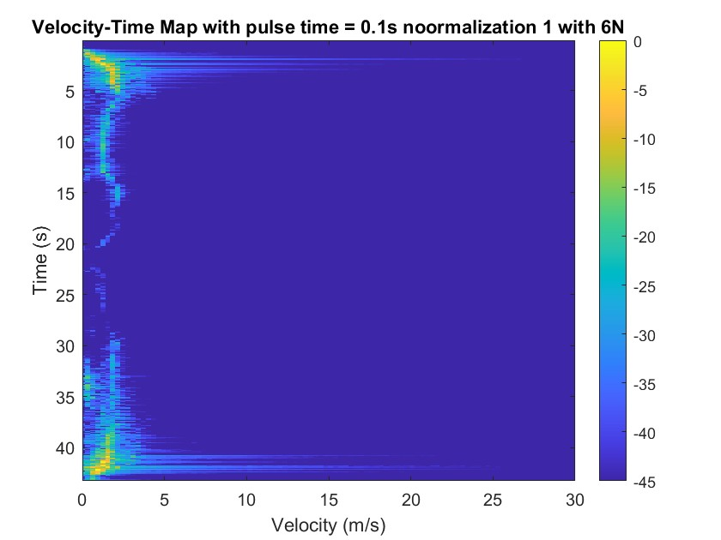
Velocity measurements: zero padding - 2N, 6N(noormalization1)

Slide 7
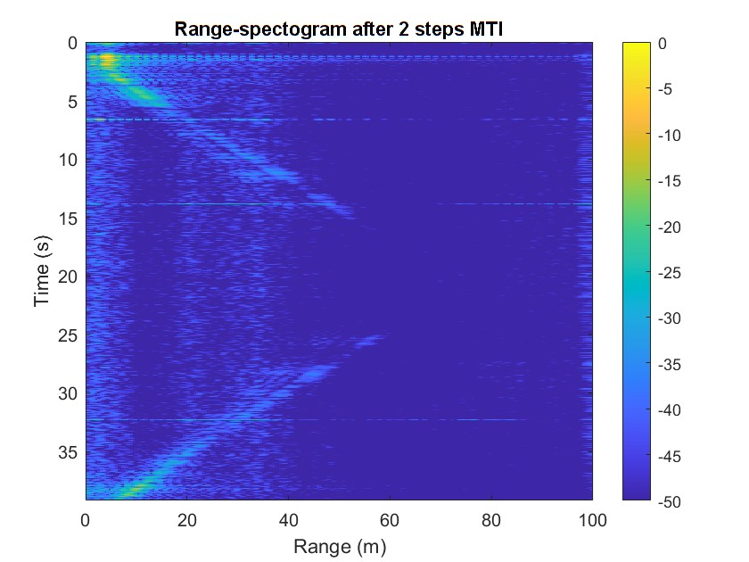

Range measurements: with(without) MS
With MS
Without MS

Slide 8
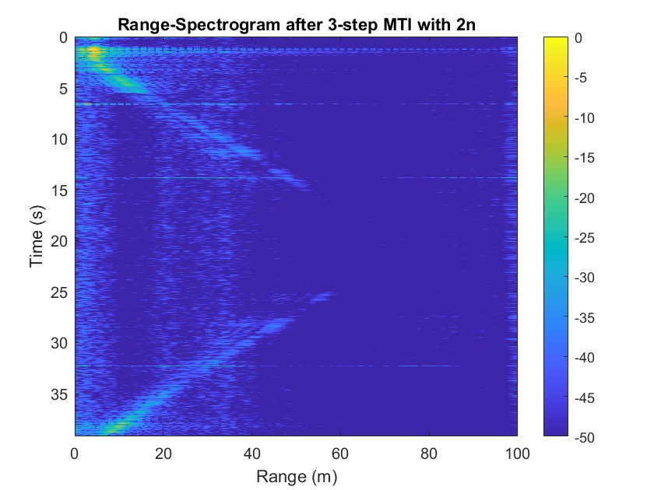

Range measurements: zero padding –2N, 6N

Slide 9

Range measurements: 2-pulse and 3-pulse MTI clutter rejection

