Slide 1
COVID-19 and its impact on stock market
Analysis on Coronavirus and S&P 500 stocks Data
Team : Azat, Gracie, Joon, Muhlis, Veysel
Notes:
Briefly introduce what are Coronavirus and S&P 500.

Slide 2
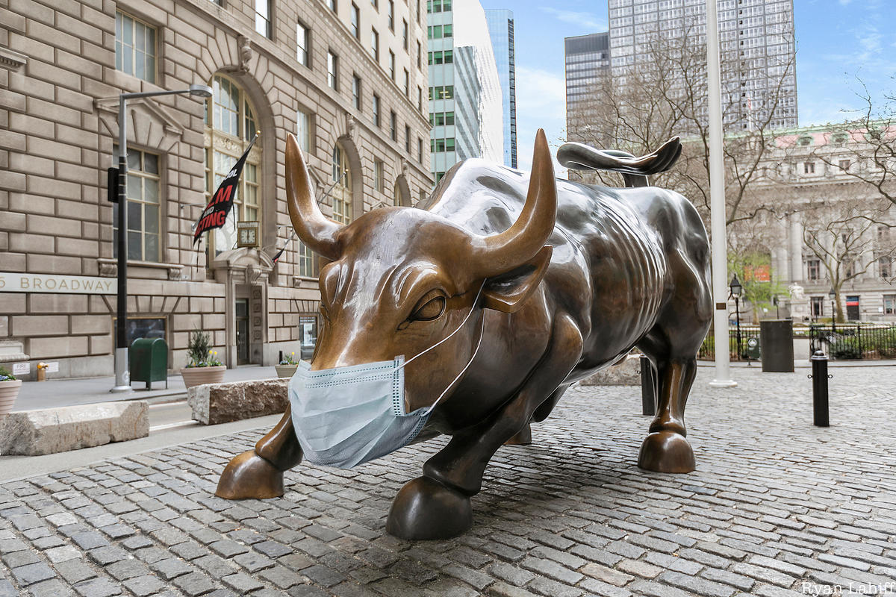

Slide 3
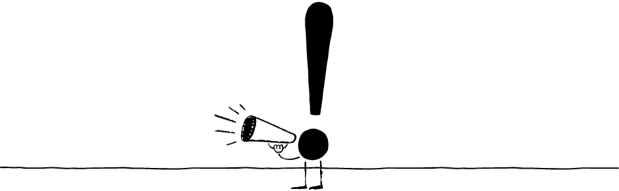



Overview / Agenda
Coronavirus has impacted various population all over the world. Use CDC data to identify the numbers, geographic location, and increment rate of deaths.
Using S&P 500 and CDC data, find the impact of Coronavirus on stock market and identify which sectors has been mostly affected.
Are these two numbers correlated?

Slide 4
Process of Data collection and cleaning
We found the data from CDC for Coronavirus and Yahoo finance for S&P 500
Collected Covid-19 dataset to analyze cases in United States
Collected S&P 500 historical Stock-Price dataset using Yahoo finance(yfinance) and API to analyze stocks in United States
Collected each Stock-Industry dataset from Wikipedia
Performed cleaning and formatting data
Digged into analysis and visualization of data

Slide 5
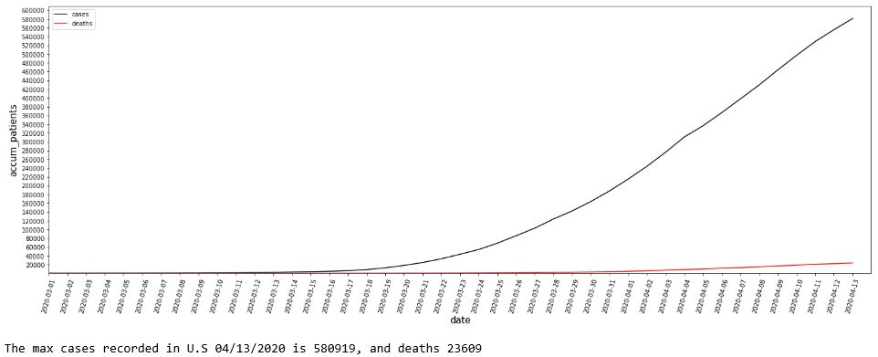
Coronavirus Disease (COVID-19)
By 04/13/2020 almost 600K cases and 24K deaths recorded across the United States.

Slide 6
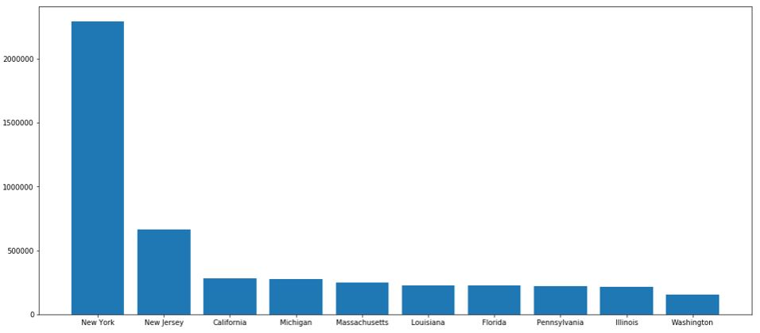
Comparing States
There is a huge gap between New York and the rest states.

Slide 7
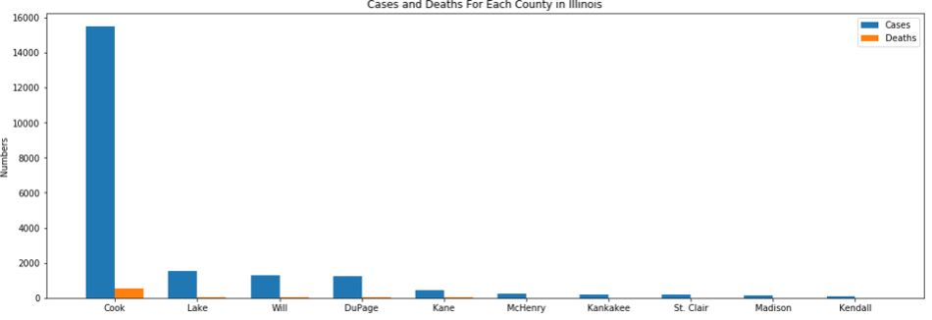
Running specifically one state
We check total cases and deaths for Illinois

Slide 8
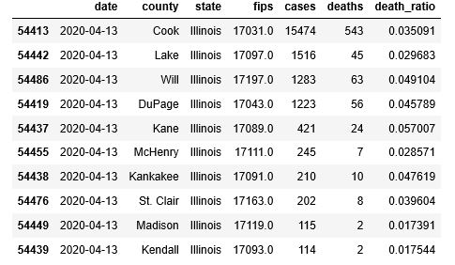
Running specifically one state

Slide 9
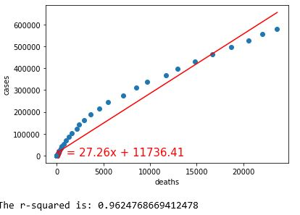
Correlation between deaths and number of cases
There is a strong positive relationship between deaths and cases

Slide 10
Getting Data From YFinance
Dependencies
import yfinance
Create Variables
list_tickers=tickers.tolist() (From existing dataframe)
start_date="2020-01-31"
end_date=pd.datetime.now().date()
yesterday = end_date - dt.timedelta(days=1)
Run API
closing_price_stocks=yf.download(list_tickers,start_date,yesterday)

Slide 11
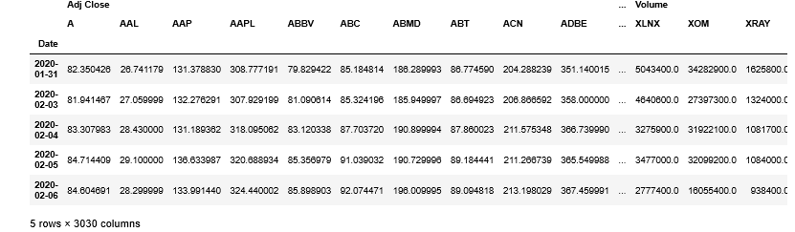
Data Format Yfinance

Slide 12
S&P 500 stocks
Find out each sector industry-Stock and calculate mean of industries
While covid-19 outbreak, stock prices changes day by day as below

Slide 13
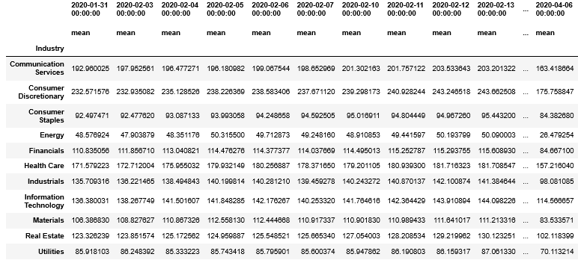
Prices Averages by Industry

Slide 14
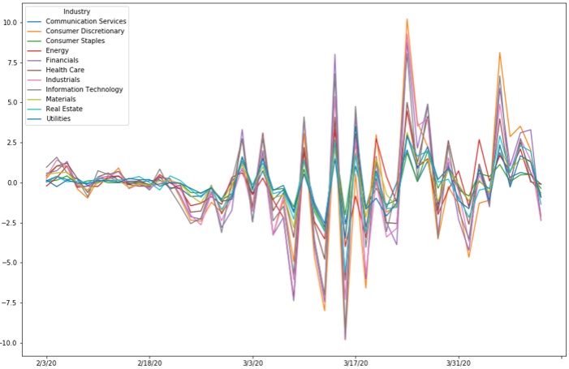

Slide 15
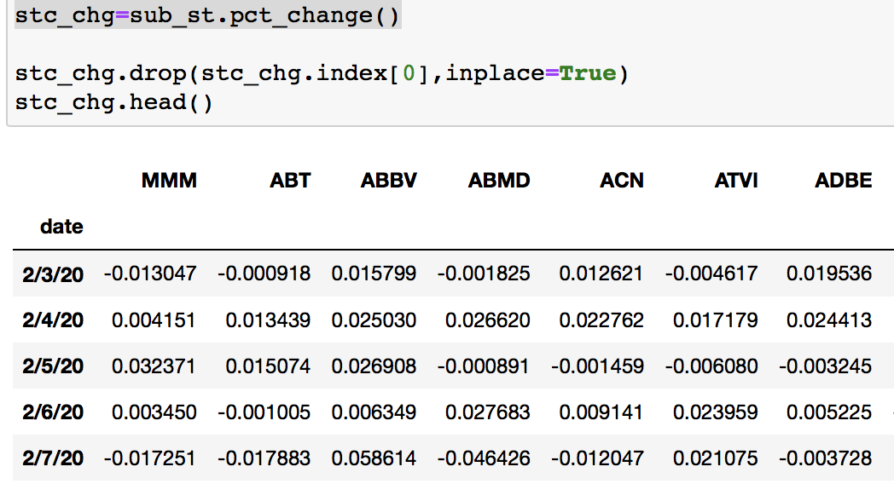
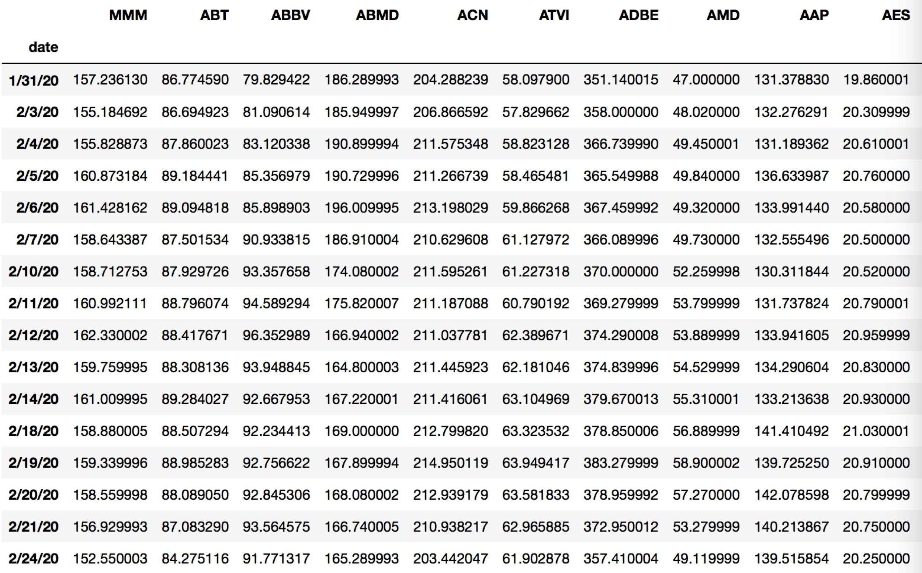
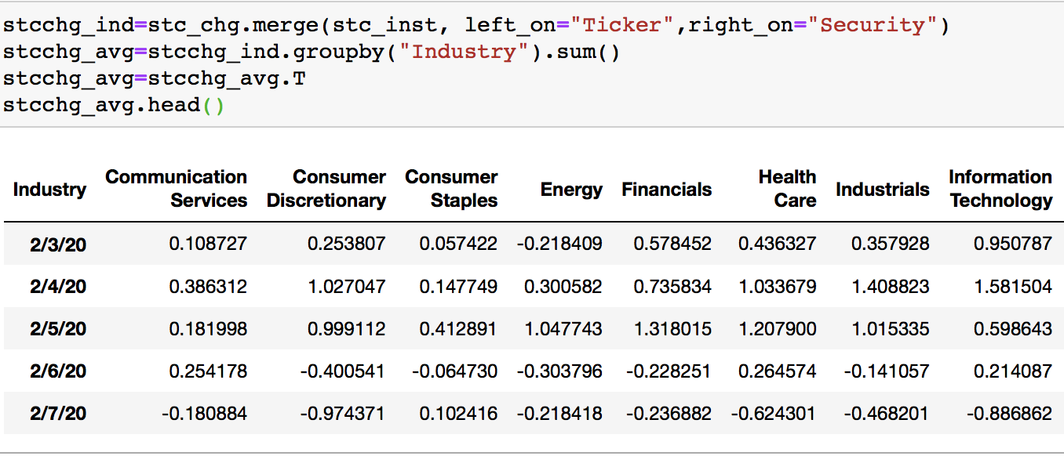

Normalized the stock price as prices percentage change and merge with 11 sectors
Get daily price percentage change that normalize the data
demo ='key'
ticker = stock_name
list_df = []
date=”2020-1-31”
requests.get(f"https://fmpcloud.io/api/v3/historical-price-full/{item}?serietype=line&apikey={demo}")
Merge with sectors(industry), group S&P500 in 11 groups

Slide 16
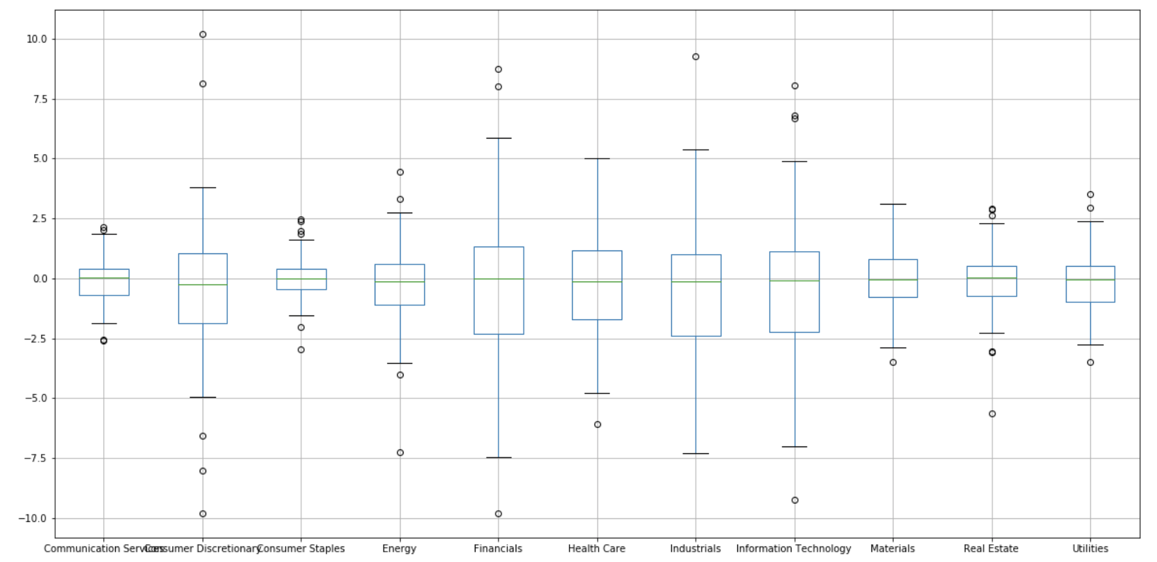
The boxplot shows Financials, Health Care, Industrials, Information Technology industries had large volatility as they as big daily price change

Slide 17
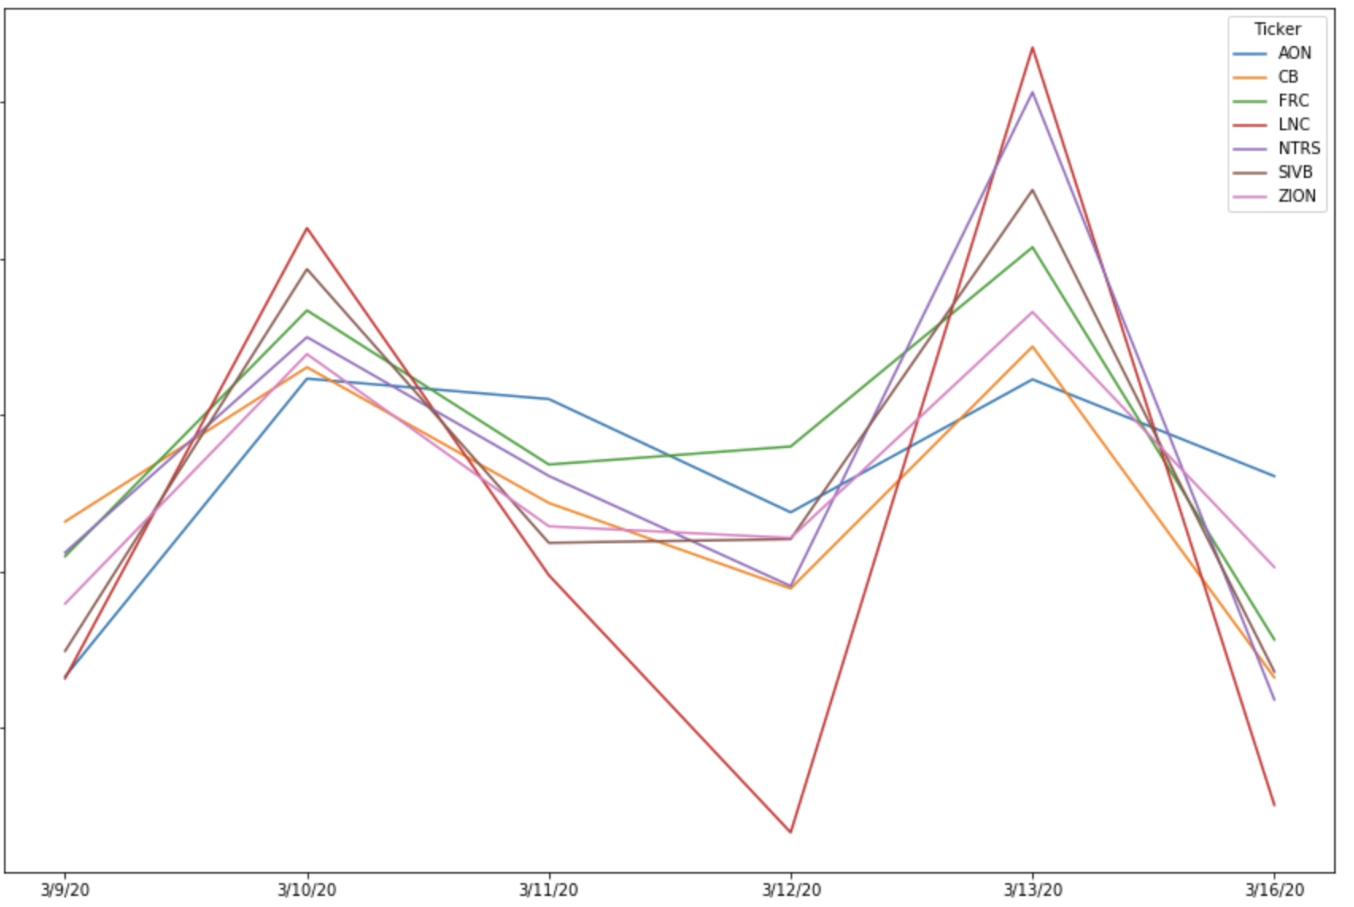
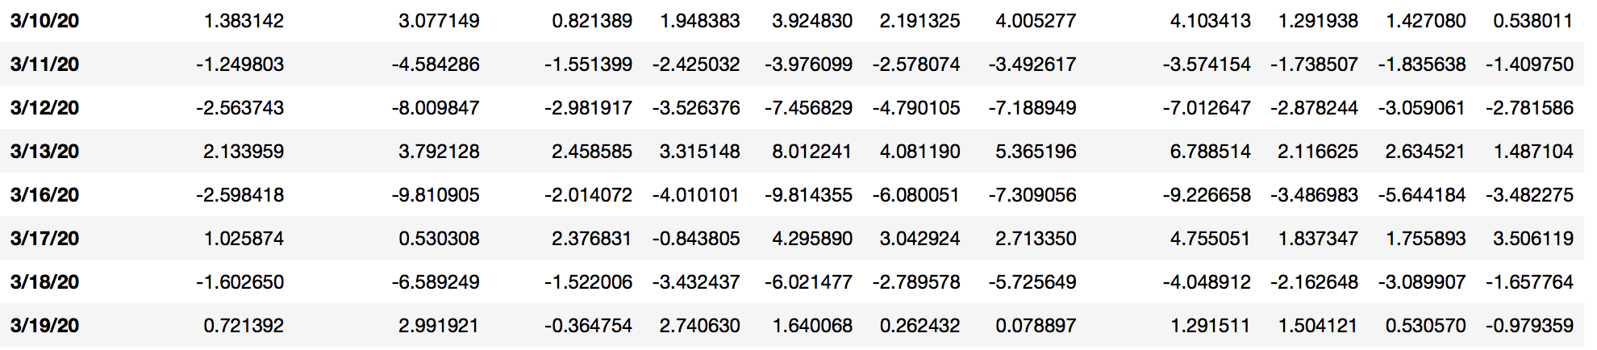
Week 3/9-3/16 had large volatility in the stock market, especially in Financial sectors, this is because of COVID-19 Cases Cross 100,000 Globally and Oil Futures Nosedived 10%
Digdown to Financials sectors
Selected following stocks --- "AON","CB","FRC","LNC","NTRS","SIVB","ZION"
and week 3/9/20-3/16/20 which has the max volatility during that week.

Slide 18
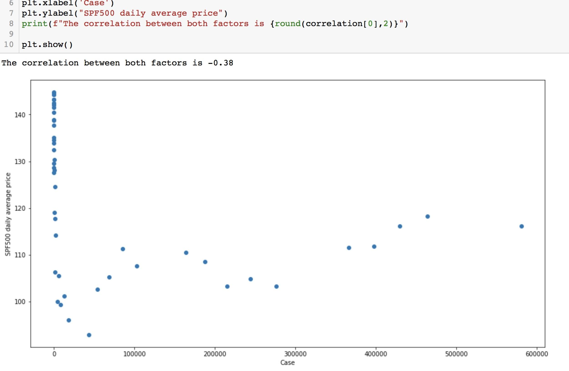
Daily Avg Stock Price and CDC data
Merge S&P500 stock price with CDC data
Calculate the S&P 500 daily average price
Did scatter plot
When case#=0, the average stock price is a vertical line

Slide 19
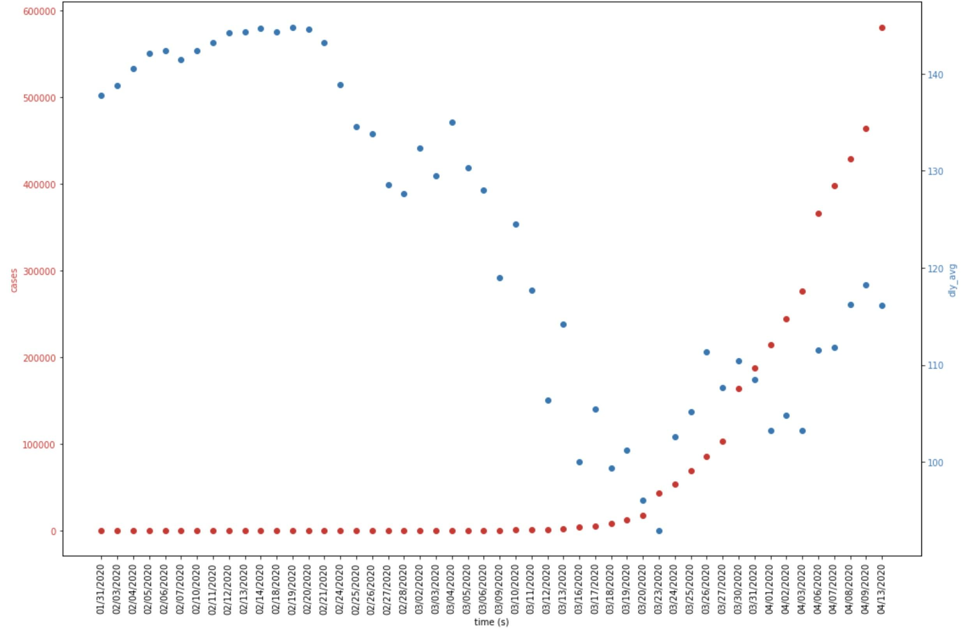
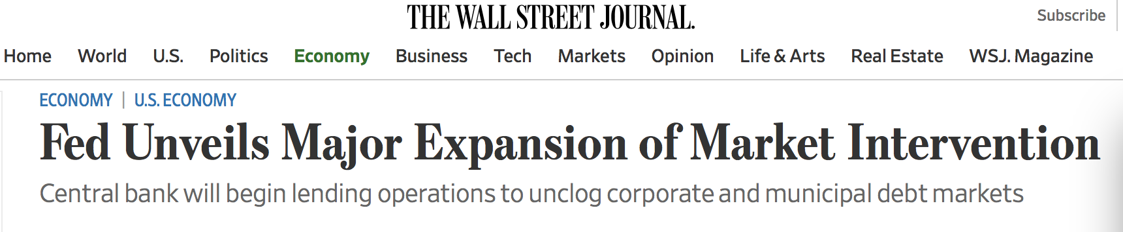
When pandemic started, the stock price went down, then up when Fed launched some aggressive solutions

Slide 20
Summary
Findings:
There is a strong positive relationship between deaths and cases, R-squared explains how well our model fits our data.
Financials, Health Care, Industrials, Information Technology industries had big volatility during the pandemic
Especially in financials, stock price began shock and down when the CDCv cases got more, then went up when Fed launched ways to save market
Improvement:
There are many other variables to consider such as consumer confidence, consumer sentiment, and daily news.

Slide 21
Thank you all
Q and A

