Slide 1


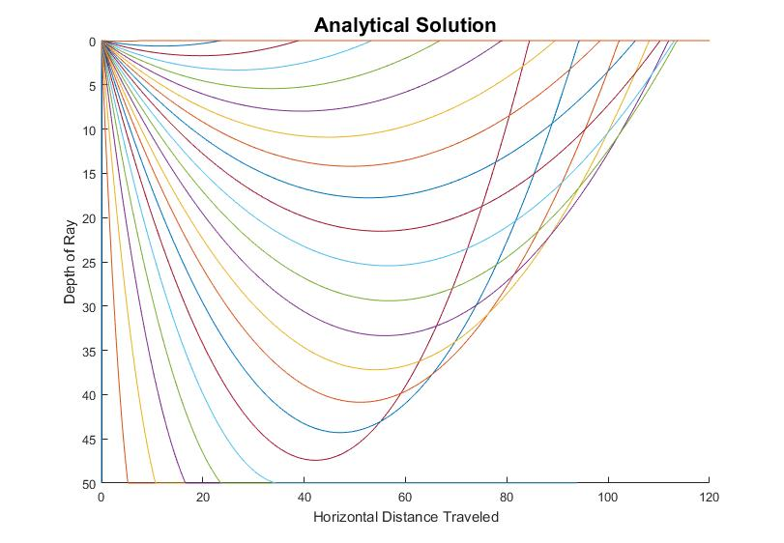
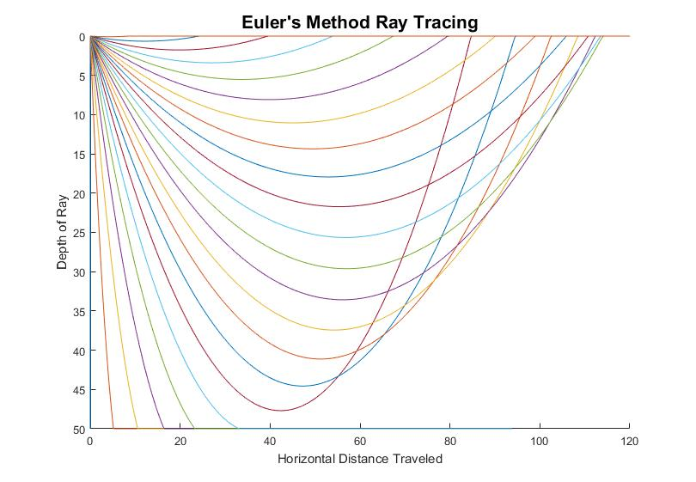
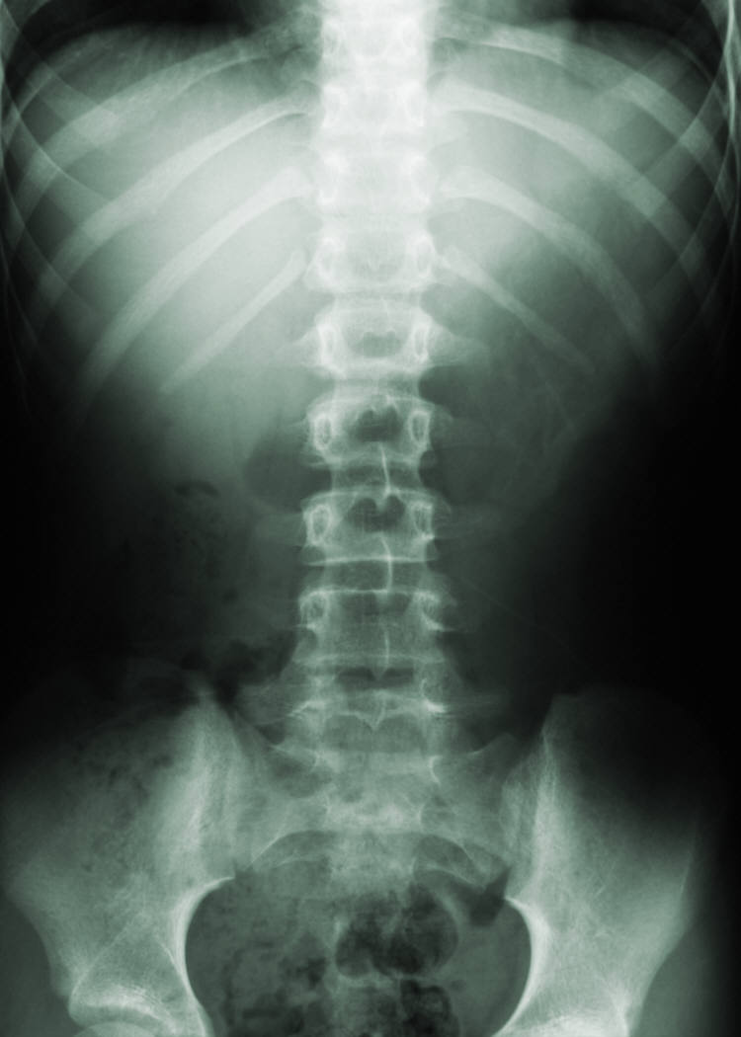
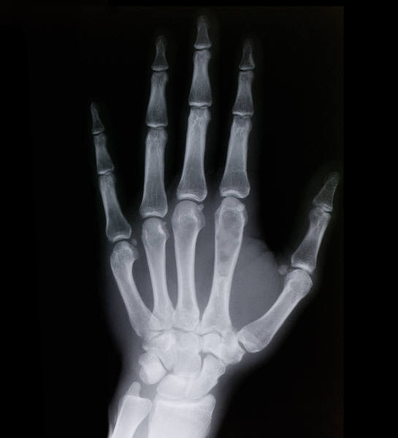
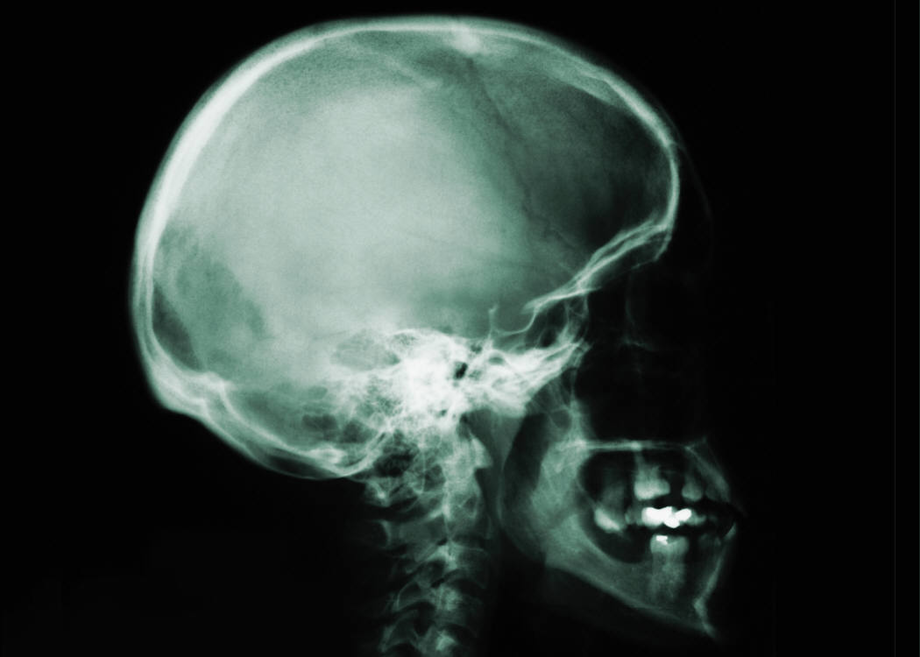

A Comparison of Numerical Methods for Seismic Ray Tracing: Error Analysis of First and Second Order Euler Methods
Ali Downard, Undergraduate B.S.
abstract
methods
results
Euler Second Order Equation
$p_{k}=p_{k−1}+ \frac{g\left(x_{k−1}\right)+g\left(x_{k}\right)}{2}∆σ$
$x_{k}=x_{k−1}+p_{k−1}∆σ+g\left(x_{0}\right)\frac{{\left(∆σ\right)}^{2}}{2}$
Euler First order equation
$x_{k}=x_{k−1}+p_{k−1}∆σ$
$p_{k}=p_{k−1}+ g(x_{k−1})∆σ$
Analytic Solution
$S\left(x\right)∇S=g_{0}$
$p\left(σ\right)=p_{0}+g_{0}σ$
$x\left(σ\right)=x_{0}+p_{0}σ+g_{0}\frac{σ^{2}}{2}$
Euler Half Steps
$p_{1/2}=p_{0}+ g(x_{0})\frac{∆σ}{2}$
$x_{1/2}=x_{0}+p_{1/2}\frac{∆σ}{2}$
$x_{1}=x_{1/2}+p_{1/2}\frac{∆σ}{2}$
$p_{1}=p_{1/2}+ g(x_{1})\frac{∆σ}{2}$
Generate velocity model with constant gradient of the slowness squared
 | Heading | Heading | Heading
Item | 122 | 233 | 345
Item | 759 | 856 | 290
Item | 228 | 134 | 238
Item | 954 | 875 | 976
Item | 324 | 325 | 301
Item | 199 | 137 | 186
background
Seismic Ray Tracing and the Need for Numerical Solutions
Background item
Background item
Background item
Orders of Accuracy
Type a caption for the data content or pictures here.
objectives
results
conclusions
Investigate the accuracy of two numerical methods for ray tracing
Distinguish where these methods can apply to more complex velocity models
Result 1
Result 2
Result 3
Conclusion 1
Conclusion 2
Conclusion 3

