Slide 1


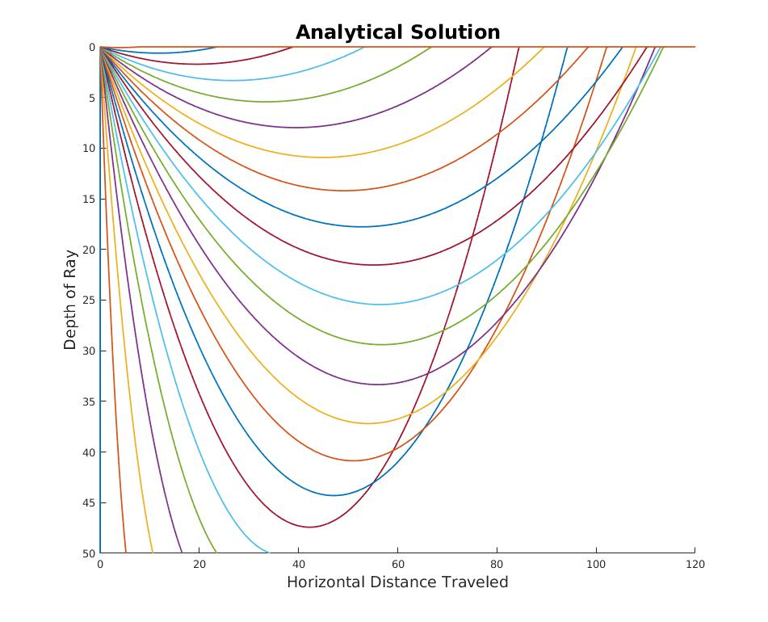
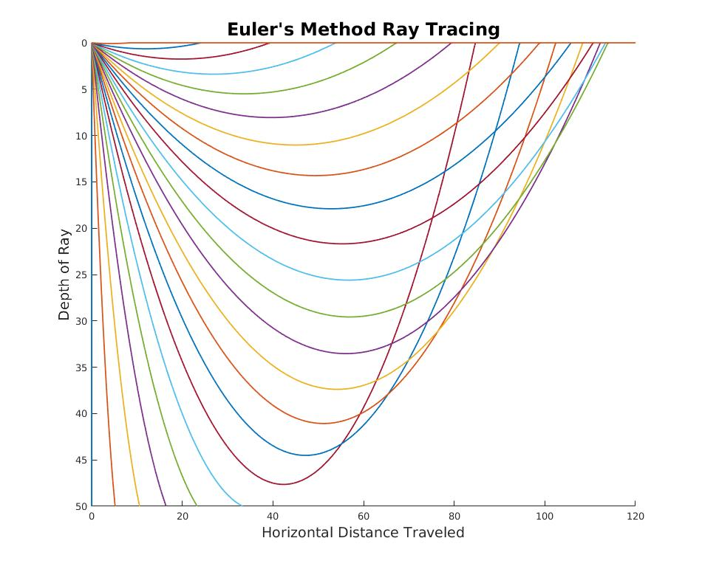


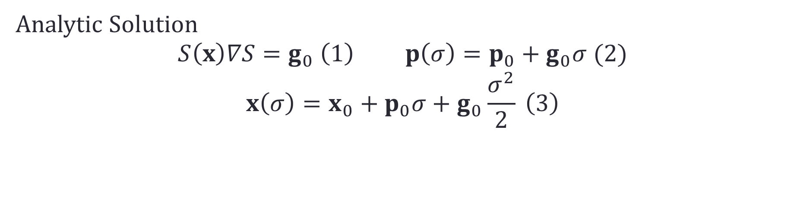

A Comparison of Numerical Methods for Seismic Ray Tracing: Error Analysis of First and Second Order Euler Methods
Ali Downard, Undergraduate B.S.
abstract
methods
results
The goal of this project was to investigate simple numerical methods and their accuracy as applied to a seismic ray tracing problem. In order to do this, a velocity model for which there exists an analytical solution i.e. in a velocity field with a constant gradient of slowness squared, was compared to rays plotted using Euler’s method. I used two different orders of accuracy for the Euler’s method implementation, to show how increasing accuracy can be achieved by manipulations of Euler’s original formula. Further research was made into how these methods could be applied to more complex velocity models.
Generate velocity model with constant gradient of the slowness squared
The constant gradient corresponds to the g₀ vector in our case having the form 0i + g₀ j
Use Euler’s Method to generate analytical solution
Use known analytical solution to compare
Plot the error between numerical and analytical solutions
Analytic Solution
$$S\left(x\right)∇S=g_{0} \left(1\right) p\left(σ\right)=p_{0}+g_{0}σ (2)$$
$$x\left(σ\right)=x_{0}+p_{0}σ+g_{0}\frac{σ^{2}}{2} \left(3\right)$$
Euler First order equation
$$x_{k}=x_{k−1}+p_{k−1}∆σ$$
$$p_{k}=p_{k−1}+ g(x_{k−1})∆σ$$
background
Euler Half Steps
$$p_{1/2}=p_{0}+ g(x_{0})\frac{∆σ}{2}$$
$$x_{1/2}=x_{0}+p_{1/2}\frac{∆σ}{2}$$
$$x_{1}=x_{1/2}+p_{1/2}\frac{∆σ}{2}$$
$$p_{1}=p_{1/2}+ g(x_{1})\frac{∆σ}{2}$$
Seismic Ray Tracing and the Need for Numerical Solutions
Background item
Background item
Background item
Orders of Accuracy
Euler Second Order Equation
$$p_{k}=p_{k−1}+ \frac{g\left(x_{k−1}\right)+g\left(x_{k}\right)}{2}∆σ$$
$$x_{k}=x_{k−1}+p_{k−1}∆σ+g\left(x_{0}\right)\frac{{\left(∆σ\right)}^{2}}{2}$$
objectives
results
conclusions
Investigate the accuracy of two numerical methods for ray tracing
Distinguish where these methods can apply to more complex velocity models
Result 1
Result 2
Result 3
Conclusion 1
Conclusion 2
Conclusion 3

