Slide 1

Flavor Planet App Development
TechConsulting

Slide 2
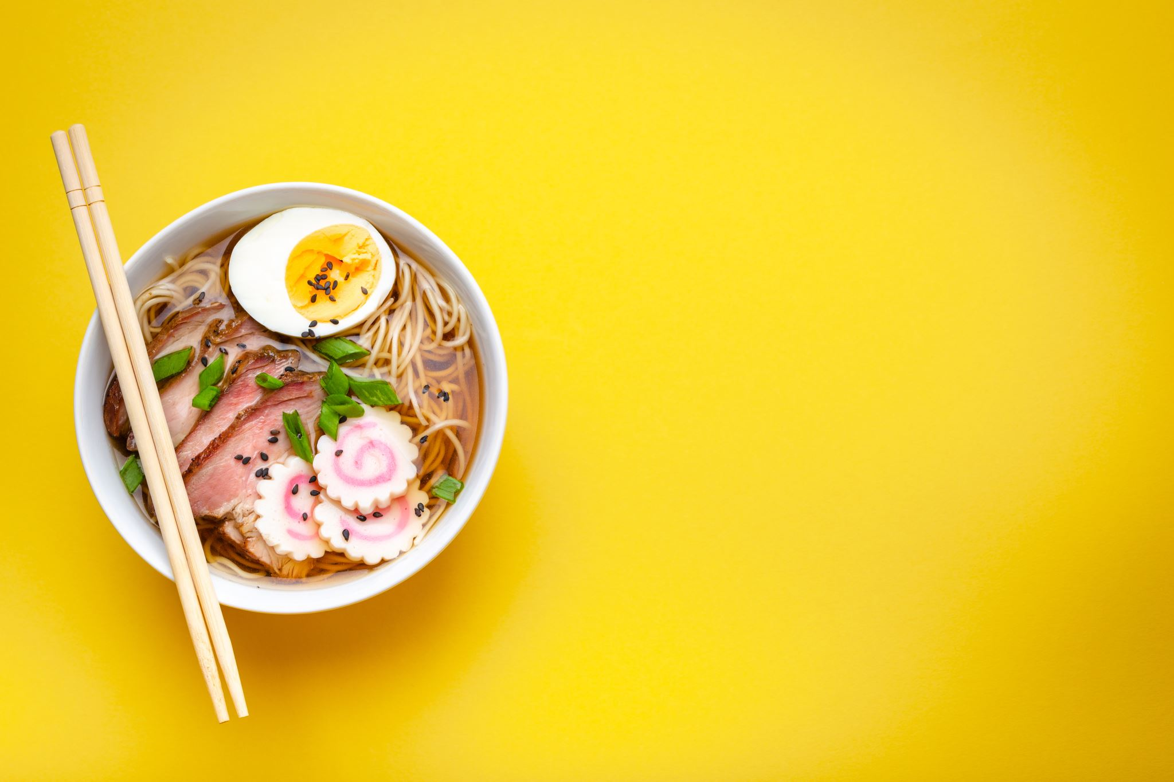
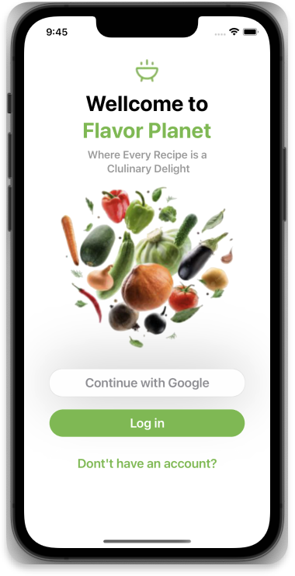
Introduction
App designed to explore recipes based on categories like:
Beef
Vegan
Pasta
etc.

Slide 3
Product Overview
Offers seamless recipe search and exploration.
Inspired by a user-friendly UI design.
Strategic Objectives
Enhance user engagement through recipe discovery.
Provide a user-friendly interface for easy navigation.
Consider monetization through premium features.

Slide 4
Functionalities
Offers seamless recipe search and exploration.
Gmail login.
Select preferred three categories @AppStore / (userDefaults).
Full list of recipes from selected categories.
Favorites (in CoreData).
Recipes Details with images and or YouTube videos.
Profile Screen UIKit.

Slide 5
Key Elements
Architecture: MVVM-C for maintainability
Frameworks: Combine, SwiftUI, CoreData, KingFisher.
Design Patterns: Observer, Singleton, Async Await.

Slide 6
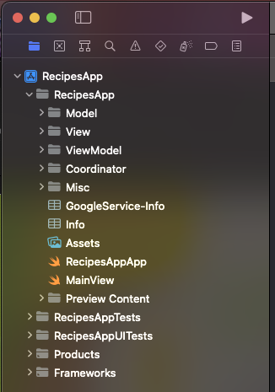
Architecture
Utilizes MVVM-C architecture for maintainable code.

Slide 7
Design Patterns
Singleton
Builder
Observer
Coordinator

Slide 8
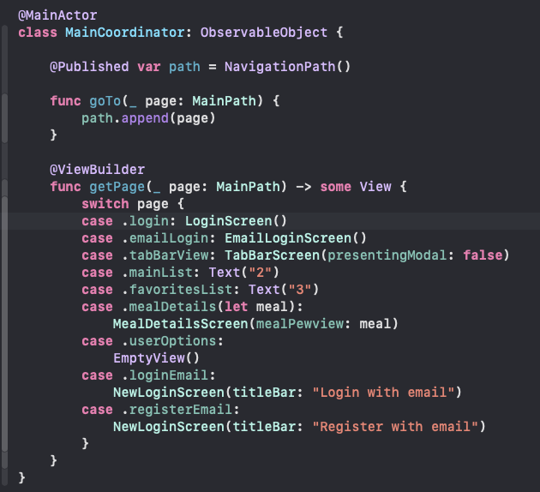
Coordinator
To enhance modularity and navigation.

Slide 9
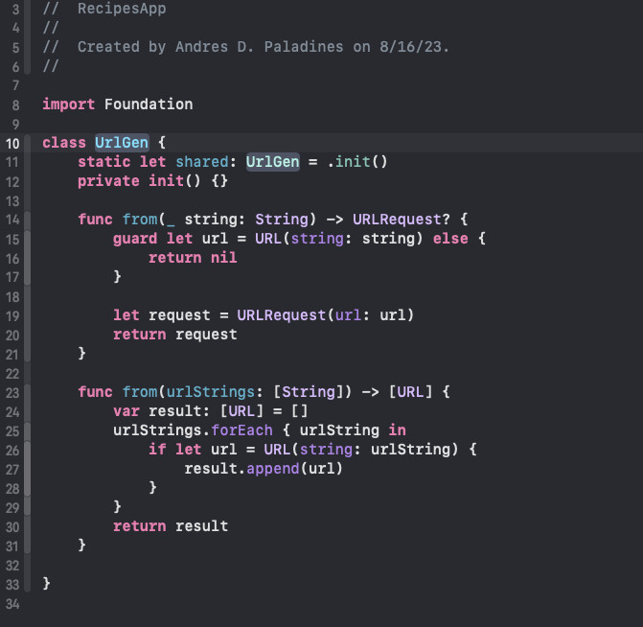
Singleton
Utilizes MVVM-C architecture for maintainable code.

Slide 10
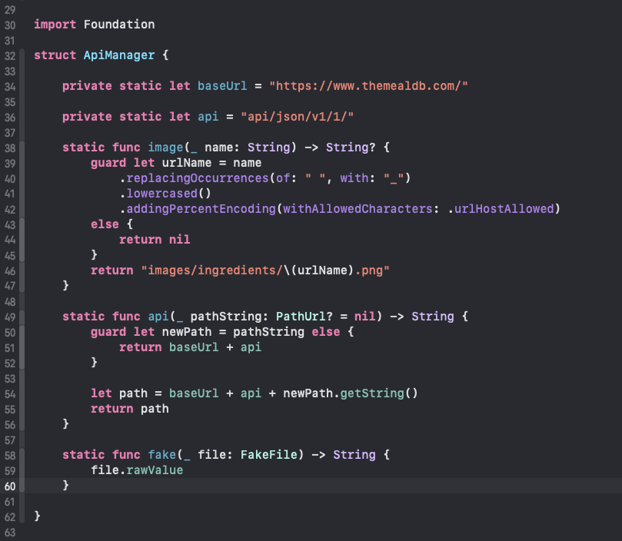
Builder
To generate appropriate URLs.

Slide 11
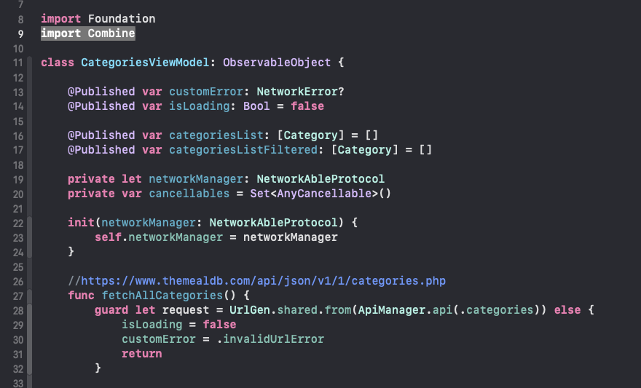
Observer
Used with combine and Observable Objects.

Slide 12
App Presentation

Slide 13
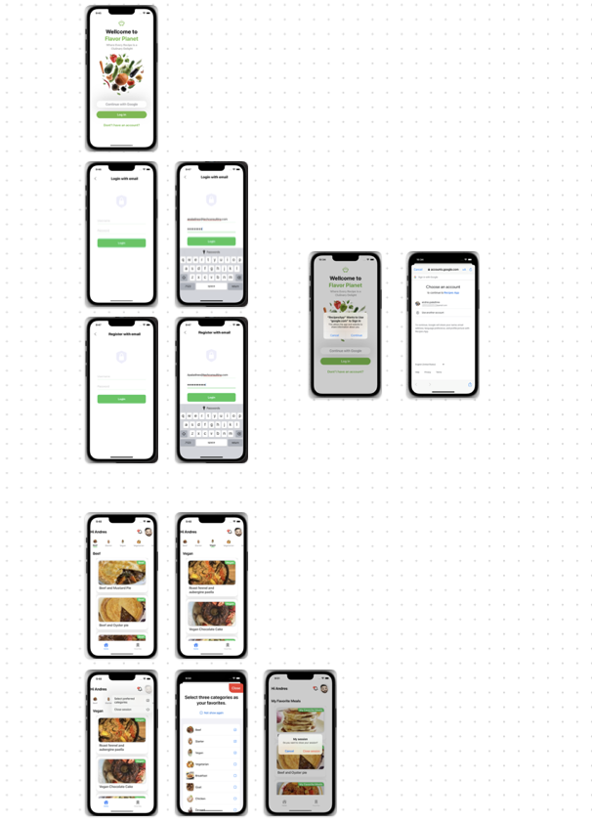
Screens

Slide 14
Login Options Screen
Screen to go to:
Register with email.
Login with email.
Login with Gmail

Slide 15
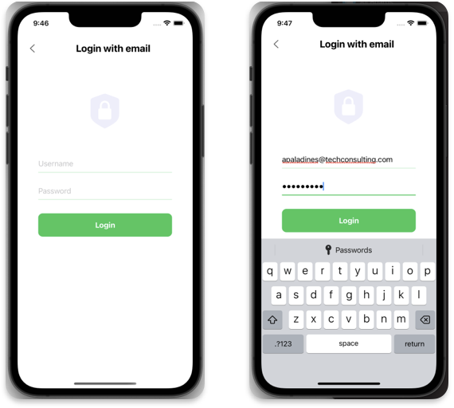
Login with email

Slide 16
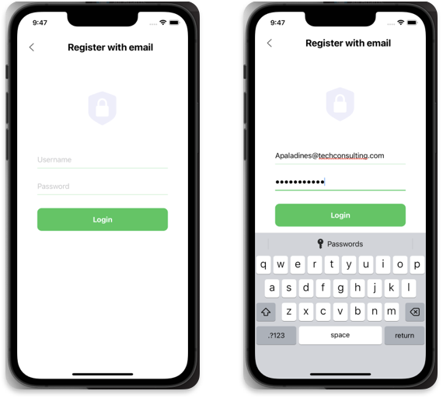
Register with email

Slide 17
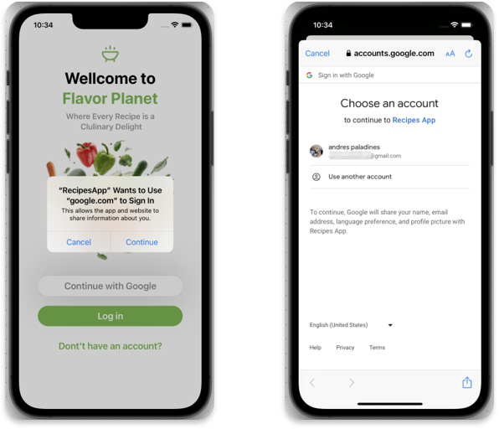
Login with Gmail

Slide 18
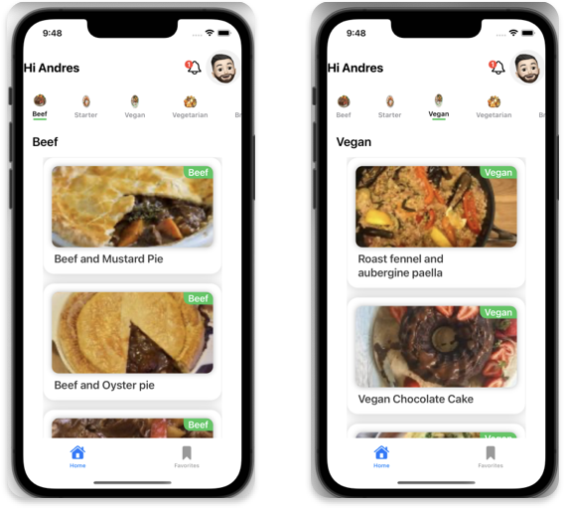
Main List Screen

Slide 19
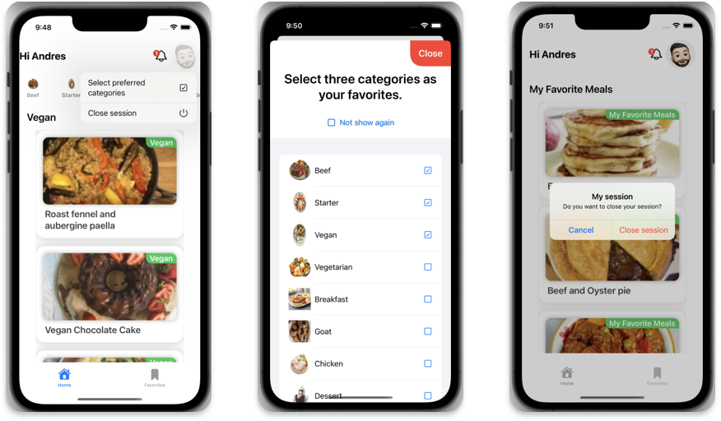
Main List Screen Options

Slide 20
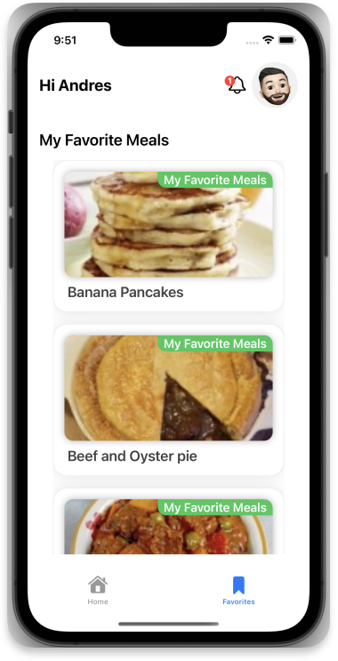
Favorites List Screen

Slide 21
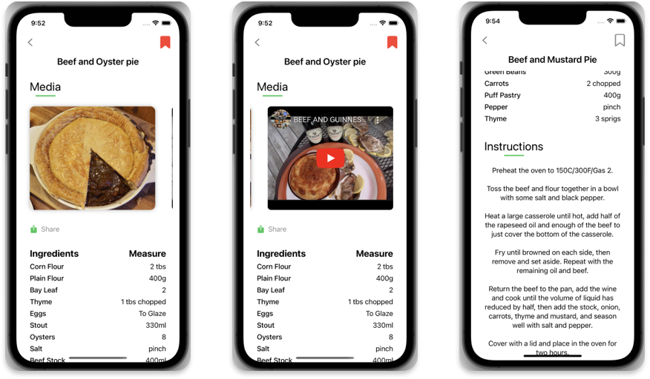
Meal Details Screen

Slide 22
Faced Challenges
Call a ViewController inside a SwiftUI app
Apple issue with LazyHGrid (used common ScrollView and HStack).
Limitations on information fetched from APIs

Slide 23
Thanks

